Slide 1
Make great Metro style apps that are touch-optimized using HTML5
APP-185T
Nick Waggoner
Program Manager
Reed Townsend
Program Manager
Microsoft Corporation

Slide 2
Agenda
Introduction and overview of touch
Scrolling and zooming
Pointer and gesture events
Integrating all the parts
You’ll leave with examples of how to
Create highly responsive scrolling/zooming experiences
Easily access the Windows 8 touch language
Code for touch, mouse, and pen in a unified way

Slide 3
Overview of Touch

Slide 4
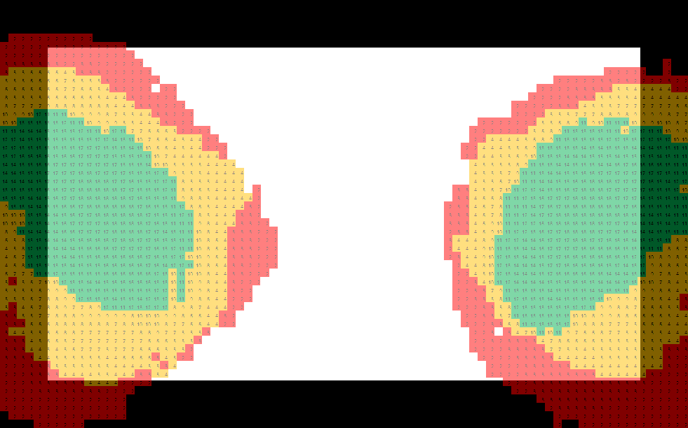
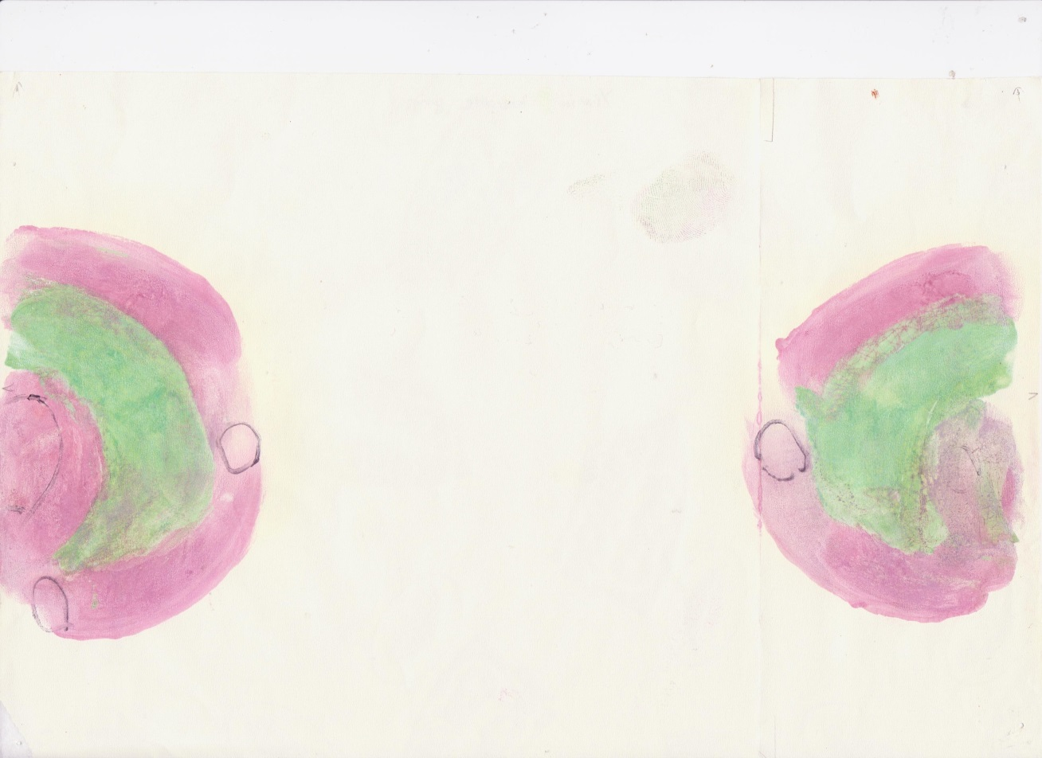
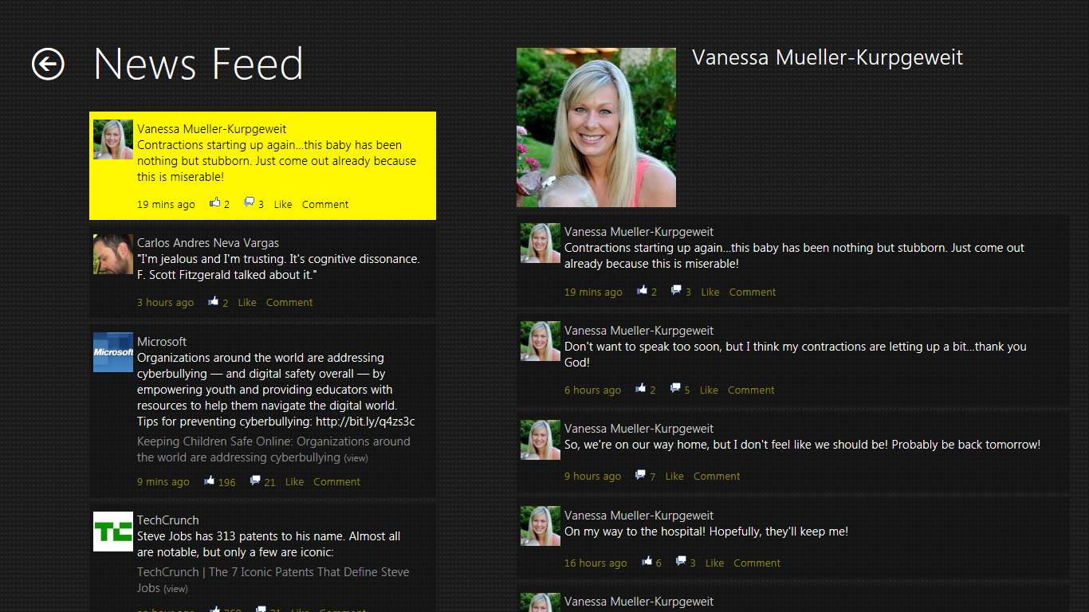
Research and User Studies
LEARN
MORE
Designing Metro style apps that are touch-optimized

Slide 5
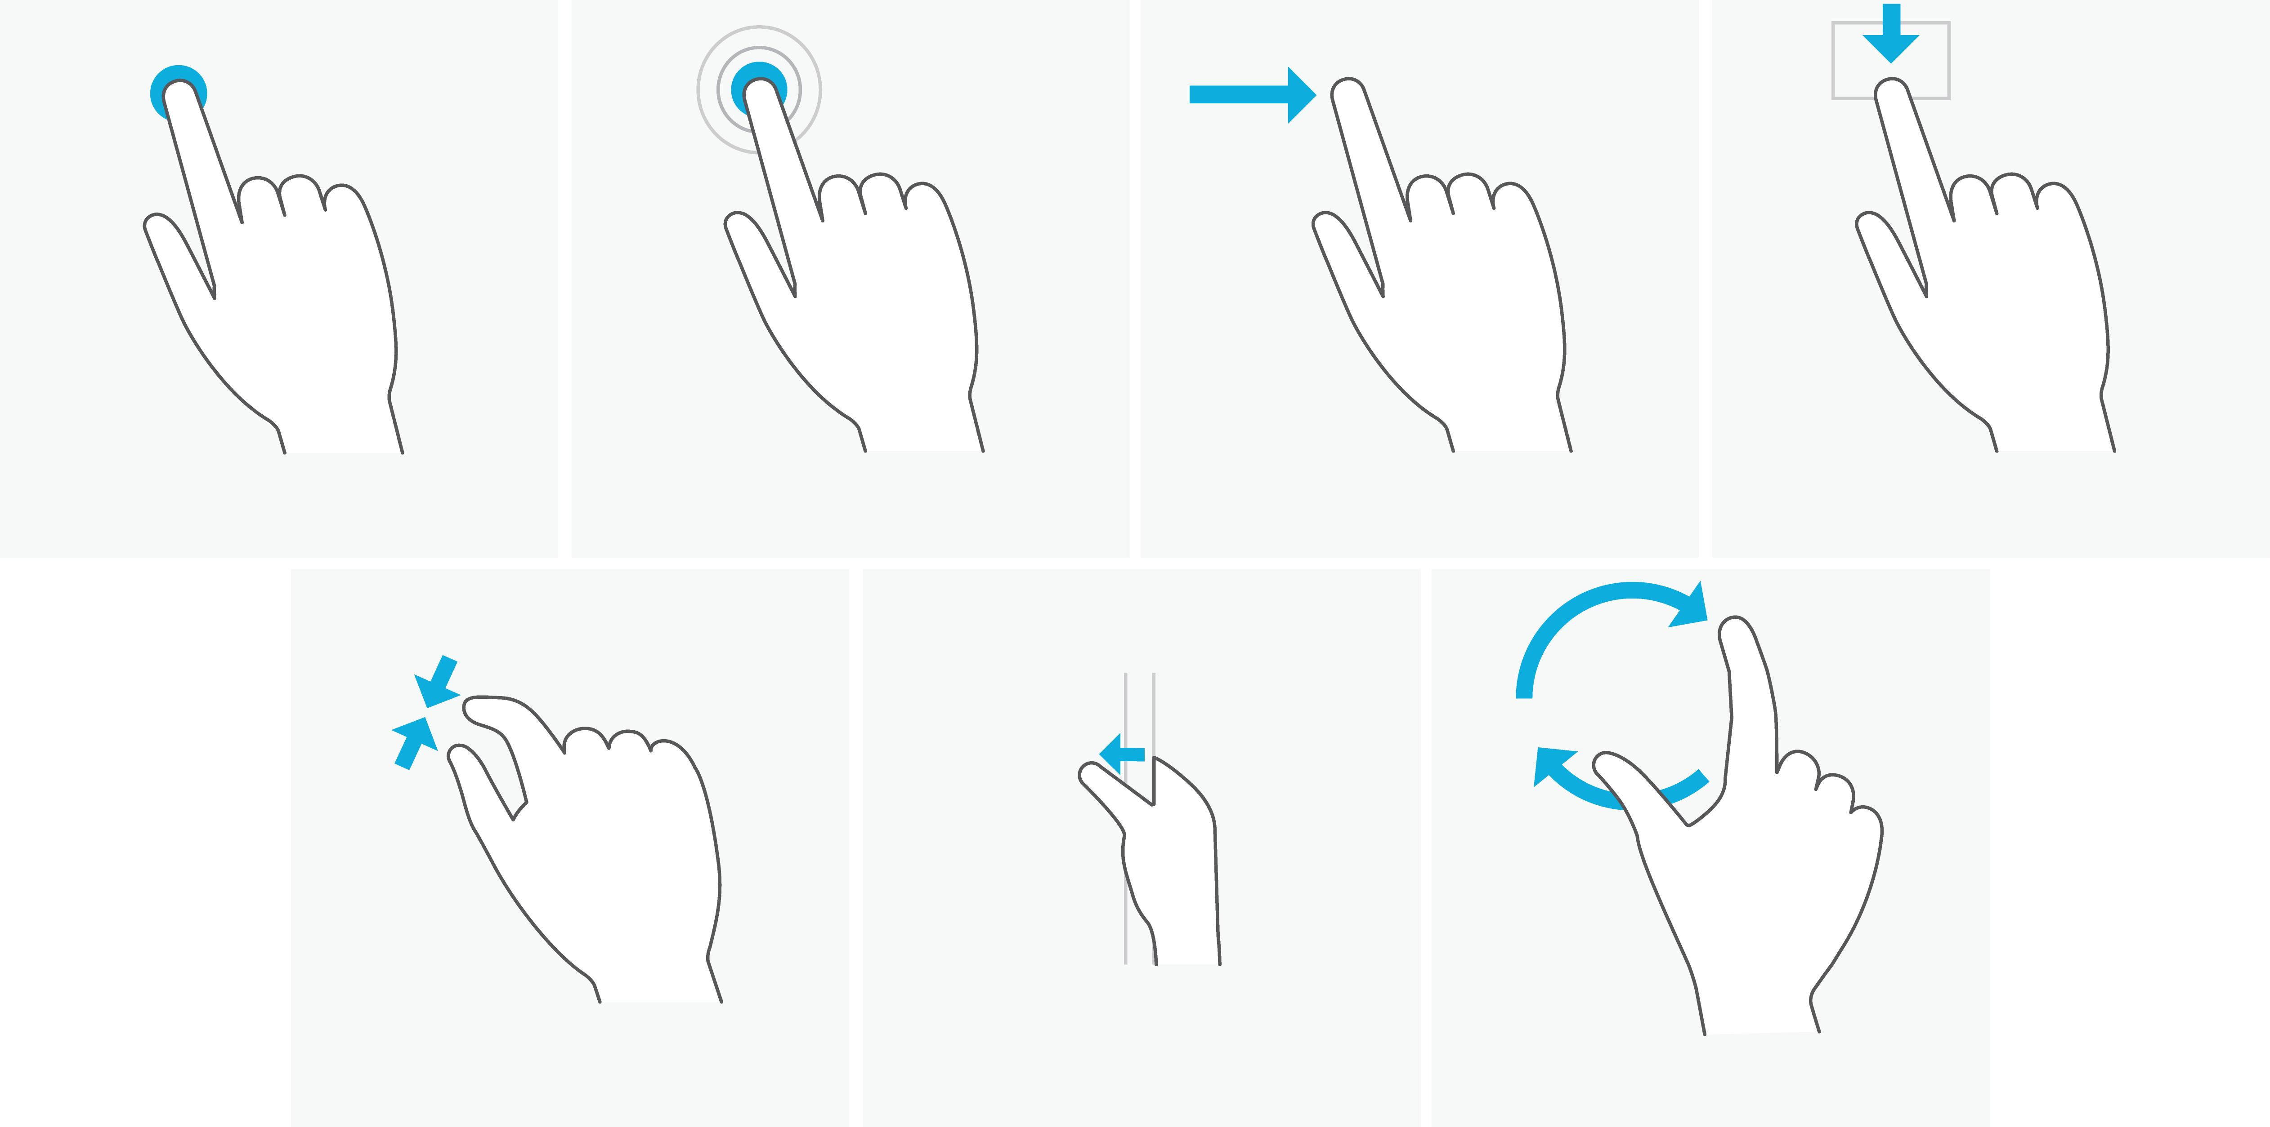
Windows 8 Touch Interactions
Press and hold to learn
Tap for primary action
Slide to drag
Swipe to select
Swipe from edge for
app and system UI
Pinch to zoom
Rotate to rotate

Slide 6
Overview of Building Touch Apps
App templates
Controls: ListView, AppBar, select control, etc.
Scrolling and zooming views
Gesture events
Pointer events
Gesture recognizers

Slide 7
Scrolling and Zooming Views

Slide 8
Scrolling and Zooming Views
Scrolling with slide
Zooming with pinch
Inertia
Over bounce on edges
Nesting scrolling/zooming
Snap-points
Integration with controls

Slide 9
News app, Form Controls SDK Sample, Start Screen
demo
Quick run through of the out of the box scrolling and zooming experience.

Slide 10
Use the built in scrolling/zooming views to get the look and feel of the Start screen and other Metro style interfaces

Slide 11
Scrolling and Zooming APIs
API surface | CSS Properties | DOM Attributes | DOM Events
Scrolling | overflow -ms-scroll-rails -ms-scroll-snap-x -ms-scroll-snap-y -ms-scroll-chaining -ms-scroll-boundary | scrollLeft scrollTop | scroll
Zooming | -ms-content-zooming -ms-content-zoom-boundary -ms-content-zoom-snap | msContentZoomFactor | MSContentZoom
Both |  |  | MSManipulationStateChanged

Slide 12
Building a simple drawing app
demo
Enabling scrolling/zooming

Slide 13
Extending the Scrolling/Zooming Experience
Snap-points
Creating specific views of the content
Helping users get to key locations
-ms-scroll-snap-type, -ms-scroll-snap-point-x
Nested Scrolling
Allowing the user to manipulate both a child and parent

Slide 14
Building a simple drawing app
demo
Using snap-points and nested scrolling.

Slide 15
Scrolling/zooming views let you harness the power of Windows 8 to build highly responsive experiences.

Slide 16
Pointer Events in the DOM

Slide 17
Building a simple drawing app
demo
Using MSPointer events to create SVG elements

Slide 18
Pointer Events in the DOM
Pointer unifies all “pointing” devices into a single, consistent set of interfaces and events
Allows you to “code for touch and get mouse and pen for free”!
Input-specific properties allow you to provide a differentiated UX when you want one
DOM pointer events follow the familiar pattern of DOM mouse events, with extensions for touch properties and interaction principles
If you know how to code for mouse input, you know the basics of coding for pointer input!

Slide 19
Pointer Events in the DOM
Basic DOM pointer events:
MSPointerDown, MSPointerMove, MSPointerUp
Pointer events behave similarly to mouse events
Derives from the same event class
Includes capture/bubble phase
Commonly used event properties:
Position (in the usual choice of coordinate systems)
Pointer type (touch, mouse, pen)
Contact id

Slide 20
More Pointer Events in the DOM
Additional DOM events (also mostly derive from similar mouse events):
MSPointerOver
MSPointerOut
MSPointerHover
MSPointerCancel

Slide 21
Building a simple drawing app
demo
Using MSPointer events to create SVG elements

Slide 22
Controlling Capture
Common touch interactions make it important to capture a contact to an element
Typically used in controls. E.g. dragging with the finger “out of the way”.
Capture APIs:
msSetPointerCapture(), msReleasePointerCapture(), msGetPointerCapture()
Capture events:
MSGotPointerCapture, MSLostPointerCapture

Slide 23
Other Goodies
getPointerList(pointerId)
Retrieves all the pointers that are part of a specified contact’s frame
E.g. check if other pointers are down before setting capture
disableMouseEvents()
Opts out of mouse promotion
navigator.msPointerEnabled()
Lets you know if pointer events can be received on the current system

Slide 24
Integrating Views and DOM Events

Slide 25
DOM Pointer/Gesture events cannot be used inside of active Scrolling/Zooming views.

Slide 26
Controlling When to Scroll/Zoom
Content that never pans or zooms
overflow:hidden
–ms-content-zooming:none
Deciding at run time
preventManipulation()
msSetPointerCapture()

Slide 27
News App, Drawing Demo
demo
Decides to pan/zoom the image or interact with a shape based on what was touched.
preventManipulation() to stop scrolling/zooming
Pointer events used to manipulate shapes

Slide 28
Gesture Events in the DOM

Slide 29
Building a simple drawing app
demo
Using MSGesture events to manipulate objects

Slide 30
Gesture Events in the DOM
We also expose a way to have the DOM perform gesture recognition, and fire gesture events that JS can listen for and handle
All you have to do is register an event listener for these events!
This includes the ability to get some gestures from mouse and pen input
Gesture event support falls into two classes:
“Static gestures” – One-shot events like tap
“Dynamic gestures” – Extended interactions or manipulations that create a stream of gesture updates

Slide 31
Static Gesture Events in the DOM
Implement simple Windows touch language gestures:
MSGestureTap
MSGestureHoldStart
MSGestureHoldCancel
MSGestureHoldEnd

Slide 32
Manipulation Gesture Events in the DOM
Manipulations are generic transforms composed of translate, scale, and rotate changes
Manipulation events:
MSGestureInit
MSGestureStart
MSGestureChange
MSInertiaStart
MSGestureEnd
The transform data in the event properties includes:
Position (center point of the manipulation)
Cumulative translation/scale/rotation
Current velocities (for each component)

Slide 33
Building a simple drawing app
demo
Using MSGesture events to manipulate objects

Slide 34
Tap vs Click Events
What is the difference between tap and click?
onclick is sent in response to mouse as well as pointer events
Tap uses a distance threshold, click doesn’t
Use:
Click for button-like controls
Tap when you need both manipulations and tap

Slide 35
Going Deeper
Windows Runtime touch APIs let you go beyond what the HTML framework provides by default:
Raw pointer data with rich properties
Componentized gesture recognition
Pointer device APIs
And more!

Slide 36
Recap

Slide 37
Building Great Touch Apps
Get started building Metro style apps using HTML!
Use the templates and controls as they codify the Windows 8 best-practices when incorporating touch.
Use scrolling/zooming views to create highly responsive slide/pinch experiences.

Slide 38
Building Great Touch Apps
Use MSPointer events to code for touch, mouse, and pen in a unified way
Use MSGesture events to get easy access to the Windows 8 touch language

Slide 39
Related sessions
[APP-211T] Create Metro style apps quickly with built-in controls
[APP-209T] Build polished collection and list apps in HTML5
[APP-162T] Building high performance Metro style apps using HTML5
[APP-391T] Designing Metro style apps that are touch-optimized
[PLAT-874T] Lap around the Windows Runtime
[APP-186T] Build advanced touch apps in Windows 8
[APP-503T] Make great touch apps using XAML

Slide 40
Further reading and documentation
SDK samples:
Panning, Scrolling, and Zooming
CanvasPaint, TouchEvents
Docs:
http://dev.windows.com
Contact info – wintouch@microsoft.com

Slide 41
thank you
Feedback and questions http://forums.dev.windows.com
Session feedback http://bldw.in/SessionFeedback

Slide 42
© 2011 Microsoft Corporation. All rights reserved. Microsoft, Windows, Windows Vista and other product names are or may be registered trademarks and/or trademarks in the U.S. and/or other countries.
The information herein is for informational purposes only and represents the current view of Microsoft Corporation as of the date of this presentation. Because Microsoft must respond to changing market conditions, it should not be interpreted to be a commitment on the part of Microsoft, and Microsoft cannot guarantee the accuracy of any information provided after the date of this presentation. MICROSOFT MAKES NO WARRANTIES, EXPRESS, IMPLIED OR STATUTORY, AS TO THE INFORMATION IN THIS PRESENTATION.

Slide 43
Windows 8
Metro style Apps
Desktop Apps
View
XAML
HTML / CSS
HTML
JavaScript
Model Controller
C
C++
C#
VB
JavaScript
(Chakra)
C
C++
C#
VB
WinRT APIs
System Services
Communication
& Data
Graphics & Media
Devices & Printing
Application Model
Internet Explorer
Win32
.NET / SL
Core
Windows Core OS Services

Slide 44
MSPointer Events
function onLoad() {
...
var workSpaces = document.getElementsByClassName("workspace");
for (i = 0; i < workSpaces.length; i++) {
workSpaces[i].addEventListener("MSPointerDown", pointerDownHandler, false);
workSpaces[i].addEventListener("MSPointerMove", pointerMoveHandler, false);
workSpaces[i].addEventListener("MSPointerUp", pointerUpHandler, false);
workSpaces[i].addEventListener("MSManipulationStateChanged",
resetInteractions, false);
}
...
}

Slide 45
MSPointer Events
this.MSPointerDown = function(evt)
{
context.beginPath();
context.moveTo(evt.offsetX, evt.offsetY);
x = evt.offsetX;
y = evt.offsetY;
brush.started = true;
};
this.MSPointerUp = function(evt)
{
if (brush.started)
{
brush.MSPointerMove(evt);
context.closePath();
brush.started = false;
}
};

Slide 46
Pointer Capture
function pointerCapture(evt)
{
evt.srcElement.msSetPointerCapture(evt.pointerId);
var str = "Event " + evt.type + " at " + evt.clientX +
", " + evt.clientY + " for pointer ID " + evt.pointerId + "<br/>";
outputEvents4.innerHTML = str + outputEvents4.innerHTML;
}

Slide 47
MSGesture Events
function onLoad()
{
var canvas = document.getElementById("paintCanvas");
addHandler(canvas, "MSGestureDoubleTap", clearCanvas);
...
}
function clearCanvas(evt)
{
context.clearRect(0, 0, canvasWidth, canvasHeight);
evt.preventDefault();
}

Slide 48
MSGesture Events
function initialize()
{
touchGesturesCanvas.addEventListener("MSGestureStart", gestureListener, false);
touchGesturesCanvas.addEventListener("MSGestureEnd", gestureListener, false);
touchGesturesCanvas.addEventListener("MSGestureChange", gestureListener, false);
touchGesturesCanvas.addEventListener("MSInertiaStart", gestureListenerInertia, false);
touchGesturesCanvas.addEventListener("MSInertiaEnd", gestureListenerInertia, false);
}
function gestureListener(evt) {
var str = evt.type + " at " + evt.clientX +
", " + evt.clientY + "<br/>";
outputEvents2.innerHTML = str + outputEvents2.innerHTML;
}
function gestureListenerInertia(evt) {
var str = evt.type + " at " + evt.clientX +
", " + evt.clientY + " Velocity " + evt.velocityX + "<br/>";
outputEvents2.innerHTML = str + outputEvents2.innerHTML;
}

Slide 49
Enabling/disabling Scrolling and Zooming
.Scrolling
{
overflow: scroll;
}
.HorizontalScrolling
{
overflow-x: auto;
overflow-y: hidden;
}
.NoScrolling
{
overflow: hidden;
}
.ZoomingAndScrolling
{
overflow: auto;
-ms-content-zooming: zoom;
}
.NoZooming
{
-ms-content-zooming: none;
}

Slide 50
Scroll Rails and Zoom Boundaries
.Unrailed
{
overflow: auto;
-ms-scroll-rails: none;
}
.Railed
{
overflow: auto;
-ms-scroll-rails: railed;
}
.ZoomingOutAndScrolling
{
overflow: auto;
-ms-content-zooming: zoom;
-ms-content-zoom-boundary-min: 25%;
-ms-content-zoom-boundary-max: 100%;
}

Slide 51
Snap-points
.MandatorySnapInterval
{
-ms-scroll-snap-type: mandatory;
-ms-scroll-snap-points-x: snapInterval(0%, 100%);
}
.ProximitySnapList
{
-ms-scroll-snap-type: proximity;
-ms-scroll-snap-points-x: snapList(100%, 200%, 300%, 400%, 500%);
}
.NoSnapping
{
-ms-scroll-snap-type: none;
}

Slide 52
Scrolling and Zooming APIs
Uses existing APIs for scrolling and specific extensions for fine tuning the experience
Overflow, scrollTop, scrollLeft, scroll event
-ms-scroll-rails, -ms-scroll-snap-type, -ms-scroll-snap-points
Zooming follows the same model
-ms-content-zoom, msContentZoomFactor, MSContentZoom

Slide 53
Tools for building touch apps
App templates
Using Windows 8 Templates to Build Metro Style Applications Using JavaScript
Controls: ListView, AppBar, select control, etc.
Using built-in controls to create great Metro style apps
Build Polished Collection and List Apps in HTML 5
Scrolling and zooming views
Gesture events
Pointer events
Gesture recognizers
Touch and Gesture Platforms: Windows Runtime and Win32

