Slide 1
Bring apps to life with Metro style animations in HTML5
APP-206T
Dale Rogerson
Principal Software Developer Engineer
Microsoft Corporation
Jason Beaumont
Principal Program Manager
Microsoft Corporation

Slide 2
Agenda
Introduce the Windows 8 Animation Library
Experience animations in Windows 8
Implement Metro style animations in your app
You’ll leave with examples of how to
Make your app Metro style using animations
Use controls and templates to get animations for free
Find the right guidance on using animations

Slide 3
Animations add beauty, energy, motion, and personality to your app

Slide 4
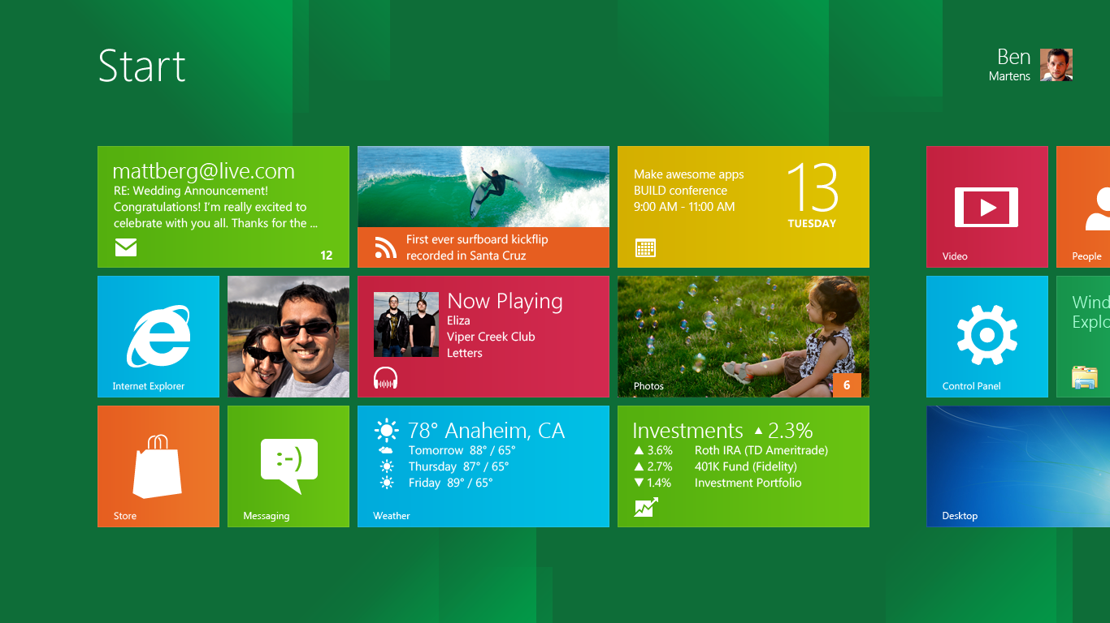
Static start screen

Slide 5
Good animations enhance the experience by
Making it clear where to focus (on the content)
Being purposeful not distracting
Adding confidence of knowing what has happened or what will happen
Reinforcing the way the system works

Slide 6
Animation completes the Metro style
It’s not an extra or an added piece, it’s integral to the design
Create a familiar personality by making apps and Windows feel part of the same family and have the same visual language
Without chrome, animation is needed to create flow and continuity

Slide 7
Using a list
demo
With and without animations

Slide 8
Adding Metro style animations to your app is easy with the Windows 8 Animation Library

Slide 9
Windows 8 Animation Library

Slide 10
Windows 8 Animation Library
Part of Windows Library for Javascript (WinJS)
Contains key Metro style app animations
Has the same storyboard values, curves, and even the same API that we use
Easily aligns your app to the Windows 8 personality

Slide 11
Scenarios covered by the Animation Library
App navigation
Animating content within a view
Revealing or hiding supplemental UI
Collections
Selection

Slide 12
Animation Library animations
App Navigation
enterPage
transitionPage

Slide 13
Animation Library animations
Animating content within a view
transitionContent
reveal / hide
reposition
crossFade
createPeekAnimation
updateBadge
expand /collapse

Slide 14
Animation Library animations
Animating supplemental UI
showPopup / hidePopup
showEdgeUI / hideEdgeUI
showPanel / hidePanel
fadeIn / fadeOut

Slide 15
Animation Library animations
Collection animations
Add / delete
Drag & drop
Selection scenarios
pointerUp
pointerDown
swipeReveal
swipeSelect
swipeDeselect

Slide 16
The Windows 8 Dev Center has great guidelines on using animations.

Slide 17
Using the Animation Library

Slide 18
Exploring the sample app
demo
No animations, no personality!

Slide 19
Animations to add to sample app
Selection
Pointer Down
Pointer Up
Navigation
Enter Page
Transition Page
Layout
Reposition

Slide 20
Animations to Add to Sample app
Selection
pointerDown(element)
Pointer Up
Navigation
Enter Page
Transition Page
Layout
Reposition

Slide 21
Adding pointerDown animation
demo

Slide 22
Best practices the Animation Library provides
Built on standards based CSS3 transitions or animations
Uses CSS transforms or opacity to avoid layout costs
No infinite or long animations

Slide 23
Animations to add to sample app
Selection
Pointer Down
pointerUp(element)
Navigation
Enter Page
Transition Page
Layout
Reposition

Slide 24
Windows Library for JavaScript (WinJS) library for building Metro style apps using JavaScript
Make your apps look and feel great
Matches the Windows Metro design style
Controls for common user experiences
Designed for touch as well as traditional input
Scales across form factors
Build your apps fast and with high quality
Web technologies you’re already familiar with
Modern patterns for responsive, reliable apps
Use interactive design tools

Slide 25
Adding pointerUp animation
demo
Using Promises to chain functionality

Slide 26
Use WinJS Promise to chain functionality.

Slide 27
Animations to add to sample app
Selection
Pointer Down
Pointer Up
Navigation
enterPage(incoming elements, offset)
Transition Page
Layout
Reposition

Slide 28
About Enter Page
Use Enter Page to display the initial content
Content can be divided into separate regions
Animations are staggered for separate regions
Some common layouts are
1
1
1
3
2
2
3
2
4

Slide 29
Enter Page animation
demo
With stagger effect

Slide 30
Tips for EnterPage
Pass an array of elements to get stagger effect
Only for loading initial content
Use transitionPage or transitionContent if content is already visible

Slide 31
Animations to add to sample app
Selection
Pointer Down
Pointer Up
Navigation
Enter Page
transitionPage(incoming, offset, outgoing elements)
Layout
Reposition

Slide 32
About Transition Page
Used when switching the majority of the existing content
Use Transition Content for changing only part of the content
Existing content is animated in addition to new content
Existing content must live for life of animation

Slide 33
Transition Page animation
demo
Holding onto the existing content

Slide 34
Tips for transitionPage
Elements that remain the same should not be animated
Outgoing and incoming sections must be separate elements since they animate at the same time
Keep the outgoing elements alive during the animation
May require restructuring your app
Plan for animations early

Slide 35
Animations to add to sample app
Selection
Pointer Down
Pointer Up
Navigation
Enter Page
Transition Page
Layout
createRepositionAnimation(elements)

Slide 36
Reposition pattern
// Call ‘create’ function, saving return value.
var animLib = WinJS.UI.Animation;
var animation = animLib.createRepositionAnimation(
elements
);
// Reposition elements.
myReposition(elements);
// Execute animation.
animation.execute();

Slide 37
Transition Page animation
demo
Holding onto the existing content

Slide 38
Animations add beauty, energy, motion, and personality to your app.

Slide 39
Good animations are clear, purposeful, confident, and reinforce the system.

Slide 40
Animations from the Animation Library give you the Windows 8 personality.

Slide 41
The Animation Library uses best practices to achieve fast smooth animations.

Slide 42
Follow the guidelines on the Windows 8 Dev Center when using animations.

Slide 43
Our most popular animations
crossfade
fadeIn / fadeOut
enterPage
transitionPage
transitionContent
expand/collapse
Add/Delete variations

Slide 44
Related sessions
[APP-162T] Building high performance Metro style apps using HTML5

Slide 45
Links
Dev Center – Animating your UI

Slide 46
thank you
Feedback and questions http://forums.dev.windows.com
Session feedback http://bldw.in/SessionFeedback

Slide 47
© 2011 Microsoft Corporation. All rights reserved. Microsoft, Windows, Windows Vista and other product names are or may be registered trademarks and/or trademarks in the U.S. and/or other countries.
The information herein is for informational purposes only and represents the current view of Microsoft Corporation as of the date of this presentation. Because Microsoft must respond to changing market conditions, it should not be interpreted to be a commitment on the part of Microsoft, and Microsoft cannot guarantee the accuracy of any information provided after the date of this presentation. MICROSOFT MAKES NO WARRANTIES, EXPRESS, IMPLIED OR STATUTORY, AS TO THE INFORMATION IN THIS PRESENTATION.

