Slide 1
Build data-driven collection and list apps using ListView in HTML5
APP-210T
Sam Spencer
Senior Program Manager
Microsoft Corporation

Slide 2
Agenda
Using Data with ListView control
How to bind a collection to in-memory data
How to control the visuals of the data in the control
How to edit the data so that the UI updates automatically
How to tie in to other data sources such as cloud services

Slide 3
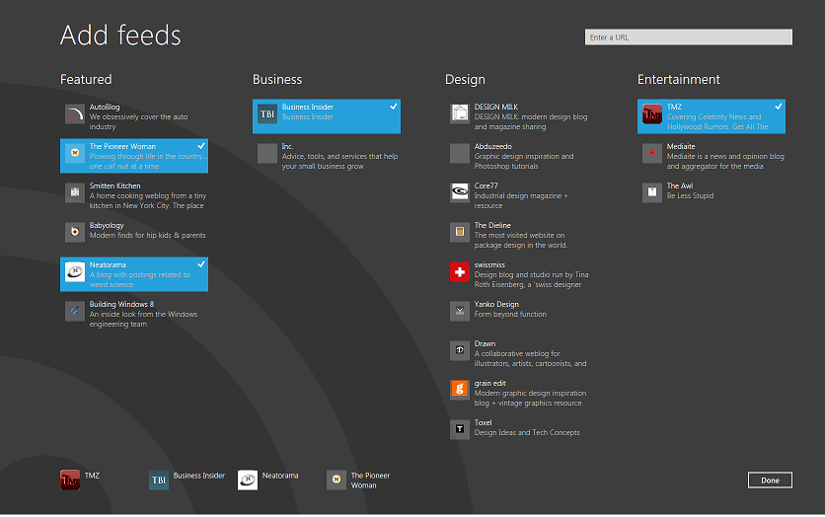
Collection controls in WinJS
ListView
Implements Windows 8 personality for lists
Flip View
Provides an item at a time view
[APP-209T] – Build polished collection and list apps in HTML5

Slide 4
How to present a collection
Data
Renderer
(Template)
Control

Slide 5
Simple word game UI
demo

Slide 6
How to present a collection
Data
Renderer
(Template)
Control

Slide 7
Array data source
Data source for in-memory data
Simple data source backed by a javascript array
Supports full read/write capability with change notifications
In memory so limited in size
Keys for items can inferred using keyOf function option
listview1.dataSource = new ArrayDataSource(array, {
keyOf: function (item) {
return item.ID; }
});

Slide 8
Updating the word game
demo
Using the array data source

Slide 9
How to present a collection
Data
Renderer
(Template)
Control

Slide 10
Templates & data binding
Templates
Re-usable generator of html defined in markup
Use where you need to insert content programmatically
Used to define how each list item will be presented
Databinding
Provides a crosslink between UI elements and data
Synchronizes UI with changes to the data
Binding converters enable customization of the binding logic
[TOOL-501T] - Introducing the Windows Libraries for JavaScript
LEARN
MORE
TOOL-501T - Introducing the Windows Libraries for JavaScript

Slide 11
Updating the word game
demo
Using a binding converter

Slide 12
Create, update & delete
Getting the UI to update based on
changes to the data

Slide 13
How to present a collection
Data
Renderer
Control

Slide 14
How to present a collection
Data
Renderer
Control

Slide 15
List data architecture
Item Template
Controls
App logic
List Data Source API
Array
Data source

Slide 16
ListDataSource API
ListDataSource
getCount()
insertAtEnd(key, data), insertBefore, …
change(key, data)
remove(string key)
moveToStart(key), moveBefore, …
beginEdits(), endEdits()
createListBinding(notificationHandler)
ListBinding
fromKey(key)
fromIndex(index)
jumpToItem(item)
current()
previous()
next()
releaseItem(item)
release()

Slide 17
List data architecture
Item Template
Controls
App logic
Change notifications
List Data Source API
Array
Data Source

Slide 18
How to insert a new data item
Get the data source object
Call insertAtEnd() method
Passing a key (optional)
Passing the data
Insert operation is async, so it returns a promise

Slide 19
Adding a new data item
demo
Using the datasource API to add an item

Slide 20
Promises
Object that is a promise for a value later
Hook up to completion with then() method
then(completion, error, progress)
then() returns another promise
Implementation in base.js: WinJS.Promise
Common.js promises/A spec
http://wiki.commonjs.org/wiki/Promises/A
[TOOL-501T] Introducing the Windows Libraries for JavaScript

Slide 21
How to update a data item
Get the key for the item if you don't already have it
Use createListBinding() on the datasource to get a binding
Call listbinding.fromIndex() method to get the item data
fromIndex is async, so wait for the promise to complete
Call change() on the item
Change is async so also returns a promise

Slide 22
Changing an existing item
demo
Using the datasource API to change
an item

Slide 23
Keys vs indices
Editing operations require keys
Indices of items are volatile
The item key enables you to uniquely identify the item
A
B
C
D
B
E
F
G
0
1
2
3
1
4
5
6
Item at index #3

Slide 24
How to delete the selected items
Convert the indices to a set of keys
Use createListBinding() on the datasource to get a binding
Call binding.fromIndex() method to get the item data
Use promise.join() to wait for the set of promises to complete
Start a batch for the changes with beginEdits()
Delete the items using remove()
End the batch with endEdits()

Slide 25
Deleting the selected items
demo

Slide 26
Listening for change notifications
User code can also listen for change notifications
Controls can make changes to data
For example drag & drop in listview to rearrange items
Items need to be flagged to receive notifications
Required for scalability with large data sources

Slide 27
How to listen for notifications
Create an object implementing the ListNotficationHandler contract
inserted(), changed(), moved(), removed() methods
Pass the object to createListBinding(handler)
Register for notifications on specific items
Request the item from the binding
Call retain() on the item promise
Release the binding when finished

Slide 28
Listening for notifications
demo

Slide 29
Custom datasources
API for interfacing to your own data

Slide 30
List data architecture
Item Template
Controls
App logic
List Data Source API
Array
Data Source
Storage
Data Source
Custom
Data Source
[PLAT-892T] Building Great Gallery Experiences in Your App
LEARN
MORE
PLAT-892T - Building Great Gallery Experiences in Your App

Slide 31
List data architecture
Item Template
Controls
App logic
List Data Source API
Array
Data Source
Storage
Data Source
Custom
Data Source

Slide 32
Custom data sources
Controls
Cloud
Data Source API
Custom
Data Source
WinRT
API

Slide 33
Word Game custom datasource
Controls
Hosted on
Windows Azure
WCF
Data Service
Cloud
Data Source API
Custom
Data Source
SQL Database

Slide 34
Using ListDataSource for custom data sources
ListDataSource object simplifies creating a custom datasource
It provides caching, change detection, data virtualization
Acts as a wrapper around the ListDataAdapter contract
ListDataAdapter is a simpler interface to implement
Stateless, REST like
Pay for Play
ListDataSource API
ListDataSource
object
Custom data source
ListDataAdapter API
Data Adapter object

Slide 35
How to create a custom data source
Create an object for the data adapter
Implement desired sub-set of ListDataAdapter API
For example, a read-only index based adapter only requires:
getCount()
itemsFromIndex()
Pass the adapter to ListDataSource constructor
Use new object as the data source

Slide 36
Read only data adapter
demo
Moving app data to Windows Azure

Slide 37
Pay for play datasource capability
ListDataAdapter API
itemsFromIndex
getCount
itemsFromKey
itemsFromStart
itemsFromEnd
getCount
insertAtEnd
change
remove
insert…, move…
AtStart
Before
After
AtEnd
Set-Notification-Handler
Readonly
Index based
Readonly
Key based
Read-write
No ordering
Read-write +
Ordering support
Sending Change notifications

Slide 38
Pay for play datasource capability
ListDataAdapter API
itemsFromIndex
getCount
itemsFromKey
itemsFromStart
itemsFromEnd
getCount
insertAtEnd
change
remove
insert…, move…
AtStart
Before
After
AtEnd
Set-Notification-Handler
Readonly
Index based
Readonly
Key based
Read-write
No ordering
Read-write +
Ordering support
Sending Change notifications

Slide 39
Read/write data adapter
demo

Slide 40
Diagnostic aids
Promises will swallow exceptions
Debug.enableFirstChanceExceptions(true);
Use DOM explorer in Visual Studio
Add logging to your datasource at beginning & end of methods
Timing can be an issue for async methods
Use console.log(string) to write to Visual Studio JS console

Slide 41
Review

Slide 42
List data architecture
Item Template
Controls
App logic
List Data Source API
Array
Data Source
Storage
Data Source
Custom
Data Source
Source of data

Slide 43
List data architecture
Item Template
Controls
App logic
List Data Source API
Array
Data Source
Storage
Data Source
Custom
Data Source
Source of data

Slide 44
List data architecture
Item Template
Controls
App logic
List Data Source API
Array
Data Source
Storage
Data Source
Custom
Data Source
Source of data

Slide 45
For more information
Related Sessions
APP-209T – Build polished collection and list apps in HTML5
TOOL-501T – Introducing the Windows libraries for JavaScript
PLAT-892T – Building Great Gallery Experiences in Your App
APP-846T – Create reusable custom Metro style controls
Documentation
Adding ListView controls
Accessing data and files (JavaScript)
Metro style app Samples home
Metro style app development forums
Windows Dev Center home: http://msdn.microsoft.com/en-us/windows/

Slide 46
thank you
Feedback and questions http://forums.dev.windows.com
Session feedback http://bldw.in/SessionFeedback

Slide 47
© 2011 Microsoft Corporation. All rights reserved. Microsoft, Windows, Windows Vista and other product names are or may be registered trademarks and/or trademarks in the U.S. and/or other countries.
The information herein is for informational purposes only and represents the current view of Microsoft Corporation as of the date of this presentation. Because Microsoft must respond to changing market conditions, it should not be interpreted to be a commitment on the part of Microsoft, and Microsoft cannot guarantee the accuracy of any information provided after the date of this presentation. MICROSOFT MAKES NO WARRANTIES, EXPRESS, IMPLIED OR STATUTORY, AS TO THE INFORMATION IN THIS PRESENTATION.

