Slide 1
Using tiles and notifications
APP-396T
Kip Olson
Partner Development Manager
Microsoft Corporation

Slide 2
Start Screen
demo

Slide 3
Agenda
Add live tiles and toast notifications to your app
Use tiles to engage users even when your app is not running
Use toast notifications to get their attention immediately
Reach millions of users with the Windows Push Notification Service (WNS)
You’ll leave with examples of how to
Create compelling tiles that bring users back to your app
Use WNS to send notifications over the internet

Slide 4
Make your app alive with activity using tiles and notifications

Slide 5
Tiles

Slide 6
Customer Goals
Start is my space for the apps I love
Connected to the new things I care about
Central place where I can confidently launch or switch to any app
Engaging and natural

Slide 7
Developer Goals
Simple to add tile and toast notification support
Help you be an artist
Easy to update
Reach millions of customers with low cost

Slide 8
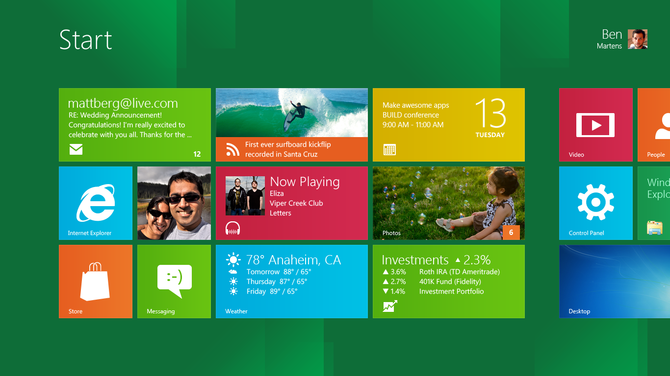

Slide 9
Tiles
Represent your app to the user
Rich and engaging view into your app
Alive with activity and continually updated
Draw users back into your app over and over
Easy to create and update!

Slide 10





Basic Tiles
Tap on tile to launch or switch to an app
Static default tile specified in app manifest
Two sizes:
Both sizes can have live updates
Square (1x1)
Wide (2x1)

Slide 11
Live Tiles
Tiles updated using pre-defined templates
Templates provide rich rendering options
Text-only, image-only or combination
JPEG or PNG only, max size 150 KB
Optional “peek” animation
Local or cloud updates

Slide 12
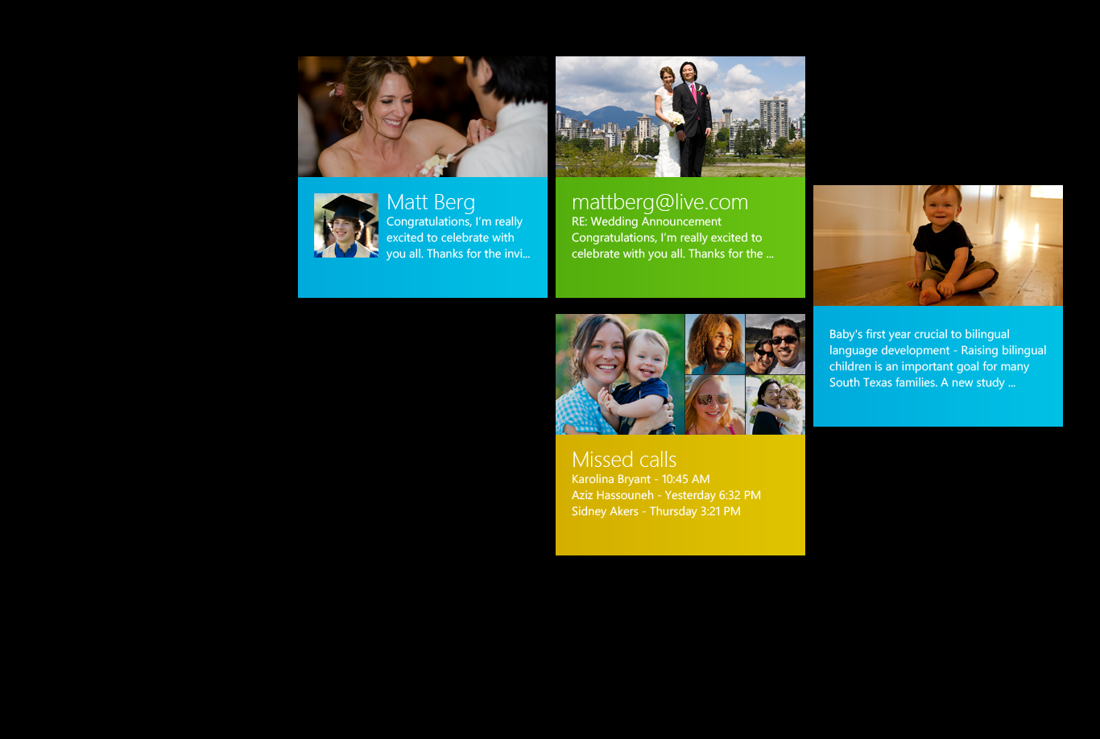
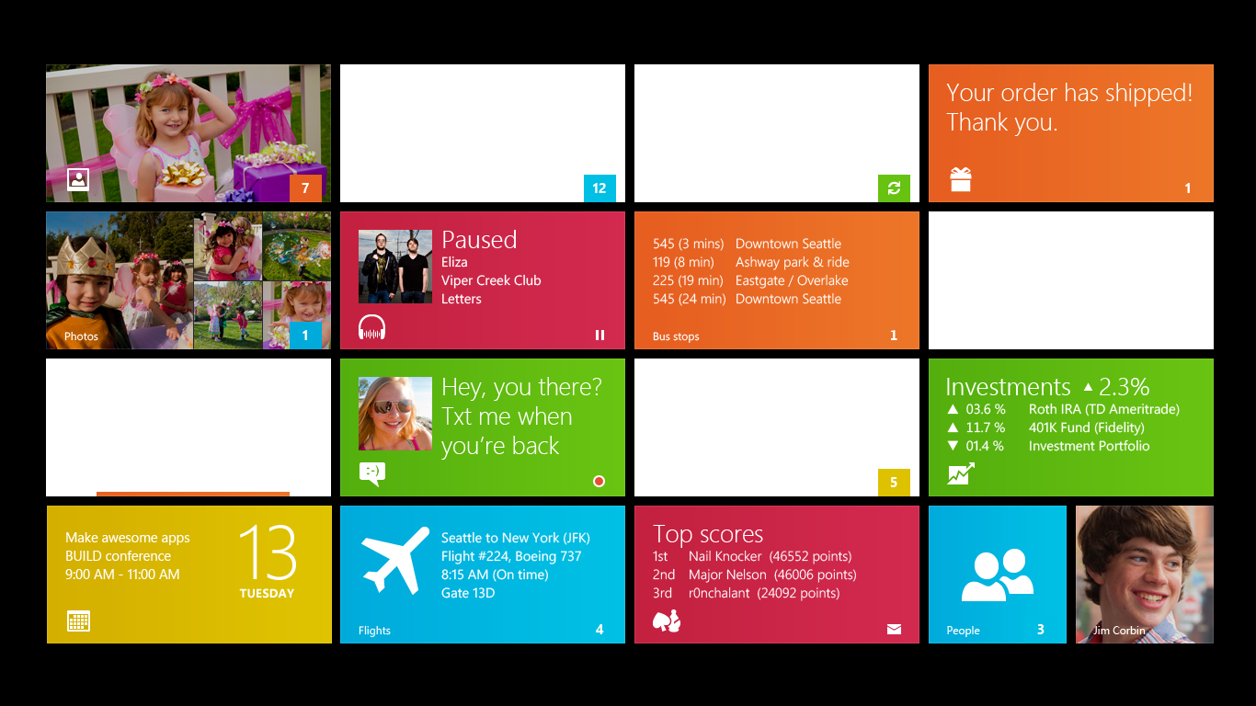
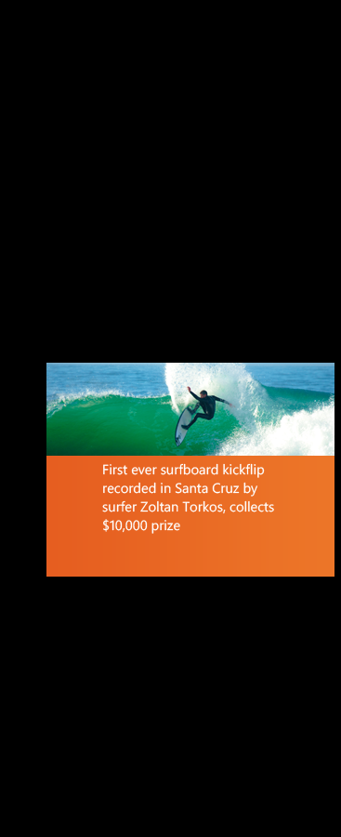

Slide 13
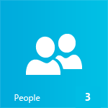
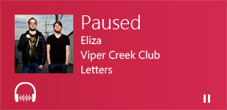
Badges
Overlays status on top of tile
Supports square and wide tiles
Number up to 99 or pre-defined glyph:
Always legible on top of images
Badge
Badge

Slide 14
Coding Live Tiles
demo

Slide 15
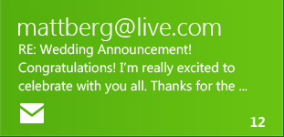

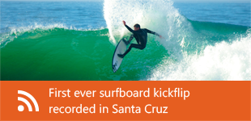
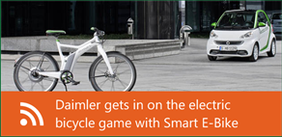
Notification Queuing
By default only last notification shown
Opt-in to automatically cycle tile through last five notifications

Slide 16
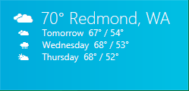
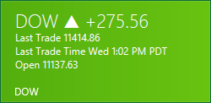
Secondary Tiles
Tiles created by “pinning” content from app
Pin initiated by app via simple runtime call
User confirms pin operation via system UI
Exposes a personalized surface for app
Same capabilities as app tiles
Launch leads to relevant content

Slide 17
Secondary Tiles
demo

Slide 18
Best Practices for Tiles
Display new, tailored and engaging content to the user
Keep tile fresh by updating as your app content changes
Reference content that lives on your app’s home page so the user can find it easily.
Keep content safely ignorable and glanceable - for short messages only
Use square size if tile is not live
No display ads! ☺

Slide 19
Toast Notifications

Slide 20
Toast Notification in Alarm app
demo

Slide 21
Toast Notifications
Toast notifications deliver transient messages outside the context of the app
Use toast notifications to get user’s attention immediately
User is in control and can permanently turn off toast notifications from your app
Allows quick navigation to a contextually relevant location in your app
Toast notifications are easy to invoke from your app or from the cloud

Slide 22
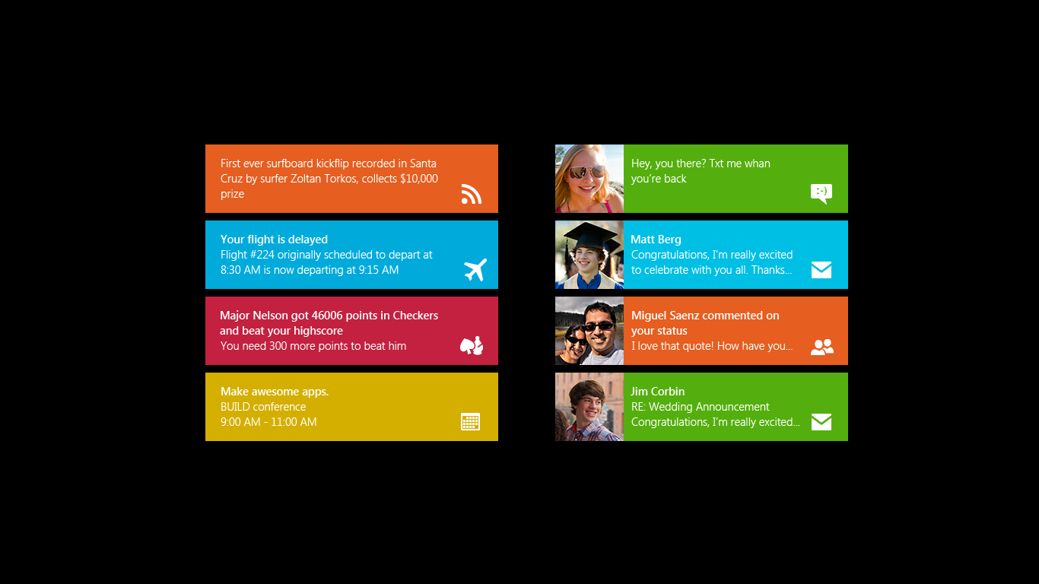
Toast Templates
  Toast notifications use the same template architecture as live tiles
  Rich set of rendering options available

Slide 23
Best Practices for Toast Notifications
Use for real-time, personal content such as IM, Call, or Mail
Provide glanceable information - for familiar, short messages only
Show enough information for the user to decide to react
Use with tiles and badges to help users find what they missed
Show toast only when app is in the background
Don’t assume user will see every toast (there is no history)

Slide 24
Windows Push Notification Service
(WNS)

Slide 25
Windows Push Notification Service
Enables delivery of tile and toast notifications over the internet.
Using WNS your app is alive with activity and always up to date with fresh content.
Tile updates and notifications shown to the user even if your app is not running.
WNS handles communication with your app
Scales to millions of users
Best of all, WNS is a free service for your app to use!

Slide 26
Three kinds of notifications
Local Notifications
  Used only when your app is running.
  Most useful for updating tiles and badges, limited use for toast.
Scheduled Notifications
  Schedule ‘preformed’ toast for a precise time.
Push Notifications
  Update tiles, show badges and raise toast from the cloud
  (even if your app isn’t running).

Slide 27
Push Notification Overview
Windows 8
App Service
Metro Style App
2
Request Channel URI
Register with your Cloud Service
Authenticate & Push Notification
POST <channel URI> HTTP/1.1
Content-Type: text/xml
Host: db3.notify.windows.com
X-WNS-Type: wns/badge
Authorization: Bearer <authentication token>
Content-Length: 58
<?xml version="1.0" encoding="utf-8"?>
<badge value="11"/>
3
1
Windows Push Notification Service
Notification
Client Platform
3

Slide 28
Requesting a Channel URI
var push = Windows.Networking.PushNotifications;
var promise = push.PushNotificationChannelManager .createPushNotificationChannelForApplicationAsync();
promise.then(function (channel) {
var uri = channel.uri;
var expiry = channel.expirationTime;
// send channel information to cloud service
…

Slide 29
WNS Information
Get more details in this upcoming talk on Thursday:
  [963] Delivering Notifications using Windows Azure and Windows Push Notification Services
The “WNS and Live Connect Application Management Site” will get you started using push notifications:
  https://manage.dev.live.com/build

Slide 30
Recap
Use tiles to engage users even when your app is not running
Use toast notifications to get their attention immediately
Reach millions of users with the Windows Push Notification Service (WNS)

Slide 31
Make your app alive with activity using tiles and notifications

Slide 32
Further reading and documentation
Quickstart: Creating a tile notification
Creating tiles and toast
UX guidelines for tiles
Creating and managing tiles, toast, and Windows push notifications
Push notification client sample

Slide 33
thank you
Feedback and questions http://forums.dev.windows.com
Session feedback
http://bldw.in/SessionFeedback

Slide 34

© 2011 Microsoft Corporation. All rights reserved. Microsoft, Windows, Windows Vista and other product names are or may be registered trademarks and/or trademarks in the U.S. and/or other countries.
The information herein is for informational purposes only and represents the current view of Microsoft Corporation as of the date of this presentation. Because Microsoft must respond to changing market conditions, it should not be interpreted to be a commitment on the part of Microsoft, and Microsoft cannot guarantee the accuracy of any information provided after the date of this presentation. MICROSOFT MAKES NO WARRANTIES, EXPRESS, IMPLIED OR STATUTORY, AS TO THE INFORMATION IN THIS PRESENTATION.

