Slide 1
Build accessible Metro style apps using XAML
APP-542C
Alnur Ismail
Program Manager
Microsoft Corporation

Slide 2
Agenda
Why build accessible apps?
Does XAML support accessibility?
How it works
Verification

Slide 3
Why build accessible apps?
Good experience for all users
Reach more customers
17% of users have disabilities
40% of users have mild impairments
Stand out
Apps in store receive “accessible tag”
Apps are listed under accessible filter

Slide 4
Does XAML support accessibility?
Yes -- in some scenarios by default!
Visual Studio Express templates are accessible
Can be used with narrator
Keyboard accessible
Supports high contrast

Slide 5
XAML infrastructure + UIA does a lot of the hard work for you.

Slide 6
Automation API
AutomationPeer (base type)
ButtonAutomationPeer
GridViewAutomationPeer
etc.
AutomationProperties
Name
HelpText
etc.

Slide 7
Verification
Accessibility testing tools are available in the Windows8 SDK
Use Inspect to verify accessibility properties
Run AccChecker to detect common errors

Slide 8
Questions?

Slide 9
thank you
Feedback and questions http://forums.dev.windows.com
Session feedback http://bldw.in/SessionFeedback

Slide 10
© 2011 Microsoft Corporation. All rights reserved. Microsoft, Windows, Windows Vista and other product names are or may be registered trademarks and/or trademarks in the U.S. and/or other countries.
The information herein is for informational purposes only and represents the current view of Microsoft Corporation as of the date of this presentation. Because Microsoft must respond to changing market conditions, it should not be interpreted to be a commitment on the part of Microsoft, and Microsoft cannot guarantee the accuracy of any information provided after the date of this presentation. MICROSOFT MAKES NO WARRANTIES, EXPRESS, IMPLIED OR STATUTORY, AS TO THE INFORMATION IN THIS PRESENTATION.

Slide 11
Slide annex

Slide 12
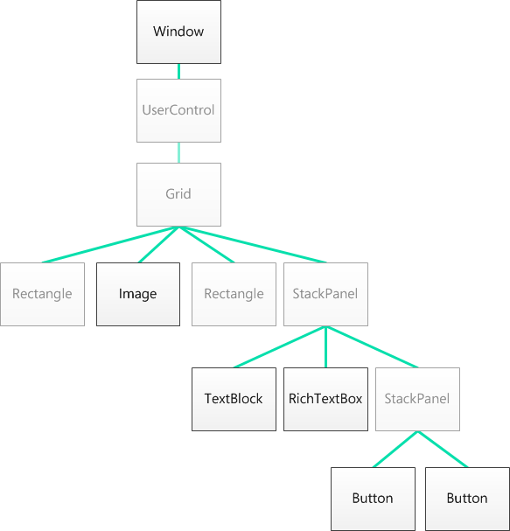
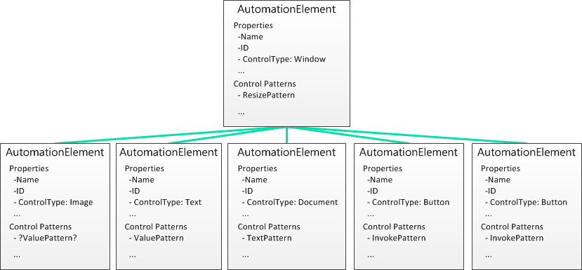
XAML’s UI automation tree
XAML’s logical tree
Automation tree

Slide 13
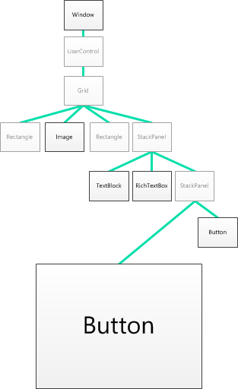
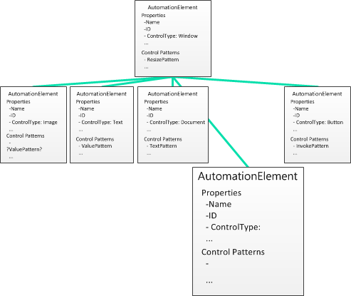
UI automation communication
XAML
Automation Client
what are you?
what are you?
??

Slide 14
UI automation communication
XAML
Automation Client
I’m a button
I’m a button
Button

Slide 15
UI automation communication
XAML
Automation Client
Invoke yourself
Button
Click
Invoke yourself
Invoke Pattern

Slide 16
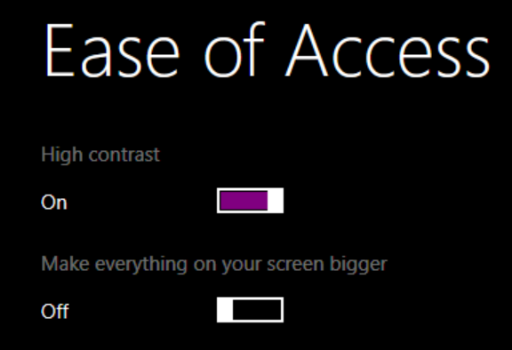
Theme dictionaries and system colors
Windows 8 styles can take advantage of built in system colors
Use theme dictionaries to apply styles respective of high contrast mode
System color examples
SystemColorWindowTextBrush
SystemColorBackgroundBrush
SystemColorWindowColor

Slide 17
Declaring ThemeDictionaries
<ResourceDictionary>
<ResourceDictionary.ThemeDictionaries>
<ResourceDictionary x:Key="Default"
Source ="Styles/SDKStyles.xaml"/>
<ResourceDictionary x:Key="HighContrastWhite"
Source="Styles/BaseTextStyles.Xaml"/>
<ResourceDictionary x:Key="HighContrastBlack"
Source="Styles/BaseTextStyles.Xaml"/>
<ResourceDictionary x:Key="HighContrastCustom"
Source="Styles/BaseTextStyles.Xaml"/>
</ResourceDictionary.ThemeDictionaries >
</ResourceDictionary>

Slide 18
Styling with Windows system colors
<Style x:Key="TitleStyle" TargetType="TextBlock">
<Setter Property="Foreground"
Value= "{StaticResource SystemColorWindowTextBrush}" />
<Setter Property="FontSize" Value="16"/>
</Style>

