Slide 1
Metro style apps using XAML: What you need to know
APP-737T
Joe Stegman
Group Program Manager
Microsoft Corporation

Slide 2
XAML, C#, VB and C++ developers: Welcome to Metro style app development.

Slide 3
Agenda
Welcome and Recap
Using XAML UI in your Metro style app
Metro style app concepts XAML developers should know
You’ll leave understanding
New concepts for XAML developers building Metro style apps

Slide 4
Windows 8
Metro style Apps
Desktop Apps
View
XAML
HTML / CSS
HTML
JavaScript
Model Controller
C
C++
C#
VB
JavaScript
(Chakra)
C
C++
C#
VB
Session Focus
WinRT APIs
System Services
Communication
& Data
Graphics & Media
Devices & Printing
Application Model
Internet Explorer
Win32
.NET / SL
Core
Windows Core OS Services

Slide 5
Keynote Recap
XAML UI developers are Metro style app developers
Existing XAML assets and knowledge carry forward
XAML and C++, like peanut butter and chocolate

Slide 6
More Details
Base controls and control model support:
Same control model supported in Silverlight and WPF
Animations, Visual State Manager (VSM) and Parts model
Content and item controls
Data binding, change notification, value converters
C++, C#, VB: first class programming languages for XAML
XAML controls are “native” WinRT APIs

Slide 7
Something old, something new…
demo

Slide 8
What’s New
C++ APIs
Metro style look and feel
Updated to support both touch and mouse
New namespace (base is Windows.UI.Xaml)
New controls
The Windows Runtime
Deployment (the Windows Store)
APIs targeted at Metro style app development

Slide 9
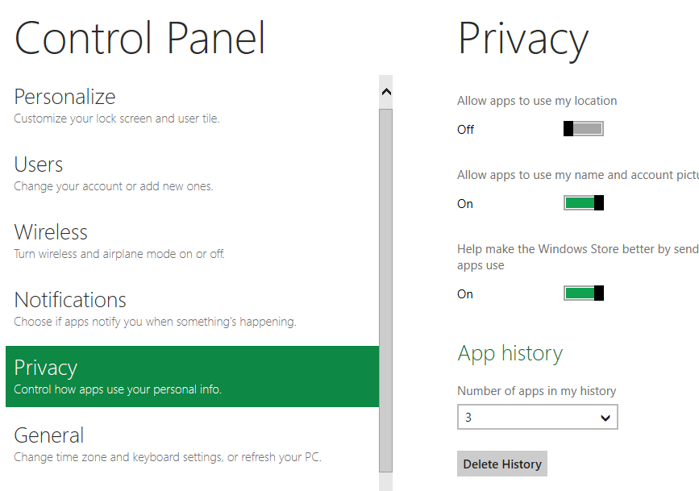
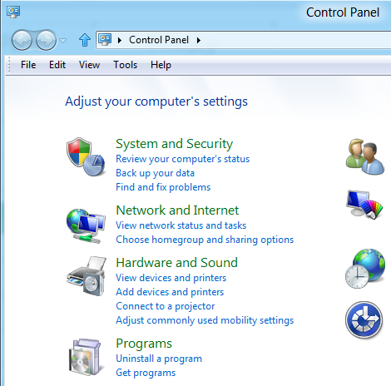
What’s New: App UX Design
Touch and Mouse
Mouse

Slide 10
Metro style UI
demo

Slide 11
Metro style App UI with XAML

Slide 12
User Interface (UI) in a Metro style App
Tile -> Splash Screen -> App (App UI)
XAML UI Starts Here

Slide 13
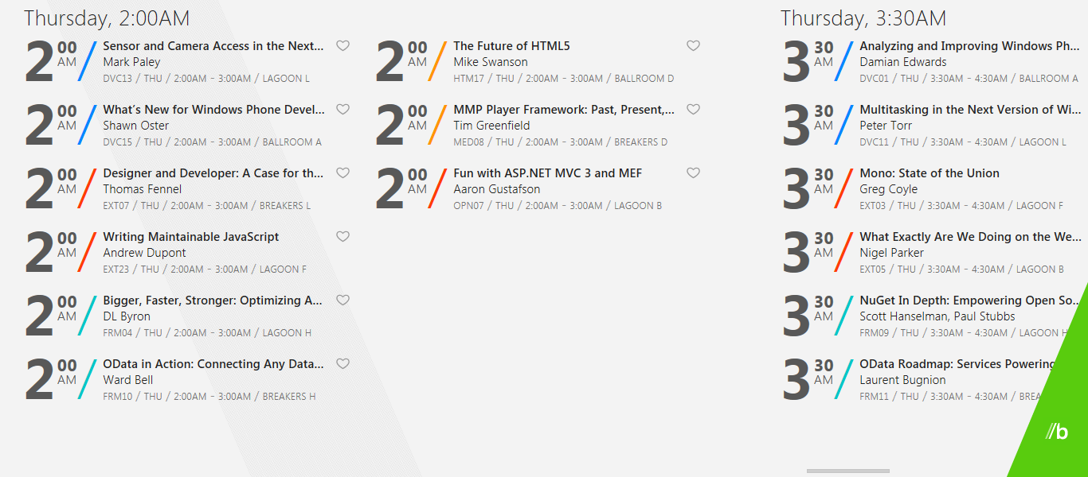
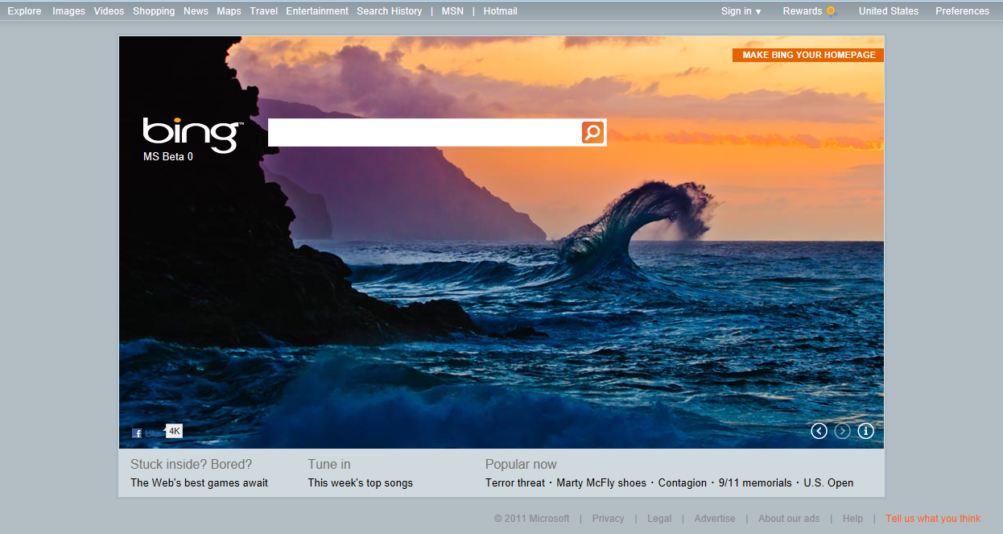
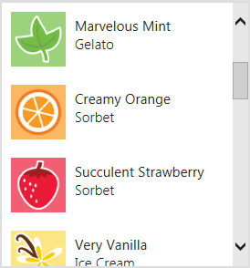
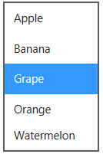
In-box Controls for Metro Style Apps
Button
Grid View
Text Box
Spell Checking
Clear Button
Checkbox
Radio Button
Progress Ring
Progress Bar
Hyperlink
Combo Box
Context Menu
Web View
Password
Reveal Button
List View
Semantic Zoom
Navigation
Slider
Flip View
List Box
Scroll Bar
Toggle Switch
Tooltip
Panning Indicator

Slide 14
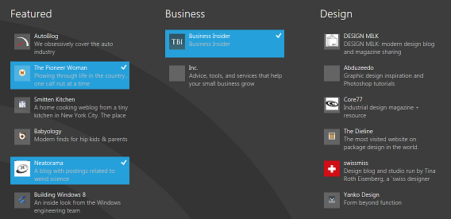
New XAML UI Controls (ListView, GridView)
List controls with distinct Windows 8 “feel”
Designed for touch
Support Windows 8 selection models
UI and Data Virtualization
Built in grouping

Slide 15
Metro style UI with GridView
demo

Slide 16
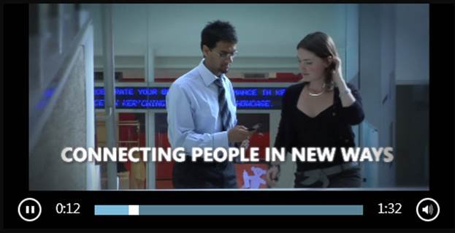
New XAML UI Controls (Continued)
MediaPlayer
ToggleSwitch
ProgressRing
FlipView
JumpViewer
Semantic Zoom Control
Supports 2 Levels

Slide 17
Metro style UI with FlipView
demo

Slide 18
New XAML UI Controls (ApplicationBar)
Contains UI for app commands
Persistent, light dismiss or time dismiss
Swipe in from top/bottom to display
ApplicationBar

Slide 19
Demo App Bar
demo

Slide 20
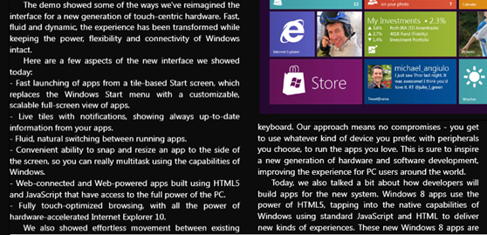
Additional Features
CPU Independent and Windows 8 Animations
Nine grid support in Image
Manipulations and gestures
Multi-column text display

Slide 21
Metro style App Concepts
Designing for ALL PCs, Windows Integration and App Lifecycle

Slide 22
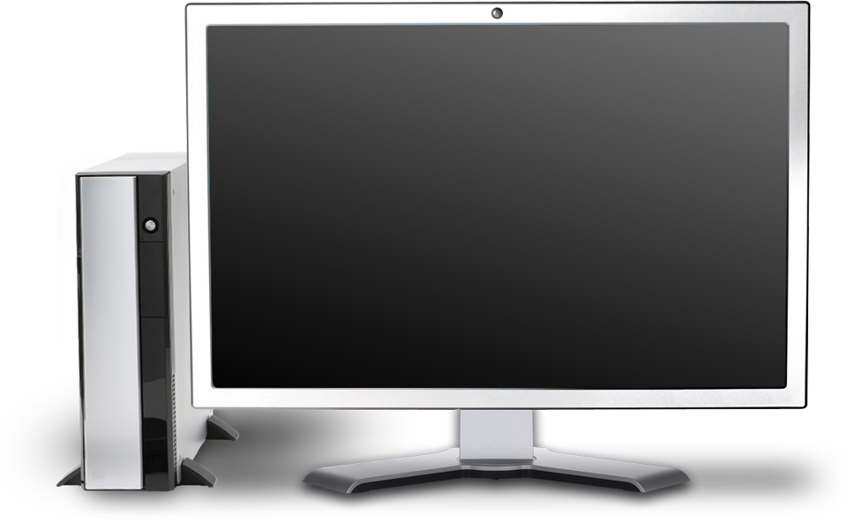
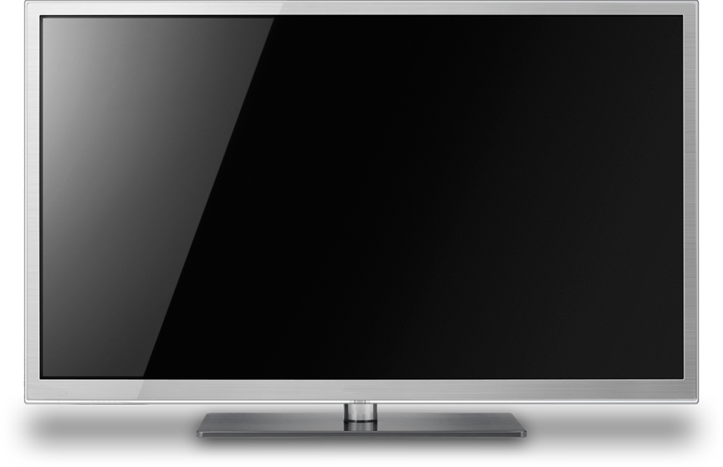
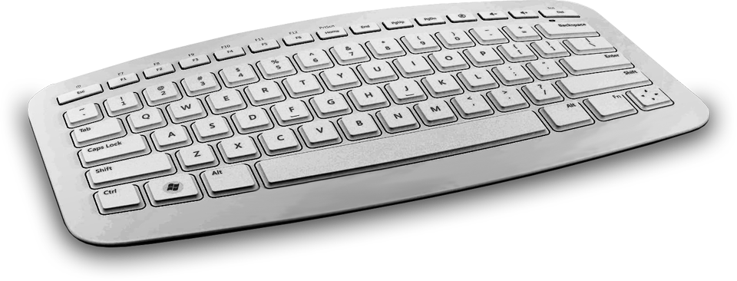
Diversity of Displays, Resolutions, Densities
Pixel Density
Snap, Filled and
Orientation
Screen Size

Slide 23
Detecting Screen Resolution
Current Resolution:
Window.Current.Bounds
Event:
Window.Current.SizeChanged
1366x768
1920x1080

Slide 24
Detecting Orientation
Current (Namespace: Windows.Graphics.Display)
DisplayProperties.CurrentOrientation
Event:
DisplayProperties.OrientationChanged
Portrait
Landscape

Slide 25
Detecting Layout
Current (Namespace: Windows.UI.ViewManagement)
ApplicationLayout.Value
Event:
ApplicationLayout.GetForCurrentView().LayoutChanged
Snapped
Filled
Full Screen

Slide 26
Demo Snapped View
demo

Slide 27
More Details
Test using the Simulator in Visual Studio
See Session APP-847T (Tim Heuer)
Reach all your customer's devices with one beautiful XAML user interface
Covers handling Pixel Density
Outlines techniques: Visual State Manager, Layout, Views

Slide 28
Windows Integration
Covered in detail in other sessions
Search: See APP-406T, APP 741T
Share: See APP-405T, APP 741T
Devices: See APP-788T, APP-914T
Settings: See the XAML Hands On Labs

Slide 29
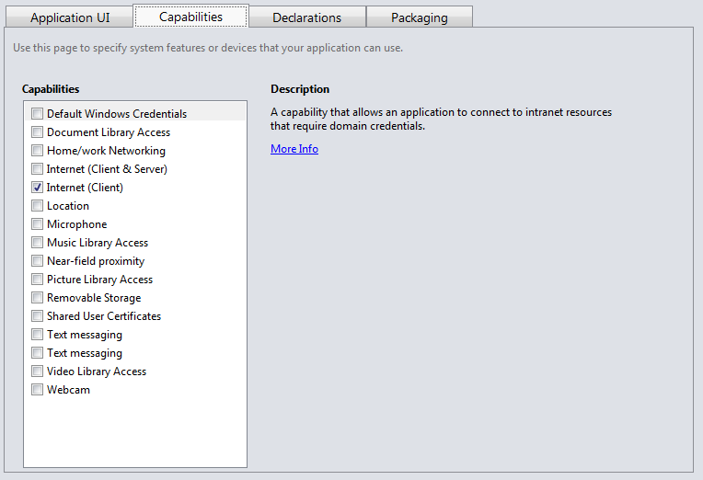
Capabilities
Specified in the Application Manifest
Declare an Apps intent towards system resources

Slide 30
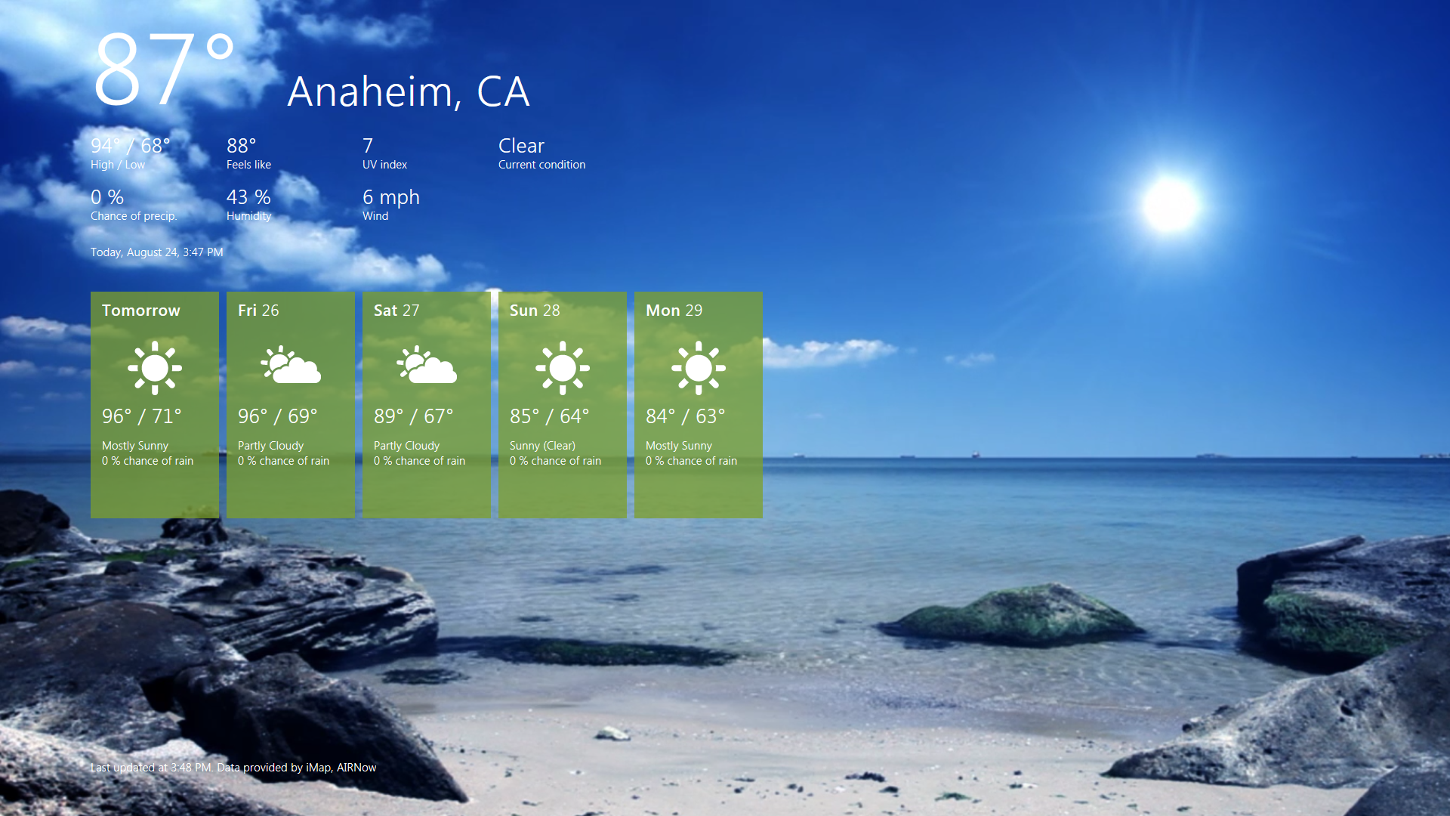
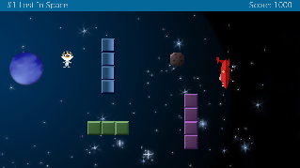
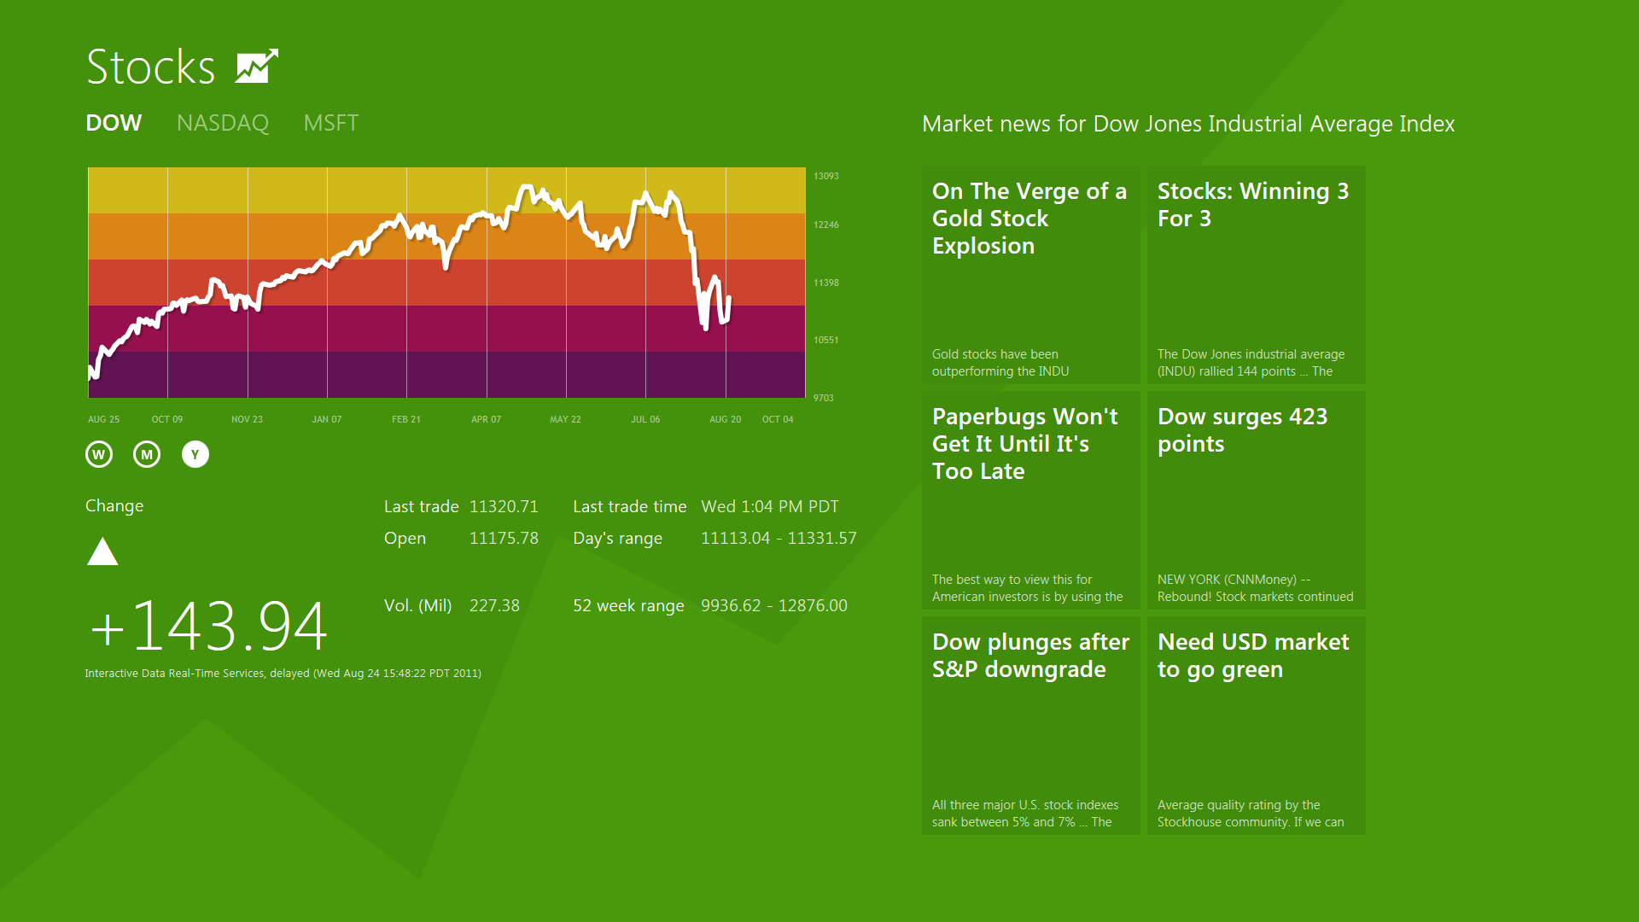
Metro Style App Process Lifetime
Foreground App is Active
Background Apps Suspended
Apps are notified
Apps may be Terminated
Apps are not notified

Slide 31
More Details on App Lifetime
Events:
Application.Current.Suspending
Application.Current.Resuming
Save state on Suspend
Restore store on Activate
For more details see Marco Matos and Ben Srour’s sessions

Slide 32
Have Fun building Metro style Apps and send us your feedback.

Slide 33
Related sessions
XAML Related Sessions
[APP-741T] Metro style apps using XAML: Make your app shine
[APP-494T] Stand out with styling and animation in your XAML app
[APP-517T] Build polished collection and list apps using XAML
[APP-503T] Make great touch apps using XAML
[TOOL-515T] Tips and tricks for developing Metro style apps using XAML
[APP-912T] Build data-driven collection and list apps using XAML
[APP-788T] Integrating stunning media experiences in XAML
[APP-914T] The lifetime of XAML text: from input to display through printing
[APP-847T] Reach all your customer's devices with one beautiful XAML user interface

Slide 34
Related sessions
XAML Chalk Talks
[APP-528C] Build world-ready Metro style apps using XAML
[APP-542C] Build accessible Metro style apps using XAML
Other Related Sessions
[APP-409T] Fundamentals of Metro style apps: How and when your app will run
[APP-396T] Using tiles and notifications

Slide 35
Further reading and documentation
Metro style app Dev Center Links
Learn to build Metro style apps
Metro style app samples
Building your first Metro style app with C#, C++, and Visual Basic
Developing basic Metro style apps with C#, C++, and Visual Basic

Slide 36
thank you
Feedback and questions http://forums.dev.windows.com
Session feedback http://bldw.in/SessionFeedback

Slide 37
© 2011 Microsoft Corporation. All rights reserved. Microsoft, Windows, Windows Vista and other product names are or may be registered trademarks and/or trademarks in the U.S. and/or other countries.
The information herein is for informational purposes only and represents the current view of Microsoft Corporation as of the date of this presentation. Because Microsoft must respond to changing market conditions, it should not be interpreted to be a commitment on the part of Microsoft, and Microsoft cannot guarantee the accuracy of any information provided after the date of this presentation. MICROSOFT MAKES NO WARRANTIES, EXPRESS, IMPLIED OR STATUTORY, AS TO THE INFORMATION IN THIS PRESENTATION.

