Slide 1
Windows Phone: how to build a game
APP-791T
Charles Cox
Program Manager, ATG
Microsoft Corporation

Slide 2
Agenda
The Windows Phone Game Development Story
Build a Game with XNA Game Studio
Let’s Go Mango!
What Now?
You’ll leave with examples of how to
Use XNA Game Studio to build a game
Integrate XNA and Silverlight together

Slide 3
The Windows Phone Game Developer Story

Slide 4
Windows Phone for Games
Powerful Hardware
Premium Gaming Features
Accelerated Development

Slide 5
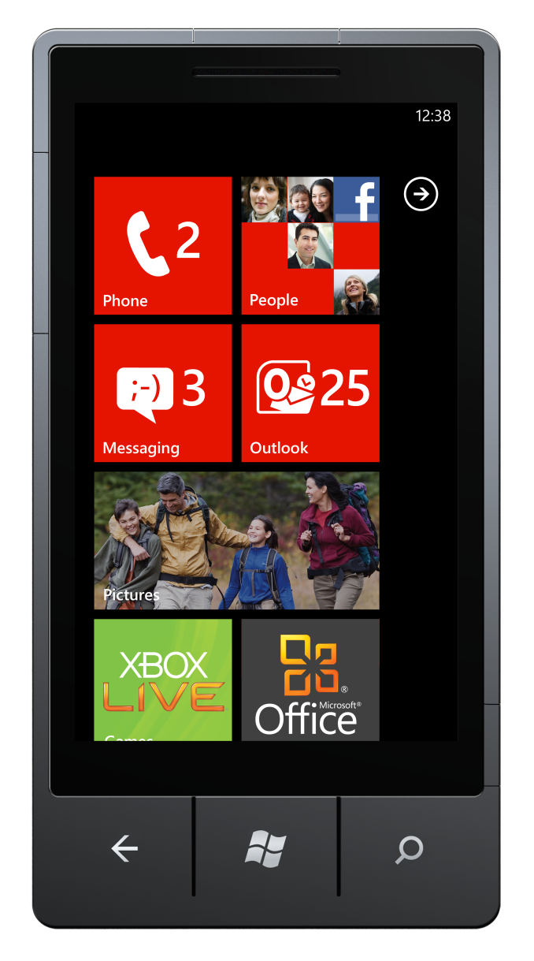
Powerful Hardware
V1 – Windows Phone OS 7.0 (Nov. 2010)
  WVGA 800x480, D3D11 API enabled GPU
  MSM8x55 CPU 1 GHz, 256 MB RAM, 8 GB flash
  4x Touch/aGPS/Accel/Compass/Light/Proximity
V2 – New Chassis Specification for OS 7.1
  MSM7x30 / MSM8x55 CPU, 800 MHz or higher
  Optional gyro

Slide 6

Premium Gaming Features
Xbox LIVE on Windows Phone
  Achievements & Leaderboards
  Avatars + Awards
  Downloadable content
  Cross-platform gaming: Full House Poker
  For Registered Developers

Slide 7


Accelerated Development
Silverlight for event-driven, control-rich apps
XNA Game Studio for games, simulation, and real-time graphics
Using C#/VB.NET in VS2010
OS 7.1: XNA + Silverlight Interop

Slide 8
Let’s Build a Game with XNA Game Studio

Slide 9
The XNA Framework Game Loop

Slide 10
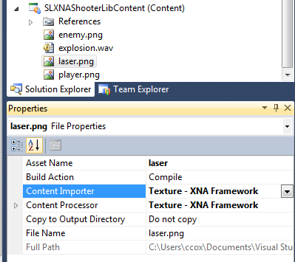
Introducing the XNA Content Pipeline
Integrated into Visual Studio 2010 build process
Incremental building of content, separate from code
Built-in support for many standard types
Extensible for your in-house formats

Slide 11
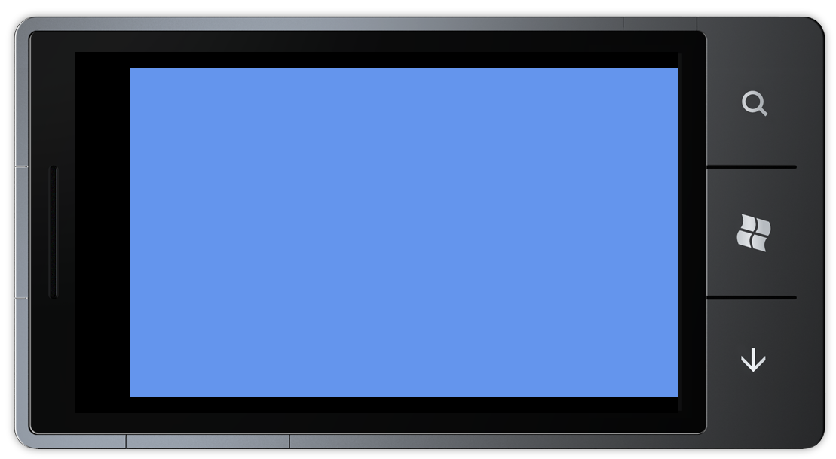

Simple Drawing in the XNA Framework
protected override void LoadContent()
{
spriteBatch = new SpriteBatch(GraphicsDevice);
playerSprite = Content.Load<Texture2D>("player");
}
protected override void Draw(GameTime gameTime)
{
GraphicsDevice.Clear(Color.CornflowerBlue);
spriteBatch.Begin();
spriteBatch.Draw(playerSprite, position,
Color.White);
spriteBatch.End();
base.Draw(gameTime);
}

Slide 12
2D Graphics in XNA Game Studio
XNA Game Studio 2D is about “blitting” textures to the screen
SpriteBatch
  Batched rendering of 2D: Alpha, Additive, Rotate, Flip, Scale
SpriteFont
  Converts fonts to sprites, draw with SpriteBatch
2D primitives can be drawn using 3D calls
If you are drawing complex 2D curves, consider Silverlight

Slide 13
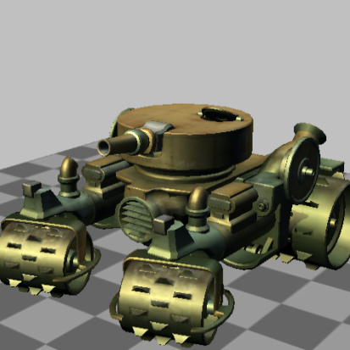
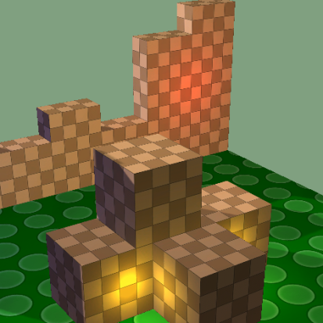
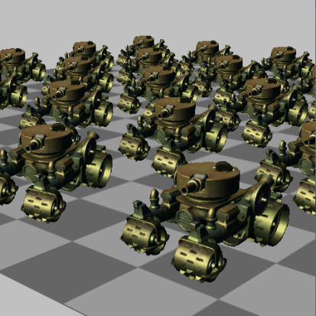


3D Graphics in XNA Game Studio
3D graphics through D3D11
Five configurable effects…
Lacks developer programmable shader support
BasicEffect
DualTextureEffect
AlphaTestEffect
EnvironmentMapEffect
SkinnedEffect

Slide 14
Taking Input in the XNA Framework
protected override void Initialize()
{
TouchPanel.EnabledGestures = GestureType.FreeDrag;
}
protected override void Update(GameTime gameTime)
{
while (TouchPanel.IsGestureAvailable)
{
GestureSample gesture = TouchPanel.ReadGesture();
if (gesture.GestureType ==
GestureType.FreeDrag)
{
position += gesture.Delta;
}
}
}

Slide 15
Input: Touch, Accelerometer, More
Gesture-based Touch through GestureSample
  Up to two touch points
  Full gesture list—drag, tap, pinch, etc.
Raw Touch input through TouchPanel.GetState()
  Up to four touch points
Accelerometer input through events
In OS 7.1, optional gyro, Motion API

Slide 16

Adding a Bad Guy
protected override void Update(GameTime gameTime)
{
enemyPosition.X -= enemySpeed;
enemyPosition.Y += (float)Math.Sin(enemyPosition.X * enemySpeed /
GraphicsDevice.Viewport.Width) * enemySpeed;
if(Rectangle.Intersect(
new Rectangle((int)position.X, (int)position.Y,
playerSprite.Width, playerSprite.Height),
new Rectangle((int)enemyPosition.X, (int)enemyPosition.Y,
enemySprite.Width, enemySprite.Height))
!= Rectangle.Empty)
{
//Hit!
OnCollisionSound();
enemyPosition = enemyStartPosition;
}
}

Slide 17
Math for Logic, Collision, and Motion
Built-in classes:
  Motion: Curve, Lerp, SmoothStep, CatmullRom, Hermite
  Transformation: Vector2/3/4, Point, Matrix, Quaternion
  Collision: BoundingBox/Sphere, Plane, Ray, Rectangle
  Includes .Intersects and .Contains methods
  And, don’t forget Random

Slide 18
Audio in Two Lines
protected override void LoadContent()
{
explosionSound = Content.Load<SoundEffect>("explosion");
}
private void OnCollisionSound()
{
explosionSound.Play();
}

Slide 19
Audio the Simple Way
SoundEffect / SoundEffectInstance
  Load WAV files (PCM, ADPCM) or from raw PCM buffer
  SoundEffect fire and forget, SoundEffectInstance to keep/modify
  Can play up to 64 concurrent sounds
  Custom formats supported through ContentProcessor
Music through MediaPlayer

Slide 20
Audio the Dynamic Way
DynamicSoundEffectInstance
Manages own internal queue of buffers
Expensive, and 16-bit PCM only
Consider dynamic for synthesized or data-sourced audio
Most games will not need to use this, stick with SoundEffect

Slide 21
Going Mango

Slide 22
New Game Dev Features in Mango
Framework
Tools
Ecosystem
Fast App Switching
XNA + Silverlight
Background Agents
Unified Motion API
Live Camera Access
SQL CE
TCP/UDP Sockets
CPU/Memory Profiler
Iso. Storage Explorer
Accel/Location Emulator
16 New Regions
Marketplace Test Kit
Integrated Ad SDK

Slide 23
Fast App Switching
Resuming ...
Fast app resume
running
deactivated
dormant
activated
State preserved!
IsAppInstancePreserved == true
Restore state!
IsAppInstancePreserved == false
Save State!
tombstoned
Tombstone
the oldest app
Phone resources detached
Threads and timers suspended

Slide 24
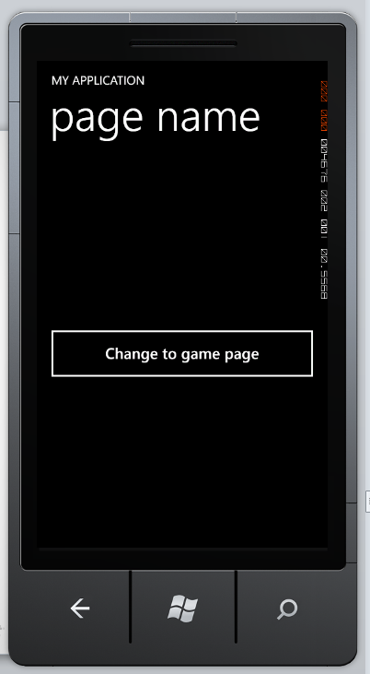
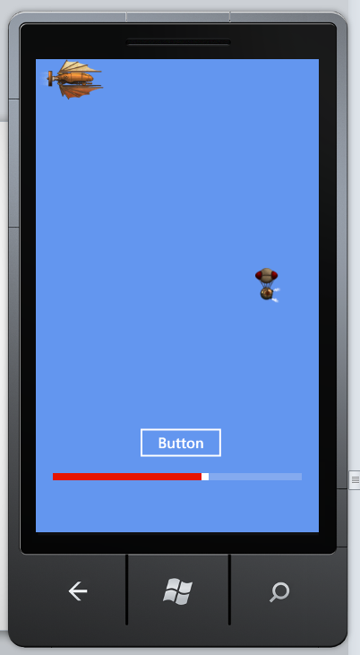
XNA and Silverlight Integration
Enables XNA Graphics in a Silverlight application
Use the Silverlight application model
Switch into XNA rendering mode
Use UIElementRenderer to draw Silverlight controls on XNA Surface

Slide 25
Moving to the Silverlight + XNA Game Loop

Slide 26
Let’s Integrate XNA/SL
demo

Slide 27
What Now?

Slide 28
Considerations as You Build Your Game…
90 MB memory limit for your game
Garbage collector kicks off at every 1 MB of allocations
More objects created/released = memory churn
OS 7.1, generational GC better than OS 7.0, but stay vigilant
  Full collection still happens…just less frequently

Slide 29
Considerations as You Build Your Game…
Easy to start with dynamic types (List<>, etc.), but trade-offs
Consider fixed arrays for performance, watch your profiler
Avoid LINQ (and its extension methods)
Prefer value types to ref types
Never fear: Classes in the XNA Math library are value types!

Slide 30
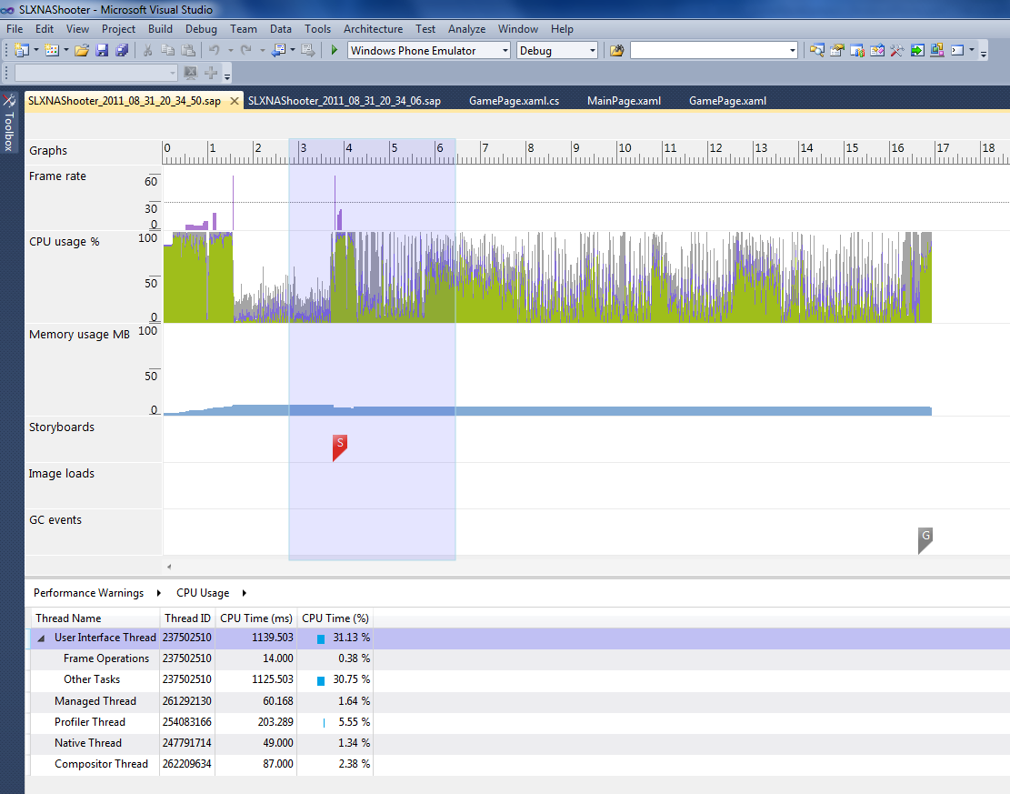
Performance and Memory Profiler
New profiler in Windows Phone SDK 7.1
Memory mode to find allocations
Performance mode to find CPU spikes
Available even on Express!

Slide 31

Marketplace Opportunities
$99/yr fee to develop/submit on physical devices, free on emulator
Free apps, can use Microsoft Advertising SDK with XNA
  Up to 100 for free, $19.99 per submission after
Paid apps, can charge from $0.99 to $499.99
  Submissions free, 70/30 split

Slide 32






What About Xbox LIVE?
If represented, contact Xbox LIVE through your publisher
If not, many publishers are available, one is MS Studios
Send info about your company and portfolio first, no cold pitching
mobilegames@microsoft.com

Slide 33










More Resources…
Start with samples at App Hub
  Full games to pull apart
  Technique samples to add to your games
  White papers and tutorials for even more
http://create.msdn.com/gamedevelopment

Slide 34
thank you
Feedback and questions http://forums.dev.windows.com
Session feedback
http://bldw.in/SessionFeedback

Slide 35

© 2011 Microsoft Corporation. All rights reserved. Microsoft, Windows, Windows Vista and other product names are or may be registered trademarks and/or trademarks in the U.S. and/or other countries.
The information herein is for informational purposes only and represents the current view of Microsoft Corporation as of the date of this presentation. Because Microsoft must respond to changing market conditions, it should not be interpreted to be a commitment on the part of Microsoft, and Microsoft cannot guarantee the accuracy of any information provided after the date of this presentation. MICROSOFT MAKES NO WARRANTIES, EXPRESS, IMPLIED OR STATUTORY, AS TO THE INFORMATION IN THIS PRESENTATION.

