Slide 1
Windows Phone Xaml apps Please sit close
APP-831T
Jesse Liberty
Developer-Community Evangelist
Microsoft Corporation

Slide 2
Agenda
Incredibly Brief Introduction
Building an application with Xaml
Fast Application Switching
Data Binding

Slide 3
Creating Great Windows Phone Applications Is Easier Because of Great Tools and Frameworks

Slide 4
Are You In The Right Session?

Slide 5
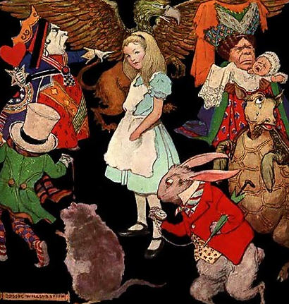
“Begin At The Beginning, Go To The End, And Then Stop.”

Slide 6
Foundations: Building an Application with Xaml

Slide 7
First Xaml Application
demo

Slide 9
Application
Closing
Application
Launching
Application
Life-Cycle
OnNavigatedFrom
Method
OnNavigatedTo
Method
Running
Application
Activated
Application
Deactivated
OnNavigatedTo
Method
OnNavigatedFrom
Method
Tombstoned
Dormant

Slide 13
Fast Application Switching
demo

Slide 14
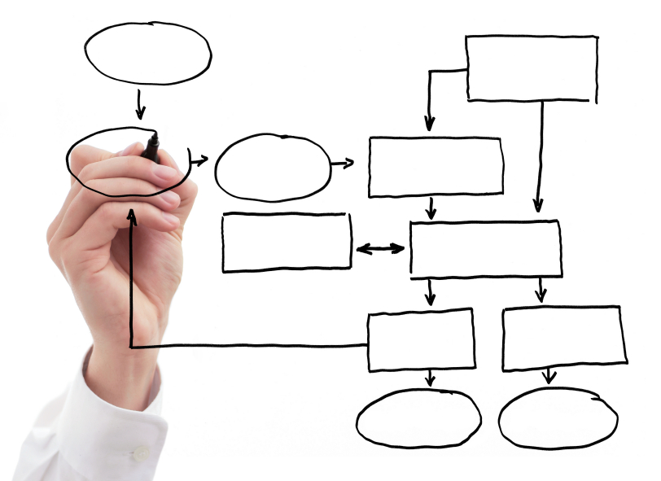

Slide 15
Data Binding
demo

Slide 16
Related sessions
[APP-832T] Windows Phone user experience design
[APP-935T] Windows Phone: building apps that customers love, end to end
[APP-791T] Windows Phone: how to build a game
[APP-823T] Windows Phone multitasking
[APP-827T] Windows Phone application performance and optimization

Slide 17
Further reading and documentation
Phone dev blog: http://wpdev.ms/wpDevBlog
MSDN: http://wpdev.ms/wpDevMSDN
http://JesseLiberty.com

Slide 18
thank you
Feedback and questions http://forums.dev.windows.com
Session feedback http://bldw.in/SessionFeedback

Slide 19
© 2011 Microsoft Corporation. All rights reserved. Microsoft, Windows, Windows Vista and other product names are or may be registered trademarks and/or trademarks in the U.S. and/or other countries.
The information herein is for informational purposes only and represents the current view of Microsoft Corporation as of the date of this presentation. Because Microsoft must respond to changing market conditions, it should not be interpreted to be a commitment on the part of Microsoft, and Microsoft cannot guarantee the accuracy of any information provided after the date of this presentation. MICROSOFT MAKES NO WARRANTIES, EXPRESS, IMPLIED OR STATUTORY, AS TO THE INFORMATION IN THIS PRESENTATION.

