Slide 1
Building great networked media devices for Play To apps
HW-177T
Edwin Heredia & Zane Salim
Program Managers
Microsoft Corporation

Slide 2
Agenda
Play To experiences from Metro style apps
How Play To works in Windows 8
Certifying your Play To device
You’ll leave with an understanding of
How to make your devices work with Play To

Slide 3
Play To makes it easy for customers to enjoy media from the web and apps on devices

Slide 4
Play To from the web and Metro style apps
demo

Slide 5
Play To from Metro style apps
Setup-free and easy to discover
Built into HTML5 media tags in IE10
Working music, video, and photo apps
Simple to support in Metro style apps

Slide 6
How Play To works
in Windows 8

Slide 7
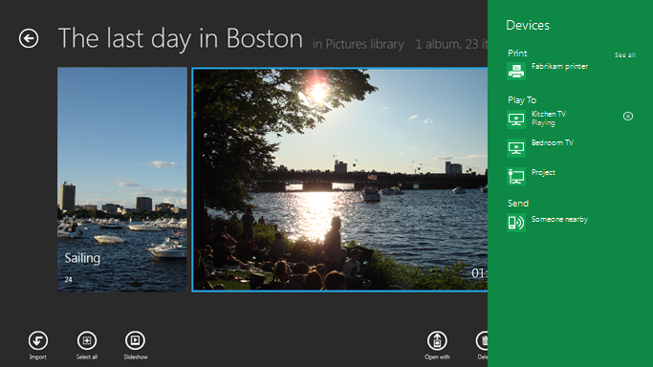
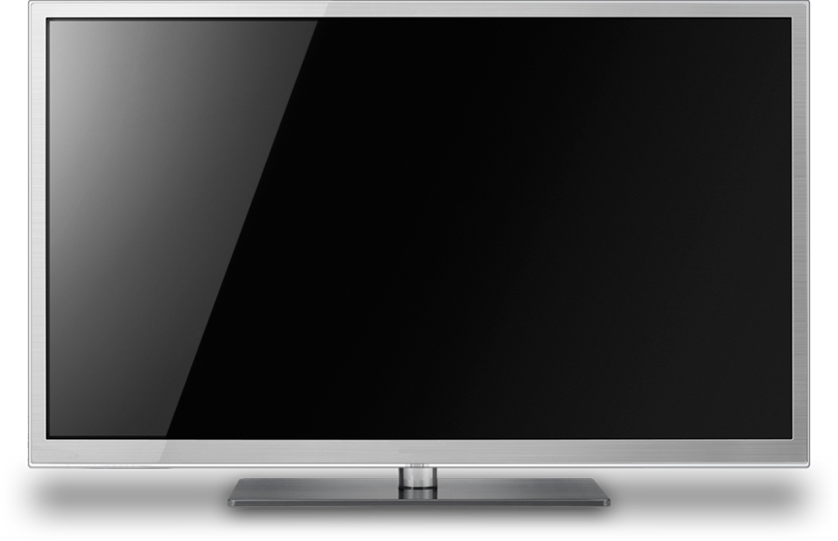
Play To user experience
Play To Controller
Play To Receiver

Slide 8
Connection Protocols
Connection Protocols
Ethernet, Wi-Fi, Wi-Fi Direct, IP, TCP, UDP
Discovery & Description
UPnP Device Architecture v1.0
Control Protocols
UPnP AV MediaRenderer v1
HTTP Streaming
HTTP 1.1, DLNA extensions
Media Formats
DLNA MF Guidelines
DLNA Guidelines

Slide 9
Play To receiver architecture
Decoders
Media
Steaming
Client
UPnP AV Media Renderer V1
Connection
Manager
AV Transport
Rendering Control
TCP/IP, UDP/IP & HTTP
Wired/Wireless/Wi-Fi Direct

Slide 10
Play To Session
1. List of supported formats/profiles
2. User selects content
3. User invokes Play To
4. Controller sends the content URI (Play)
5. HTTP Request
6. Content stream
TV plays content progressively
7. Pause, Stop, Seek

Slide 11
Enabling Play To in apps
<body>
<video id=“videoplayer” src=“http://www.contoso.com/clip.mp4” controls autoplay />
<script type=“text/javascript”>
// Step 1: Obtain PlayToManager object for the application’s current view
var ptm = Windows.Media.PlayTo.PlayToManager.getForCurrentView();
// Step 2: Register for the sourcerequested event so a media source can be specified
ptm.addEventListener(“sourcerequested”, function(e) {
// Step 3: Specify the mediaElement to stream.
// The user chooses a target device in the UI.
var request = e.sourceRequest;
var deferral = request.getDeferral();
request.setSource(document.getElementById(“videoplayer”).msPlayToSource);
deferral.complete();
});
</script>
</body>

Slide 12
Certifying your Play To device

Slide 13
Quality Media Experiences
Windows only shows certified Play To devices in the Devices charm
Protocol Compliance Requirements (DLNA)
Product Quality and User Experience Requirements
Windows Device Certification
+
=
Usability and Performance
Consistent and reliable experience
Optimized for common formats
High-quality media rendering
Delivers complete experiences

Slide 14
Usability, performance, and quality
A certified Play To receiver
Is always available and very responsive
Has low latency when a user plays audio, video or pictures
Selects the content variant that offers the best quality
Supports natively H.264 video with AAC-LC audio in MP4 containers

Slide 15
Consistent, reliable, and complete
A certified Play To receiver
Complies with standardized protocols (DLNA)
Implements good error handling
Supports rich user libraries
Implements all the transport controls
Saves energy (stand-by mode) but also Wake-on-LAN
Supports Play To over Wi-Fi Direct

Slide 16
Certifying your Play To device
Creates a consistent and reliable experience for customers
Ensures that your device works well with Metro style apps
Enables you to create a Metro style device app that is automatically installed with the device

Slide 17
Developer Preview receivers and apps
Receivers
Western Digital TV Live Hub
Windows 7 certified Onkyo AV Receivers
Windows 7 and Windows 8 PCs running Windows Media Player
Metro style apps
Internet Explorer
Conference app
Notespace

Slide 18
Recap

Slide 19
Play To in Windows 8
Makes it easy for customers to enjoy media from the web and apps on your devices
Delivers a setup-free, and easy to discover experience
Works with HTML5 websites using IE10 and Metro style apps

Slide 20
Call to action
Partner with us to deliver compelling Play To device experiences with Windows 8
Design and build devices that work well with media from the web and Metro style apps
Get your Play To devices certified for Windows 8

Slide 21
Related sessions
[HW-745T] Reimagining the experience for connecting with devices
[PLAT-775T] Your Metro style app, video and audio, Part 1
[HW-329T] Understanding Wi-Fi Direct in Windows 8
[APP-788T] Integrating stunning media experiences in XAML
[APP-408T] Integrating with the Windows device experience
[HW-275T] Building and delivering a great Metro style app for your device
[HW-286T] Simplifying wireless and network device discovery and pairing
[HW-260T] Windows Certification: improvements to the logo program

Slide 22
Further reading and documentation
Whitepapers:
Design Guidelines for Play To Receivers
Play To & Media Sharing for Metro Style Apps
Developer Center:
Streaming media to devices using PlayTo
Quickstart: Using PlayTo in applications
Windows.Media.PlayTo namespace
Windows Application Contracts
Windows Dev Center home

Slide 23
thank you
Feedback and questions http://forums.dev.windows.com
Session feedback http://bldw.in/SessionFeedback

Slide 24
© 2011 Microsoft Corporation. All rights reserved. Microsoft, Windows, Windows Vista and other product names are or may be registered trademarks and/or trademarks in the U.S. and/or other countries.
The information herein is for informational purposes only and represents the current view of Microsoft Corporation as of the date of this presentation. Because Microsoft must respond to changing market conditions, it should not be interpreted to be a commitment on the part of Microsoft, and Microsoft cannot guarantee the accuracy of any information provided after the date of this presentation. MICROSOFT MAKES NO WARRANTIES, EXPRESS, IMPLIED OR STATUTORY, AS TO THE INFORMATION IN THIS PRESENTATION.

