Slide 1
Windows Certification: improvements to the logo program
HW-260T
Oscar Koenders
Principal Group Program Manager
Microsoft Corporation

Slide 2
Agenda
Learning from Windows 7 Logo
Goals & initiatives for Windows 8
Get started with certification
You will leave understanding
The direction of the certification program
How to get ready for Windows 8

Slide 3
Thank You!

Slide 4
What partners said
“I don’t know if consumers grasp the purpose of the Windows Logo program …. That it is a sign of quality .. Its not just the sign that Windows is installed on a system but it’s a sign that it has really been certified.”
I’d try to flip the program to be more end-user driven than Microsoft focused in terms of flexibility and guidelines for compliance …
Requirements are now online …and it can change anytime, and it changes with no notification or log file..
I would argue that if a requirement is really, truly important, to Microsoft they should document how to validate that requirement ….
They added a new set of tools that are intensely complex, far more complex than ever before. Its called DTM. Extremely difficult, complex system to work with…
Microsoft does not do a good job of communicating what are the newer test cases being added.
DTM documentation is really poor.
SOURCE: Gartner Research commissioned by Microsoft, Fall 2009

Slide 5
What customers said
66% of customers want logo to stand for quality & premium user experience
Response to the question: “What should the Logo stand for?” Survey conducted by Gartner, commissioned by Microsoft in 2009

Slide 6
Goals for the Windows Certification Program
Great experience for end users and developers
Streamlined certification experience
Broad and timely availability of quality products

Slide 7
Great experiences for end users and developers by anchoring on end user scenarios

Slide 8
Windows 7 Certification foundation
Requirements
Tests
Display
Storage
DevFund
SysFund
0001
0002
….
0001
0002
….
0001
0002
….
0001
0002
….

Slide 9
Windows 8 Certification foundation
User Scenarios
Features
Tests
Requirements

Slide 10
Example: video chat
User Scenarios
Features
Tests
Requirements
Streaming video
Streaming audio
USB
H.264 Support
Support for 720p 30 fps on all built-in cameras
Smooth audio when supporting multiple audio & video streams
Glitch free HD Video Playback
H264 AVC Payload base
Glitch free Audio

Slide 11
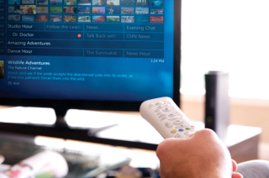
Example: watching an HD movie
User Scenarios
Features
Tests
Requirements
Video Playback
Audio
Smooth HD Video Playback
Smooth audio when supporting multiple audio/video streams
Glitch free HD Video Playback
Glitch free Audio

Slide 12
sAnchoring on user Scenarios helps you
Create innovative products that deliver experiences customers want
Have a consistent, predictable experience developing apps and hardware

Slide 13
Streamlined certification experience through better tools

Slide 14
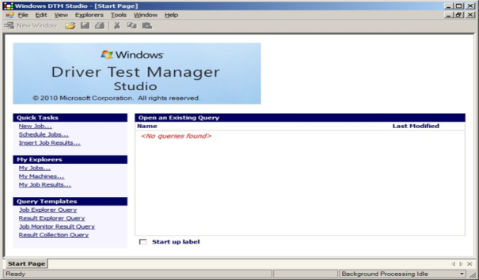
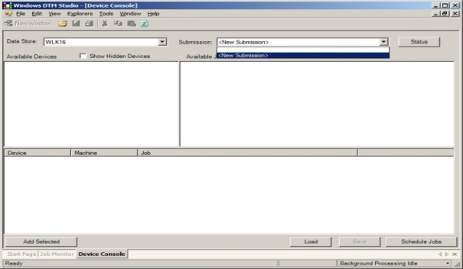
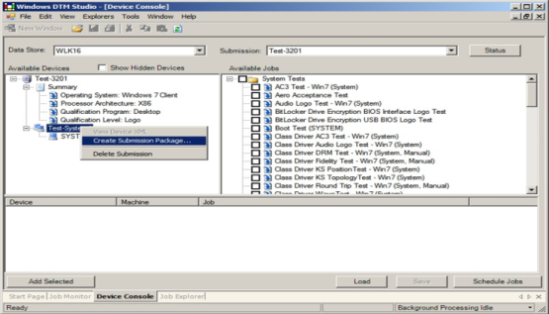
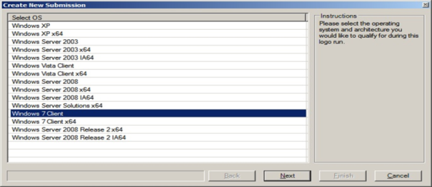
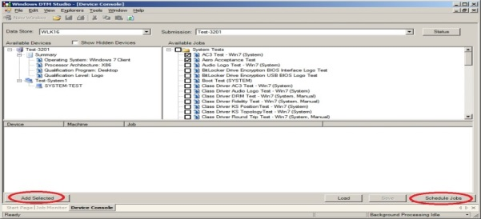
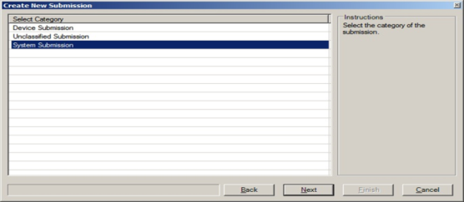
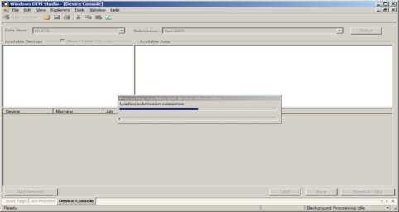
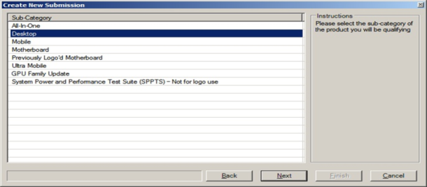
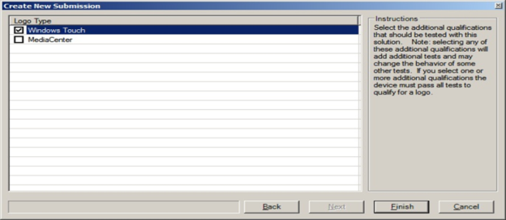
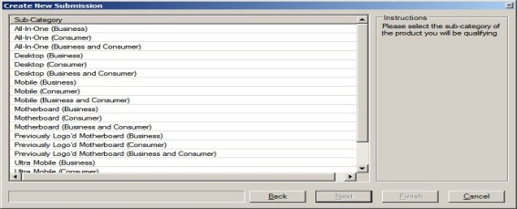
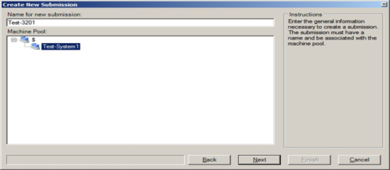
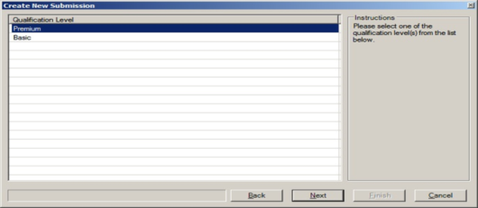
Windows Logo Kit 1.6

Slide 15
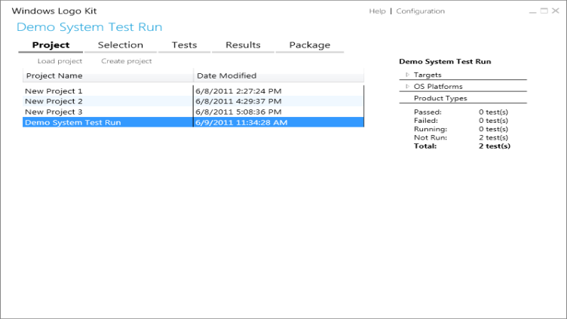
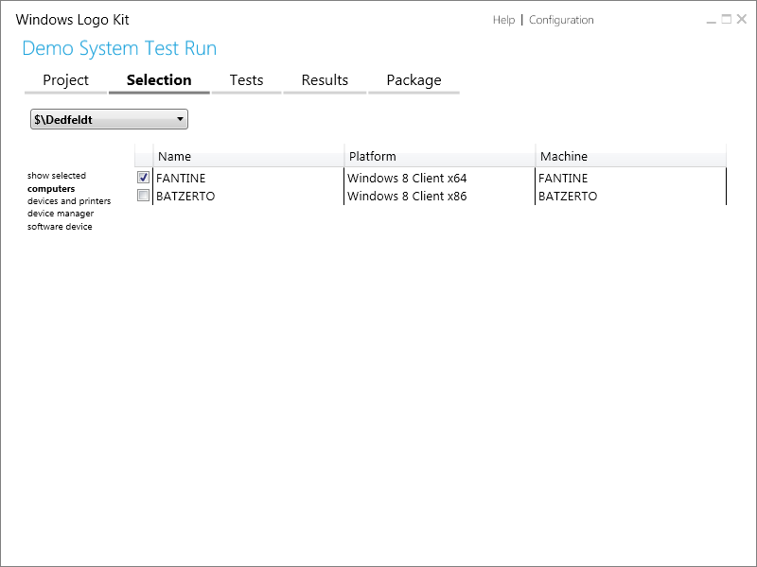
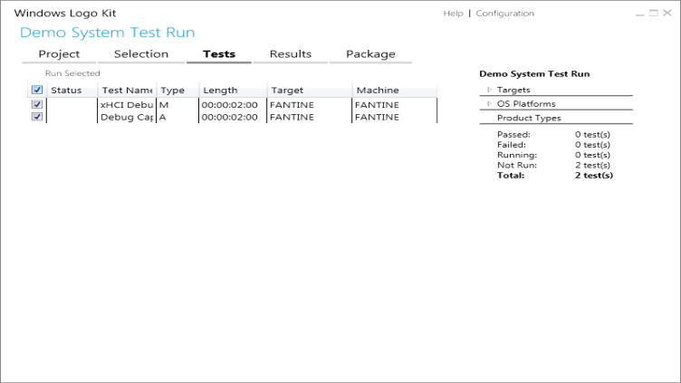
Windows Hardware Certification Kit
New user interface
Simplified workflow
Powerful automation

Slide 16
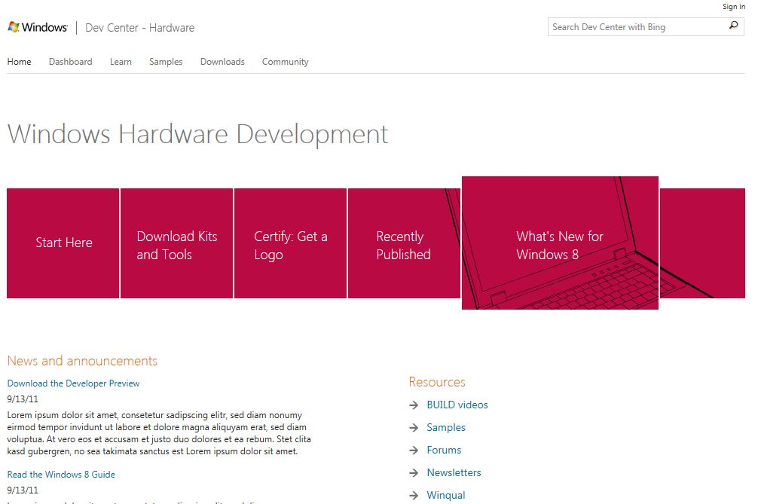
Single place for all Windows information
The Development Center will be the ‘go to’ place for all Windows information including certification
Program details
Requirements
Kits
Submission, Driver Distribution, Telemetry…

Slide 17
How better tools help you
Greatly reduced training times
Much shorter test durations (single run for all features)
Pre-defined test categories eliminated
Comprehensive testing of your features

Slide 18
Broad and timely availability of quality products through synchronization with
Windows releases

Slide 19
In sync with Windows
Requirements and tests released in sync with Windows
Tools available in time before RTM to be ready for the Windows 8 launch

Slide 20
How Synchronization Helps You
You get to focus on innovation and quality, not on keeping track of changes
The impact of your products & Windows innovations are amplified

Slide 21
Summary

Slide 22
Windows Certification Program
Goals
Initiatives
Great experience for end users and developers
Streamlined certification experience
Broad and timely availability of quality products
Anchoring in end user scenarios
Better tools
Synchronization with Windows releases

Slide 23
Get started now for Windows 8 Certification
At //BUILD
Between now and Beta
Beta to Start
of Certification
Attend related sessions
Visit hands-on labs
Learn about technology- specific certification requirements
Familiarize yourself with the requirements and kits (HCK & ACK)
Provide feedback
Get trained
Test your products for certification with new kits

Slide 24
Related sessions
[HW-659T] Certifying hardware with the Windows Hardware Certification Kit
[HW-665C] Windows Certification Program, process and tools
[HW-719H] (Lab) Experiencing the Windows Hardware Certification Kit
[APP-840H] (Lab) Hands on lab for Windows App Certification Kit
[SAC-932T] Windows Server 8 software and hardware certificationCertification

Slide 25
Further Reading and Documentation
Windows 8 Certification Requirements – Preview
Windows Hardware Certification Kit – Preview
Whitepaper: Using the Windows App Certification Kit
Windows Server 8 SW Certification Requirements Draft
Windows Logo Program for Hardware: Overview
Windows Hardware Developer Center Dashboard
Windows Hardware Developer Center
Windows Developer Center
Contact Info: logofb@microsoft.com

Slide 26
thank you
Feedback and questions http://forums.dev.windows.com
Session feedback http://bldw.in/SessionFeedback

Slide 27
© 2011 Microsoft Corporation. All rights reserved. Microsoft, Windows, Windows Vista and other product names are or may be registered trademarks and/or trademarks in the U.S. and/or other countries.
The information herein is for informational purposes only and represents the current view of Microsoft Corporation as of the date of this presentation. Because Microsoft must respond to changing market conditions, it should not be interpreted to be a commitment on the part of Microsoft, and Microsoft cannot guarantee the accuracy of any information provided after the date of this presentation. MICROSOFT MAKES NO WARRANTIES, EXPRESS, IMPLIED OR STATUTORY, AS TO THE INFORMATION IN THIS PRESENTATION.

