Slide 1
Building and delivering a great Metro style app for your device
HW-275T
Max Morris
Principal Program Manager
Microsoft Corporation

Slide 2
Agenda
How to differentiate your device using a Metro style app
Anatomy of a device experience
Development lifecycle for a device experience
You’ll leave with examples of how to
Create a Metro style app for your device
Make a device experience for Windows 8

Slide 3
You can create a Metro style app to differentiate your device, and Windows will distribute it for you

Slide 4
With Metro style device apps
Your code gets into your customers’ hands… automatically
You own all the pixels
You can naturally integrate with built-in Windows experiences
You can use custom functionality from your device & driver
You have the power of easy & comprehensive tools

Slide 5
How to differentiate your device using a Metro style app

Slide 6
LifeCam Studio
demo

Slide 7
Create a Metro style app
Control all the pixels
Use familiar languages with common tools
Integrate services from the web
Integrate with Windows through app contracts

Slide 8
Differentiate your app with your device
Windows installs your app when your device is setup
Your app can access functionality you restrict on your device
Your app can extend built-in experiences thru app contracts

Slide 9
Metro style device apps can extend built-in experiences in a natural way

Slide 10
Built-in experiences
Apps
Print
Windows has several built-in experiences for devices
Your app can extend these through app contracts where appropriate
Play To
Capture
Connect
Share

Slide 11
LifeCam’s app extends the capture experience
LifeCam
Studio
Capture
Change camera options

Slide 12
Anatomy of a device experience

Slide 13
Device experience components
app
meta
+
+
+
+
Device
Device driver
Metro style app
Device metadata

Slide 14
Device metadata
Device metadata package
PackageInfo
DeviceInfo
XML files that bind together your device, driver, and app
XML and graphics files that create a desktop experience & work down-level on Windows 7
DeviceStage
WindowsInfo
SoftwareInfo
ServiceInfo
Signatures

Slide 15
Identifying the device
Developer specifies a
Plug and Play ID…
Device
ID
…and adds it to the device to report to Windows

Slide 16
Identifying the app and the device metadata
Developer generates a GUID as the device experience ID
Exp
ID
Developer adds device experience ID to app
app
meta
Developer adds device experience ID to device metadata

Slide 17
Binding the driver, metadata and app
+
Winqual verifies certification of device & device driver
Microsoft signs the device driver package
Winqual verifies device ID & device experience ID in device metadata
meta
Microsoft signs the device metadata package
Winqual verifies device experience ID in app
app
Store validates app

Slide 18
A device experience coming together
Windows reads device ID during setup
Windows matches the device ID to the device metadata & installs it
meta
Windows matches the device ID to the device driver & installs it
Privileged access specified in device metadata permitted
Windows reads the app info from device metadata & installs the app
app
Device app specified in device metadata activated to extend built-in experience
contract

Slide 19
Development lifecycle of a device experience

Slide 20
Development lifecycle
plan
create
distribute
update

Slide 21
Plan the integration of your hardware and software

Slide 22
Planning your device experience
Plan your software & hardware together to differentiate your experience
Plan specialized functionality & target Windows 8 certification
app
Leverage specialized functionality & extend built-in experiences
meta
Know how to identify your device & the geographies it will be in

Slide 23
Create the driver, app, and metadata to complete your product offering in software

Slide 24
Creating your device experience
Implement the custom functionality you want on your device
Provide access to specialized functionality in your device driver

Slide 25
Driver → nx6000.inf
; Copyright (C) Microsoft Corporation. All rights reserved.
; Last modified: 08/05/2011
...
[Manufacturer]
%Msft%=Microsoft, NTamd64.6.1, NTamd64.6.2
...
[Microsoft.NTamd64.6.1]
%USBVideoHDStudio.DeviceDesc%=USBVideoHDStudio,USB\VID_045E&PID_0772&MI_00
...
[MSHUSBVideo.RegSvr32.LcMFT.AddReg]
; LcMFT 1.0 Type Library
HKCR,TypeLib\{700e5317-7d3d-4590-a0b7-d60c84f0b4f1}\1.0\0\win64,, 0x00004000,"%16422%\Microsoft LifeCam\DriverComponents\LcMft.dll"
; LcMft Interfaces
HKCR,Interface\{21F14081-87BE-4508-92FC-8794BC167B92},,0x00004000,"ITrueColorConfig"
HKCR,Interface\{4BADA25D-2B53-4691-A9F5-4387CA1512F8},,0x00004000,"IVisualFxConfig"
...

Slide 26
Creating your device experience
Implement the custom functionality you want on your device
Provide access to specialized functionality in your device driver
app
Use your device & support all the appropriate app contracts

Slide 27
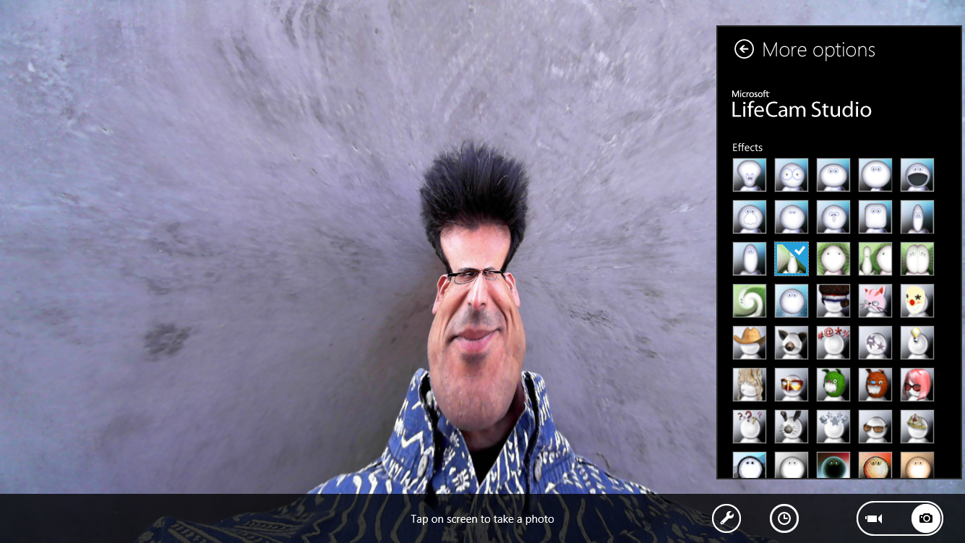

Slide 28
App → StoreManifest.xml
<?xml version="1.0" encoding="UTF-8"?>
<StoreManifest
xmlns:xsi="http://www.w3.org/2001/XMLSchema-instance"
xsi:noNamespaceSchemaLocation="StoreManifest.xsd"
xmlns="http://schemas.microsoft.com/appx/2010/StoreManifest">
<ProductFeatures>
<DeviceCompanionApplication>
<ExperienceIds>
<ExperienceId>0f29ee8f-0a6c-45b0-be33-8d45fadeb625</ExperienceId>
</ExperienceIds>
</DeviceCompanionApplication>
</ProductFeatures>
</StoreManifest>

Slide 29
App → AppxManifest.xml
<?xml version="1.0" encoding="utf-8"?>
<Package xmlns="http://schemas.microsoft.com/appx/2010/manifest">
...
<Applications>
<Application Id="lifecamsettings.App" Executable="lifecamsettings.exe“
EntryPoint="LifeCamSettings.App">
...
<SplashScreen Image="SplashScreen.png" />
</VisualElements>
<Extensions>
<Extension Category="windows.cameraSettings" Executable="lifecamsettings.exe" EntryPoint="LifeCamSettings.App" />
</Extensions>
</Application>
</Applications>
...
</Package>

Slide 30
App → DashboardView.xaml
<UserControl x:ConnectionId='1' x:Class="LifeCamSettings.DashboardView" ...>
...
<Grid x:Name="LayoutRoot" Background="{StaticResource BasicBackgroundBrush}">
<ScrollViewer
HorizontalScrollMode="Disabled"
ZoomMode="Disabled">
<StackPanel>
<TextBlock x:Name="EffectsLabel" Style="{StaticResource LabelText}"
Text="Effects"/>
<ListView x:ConnectionId='4'
x:Name='Effects'
Background="Black"
Template="{StaticResource listboxStyle}"
SelectedIndex="{Binding SelectedEffectIndex, Mode=TwoWay}"
ScrollViewer.VerticalScrollBarVisibility="Hidden”
...

Slide 31
Creating your device experience
Implement the custom functionality you want on your device
Provide access to specialized functionality in your device driver
app
Use your device & support all the appropriate app contracts
meta
Identify your device, declare your app for install & privilege

Slide 32
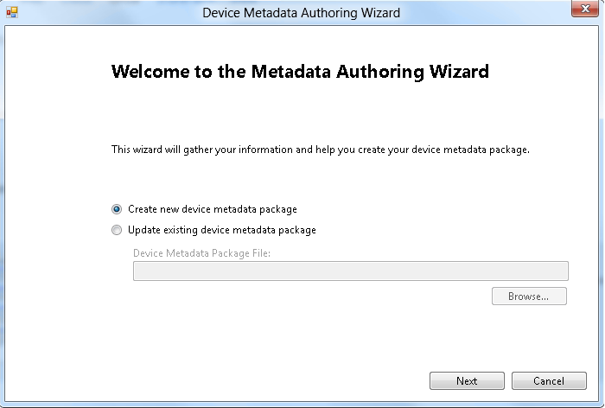

Slide 33
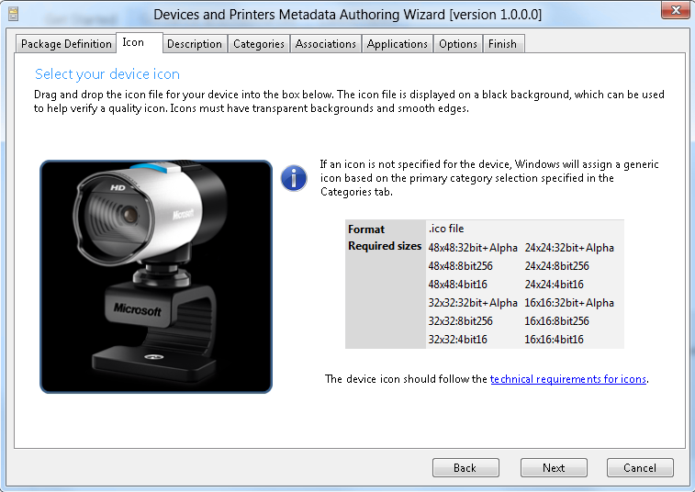

Slide 34
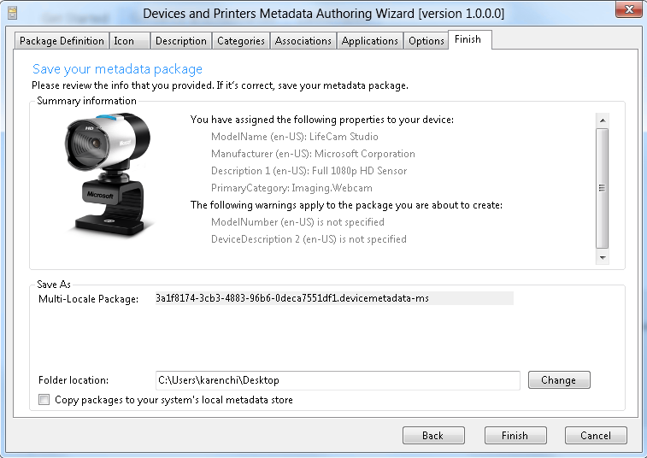

Slide 35
Behind the curtain of the device metadata tool…

Slide 36
Device metadata → PackageInfo.xml
<?xml version="1.0" encoding="utf-8" standalone="yes"?>
<PackageInfo ...
<MetadataKey>
<HardwareIDList>
<HardwareID>DOID:USB\VID_045E&amp;PID_0772&amp;MI_00</HardwareID>
</HardwareIDList>
<Locale default="true">en-US</Locale>
<LastModifiedDate>2011-08-05T17:06:33Z</LastModifiedDate>
<MultipleLocale ...>true</MultipleLocale>
</MetadataKey>
...

Slide 37
Device metadata → PackageInfo.xml
...
<PackageStructure>
<Metadata ...>PackageInfo.xml</Metadata>
<Metadata ...>DeviceInformation</Metadata>
<Metadata ...>WindowsInformation</Metadata>
<Metadata ...>DeviceStage</Metadata>
<Metadata ...>SoftwareInfo</Metadata>
</PackageStructure>
<Relationships>
<ExperienceID>0f29ee8f-0a6c-45b0-be33-8d45fadeb625</ExperienceID>
</Relationships>
<MetadataBuilderInformation>
<Application>Microsoft Device Metadata Package Authoring Tool</Application>
<Version>1.0</Version>
</MetadataBuilderInformation>
</PackageInfo>

Slide 38
Device metadata → SoftwareInfo.xml
<?xml version="1.0" encoding="UTF-8"?>
<SoftwareInfo ...
<DeviceCompanionApplications>
<Package>
<Identity Name="lifecamsettings" Publisher="CN=Microsoft"/>
<Applications>
<Application Id="lifecamsettings.App"/>
</Applications>
</Package>
</DeviceCompanionApplications>
</SoftwareInfo>

Slide 39
Windows services take care of distribution for you

Slide 40
Distributing your device experience
Run the Windows 8 certification tests against your device & device driver
Submit your device driver to Winqual for distribution via Windows Update
app
Submit your app to the Windows Store
meta
Submit your device metadata package to Winqual for distribution via Windows Metadata and Internet Services

Slide 41
You can easily add more features to your app later via an update

Slide 42
Updating your device experience
You can make one device experience work with multiple devices
Windows doesn’t automatically install a new driver over an old driver
app
Users manually install app updates, so be robust to driver versioning
meta
Windows automatically installs updated device metadata

Slide 43
Recap

Slide 44
You can create a Metro style app to differentiate your device, and Windows will distribute it for you

Slide 45
With Metro style device apps
Your code gets into your customers’ hands… automatically
You own all the pixels
You can naturally integrate with built-in Windows experiences
You can use custom functionality from your device & driver
You have the power of easy & comprehensive tools

Slide 46
Related sessions
[HW-745T] Reimagining the experience for connecting with devices
[HW-283T] Introducing Metro style device apps
[HW-715T] Building a great Metro style device app for your camera
[HW-288T] Building great Metro style apps for mobile broadband devices
[HW-652T] Building a great Metro style app for your printer
[HW-747T] Building Metro style apps that connect to specialized devices
[PLAT-905C] Under the hood: installation and updates for Metro style apps
[HW-235T] Developing drivers in Visual Studio
[HW-907C] Inside the Windows 8 driver developer workflow

Slide 47
Further reading and documentation
Reimagining the Device Experience for Windows 8
Metro style device app
Windows Dev Center home
Questions?
Please visit the forums on the Windows Dev Center at http://forums.dev.windows.com
For best response, please include the Build Session #275 in the title of your post

Slide 48
thank you
Feedback and questions http://forums.dev.windows.com
Session feedback http://bldw.in/SessionFeedback

Slide 49
© 2011 Microsoft Corporation. All rights reserved. Microsoft, Windows, Windows Vista and other product names are or may be registered trademarks and/or trademarks in the U.S. and/or other countries.
The information herein is for informational purposes only and represents the current view of Microsoft Corporation as of the date of this presentation. Because Microsoft must respond to changing market conditions, it should not be interpreted to be a commitment on the part of Microsoft, and Microsoft cannot guarantee the accuracy of any information provided after the date of this presentation. MICROSOFT MAKES NO WARRANTIES, EXPRESS, IMPLIED OR STATUTORY, AS TO THE INFORMATION IN THIS PRESENTATION.

