Slide 1
Building great Metro style apps for mobile broadband devices
HW-288T
Dhiraj Gandhi
Program Manager
Microsoft
Samer Sawaya
Program Manager
Microsoft

Slide 2
Agenda
Windows 8 mobile broadband experience
Building a metro style mobile broadband app
Powering the experience with metadata
You’ll leave with an understanding of how to
Create a rich, integrated mobile broadband experience for your devices

Slide 3
You can create a differentiated mobile broadband experience that integrates with Windows.

Slide 4
Robust platform for differentiation
Integrates your experience with Windows Connection Manager
Enables users to find and purchase connectivity
Keep users aware of their data usage
Helps users discover value added services

Slide 5
AT&T Mobile Broadband Experience
demo
Jon Sharp
Principal Product Development Engineer
AT&T

Slide 6
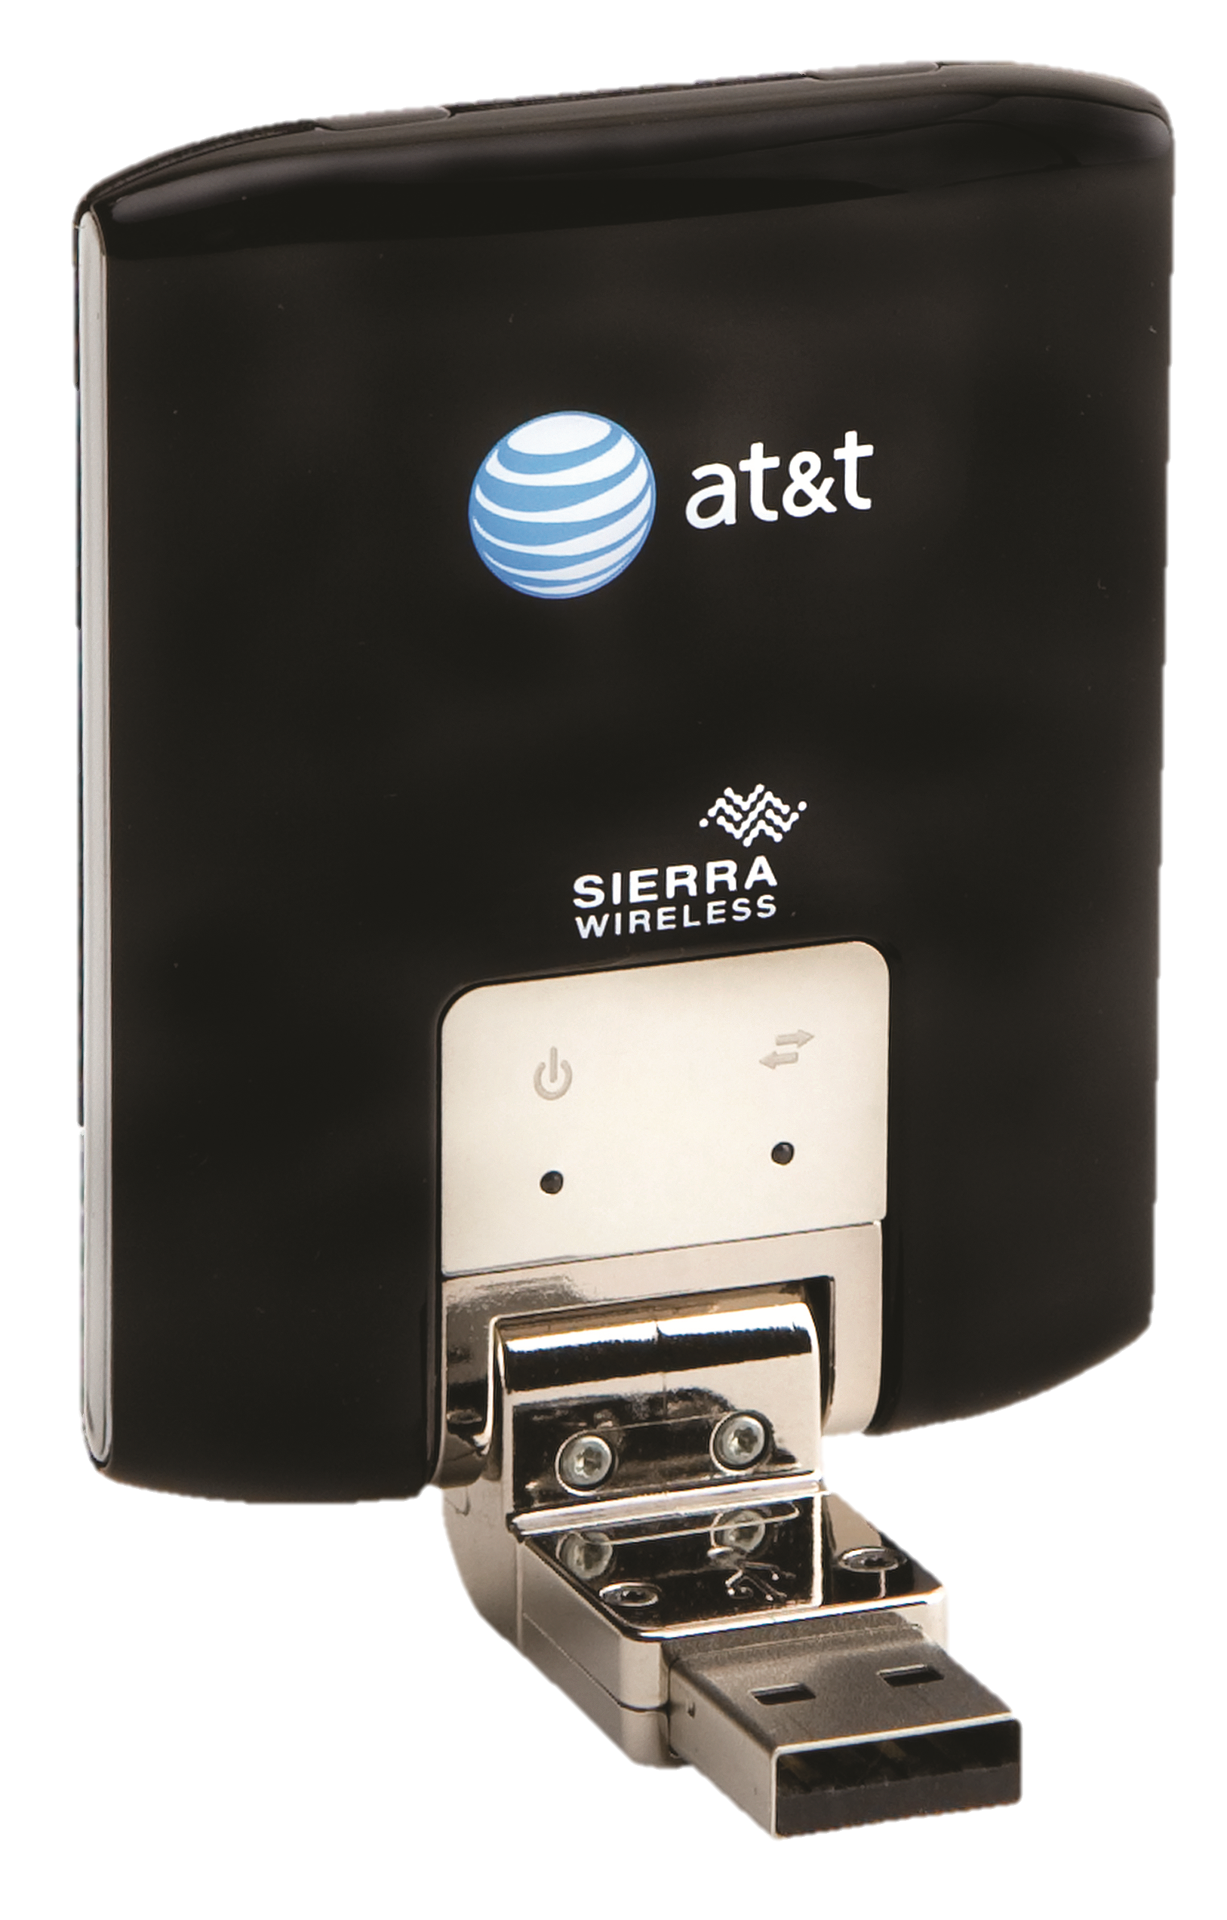
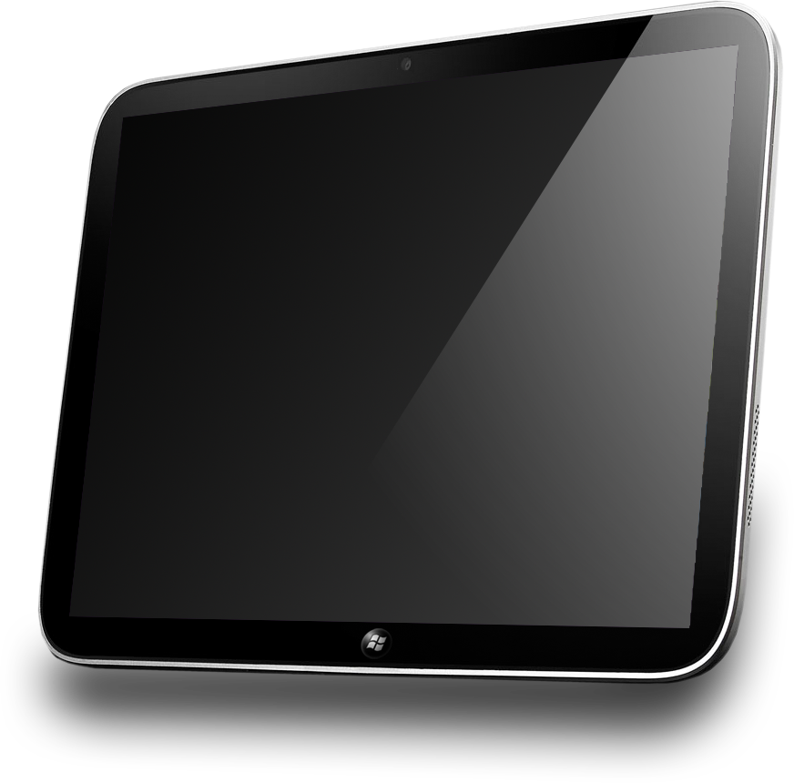
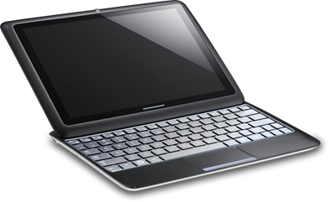
Building a differentiated experience
app
+
+
Mobile broadband service
Device
Metro Style App
Device Metadata

Slide 7
Building a differentiated experience
app
Plan
Account
Help
Notifications
Metro Style App

Slide 8
Scenario: Plan Purchase
Drive greater adoption of service through simple and predictable purchase experience
Integrated with Windows Connection Manager
Design Considerations
Simplify user experience by retrieving device information
Provide seamless connection experience using provisioning
Integrate with purchase backend via Web services, SMS, or USSD

Slide 9
Scenario: Account Management
Give your customers easy access to account management
View current data usage
Manage bill payment and account details
Enable custom experience and branding
Design considerations
Reduce backend load by combining local and server data usage information

Slide 10
Scenario: Help and Support
Reduce customer support cost through simplified access to self help
Design considerations
Show relevant help by retrieving device information
Help user to solve problems without calling customer support
Create frequently asked questions
Enable diagnostic information

Slide 11
Scenario: Service Notifications
Keep customers informed with notifications
Approaching Data Cap
Currently roaming
Plan Activation
Design Considerations
Use Windows Push Notifications framework or use existing SMS or USSD notifications channels
Service SMS notifications separated from general SMS API
Provide operator SMS notification filtering rules using Provisioning Metadata
New service SMS and USSD notification background event

Slide 12
Other design considerations for your app
Present relevant information using Start Screen tile
Increase awareness of your value added services
Enable cost aware networking
Background processing
Connection status change
Data usage
SMS/USSD notifications

Slide 13
APIs for Metro style mobile broadband app
SMS
USSD
Connection Status
Subscriber & Device Information
Device Services
Local Data Counter
Data Usage
Provisioning

Slide 14
Sample Code: Device Information API
var hardwareInfo = mobileBroadbandAccount.tryGetNetworkDeviceInformation();
if (hardwareInfo.isValid) {
var networkDeviceInfo = hardwareInfo.deviceInfo;
document.writeln("Device ID : " + networkDeviceInfo.deviceId);
document.writeln("Subscriber ID : " + networkDeviceInfo.subscriberId);
document.writeln("Phone Number : " + networkDeviceInfo.telephoneNumbers[0]);
document.writeln("SIM ICC ID : " + networkDeviceInfo.simIccId);
document.writeln("Model : " + networkDeviceInfo.model);
}

Slide 15
Sample Code: Sending USSD Message
var messageText = "*101#";
var session = UssdSession.createFromNetworkAccountId(accountId);
var message = new UssdMessage(messageText);
session.sendMessageAndGetReplyAsync(message).then (function (reply){
var payloadAsText = reply.message.payloadAsText;
document.writeln(" Network Response: " + payloadAsText);
}

Slide 16
Building a differentiated experience
app
+
+
Mobile Broadband Service
Device
Metro Style App
Device Metadata

Slide 17
Types of Device Metadata
APN database
Experience metadata
Provisioning metadata
Device Metadata

Slide 18
APN database
Enables simple first time connectivity experience for consumers
Reduces deployment and maintenance costs for partners
Contains
Operator identification data
List of APNs or Access Strings
URL for Web Based Purchase Experience

Slide 19
Updating the APN Database
Operator
Windows Hardware Dev. Center
Windows Update
Windows 8
APN Database

Slide 20
Experience metadata
Enables branding in Windows connection experience
Auto download of metro style mobile broadband app
Contains
Operator icon for Windows connection experience
Customized name for network
Connection information
Operator identification data
App IDs for access to Restricted APIs

Slide 21
Automatic Detection and Deployment
Windows Metadata and Internet Services
Windows Store
Windows 8
Windows detects mobile broadband device
Experience Metadata
Metro style mobile broadband app

Slide 22
Provisioning Metadata
Enables operators to provide connection and subscriber specific information
Contains
Mobile broadband information (APN, access strings)
Wi-Fi hotspots (SSIDs, WISPr credentials)
Plan information

Slide 23
Applying Provisioning Metadata
Operator Backend
Windows 8
Metro style mobile broadband app
Windows Provisioning Engine

Slide 24
Recap

Slide 25
Windows 8 enables operators to differentiate their offerings while providing users with a seamless connection experience.

Slide 26
Opportunities
Create a customer centric and integrated experience for mobile broadband devices with your metro style app
Provide metadata to simplify the connection experience and enable rich branding

Slide 27
Related sessions
[HW-275T]: Building and delivering a great Metro style app for your device
[HW-283T]: Introducing Metro style device apps
[HW-331T]: Understanding mobile broadband and connection management in Windows 8
[HW-732T]: Connecting Windows 8 to mobile broadband and Wi-Fi networks
[HW-745T]: Reimagining the experience for connecting with devices
[PLAT-785T]: Creating connected apps that work on today's networks

Slide 28
Further reading and documentation
Mobile Network Operator Companion Application Platform
Service Metadata Schema Package for Windows 8
Windows.Devices.Sms namespace
Windows.Networking.NetworkOperators namespace
Tailored Device Experience Onboarding
Contact info – windowswireless@microsoft.com

Slide 29
thank you
Feedback and questions http://forums.dev.windows.com
Session feedback http://bldw.in/SessionFeedback

Slide 30
© 2011 Microsoft Corporation. All rights reserved. Microsoft, Windows, Windows Vista and other product names are or may be registered trademarks and/or trademarks in the U.S. and/or other countries.
The information herein is for informational purposes only and represents the current view of Microsoft Corporation as of the date of this presentation. Because Microsoft must respond to changing market conditions, it should not be interpreted to be a commitment on the part of Microsoft, and Microsoft cannot guarantee the accuracy of any information provided after the date of this presentation. MICROSOFT MAKES NO WARRANTIES, EXPRESS, IMPLIED OR STATUTORY, AS TO THE INFORMATION IN THIS PRESENTATION.

