Slide 1
Understanding Connected Standby
HW-456T
Pat Stemen
Lead Program Manager
Microsoft Corporation

Slide 2
Connected Standby enables apps to stay fresh, even when the computer is off.

Slide 3
Agenda
Connected vs. Standby
Enabling Connected Standby in Windows 8
At the end of this session, you will understand
App model impact of Connected Standby
Platform requirements for great Connected Standby battery life

Slide 4
Mobile PCs that support Connected Standby
Hardware includes low-power DRAM, busses, and devices
Always connected to the internet
App experiences are always fresh and up to date
Transitions instantly between on and off states
Requires very low idle power to enable a Connected Standby

Slide 5
Connected vs. Standby
Standby (ACPI S3)
No code execution
High idle power
Power Consumption
time in seconds
Screen Off
Rare code execution
Very low platform idle power
Constant connectivity
Power Consumption

Slide 6
Mechanics
Screen Off
(Connected Standby)
User not present, still connected
Screen On
(Active)
User present and using device
Shutdown
User not present, no context saved
Entered with the power button or idle timeout
Exited on the power button, or attached input device
Modeled as the system is “on” with the screen off
Yet, must have consistent, long battery life -> the system is “off!”

Slide 7
Consistent low power
Device power management
Idle hygiene
App model right by design for power
Connectivity enhancements
Windows 7
Idle, Screen Off
15 seconds
Connected Standby
Conceptual

Slide 8
Device power management
Platform diversity abstracted from apps
Hardware diversity enabled with miniports and firmware
New power manager miniport (PEP) for fast and frequent device power management
App
App
App
App
App Interfaces
Device Interfaces
Windows Kernel
Function Driver
Power Manager
Port Driver
Miniport
Power-Engine Plugin (PEP)
Bus Driver
Bus Driver
ACPI Firmware

Slide 9
WiFi offloading
Lowest power when chipset remains in deepest idle state
Offload basic networking functionality to WiFi device
Pattern matching and wake used for push notifications and real-time apps
Some offload technologies also applied when the screen is on!
Low-Power Platform
Low-Power Chipset
Low-Power
Memory
Low-Power
Memory
Offloaded
Wi-Fi
Flash Storage

Slide 10
Getting idle and staying idle
Energy Consumed
Average Power
Longest Connected Standby battery life when core chipset remains in its deepest idle state
power
Eliminate
Exit Events
Reduce
Software Activity
Extend Idle Duration
time
Note: Extending work duration typically doesn’t help for light workloads given “race to idle”

Slide 11
Metro style app model
App model is right by design for power
Apps are suspended when the computer enters Connected Standby
Apps may register background activity in Background Tasks
Notifications API allows suspended apps to handle incoming events from the cloud
Running
Resuming
Suspending
Connected
Standby
Suspended
Notifications
Scheduled Tasks

Slide 12
Desktop Activity Moderation (DAM)
Win32 app model does not have power management guidance built-in
Hard to get power optimizations right as a developer
Any single Win32 app can significantly impact battery life
The DAM automatically suspends activity of Win32 apps and services

Slide 13
Connected Standby Basics
demo

Slide 14
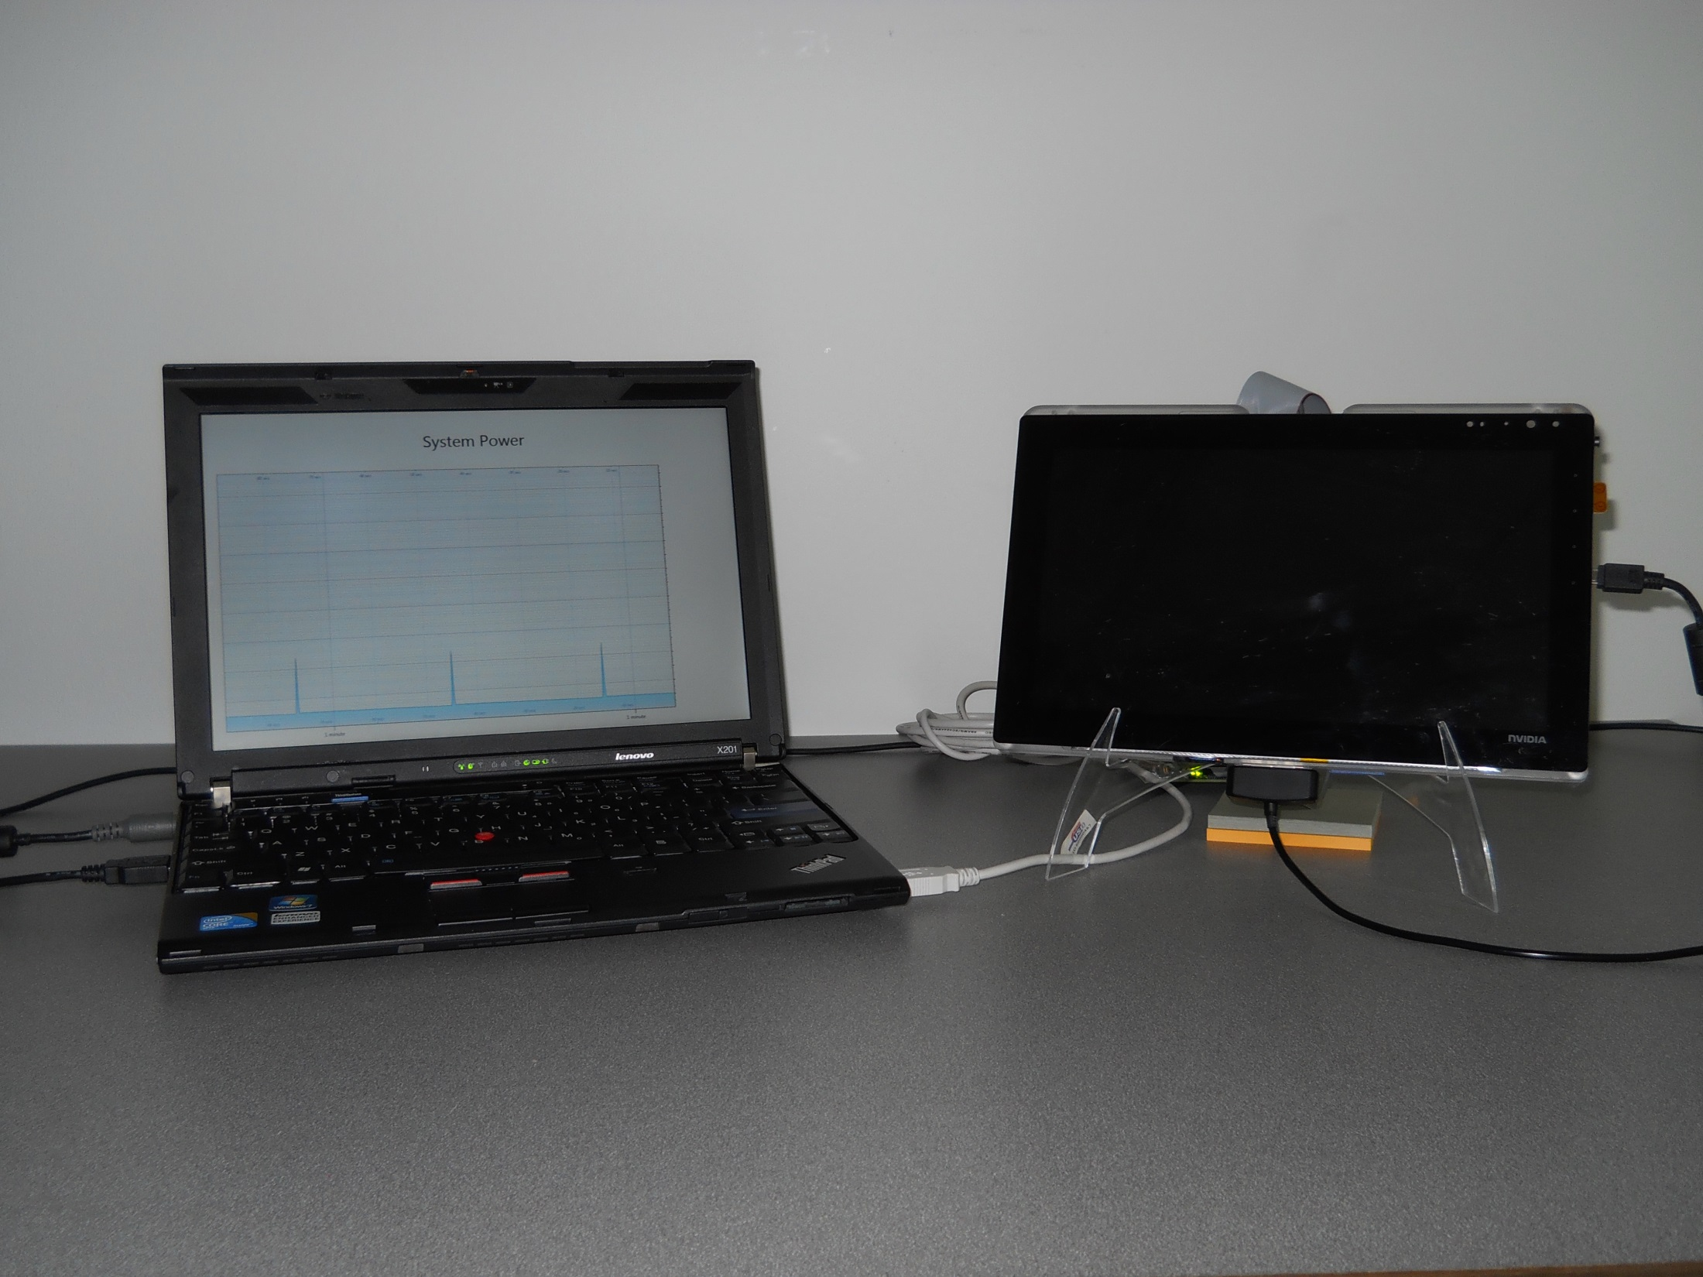
Windows 8
with Power Metering Software
NVIDIA Tegra
Development Platform
The Setup

Slide 15
Designing a great Connected Standby mobile PC
Certification tests help ensure that Connected Standby systems have great battery life and end-user experience
Power consumption and performance tests
Less than 5% battery drain over 16 hour period in Connected Standby
Less than 300ms exit latency from power button press to display enabled
Windows 8 validation
Non-rotational boot volume
WiFi device supports NDIS 6.3 features (D0 offload, Wake on Push, etc.)
ACPI 5.0 flag indicating low-power S0 over S3

Slide 16
Key points
Connected Standby enables applications to stay up-to-date while the computer looks “off”.
Metro style apps can stay fresh and up-to-date during Connected Standby
Desktop apps are automatically suspended during Connected Standby

Slide 17
Related sessions
(HW-149P) Improving battery life and energy efficiency
(HW-251T) Introducing low-power buses for Windows 8
(HW-255T) Integrating Bluetooth on low-power buses
(HW-342T) Understanding Wi-Fi networking in Windows 8
(APP-396T) Using Tiles and Notifications
(HW-566T) Networking for connected standby
(HW-774T) Building great Windows 8 systems

Slide 18
thank you
Feedback and questions http://forums.dev.windows.com
Session feedback http://bldw.in/SessionFeedback

Slide 19
© 2011 Microsoft Corporation. All rights reserved. Microsoft, Windows, Windows Vista and other product names are or may be registered trademarks and/or trademarks in the U.S. and/or other countries.
The information herein is for informational purposes only and represents the current view of Microsoft Corporation as of the date of this presentation. Because Microsoft must respond to changing market conditions, it should not be interpreted to be a commitment on the part of Microsoft, and Microsoft cannot guarantee the accuracy of any information provided after the date of this presentation. MICROSOFT MAKES NO WARRANTIES, EXPRESS, IMPLIED OR STATUTORY, AS TO THE INFORMATION IN THIS PRESENTATION.

