Slide 1
Delivering a secure and fast boot experience with UEFI
HW-457T
Arie van der Hoeven
Principal Lead Program Manager
Microsoft Corporation

Slide 2
Agenda
Improving the boot experience
Enhancing security
Design guidance and requirements
You’ll leave knowing how to
Prepare for coming firmware changes in Windows 8
Inform others of the motivations and value proposition of UEFI

Slide 3
With UEFI, the boot experience is fast, safe and beautiful leading to higher customer satisfaction and opportunity for product differentiation.

Slide 4
Improving the boot experience

Slide 5

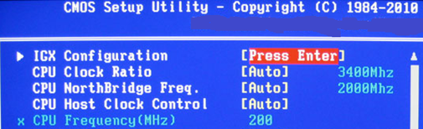
The boot experience today
Time delay at POST
Boot Kit threats
Lots of <Fn> key options at boot
Confusing OS boot menus
No connection between OS and BIOS boot menus
BIOS menus circa 1980
Boot disk size limited to 2.2TB

Slide 6
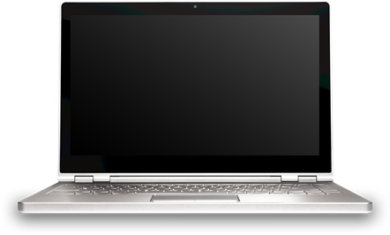

Re-imagining the boot experience
Startup and shutdown is…
  Performed by many users on a daily basis
  How many consumers judge PC performance
  Heavily dependent on firmware
The new boot experience should be
  Fast
  Tailored
  A result of both OS and firmware innovation

Slide 7
UEFI and Windows 8: a faster way to On
Explorer Ready
Windows 7
POST
OS Initialization
Service & App Initialization
Explorer Ready
Windows 8
POST
Service & App Init
Device Initialization
Hiberfile Read
Looks and feels like a regular shutdown / boot
Uses hibernate technology to cache the core system
Enabled by default
Delivering considerable improvements
  Boots more than twice-as-fast on SSD based netbooks, including POST
  Need partners to continue work to reduce POST times

Slide 8
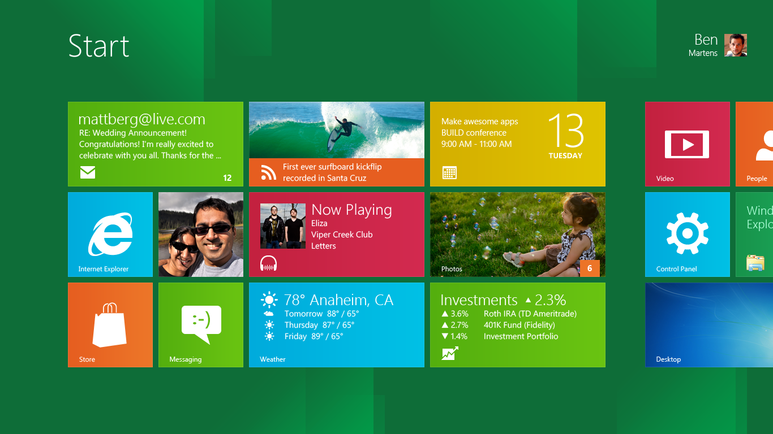
A seamless experience
A new experience, to go with the new time scale
    Post with highest supported native resolution
Seamless single graphics transition from firmware to native OS driver
Clean, high-resolution branding elements persist through OS boot
OEM Logo
OEM Logo
User View
Boot Phase
POST
Hiber Resume
Device Init.
Explorer Init.
Seconds
2s 4s 6s 7s

Slide 9
Windows 8 fast startup
demo

Slide 10
Enhancing security

Slide 11
Secure boot
Current issues with boot
  Growing class of malware targets the boot path
  Often the only fix is to reinstall the operating system
UEFI and secure boot harden the boot process
  All firmware and software in the boot process must be signed by a trusted Certificate Authority (CA)
  Required for Windows 8 client
  Does not require a Trusted Platform Module (TPM)
  Reduces the likelihood of bootkits, rootkits and ransomware

Slide 12
Boot Process Flow and Remediation
Normal boot
Boot delayed
Action Required
POST
Windows Logon
UEFI
Windows
Firmware OK?
BootMgrOK?
Early Launch Anti-malware
(ELAM)
Boot Critical Drivers OK?
NTOS Kernel OK?
Normal
Boot
No
No
No
Remediated
Boot
No
Windows + 3rd party drivers & applications
Secure Boot Remediation / Recovery
UEFI Recovery?
Yes
Yes
No
No
Measured Boot with Trusted Platform Module (TPM)
Firmware Last Resort
Reboot

Slide 13
UEFI, Windows 8 and BitLocker
Native support for encrypted hard drives
  Requires Windows 8, TPM and UEFI
  BitLocker offers central key management, predictable protection, zero-cost provisioning, and security against loss/theft
  Encrypted hard drives add instant encryption and great performance
Network Unlock for BitLocker
  Requires Windows 8, TPM, DHCP and UEFI
  Allows admins to boot remote systems without user interaction
  If taken outside the trusted location, the machine will require a PIN in order to boot
  No more trade-offs between security and power management or servicing

Slide 14
Design guidance

Slide 15
UEFI firmware evolution
Windows OS
Today
Pre-1998
1998 ~
BIOS OS Loader
ACPI Driver
UEFI OS Loader
UEFI Win32/NT APIs
Firmware
BIOS Mode
UEFI Mode
UEFI Runtime Services
Compatibility Support Module (CSM)
ACPI Registers
ACPI BIOS
ACPI Tables
Legacy BIOS
Platform Specific UEFI Firmware
System Hardware

Slide 16
Advantages of UEFI vs. BIOS
Interface | Legacy BIOS | UEFI
Architecture | x86 / X64 only | Agnostic
Mode | 16 bit (real mode) | 32/64 bit
Boot Partition | MBR (2.2 TB limit) | GPT (9.4 ZB* limit)
Runtime Services | No | Yes
Driver model | No | Yes
POST Graphics | VGA | Graphical Output Protocol (GOP)
* A zettabyte is equal to 1B terabytes. The total amount of global data was expected to pass 1.2 ZB sometime during 2010.

Slide 17
Certification for UEFI Simplified
New Windows 8 requirements:
  Windows 8 client systems must be certified in UEFI mode
  Secure boot
  Secure firmware update process
  UEFI GOP driver support
  New graphics requirements
  POST time maximums
If implemented
  BitLocker network key protector
  BitLocker encrypted hard drive support

Slide 18
Recap

Slide 19
Related sessions
HW-462T - Building hardware-based security with a Trusted Platform Module (TPM)
HW-260T - Windows Certification: improvements to the logo program

Slide 20
thank you
Feedback and questions http://forums.dev.windows.com
Session feedback
http://bldw.in/SessionFeedback

Slide 21

© 2011 Microsoft Corporation. All rights reserved. Microsoft, Windows, Windows Vista and other product names are or may be registered trademarks and/or trademarks in the U.S. and/or other countries.
The information herein is for informational purposes only and represents the current view of Microsoft Corporation as of the date of this presentation. Because Microsoft must respond to changing market conditions, it should not be interpreted to be a commitment on the part of Microsoft, and Microsoft cannot guarantee the accuracy of any information provided after the date of this presentation. MICROSOFT MAKES NO WARRANTIES, EXPRESS, IMPLIED OR STATUTORY, AS TO THE INFORMATION IN THIS PRESENTATION.

Slide 22
Further reading and documentation
UEFI 2.3.1. Specficiation: http://www.uefi.org/
Trusted Computing Group: http://www.trustedcomputinggroup.org/
Tianocore: http://www.tianocore.sourceforge.net
UEFI and Windows: http://msdn.microsoft.com/en-us/windows/hardware/gg463149
MSDN: http://msdn.microsoft.com/
  Search on keyword “UEFI”
Beyond BIOS: http://www.intel.com/intelpress/sum_efi.htm

Slide 23
BACKUP

Slide 24
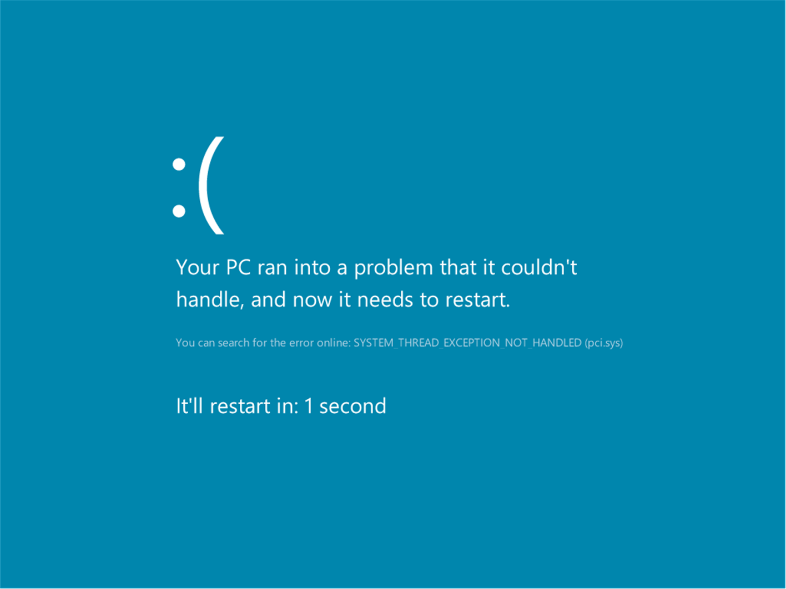

Slide 25
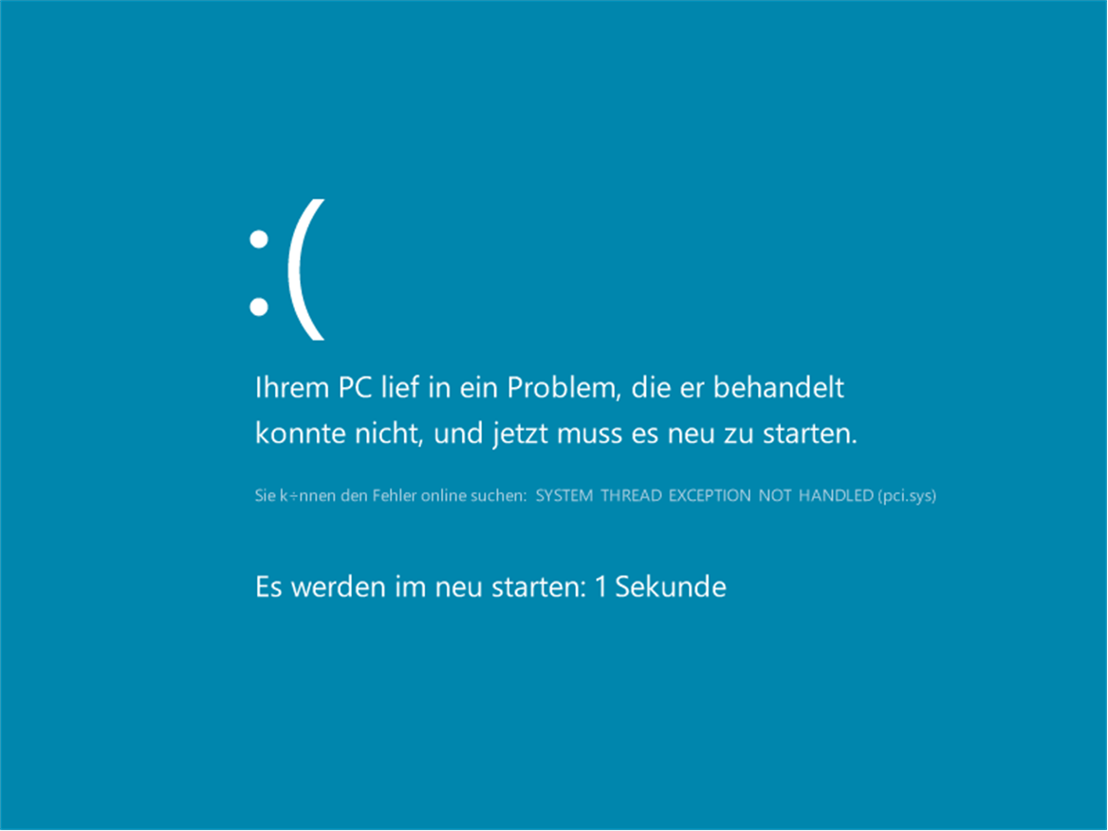

Slide 26
Useful Terms
  Class 2 System: UEFI definition of a system that can boot into UEFI mode or BIOS mode
  Class 3 System: UEFI definition of a system that can only boot into UEFI mode
  CSM: Compatibility Support Module. Allows as Class 2 UEFI system to boot into BIOS mode.
  GPT: GUID Partition Table (GPT). GPT disks use 64-bit values to describe partitions, allowing larger partitions. Used by Windows on UEFI mode systems.
  MBR: Master Boot Record (MBR) partitioning scheme. MBR uses 16-bit values to describe partitions thus limiting it to booting from 2.2TB or less.
  TCG: Trusted Computing Group
  TPM: Trusted Platform Module
  Tianocore: Open source components of Intel's implementation of UEFI
  UEFI 2.3.1 Latest Version of the UEFI specification.

Slide 27
OEM Boot Branding
Center of logo is always 38.2% from the top, and centered on the screen
No text should be placed around logo
Logos should fit within a box that is 40% of the height by 40% of the width
Progress indications may be drawn by OS in the bottom portion of the screen
Background must be black
38.2% from top to middle of logo
LOGO
Max 40%
Max 40%
This space reserved for OS

