Slide 1
Building hardware-based security with a Trusted Platform Module (TPM)
HW-462T
Rob Spiger
Senior Program Manager
Stefan Thom
Senior Software Development Engineer
Microsoft Corporation

Slide 2
Agenda
Security goals for Windows 8
Trusted Platform Module basics
Improving security during boot with TPMs
TPM-enabled features in Windows 8
Provisioning and control
TPM hardware evolution and guidance
You will leave understanding
How TPMs are used by Windows 8 and apps
What kind of TPM hardware to expect on Windows 8 systems

Slide 3
Certificate based authentication
demo

Slide 4
Our world today
Cyber crime focuses on stealing data for monetary gain
Worrying about cybercrime is universal
Ranging from governments to your mom
And everyone in between
Socially engineered attacks are particularly successful on machines used with administrator accounts
Bootkit and rootkit attacks can infect anti-malware software and alter boot logs to avoid detection

Slide 5
Security goals for Windows 8
Windows 8 is a trusted platform for consumers, businesses and financial institutions
Hardware helps anti-malware products reduce persistent malware
System compromise by malware reduced
Sophisticated malware can be reliably detected and removed
New tools, APIs, and hardware capabilities for anti-malware products
Customers benefit from easy-to-use hardware-based security

Slide 6
Trusted Platform Module basics

Slide 7
Trusted Platform Module basics
TPM
TPMs are passive security devices that provide hardware-based security and cryptographic functions
Specs are published by the Trusted Computing Group
Business laptops often have a TPM 1.2 used for BitLocker

Slide 8
TPM basics
System firmware and the TPM work together
Firmware records boot measurements in the TPM
TPM measurements are not reset until the next power cycle
TPM created keys can be bound to boot measurements

Slide 9
Improving security during boot with TPMs

Slide 10
Secured boot: Improving malware resistance during boot
Secure boot
Using Firmware Policy to validate the OS loader
Early launch anti-malware
Starting anti-malware products first before other 3rd party code
Measured boot
Recording the start state of the system as evidence for external verification

Slide 11
UEFI secure boot
Existing Boot
Processes
BIOS
Any OS Loader Code
OS Start
The BIOS starts any OS loader, even malware
Now firmware enforces policy, only starting trusted OS loaders
OS loader enforces signature verification of later components
Secure Boot with Windows 8
Native UEFI 2.3.1
Verified OS Loader Only
OS Start
UEFI will only launch a verified OS loader – such as Windows 8
Essentially malware cannot replace the boot loader

Slide 12
Early launch anti-malware (ELAM)
BIOS
Any Loader Code
Any 3rd Party Drivers
Anti- Malware Software
Windows Logon
Existing boot
processes
Windows 8 boot process
Native UEFI
Windows 8 OS Loader
ELAM
3rd Party Drivers
Windows Logon
Policy Enforcement
The Anti-Malware boot driver is specially signed
Windows starts ELAM software before any other 3rd party boot drivers
ELAM driver can enforce policy even for boot start drivers
Rootkit malware can no longer bypass anti-malware inspection

Slide 13
Measured boot with Attestation
Existing boot
processes
BIOS
OS Loader
Kernel Initialization
3rd Party Drivers
Anti- Malware
TPM
Windows 8 boot process
UEFI
OS Loader
Kernel Initialization
ELAM
3rd Party Drivers
Attestation
Policy Enforcement
Post-boot clients can use signed TPM measurements to prove initial system state and ELAM software
ELAM software can invalidate client health assertions if the client stops enforcing policy (i.e. providing no signature updates or running unknown software)

Slide 14
Secured boot architecture
1
Secure Boot prevents running an unknown OS loader
UEFI Boot
Boot Policy
3
2
ELAM starts first and enforces its policy
1
Win 8 OS Loader
AM Policy
TPM
3
Boot measurements were recorded during boot
Windows Kernel
ELAM Software
4
Signed TPM boot measurements can be sent to an off-box service for analysis
3rd Party Software
4
2
Anti-Malware Client
Healthy?
Attestation Service
Windows Logon
Quote

Slide 15
TPM-enabled features in Windows 8

Slide 16
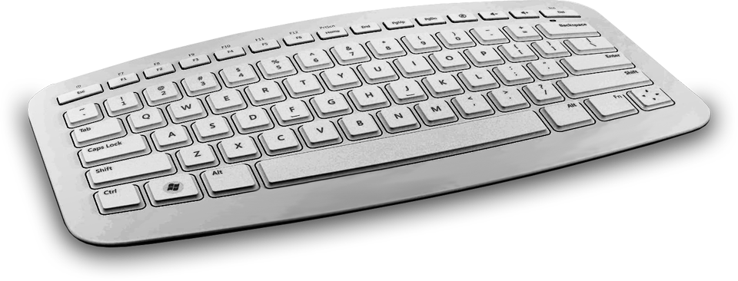
BitLocker network unlock for Windows 8
1
2
TPM + PIN (Windows 7)
BitLocker Network Unlock
Native UEFI Boot
TPM
Windows 8 WDS Server
Key Request
UEFI DHCP
4 or 6
PIN
Encrypted OS Volume
Client Key
TPM
Encrypted OS Volume
For environments with a physically secure network connection
1
Continued investment in BitLocker Drive Encryption™ and TPM
No user PIN required when booting on a physically secured network (a PIN is still required when roaming)
2

Slide 17
TPM based certificate storage
Certificates have many uses such as e-mail/document signing and authentication with or without a user supplied PIN
The certificate template can be configured to specify the TPM is used to store the private key
Software can never discover the private key
The TPM protects the PIN with its dictionary attack logic
These protections are malware resistant
Your apps can use the new Platform Crypto Provider KSP to create and store keys

Slide 18
TPM based Virtual Smart Card
Physical Smart Card
Application
Reader
Windows 8 enables a TPM to act like a permanently-inserted Smart Card
Scenarios include logging onto Windows, simplified use of Direct Access
Enables enterprises to extend existing investments in physical smart cards
Smart
Card
Virtual Smart Card
App
Reader Simulation
TPM

Slide 19
TPM provisioning
and control

Slide 20
TPM Auto Provisioning
Out of Box
After Reboot
Later
Windows State
Not Ready
Not Ready
Ready
User in Control
Provisioning Flag = True
Provisioning Flag = True
Provisioning Flag = True
The user chooses to use the TPM by turning on a TPM-enabled feature or running a
TPM-based application
Firmware State
Disabled
Enabled
Enabled
TPM State
Deactivated
Activated
Activated
Ownership Not Taken
Ownership Not Taken
Ownership Taken
Windows prepares the TPM for use without physical presence
New TCG Physical Presence Interface Specification 1.2

Slide 21
TPM Manual Provisioning Wizard
Is TPM State Ready?
TPM Based App Runs
App Launches OS Wizard
Windows 8
TPM Wizard
No
Yes
App Uses the TPM
Administrator Interaction
Clear TPM
(If necessary)
Older hardware or system state may prevent auto-provisioning
The app may be ready to use the TPM before it is provisioned
New Windows 8 wizard for preparing the TPM
Applications do not need their own TPM provisioning logic

Slide 22
TPM hardware evolution and guidance

Slide 23
Windows 8 supports TPM 1.2
& TPM 2.0*
Existing TPM 1.2 Apps
TPM Application for Windows 8
Direct TPM Commands
Key Storage Provider
TPM Provisioning
TPM Virtual Smart Card
Windows Internal TPM 1.2 or TPM 2.0
Abstraction Layer (RSA & SHA-1)
Microsoft TPM Stack
Microsoft TPM Stack
TPM 1.2
TPM 2.0
Microsoft is working with partners to support discrete and integrated TPMs for different form factors and market segments
Build your apps using new Windows 8 APIs so it works with
TPM 1.2 or TPM 2.0
Microsoft refers to the TCG “TPM Next” as “TPM 2.0”

Slide 24
Certificate Based Authentication
demo

Slide 25
Summary
There are many compelling TPM scenarios
Expect TPM 1.2 and TPM 2.0 on a wide array of platforms
TPMs are useful for apps with familiar programming models like smart cards, certificates and a key storage provider
Windows 8 has a bunch of new TPM-enabled features

Slide 26
Related sessions
Designing Systems for Continuous Availability Multi-Node with Block Storage
Delivering a secure and fast boot experience with UEFI

Slide 27
Further reading and documentation
Trusted Computing Group
Links to MSDN
Windows Hardware Dev Center
Windows Dev Center

Slide 28
thank you
Feedback and questions http://forums.dev.windows.com
Session feedback http://bldw.in/SessionFeedback

Slide 29
© 2011 Microsoft Corporation. All rights reserved. Microsoft, Windows, Windows Vista and other product names are or may be registered trademarks and/or trademarks in the U.S. and/or other countries.
The information herein is for informational purposes only and represents the current view of Microsoft Corporation as of the date of this presentation. Because Microsoft must respond to changing market conditions, it should not be interpreted to be a commitment on the part of Microsoft, and Microsoft cannot guarantee the accuracy of any information provided after the date of this presentation. MICROSOFT MAKES NO WARRANTIES, EXPRESS, IMPLIED OR STATUTORY, AS TO THE INFORMATION IN THIS PRESENTATION.

