Slide 1
Certifying hardware with the Windows Hardware Certification Kit
HW-659T
Craig Rowland
Senior Program Manager
Microsoft Corporation

Slide 2
Agenda
Introducing the Windows Hardware Certification Kit
New concepts and features
Streamlined UX
Flexible infrastructure
Straight-forward automation
Unified toolset
You’ll leave with examples of how to
Run certification testing for a system using the new kit
Run certification testing for a multi-function device in a single test pass
Automate the certification testing process using a simple C# app
Use the new Studio application to view offline data (submission packages)

Slide 3
Product development is a cycle
Customer and Partner Connection
Design and Develop
Assess and Certify
Certification documentation is more straight-forward, clear and connected
Test have been moved upstream
Certification should be a final verification only

Slide 4
The Hardware Certification Kit is a tool to help you deliver hardware for Windows that fulfills customer expectations.

Slide 5
Windows Certification Program Goals
Great experiences
Broad and timely availability
Streamlined certification experience

Slide 6
The Windows Hardware Certification Kit enables a clear and direct path to certification.

Slide 7
Streamlined user experience

Slide 8
Streamlined user experience
Intuitive
Simple, uncluttered interface makes the steps of the certification process easy to understand even for novice users
Efficient
Streamlined design makes experienced users more efficient

Slide 9
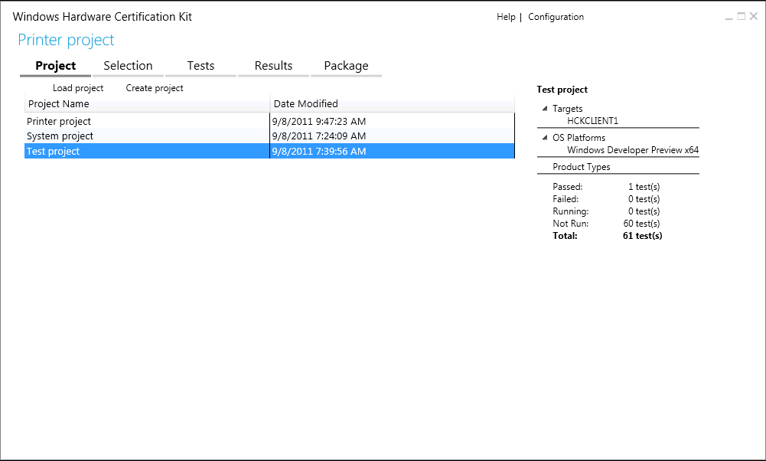
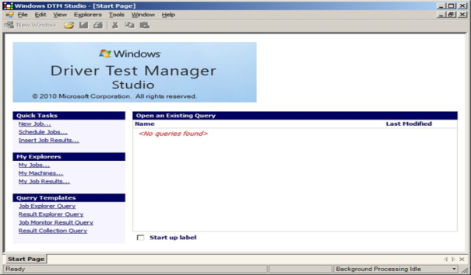
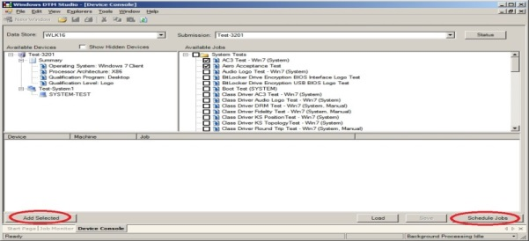
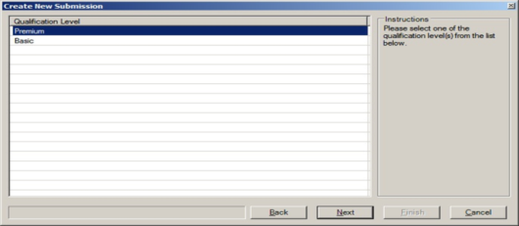
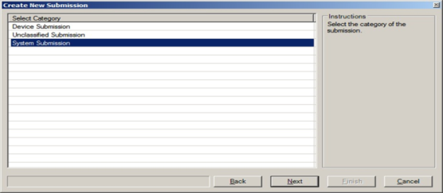
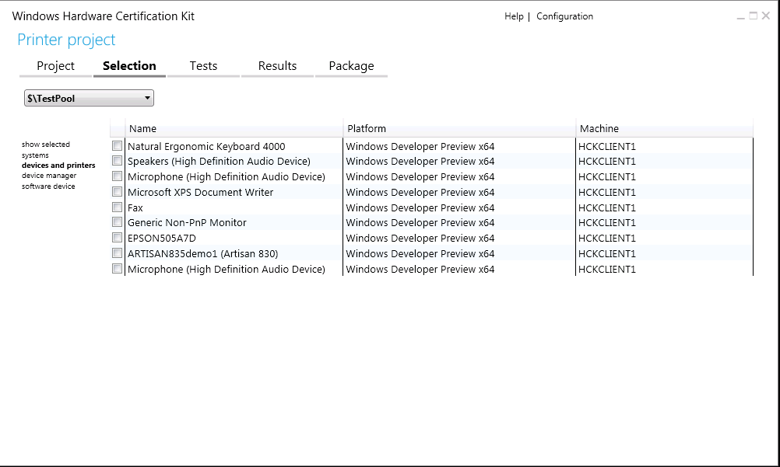
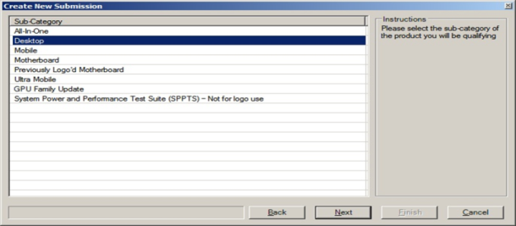
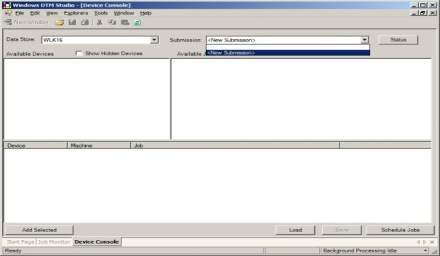
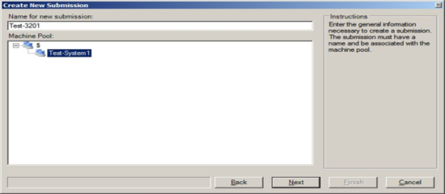
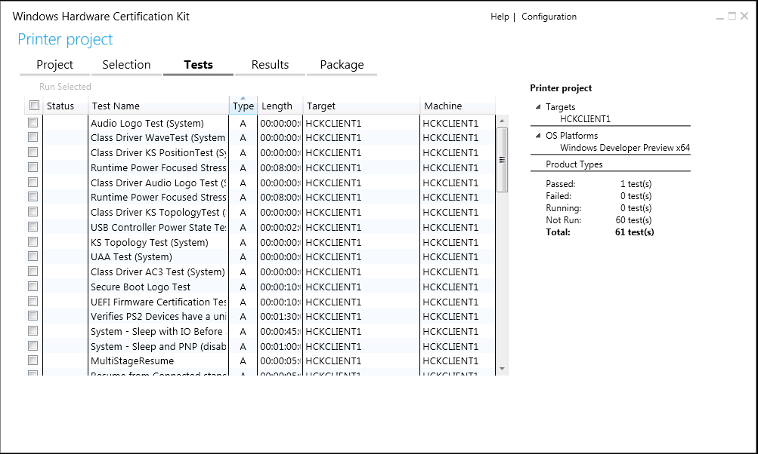
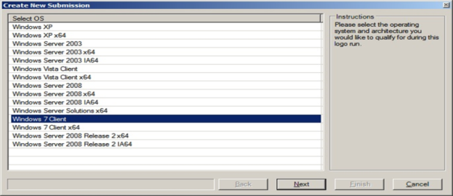
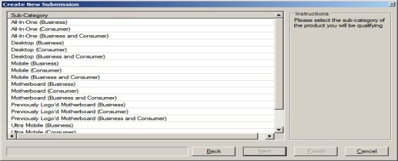
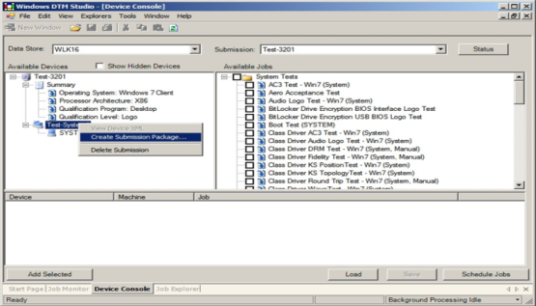
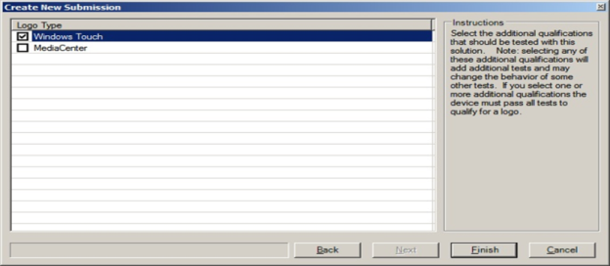
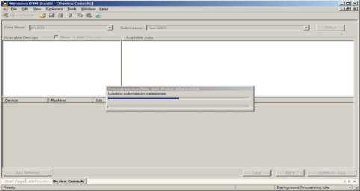
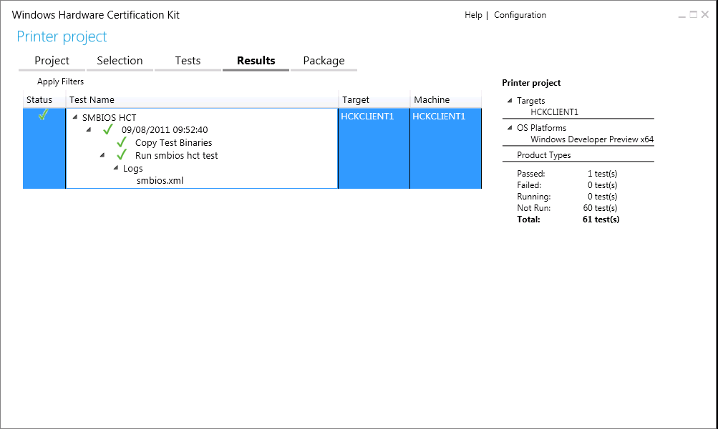
Streamlined user experience

Slide 10
System Certification
demo

Slide 11
Feature based infrastructure

Slide 12
Feature based infrastructure
Flexible
The kit automatically adapts to your innovative products
Tests map to requirements with clearly articulated value
Requirements map to features that are integral to Windows experiences
Relevant

Slide 13
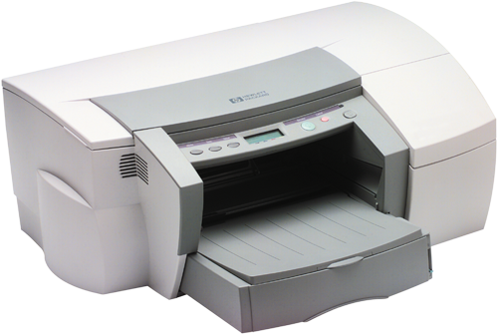
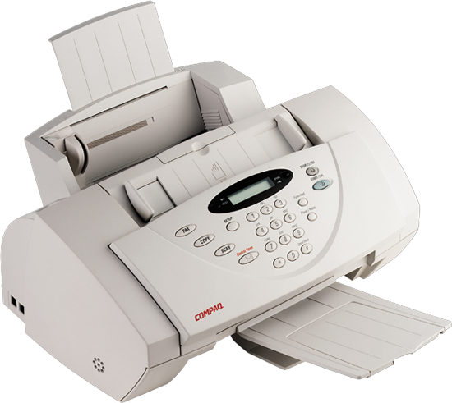
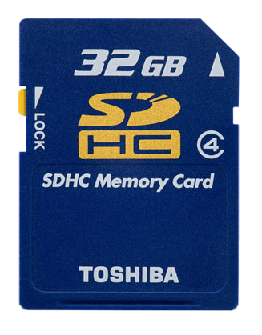
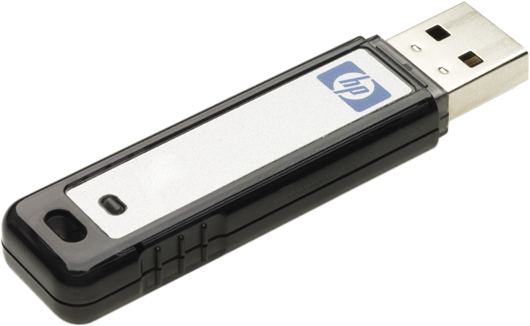
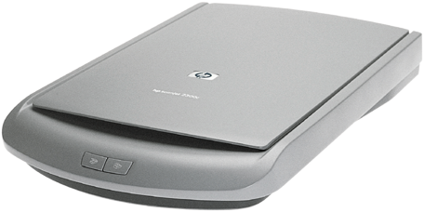
Feature based infrastructure
x86
x64

Slide 14
Certifying a multi-function device
demo

Slide 15
Automation using C#
or PowerShell

Slide 16
Automation using C# or PowerShell
Complete
Automation exposes the same functionality as provided by the user interface
Straight Forward
Functionality is accessed by straight forward programming interfaces

Slide 17
Creating a project
//---------------
// creating a project
//---------------
Console.WriteLine("Creating project: {0}", projectName);
Project project = manager.CreateProject(projectName);

Slide 18
Picking a target
// this is the hardware id that corresponds to MOST keyboards, which all systems generally have.
string targetHwId = @"HID_DEVICE_SYSTEM_KEYBOARD";
Console.WriteLine("Looking for target with Id '{0}'", targetHwId);
ReadOnlyCollection<TargetData> data = pi.FindTargetFromId(targetHwId);
// the FindTarget APIs return a list of potential targets,
// for now, just use the first one found
TargetData targetData = data.First();
pi.CreateTarget(targetData);
Console.WriteLine("Added target to the project");

Slide 19
Scheduling tests
//---------------
// Running tests
//---------------
string testName = "DevFund INF Test";
Console.WriteLine("Running test '{0}'", testName);
Test test = project.GetTests().Where(x => x.Name == testName).First();
Console.WriteLine("Estimated run time: {0}", test.EstimatedRuntime);
test.QueueTest();
Console.Write("Job is running");

Slide 20
Automating Certification Tasks
demo

Slide 21
One toolset for all scenarios

Slide 22
One toolset for all scenarios
Unified
One toolset supports the entire certification cycle from start of certification testing through final submission
Complete
One toolset for all users in all scenarios: certification testing, driver updates, information sharing, off-site analysis, etc.

Slide 23
Packaging and working with offline data
demo

Slide 24
Review
The Hardware Certification Kit helps you deliver Windows hardware that fulfills customer expectations
New functionality makes the certification process simpler, faster, and more direct
Improved user interface
Greater flexibility & relevancy
Straight-forward automation
Unified toolset

Slide 25
Get started now For Windows 8 Certification
At //build/
Between Now and Beta
Beta to Start
of Certification
Visit hands-on labs
Chalk-talk
Familiarize yourself with the requirements and kits (HCK & ACK)
Get trained
Test your products for certification with new kits

Slide 26
Related sessions
http://buildwindows.com

Slide 27
Further reading and documentation
Windows 8 Certification Requirements - Preview
Windows Logo Program for Hardware: Overview
Windows Hardware Developer Center Dashboard
Windows Hardware Dev Center
Windows Dev Center

Slide 28
thank you
Feedback and questions http://forums.dev.windows.com
Session feedback http://bldw.in/SessionFeedback

Slide 29
Questions?

Slide 30
© 2011 Microsoft Corporation. All rights reserved. Microsoft, Windows, Windows Vista and other product names are or may be registered trademarks and/or trademarks in the U.S. and/or other countries.
The information herein is for informational purposes only and represents the current view of Microsoft Corporation as of the date of this presentation. Because Microsoft must respond to changing market conditions, it should not be interpreted to be a commitment on the part of Microsoft, and Microsoft cannot guarantee the accuracy of any information provided after the date of this presentation. MICROSOFT MAKES NO WARRANTIES, EXPRESS, IMPLIED OR STATUTORY, AS TO THE INFORMATION IN THIS PRESENTATION.

