Slide 1
Reimagining the experience for connecting with devices
HW-745T
Robin Goldstein
Group Program Manager
Microsoft Corporation
Craig Zhou
Test Manager
Microsoft Corporation

Slide 2
Agenda
Experience overview for connected devices in Windows
Connectivity and setup
Experience with devices and apps
Device maker opportunity
You’ll leave with examples of how to
Have a great experience with your device in Windows 8
Attend more sessions at //build/ that tell you how you can participate

Slide 3
We’ve reimagined the experience for connecting devices to Windows.

Slide 4
Why…
People are using more devices and more pc’s
They are connecting to apps and services in new ways
Device makers want the flexibility to differentiate

Slide 5
Windows 8 is connected and ready to use with devices.

Slide 6
Windows 8
Makes device connectivity and setup effortless
Includes built-in device experiences that are available to app developers
Enables device makers to differentiate with Metro style device apps

Slide 7
Connectivity and setup

Slide 8
Windows 8 makes device connectivity and setup effortless.

Slide 9
Setting up devices with Windows 8
demo
Craig Zhou
Test Manager, Microsoft Corporation

Slide 10
Connectivity and setup for devices
Device Layer
USB 3.0
Connected devices are faster than ever
WiFi Direct
High bandwidth local wireless sharing and play to
Bluetooth LE
Low power wireless for new device classes
NFC
Low bandwidth short range for personal sharing
Setup and Use
Auto-Discover
Automatic network setup and new ways to pair
V4 Print Driver
Works everywhere, less code, UI extensibility
App Install
Automatic download of Metro style device apps
Windows to Go
Run Windows from a USB device

Slide 11
Experience with apps

Slide 12
Windows 8 includes built-in device experiences that are available to app developers.

Slide 13
Built-in device experiences for Metro style apps
demo

Slide 14
Metro style apps can easily access devices
Widows runtime connects apps and devices
Print
Send documents to connected printers
Play To
View media on network connected receivers
Capture
Capture photos and video
Share
Share with someone nearby via Tap & Go
Transfer
Send content to a device via Share charm
Store
Pick from or save to a portable device
Communicate
Send or receive SMS text messages

Slide 15
Device maker differentiation

Slide 16
Windows 8 enables device makers the flexibility to differentiate with Metro style device apps.

Slide 17
Differentiation with Metro style device apps
Demo

Slide 18
Metro style device apps
Extend the built-in experiences
Printers
Custom settings, notifications and creative apps
Webcam
Custom settings and creative effects
MB SIM
Brand the connection, link to account app
Build your own experience
Portable
Access unique device capabilities via new Window runtime.
All Metro style device apps automatically install when device is connected
Storage
Networked
Other

Slide 19
Takeaways

Slide 20
Windows 8 is connected and ready to use with devices.

Slide 21
Windows 8
Makes device connectivity and setup effortless
Includes built-in device experiences that are available to app developers
Enables device makers the flexibility to differentiate

Slide 22
Asks
Improve connectivity experiences by enabling Windows 8 technologies that simplify setup and improve the performance of your device
Design great devices that support built-in app experiences
Build Metro style apps to differentiate your devices and extend the Windows experience
Attend related device sessions at //build/

Slide 23
Related sessions
Device Maker
[HW-329T] Understanding Wi-Fi Direct in Windows 8
[HW-773T] Building great USB 3.0 devices
[HW-254T] Connecting Bluetooth Low Energy devices to Windows
[HW-286T] Simplifying wireless and network device discovery and pairing
[HW-177T] Building great networked media devices for Play To apps
[HW-238T] Connecting printing devices to Windows using v4 printer drivers
[HW-245T] Running Windows from an external USB drive with Windows To Go
[HW-283T] Introducing Metro style device apps
[HW-275T] Building and delivering a great Metro style app for your device
[HW-288T] Building great Metro style apps for mobile broadband devices
[HW-652T] Building a great Metro style device app for your printer
[HW-715T] Building a great Metro style device app for your camera
[HW-747T] Building Metro style apps that connect to specialized devices
Developer
[APP-408T] Integrating with the Windows device experience

Slide 24
Further reading and documentation
Windows 8 Guide
Devices: Overview
Metro style apps Learn landing page
Metro style apps home
Windows Hardware Development

Slide 25
thank you
Feedback and questions http://forums.dev.windows.com
Session feedback http://bldw.in/SessionFeedback

Slide 26
© 2011 Microsoft Corporation. All rights reserved. Microsoft, Windows, Windows Vista and other product names are or may be registered trademarks and/or trademarks in the U.S. and/or other countries.
The information herein is for informational purposes only and represents the current view of Microsoft Corporation as of the date of this presentation. Because Microsoft must respond to changing market conditions, it should not be interpreted to be a commitment on the part of Microsoft, and Microsoft cannot guarantee the accuracy of any information provided after the date of this presentation. MICROSOFT MAKES NO WARRANTIES, EXPRESS, IMPLIED OR STATUTORY, AS TO THE INFORMATION IN THIS PRESENTATION.

Slide 27
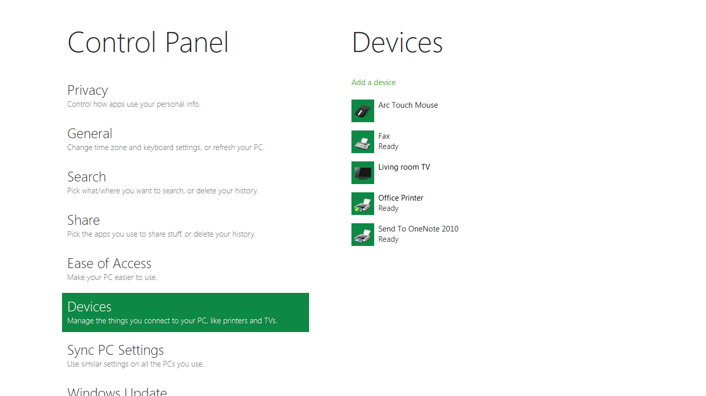

Slide 28
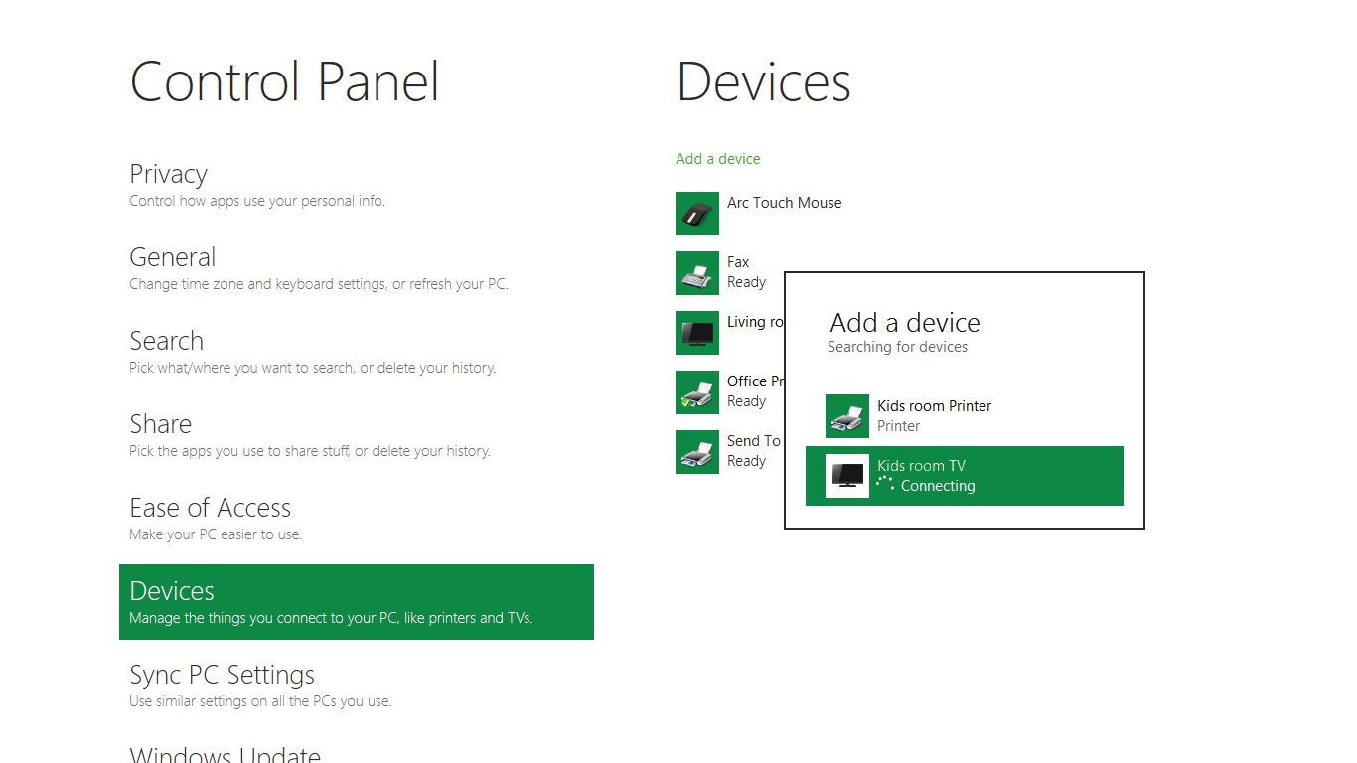

Slide 29
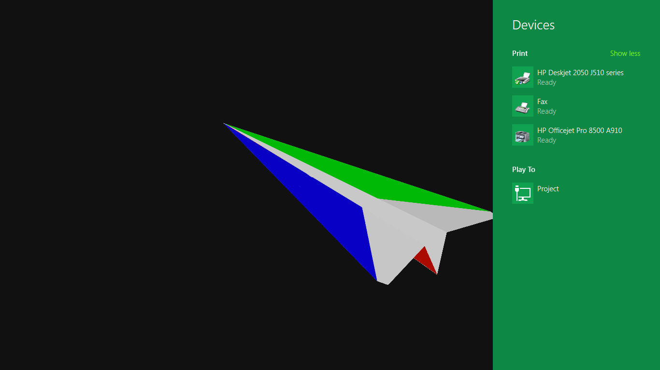

Slide 30
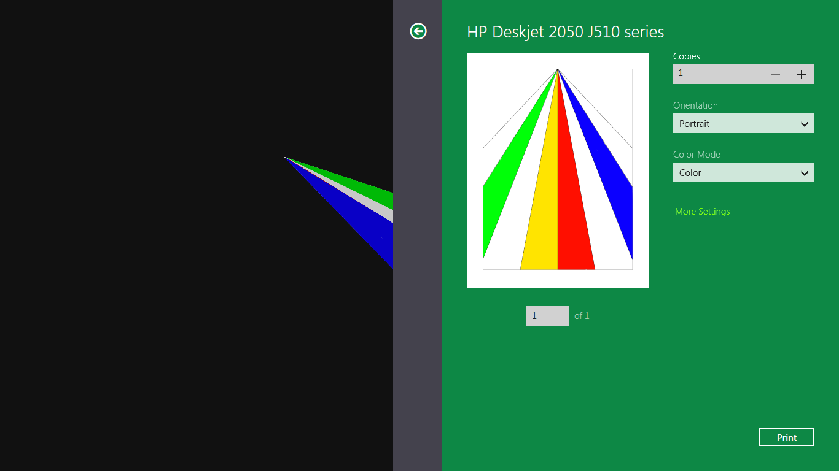

Slide 31
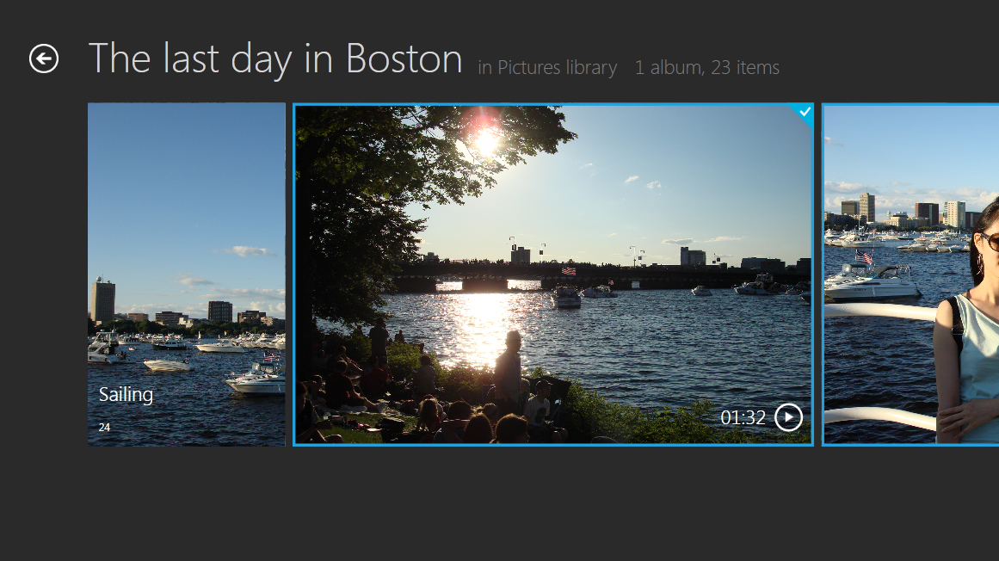
Devices
Print
See all
Fabrikam printer
Play To
Kitchen TV
Bedroom TV
Project
Send
Someone nearby

Slide 32
Devices
Print
See all
Fabrikam printer
Play To
Kitchen TV
Playing
Bedroom TV
Project
Send
Someone nearby

Slide 33
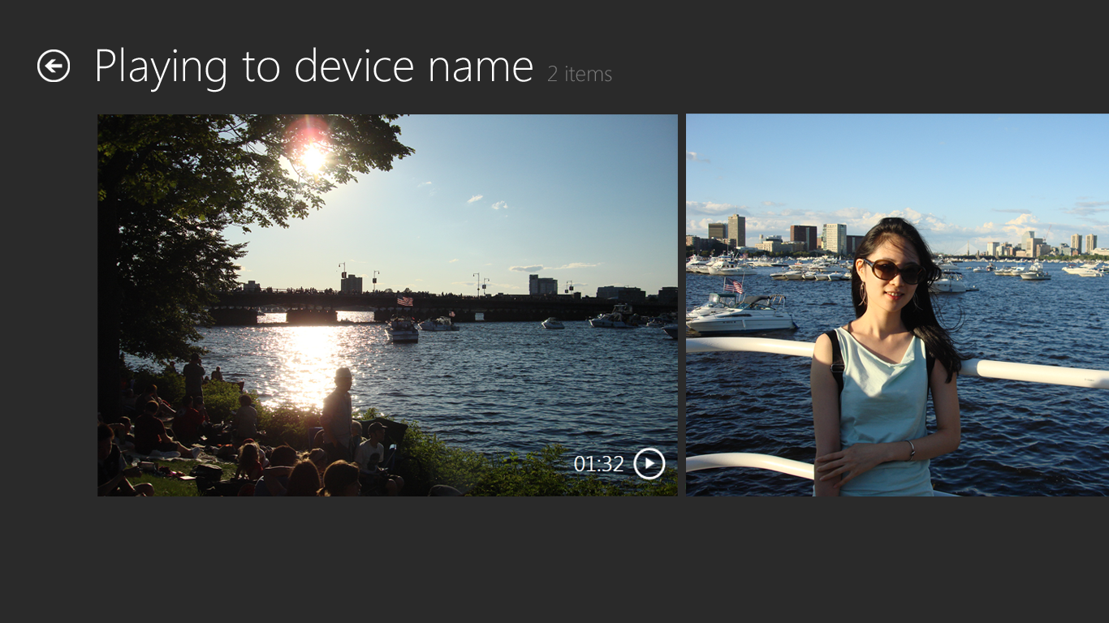

Slide 34
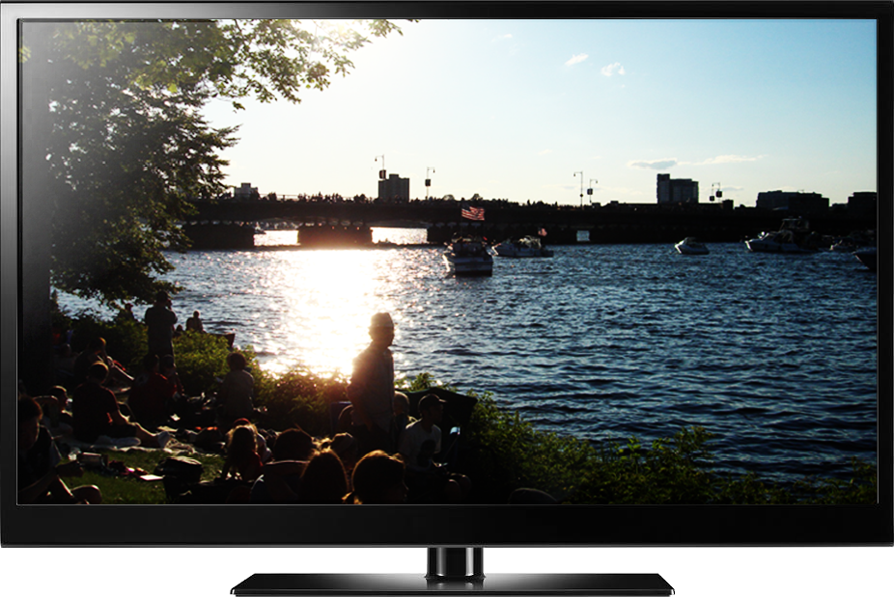

Slide 35
Tap screen to take a photo

Slide 38
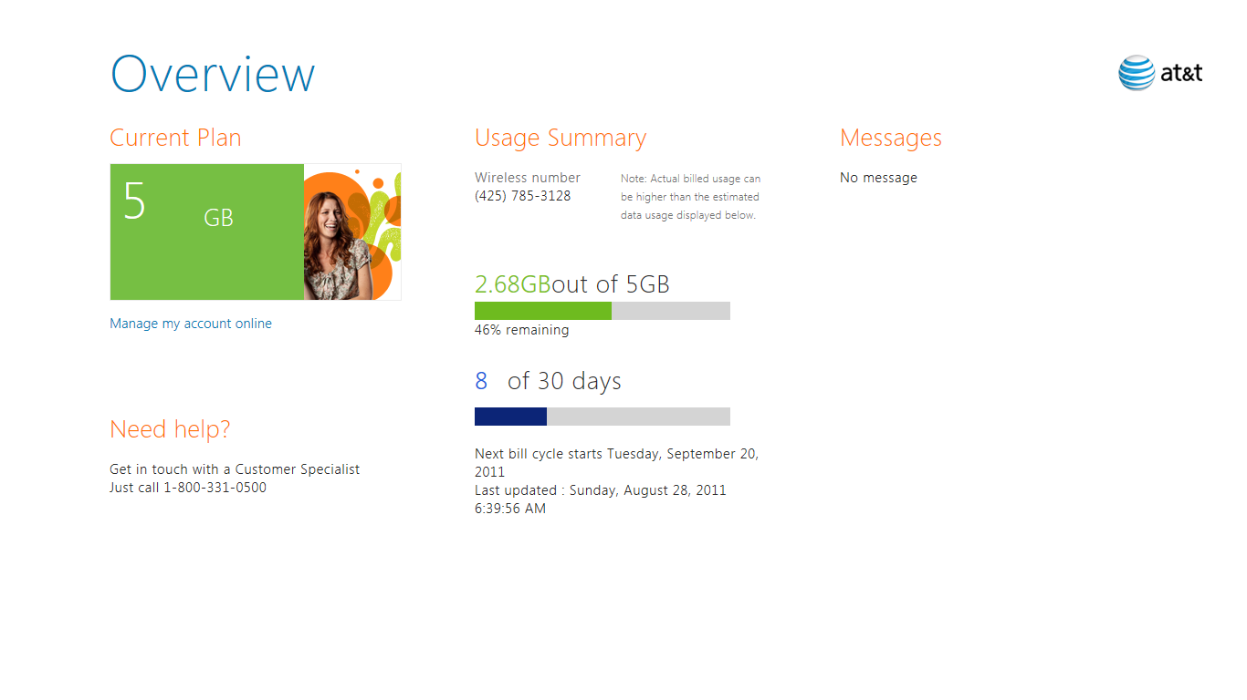

Slide 39
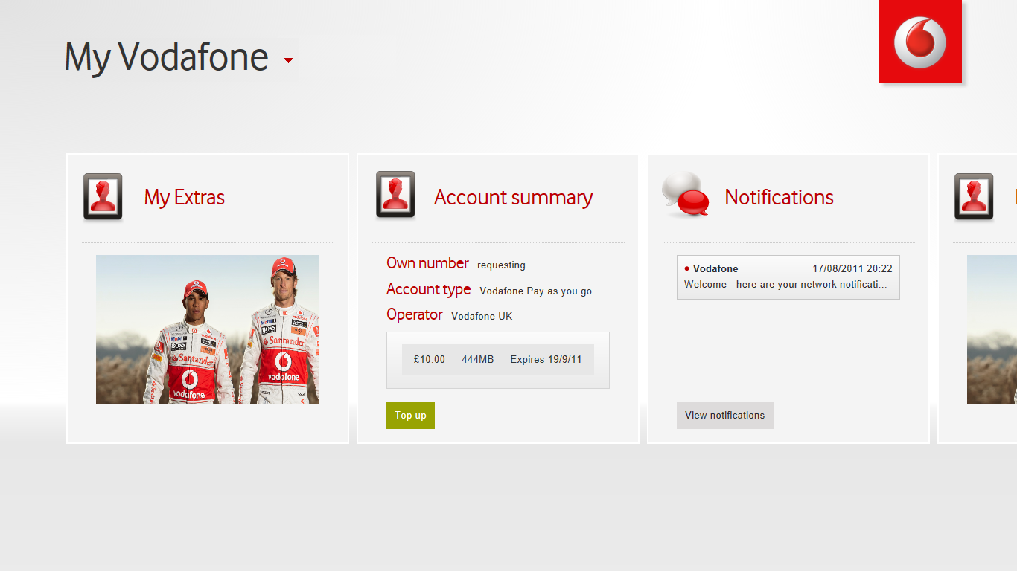

Slide 40
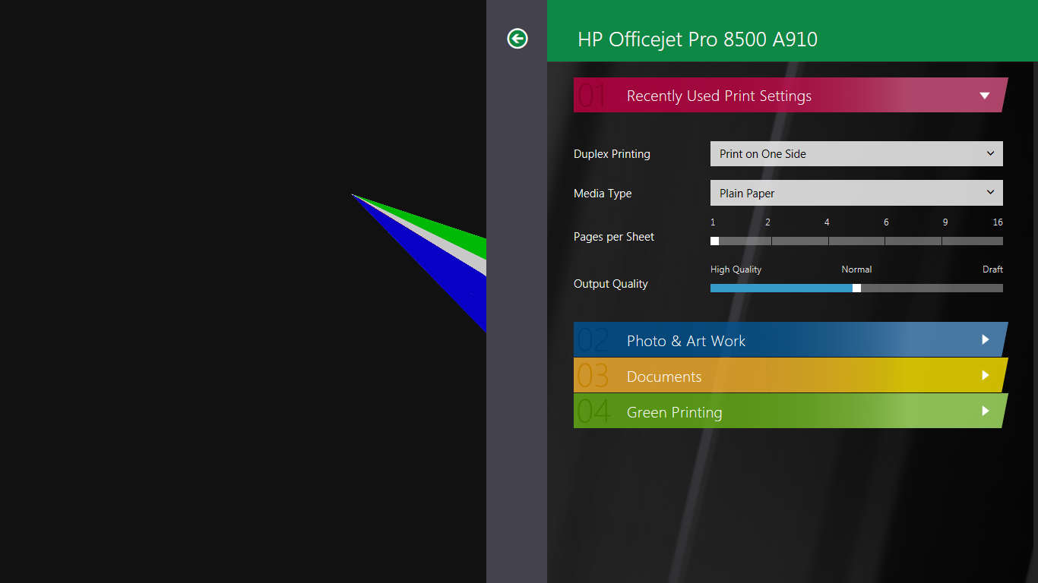

Slide 42
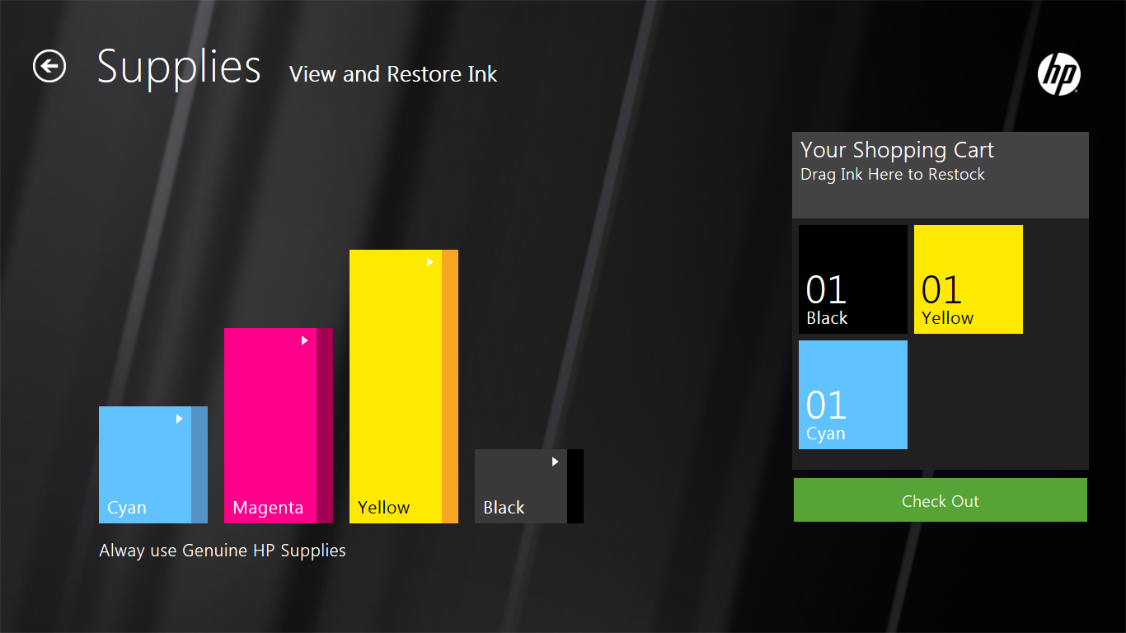

Slide 44
