Slide 1
Understanding VirtualAlloc usage using Windows Performance Analyzer
HW-977P
Joe Laughlin
Principal SDE
Microsoft Corporation

Slide 2
Agenda
VirtualAlloc Overview
Demo: Collecting and Analyzing VirtualAlloc Data
Guidelines and Best Practices
Key Takeaways

Slide 3
VirtualAlloc Overview

Slide 4
VirtualAlloc Overview
VirtualAlloc is used for large dynamic memory allocations
Allocations are made directly via VirtualAlloc API
Typical usage – Bitmaps, Buffers
Key Concepts
Reservation - Reserves an address range for usage but does not acquire memory resources
Commit - Ensures that either physical memory or page file space will be available if the addresses are referenced
Reference - Allocates a physical memory page

Slide 5
VirtualAlloc Data Collection and Analysis

Slide 6
VirtualAlloc Vocabulary
General
Reserve, Commit
Basic Data
Commit/Reserve Lifetime – How long an allocation remains outstanding
Stack – Stack corresponding to the allocation
Address – Address corresponding to allocation
Metadata
Flags – Flags passed to the VirtualAlloc APIs
Desired size – Requested size of a reservation or commit
Committed/Reserved Actual – Amount of memory actually committed/reserved
Context:
Transient – allocations with a short lifetime, measured in milliseconds
Outstanding Committed/Reserved– allocations that remain alive at the point in time being investigated

Slide 7
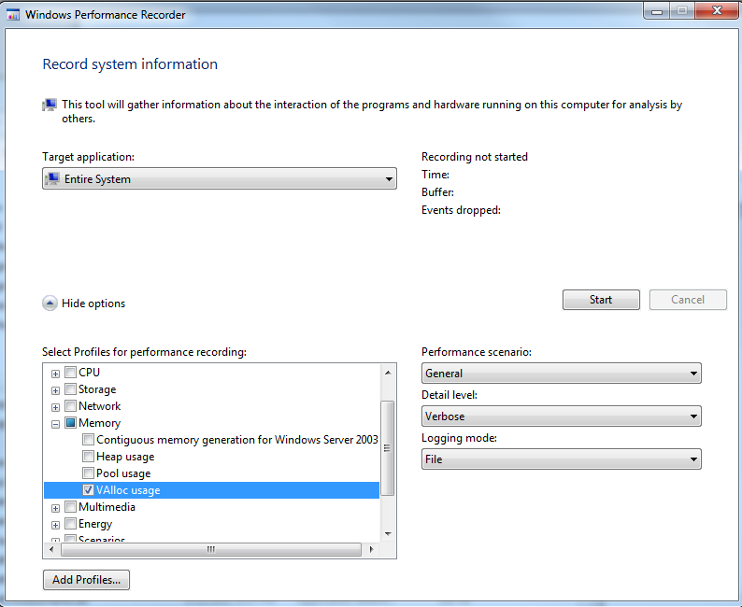
Data Collection
VirtualAlloc data is collected system wide and not restricted to a single process
Steps
Open Windows performance recorder UI
Select Target application to be “Entire System”
Select VAlloc Usage from the Memory Profiles
Select scenario of Interest
Click on ‘Start’ to start tracing and ‘Save’ to save the trace when done
Windows Performance Recorder UI

Slide 8
WPA VirtualAlloc Analysis
VirtualAlloc Cumulative Commit Count
What is the total number of allocations alive at a given point in time?
VirtualAlloc Cumulative Commit Size
What is the total number of allocation to a particular point in time?
VirtualAlloc Outstanding Commit Size
What is the total size of allocations alive at a given point in time?
VirtualAlloc Outstanding Commit Count
What is the total number of allocations to a particular point in time?

Slide 9
Summary Table
Raw data is exposed via summary tables
Vocabulary
Allocation lifetime is expressed based on the visible portion of the graph
AIFO - Allocated inside, freed outside
AIFI - Allocated inside, freed inside
AOFO - Allocated outside, freed outside
AOFI - Allocated outside, freed inside

Slide 10
Demo

Slide 11
Guidelines and Best Practices

Slide 12
Guidelines and Best Practices
Approach
Understand how dynamic memory allocations impact the VA space of a process
Follow your allocation patterns – Transient and Steady state
Guidance
Reduce
Number and size of outstanding allocations
Total number of allocations
Be judicious about what you Commit
Ensure that scenario specific transient allocations are freed as soon as possible
Avoid intermingling long lived allocations with short lived ones which can fragment VA space

Slide 13
Key Takeaways
Concepts of Commit, Reserve and Reference
Understand the VirtualAlloc usage of your component and utilize the tools to identify areas for optimization

Slide 14
For more information
RELATED SESSIONS
HW-59T Improving performance with the Windows Performance Toolkit
HW-141T Reducing the memory footprint of drivers and apps
HW-927P Understanding pool usage using Windows Performance Analyzer
HW-928P Understanding heap data Using Windows Performance Analyzer
HW-925P Customizing WPA Trace Views
HW-926P Introduction to the new WPA User interface

Slide 15
thank you
Feedback and questions http://forums.dev.windows.com
Session feedback http://bldw.in/SessionFeedback

Slide 16
© 2011 Microsoft Corporation. All rights reserved. Microsoft, Windows, Windows Vista and other product names are or may be registered trademarks and/or trademarks in the U.S. and/or other countries.
The information herein is for informational purposes only and represents the current view of Microsoft Corporation as of the date of this presentation. Because Microsoft must respond to changing market conditions, it should not be interpreted to be a commitment on the part of Microsoft, and Microsoft cannot guarantee the accuracy of any information provided after the date of this presentation. MICROSOFT MAKES NO WARRANTIES, EXPRESS, IMPLIED OR STATUTORY, AS TO THE INFORMATION IN THIS PRESENTATION.

