Slide 1
Building Xbox LIVE Games for Windows 8
PLAT-756T
Avi Ben-Menahem
Principal Program Manager Lead
Microsoft Corporation

Slide 2
35 Countries
2.1 Billion hours played per month
35 Million Users
176,802,201,383 Gamer Points have been scored
More than 6.3 Billion achievements granted

Slide 3
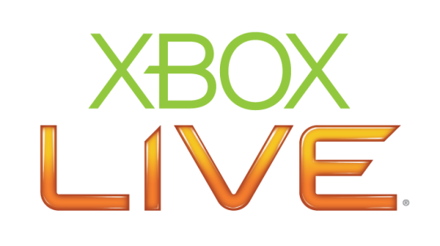
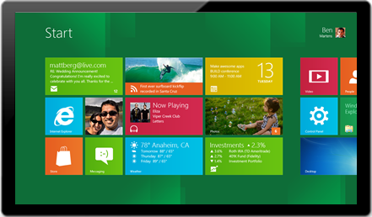
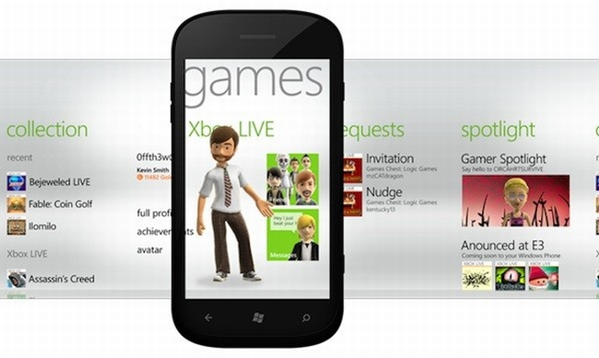
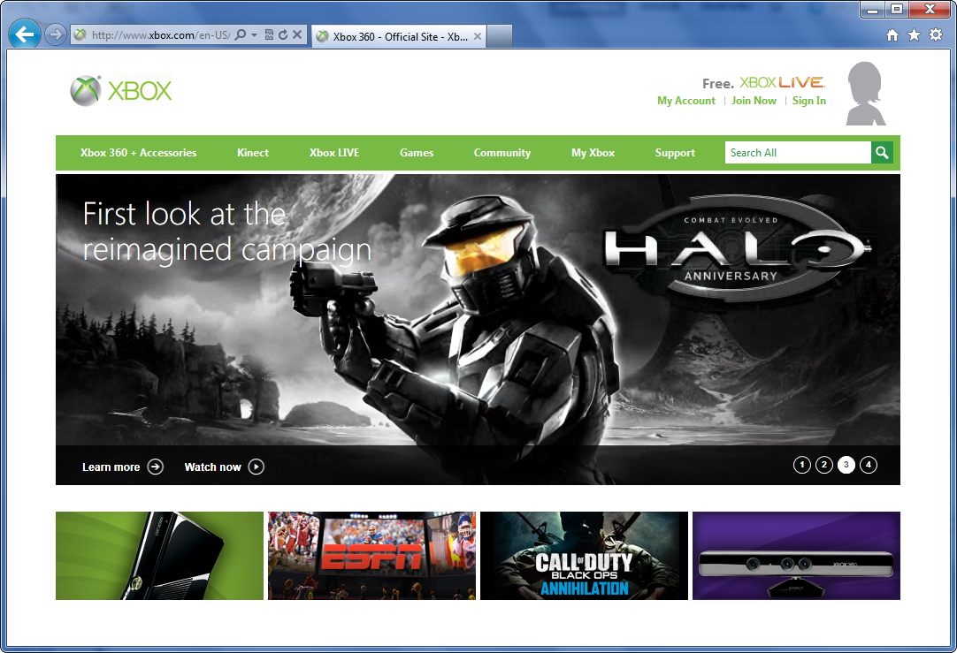
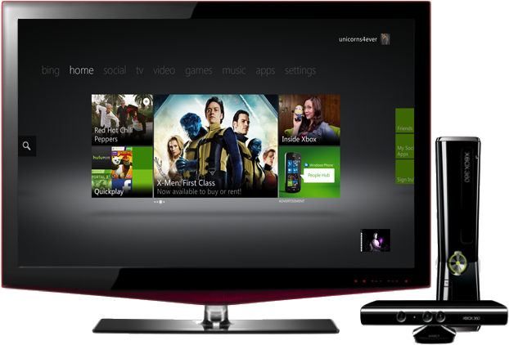
Xbox LIVE on Windows

Slide 4
Identity
Multiplayer
Your Great Content
Achievements
Music
Leaderboards
Television
Movies
Avatars
Real Time Counting Service
Friends
Roaming Storage
Beacons

Slide 5
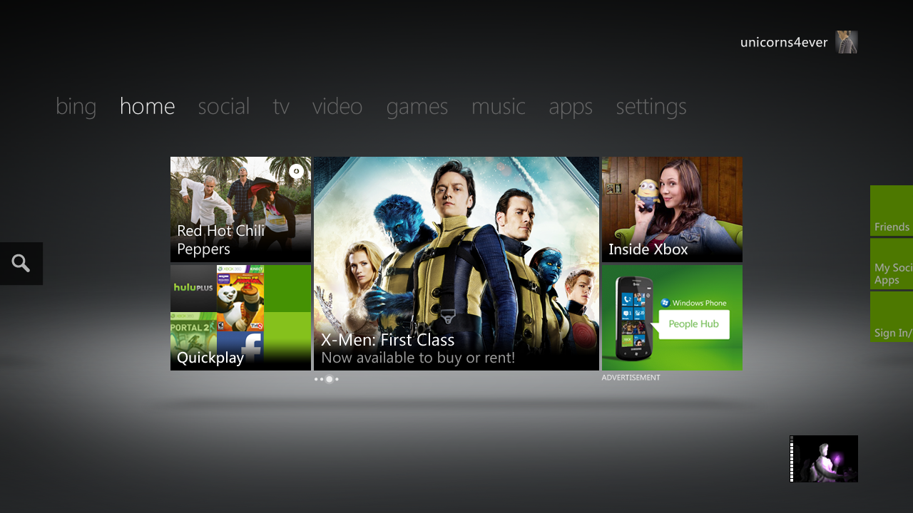
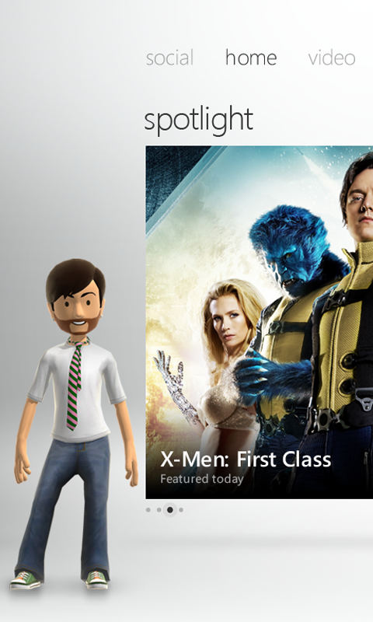
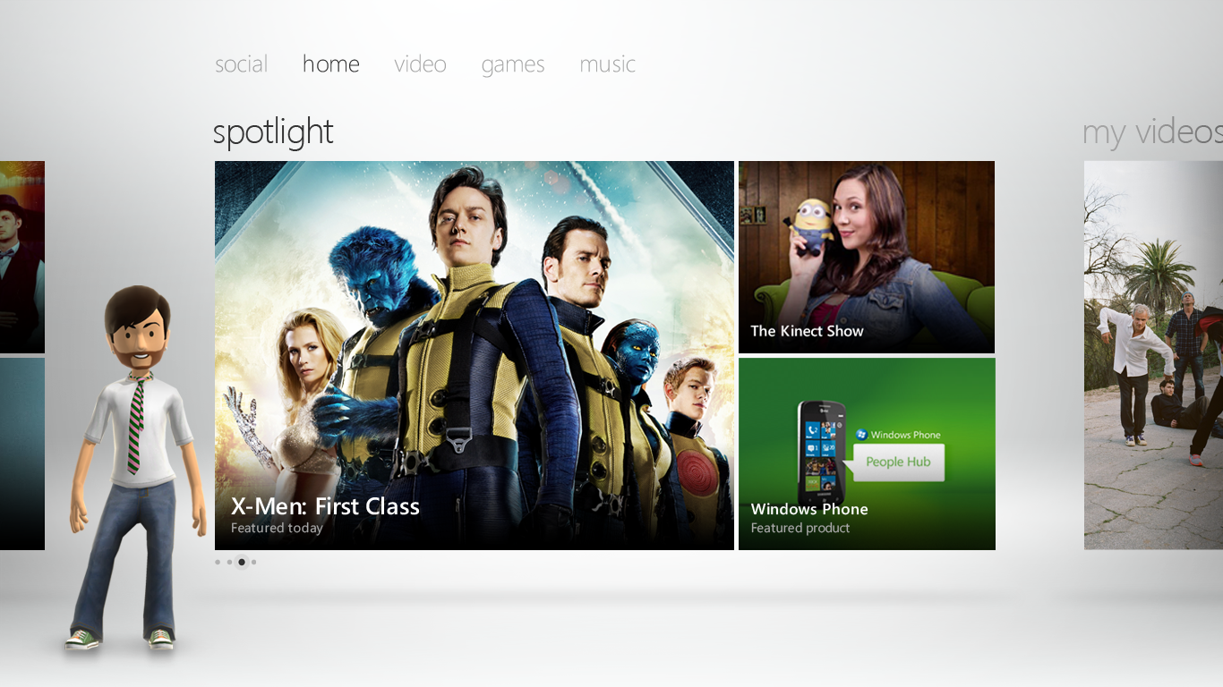

Slide 6
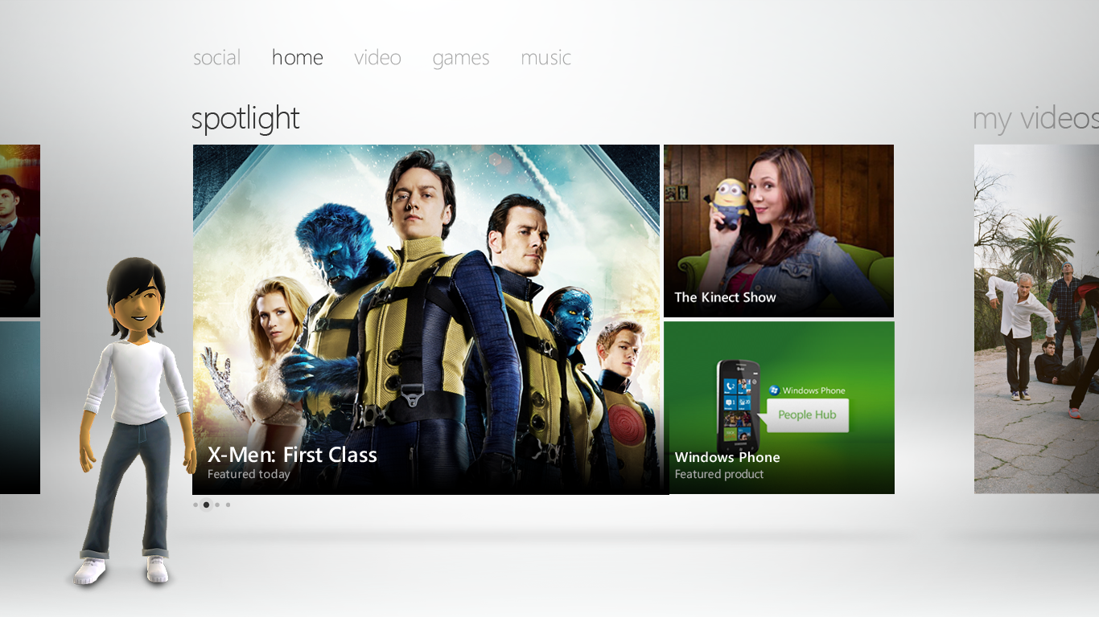

Slide 7
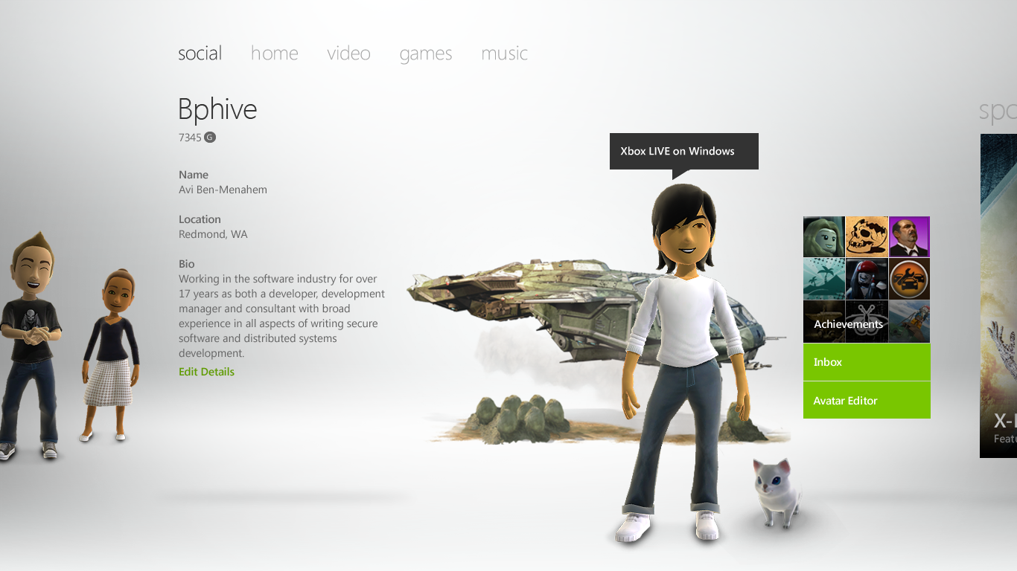

Slide 8
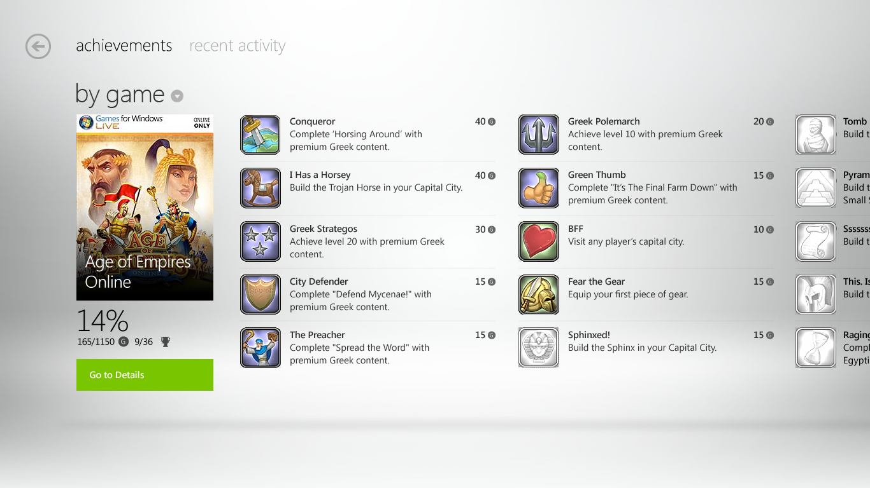

Slide 9
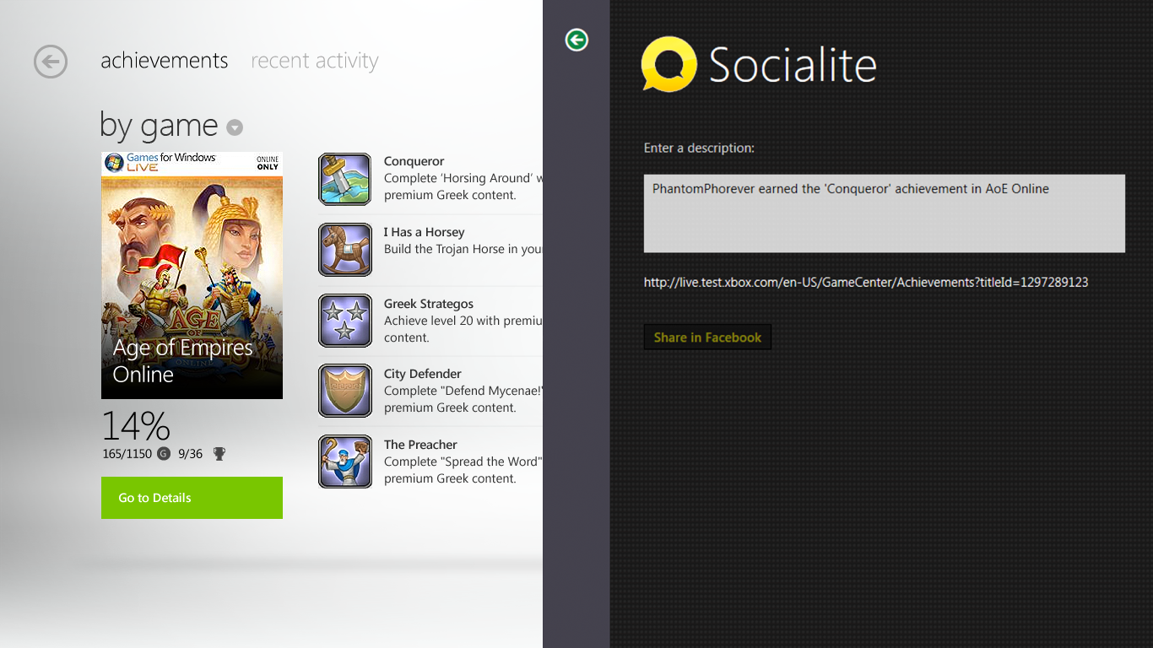

Slide 10
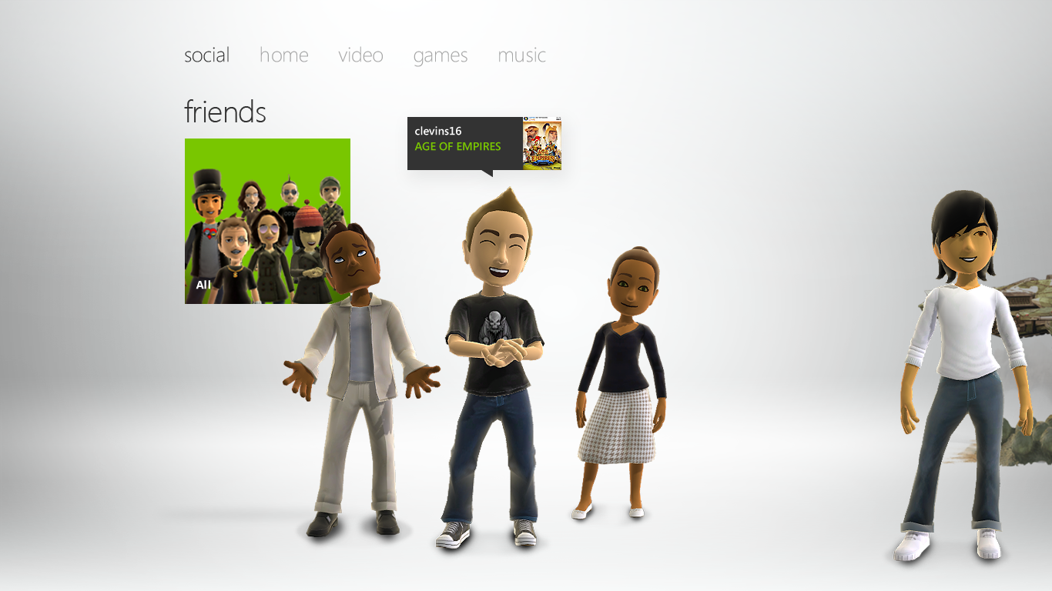

Slide 11
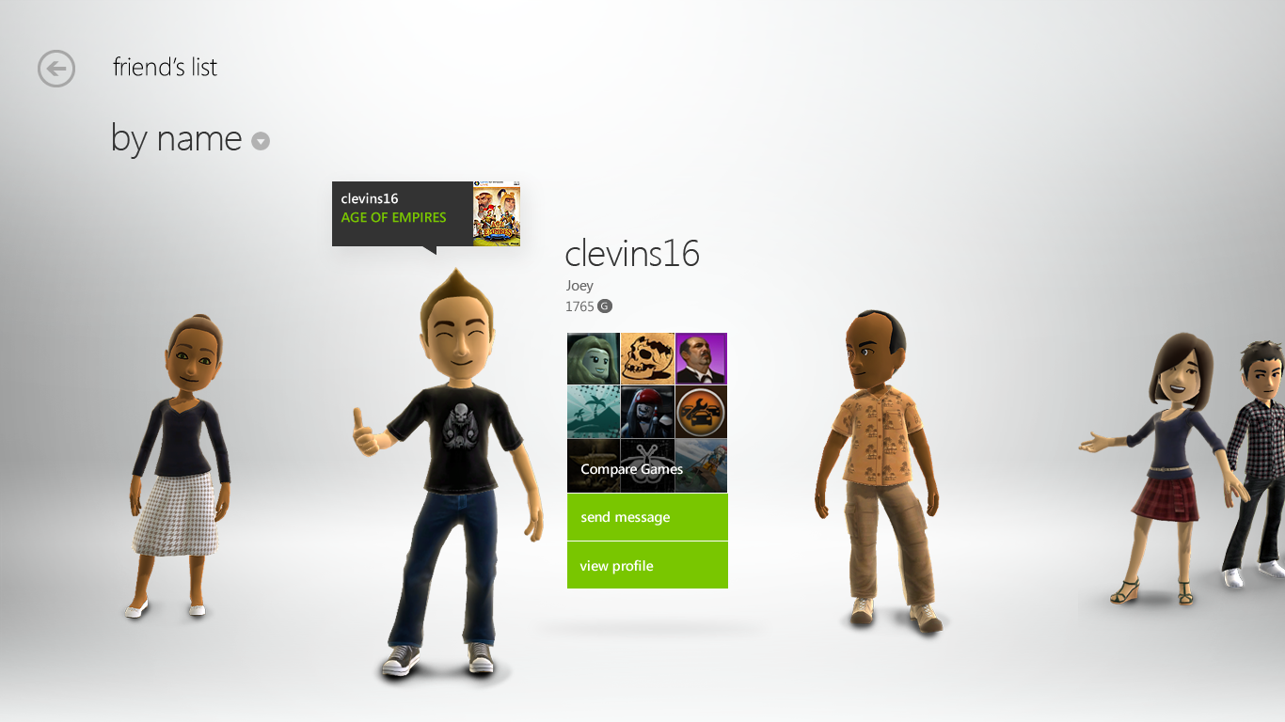

Slide 12
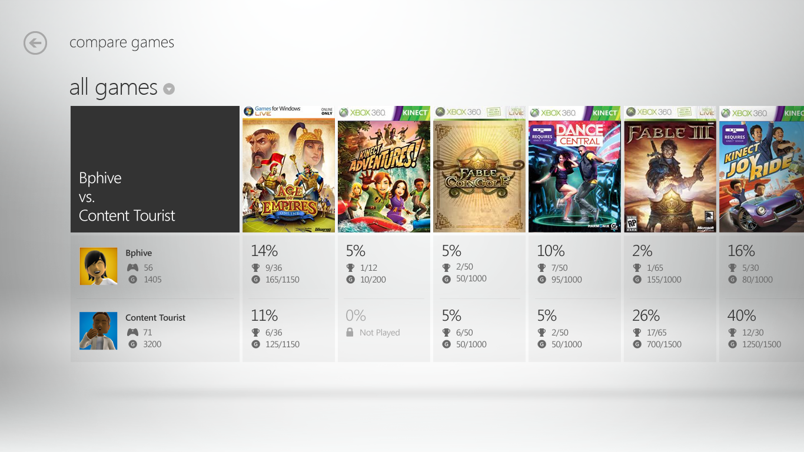

Slide 13
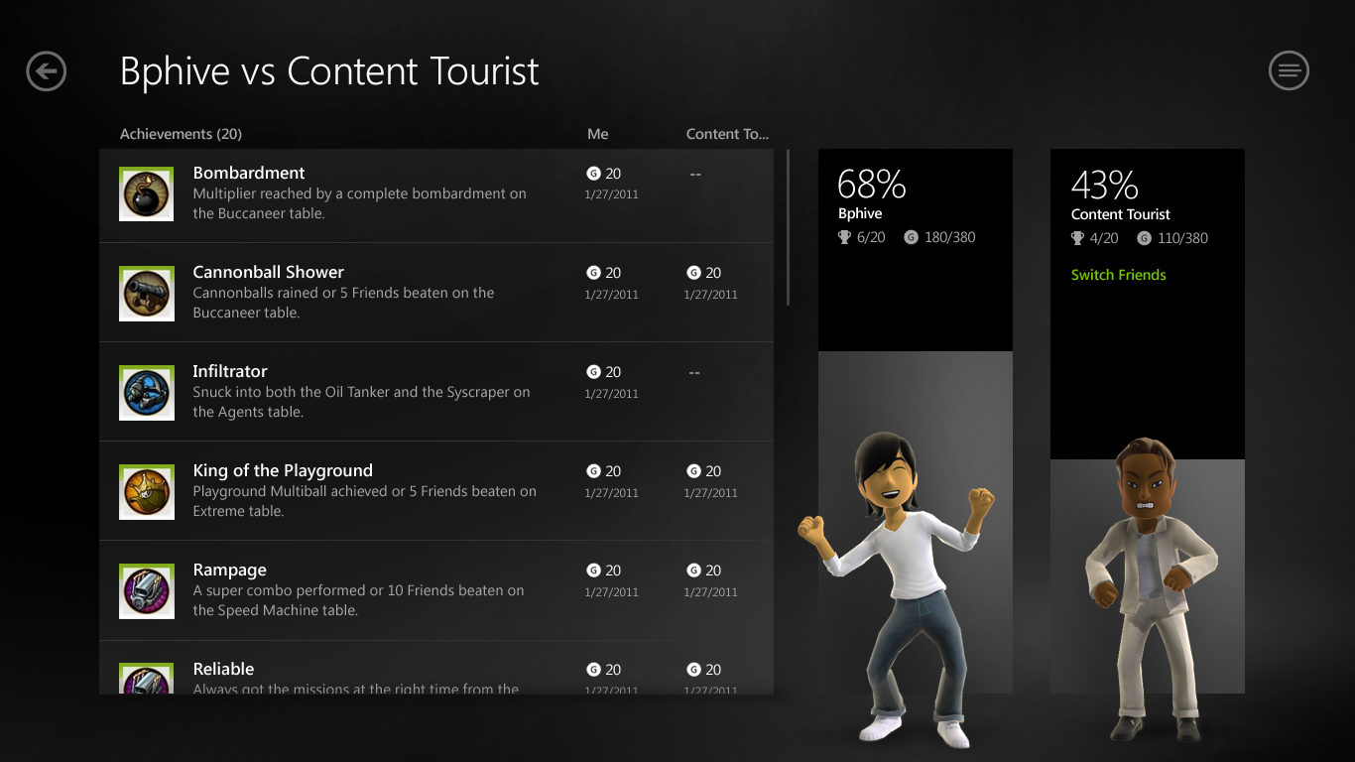

Slide 14
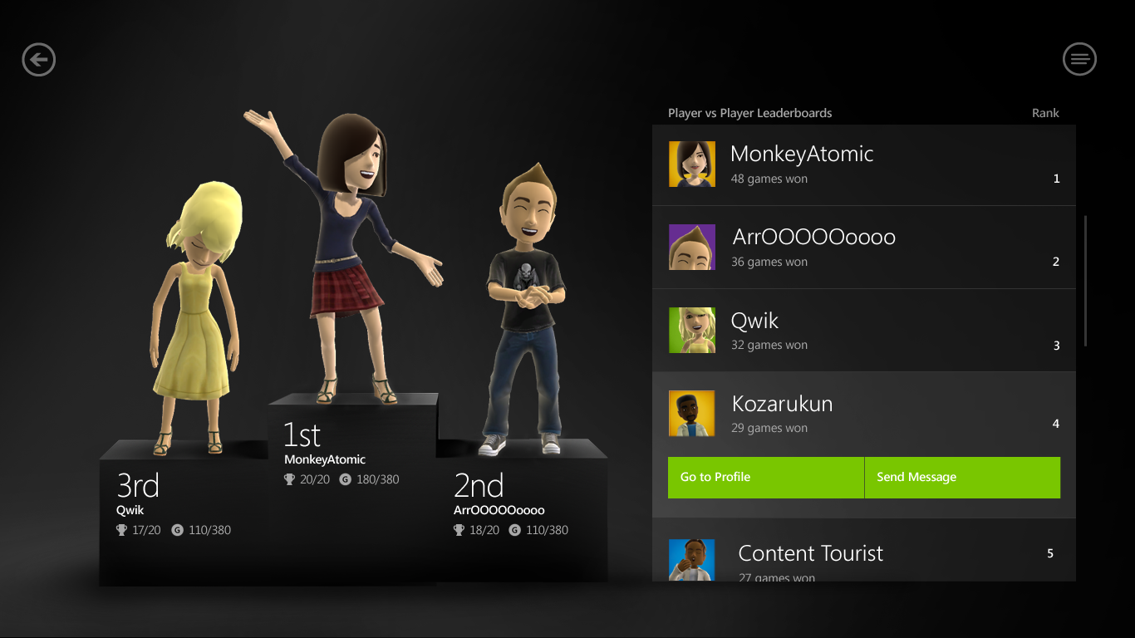

Slide 15
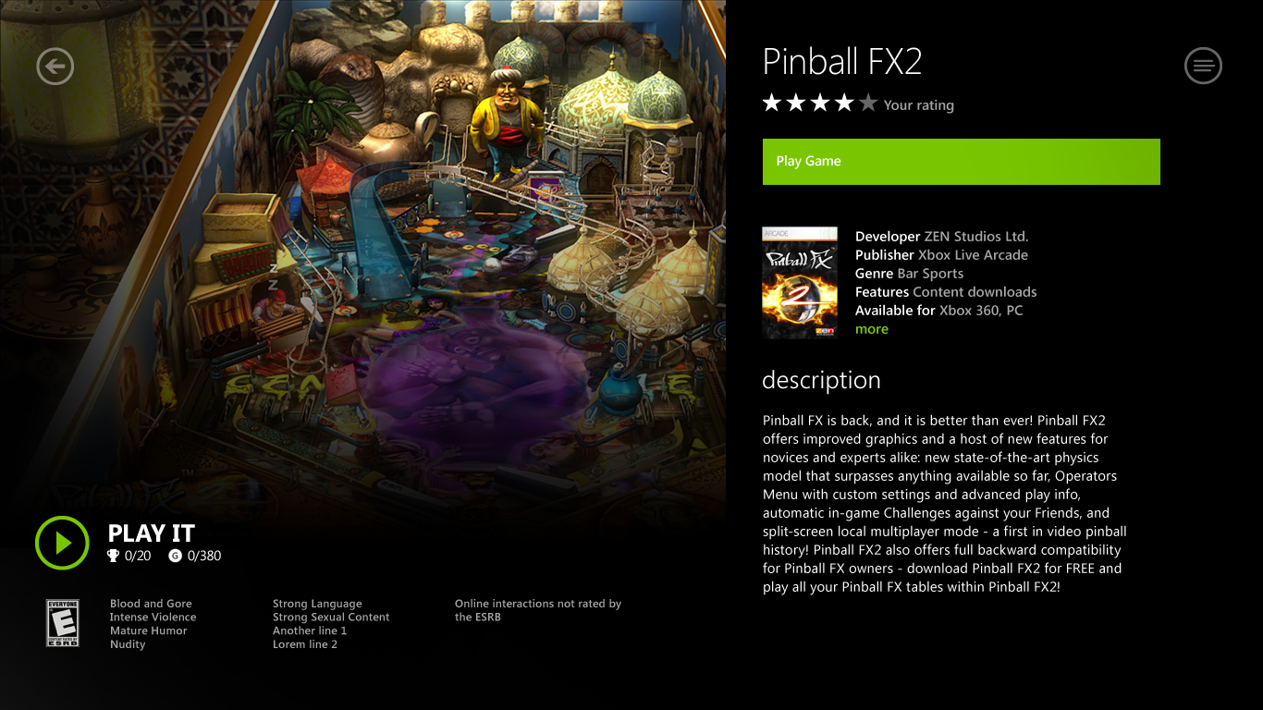

Slide 16
Pinball FX 2 on Windows 8
demo
Avi Ben-Menahem
Microsoft Corporation

Slide 17
Xbox LIVE on Windows 8 A Complete Development Platform
Comprehensive, Proven Xbox LIVE Feature Set
Multiplayer
Achievements & Gamerscore
Avatars
Friends List & Community
Roaming Save State
Title Managed Storage
Beacons
Avatar Awards

Slide 18
Xbox LIVE on Windows 8 A Complete Development Platform
Comprehensive, Proven Xbox LIVE Feature Set
Xbox LIVE SDK for Windows Metro Style Game Development
Enhanced cloud-based anti-piracy
Supporting choice of development technology
Notifications and Presence
Up and running in days

Slide 19
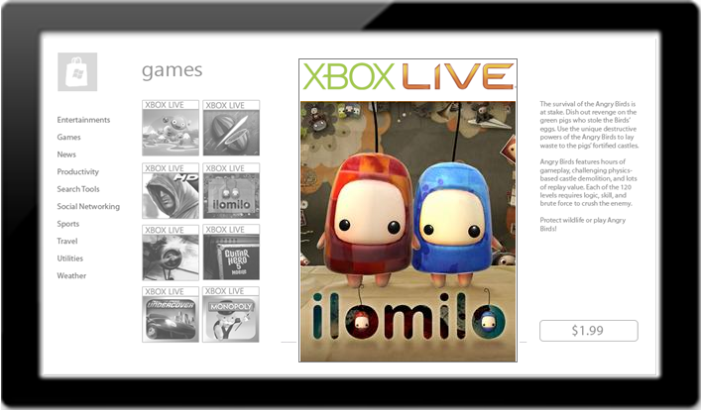
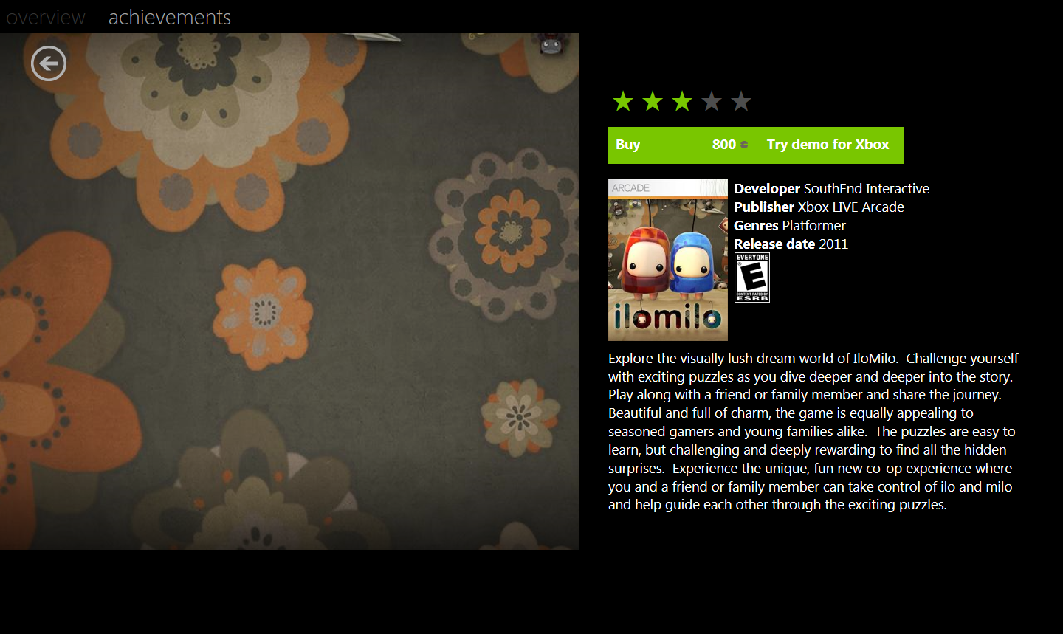
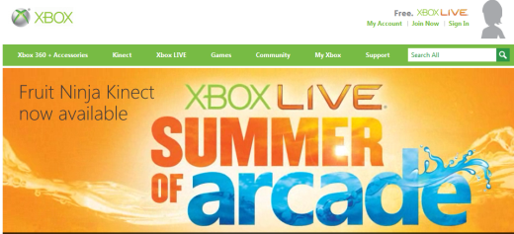
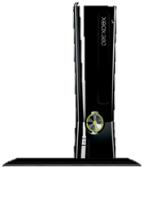
Xbox LIVE on Windows 8 A Complete Development Platform
Comprehensive, Proven Xbox LIVE Feature Set
Xbox LIVE SDK for Windows Metro Style Game Development
Differentiated Experiences For Your Application
Xbox LIVE Experiences on Windows 8
The Xbox LIVE on Windows App will be available in all countries that are Xbox LIVE-enabled
Xbox LIVE branded
Designed for
cross-device game development

Slide 20
The Xbox LIVE on Windows Developer Platform

Slide 21
Xbox LIVE on Windows Developer Platform
Your Games and Apps
Xbox LIVE Services
Ingestion & Certification
Xbox LIVE on Windows Runtime
Marketplace Distribution
Developer Tools

Slide 22
Xbox LIVE Services Overview
Your Games and Apps
Xbox LIVE on Windows Runtime
REST
REST
Xbox LIVE Services
User Profile & Settings
Presence
Avatars
Friends
Achievements
Avatar Awardables
Leaderboards
Multiplayer
Text Messaging
Roaming Game State
Beacons
Real Time Counting Service

Slide 23
What are REST-ful Services?
RESTful Services
REST stands for Representational State Transfer
It is not a standard or a RFC, rather it is an architectural style that leverages HTTP(s) protocol
Each unique URI is a representation of a resource
APIs based on four http verbs: GET, PUT, POST, DELETE to manipulate the resources defined by the URI
Responses can use XML or JSON
JavaScript Object Notation (JSON)
A lightweight text-based human readable open standard designed for data interchange

Slide 24
Xbox LIVE Service REST API Overview 2011
https://services.xboxlive.com
Aggregation (Real Time counting Service)
Leaderboards
Friends
Matchmaking, Messaging & Session
Storage
Progress
User

Slide 25
Reading Achievements Example Read an achievement from the current user
Http Request
https://services.xboxlive.com/users/xuid(1234567890)/progress/achievements?skipItems=1&maxItems=3
JSON
{
"achievements":
[{
"description":"Won a Pro Takedown.",
"flags":1245192,
"gamerscore":10,
"id":2,
"imageId":2,
"isSecret":false,
"lockedDescription":"Win a Pro Takedown.",
"name":"Took Down a Pro",
"platform":1,
"sequence":2,
"timeUnlocked":"2004-02-20T19:42:13.0200000",
"titleId":1297287442,
"type":1,
"unlockedOnline":true
},…

Slide 26
The Xbox LIVE on Windows Runtime
Microsoft.Xbox
SocialNetwork
MatchmakingService
MultiplayerSession
User
LeaderboardService
StorageService
Property Bags
Internal Security, Caching, Offline

Slide 27
Design and Call Pattern
A new Namespace
using Microsoft.Xbox;
private void ReadProfile()
{
IUser signedInUser = new User();
IAsyncOperation<IUserProfile> asyncProfile = signedInUser.GetProfileAsync();
asyncProfile.Completed = new
AsyncOperationCompletedHandler<IUserProfile>(GetProfileComplete);
asyncProfile.Start();
}
private void GetProfileComplete(IAsyncOperation<IUserProfile> pAsync)
{
IUserProfile profile = pAsync.GetResults();
this.motto = profile.Motto;
}
User object encapsulates all user management complexity
Async interfaces
Use Delegates to handle callbacks
Handle returned data – Property Bag in most cases

Slide 28
Reading Profile data (C++)
#using <Microsoft.Xbox.winmd>
using namespace Microsoft::Xbox;
void MainPage::GetUserProfile() {
Microsoft::Xbox::IUser ^user = ref new Microsoft::Xbox::User();
auto operation = user->GetProfileAsync();
operation->Completed = ref new AsyncOperationCompletedHandler<IUserProfile^>(this,
&MainPage::HandleUserProfileComplete);
operation->Start();
}
void MainPage::HandleUserProfileComplete( IAsyncOperation<IUserProfile^>^ pAsync ) {
HResult result = pAsync->ErrorCode;
IUserProfile^ profile = pAsync->GetResults();
if (profile != nullptr) {
String^ tag = profile->GamerTag;
m_profile = tag;
}
}

Slide 29
Reading Profile data (JavaScript)
var motto;
var signedInUser = new Microsoft.Xbox.User();
signedInUser.getProfile().then(
function getProfileCompleted(profile) {
motto = profile.motto;
}

Slide 30
Reading Achievements
IUser user = new User();
// Get list of achievements
IAsyncOperation<IAchievementCollection> async = user.GetAchievementsForTitleAsync(
titleId,
skipElements,
topElements,
unlockedOnly,
AchievementSortType.TitleId);
async.Completed = new
AsyncOperationCompletedHandler<IAchievementCollection>(GetAchievementsComplete);
async.Start();
…
Most interfaces take In-Params to simplify query construction

Slide 31
Multiplayer Posting A Matchmaking Request
Multiplayer ‘goodies’ namespace
using Microsoft.Xbox;
using Microsoft.Xbox.Multiplayer;
IMatchmakingService matchmaker = new MatchmakingService();
IMatchProperty skill = new MatchProperty( "Skill",
"Beginner",
MatchType.MatchTypeString);
IMatchProperty score = new MatchProperty( "Victories",
"10",
MatchType.MatchTypeInteger);
IMatchRequest request = new MatchRequest();
request.MatchCriteria.Equal.Add(skill);
request.MatchCriteria.LessThan.Add(score);
IAsyncOperation<IMatchRequestResult> asyncOperation = matchmaker.PostRequestAsync(request);
asyncOperation.Completed = new AsyncOperationCompletedHandler<IMatchRequestResult>(PostRequestComplete);
asyncOperation.Start();
Init the Matchmaking service
Add as many MatchProperties as you’d like
Add the MatchProperties to the MatchRequest, including match criteria
Post the request

Slide 32
Multiplayer Initiating A Session
public void PostRequestComplete(IAsyncOperation<IMatchRequestResult> requestAsync)
{
this.request = requestAsync.GetResults();
IAsyncOperation<IMatchRequestStatus> statusOperation = this.matchmaker.GetRequestStatusAsync(this.request.RequestId);
statusOperation.Completed = new AsyncOperationCompletedHandler<IMatchRequestStatus>(GetRequestStatusComplete);
statusOperation.Start();
}
public void GetRequestStatusComplete(IAsyncOperation<IMatchRequestStatus> statusAsync)
{
IMatchRequestStatus status = statusAsync.GetResults();
if (status.Status == MatchStatus.MatchStatusMatchFound)
{
IAsyncOperation<IMultiplayerSession> joinOperation = this.signedInUser.JoinMultiplayerSessionAsync(
status.SessionId, 0, customUserData);
joinOperation.Completed = new
AsyncOperationCompletedHandler<IMultiplayerSession>(JoinMultiplayerSessionComplete);
joinOperation.Start();
}
}
A request can be long-lived, use the Request ID to poll for status
IMatchRequestStatus property bag represents the match request status
If a match was found
Join current user to the returned SessionId

Slide 33
Multiplayer Information Exchange
private void JoinMultiplayerSessionComplete
(IAsyncOperation<IMultiplayerSession> async)
{
this.session = async.GetResults();
IRandomAccessStream data = this.CreateDataStream("e4 e5");
this.session.PostGameMessageAsync(0, false, 0, data);
}
Create a RandomAccessStream to send data between session members
Post data to all session members

Slide 34
Xbox LIVE Developer Platform Interfaces Best Practices
Xbox LIVE Service (REST)
Xbox LIVE on Windows Runtime
Designed for lightweight experiences
Optimized for access from any device
Always connected
Async Multiplayer only
Great for service-to-service integration
Designed for full title development
Offline or Online
Enhanced cloud-based Anti-Piracy
Multiplayer (Async and Sync Subnet and Internet)
Up to 99 achievements
Up to 1000 Gamer score
Windows Notification Support
Presence

Slide 35
Developer Onboarding
Xbox LIVE is a managed system with a broad portfolio scope
ALL developers can submit game concepts
Participation in the program is free
Developers get test environment access
Developers can use free developer support
To get started, go to: http://go.microsoft.com/fwlink/?LinkId=228422
Submit Concept
Microsoft Review
Agreement
SDK Access

Slide 36
Review

Slide 37
Xbox LIVE is coming to Windows 8.

Slide 38
Xbox LIVE provides a complete set of services for Windows 8 Game developers that is comprehensive and proven.

Slide 39
Xbox LIVE portfolio on Windows 8 is open to all developers. Submit your game concept to become part of it!

Slide 40
Related sessions
PLAT-751T - 3D Graphics in Metro Style Apps and Games
PLAT-752T - Tuning GPU usage for any form factor
PLAT-754T- From touch to gamepads: master player input in your Metro style game
PLAT-755T - Compelling audio and video for Metro style games
TOOL-761T - A lap around DirectX game development tools
PLAT-766T - Introduction to DirectX for Metro style apps
PLAT-769T - Achieving high performance 2D graphics with Direct2D
PLAT-770T - Create cool image effects with Direct2D

Slide 41
Further reading and documentation
Xbox LIVE: http://developer.xboxlive.com
Game Submission: http://go.microsoft.com/fwlink/?LinkId=228422
MSDN DirectX Developer’s Center: http://msdn.microsoft.com/directx

Slide 42
thank you
Feedback and questions http://forums.dev.windows.com
Session feedback http://bldw.in/SessionFeedback

Slide 43
© 2011 Microsoft Corporation. All rights reserved. Microsoft, Windows, Windows Vista and other product names are or may be registered trademarks and/or trademarks in the U.S. and/or other countries.
The information herein is for informational purposes only and represents the current view of Microsoft Corporation as of the date of this presentation. Because Microsoft must respond to changing market conditions, it should not be interpreted to be a commitment on the part of Microsoft, and Microsoft cannot guarantee the accuracy of any information provided after the date of this presentation. MICROSOFT MAKES NO WARRANTIES, EXPRESS, IMPLIED OR STATUTORY, AS TO THE INFORMATION IN THIS PRESENTATION.

