Slide 1
Windows Server performance improvements and optimizations
SAC-417T
Ahmed Talat
Lead Program Manager
Microsoft Corporation

Slide 2
Agenda
Overview
Performance features
Results and Improvements
Wrap-up & Summary

Slide 3
Windows Server 8 …
Supports the largest servers on the market
Scales your I/O heavy mission critical applications inside very large virtual machines
Meets low latency application requirements for throughput
Optimized for real world customer scenarios

Slide 4
Performance Themes and Motivations

Slide 5
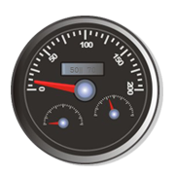
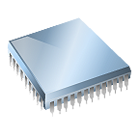
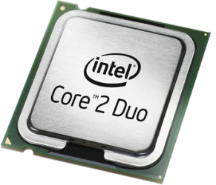
High Speed
Networking
Virtualization
Hardware Inflection Points
Multi-sockets
Solid State Drives

Slide 6
Performance Features

Slide 7
Performance Features
Scalability
Virtualization
Networking
File Server

Slide 8
Native Scalability: History in the making
Windows Server 8 supports up to 640 logical processors (LPs)
Max Logical Processors and Max Memory Support
800
5000
700
640LP
4TB
4500
4000
600
LP count
3500
500
Memory (MB)
3000
400
64LP
2TB
256LP
2TB
2500
300
2000
1500
200
64LP
512 GB
1000
100
8LP
4GB
32LP
64GB
500
0
0
NT 4.0
Windows
Windows
Windows
Win Server
Windows Server 8
(1997)
2000
Server 2003
Server 2008
2008 R2
(2011)
Windows Server Releases

Slide 9
Native Scalability on >256LP
video

Slide 11
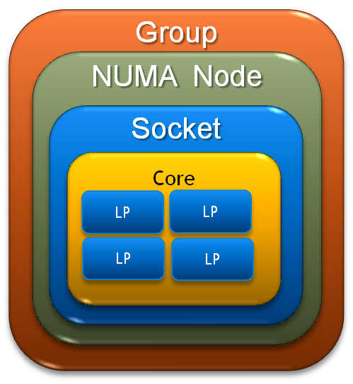
Native Scalability: What you need to know
K-Groups (Kernel Groups)
Processes assigned round-robin to nodes
Threads inherit group affinity
Can be overridden by NUMA aware applications assigning threads to different K-Groups
Most applications not affected
For “legacy” APIs, group is implied
New APIs expose group information
NUMA (Non Uniform Memory Access)
CPUs grouped in nodes with own memory
NUMA nodes are interconnected
Faster to access “near” memory vs. “far” memory
x2APIC
Assign interrupt vectors to more than 255 Logical Processors
MSI-X
Interrupt distribution across logical processors

Slide 12
Driver Scalability: Best Practices
Use the Ex version of an API to be K-Group aware
Consider using queued spinlocks
What’s a spinlock? A spinlock is a locking primitive associate with global data structures that prevents multiple threads from simultaneously modifying important data
Waiting threads “spin” doing nothing waiting for access to the lock
Use 64-bit DMA if hardware supports it
Distribute I/O processing with:
MSI-X
Concurrent channels for HBAs
DPC redirection (e.g. RSS or NUMA I/O)

Slide 13
Application Scalability: Best Practices
Use the Ex version of APIs to see other K-Groups
Can specify node preference on process creation
Set thread affinity to ensure all threads of a process run on same node
Minimize accessing memory from remote nodes
Partition shared data by CPU or NUMA node
Use VirtualAllocExNuma( ) to specify which node for the memory
Use new memory counters to get per node available memory
NUMA Node Memory Utilization\Available Physical Memory MB
NUMA Node Memory Utilization\Free and Zeroed Page List Size MB
NUMA Node Memory Utilization\Standby List Size MB
NUMA Node Memory Utilization\Total Physical Memory MB

Slide 14
Programming for >64 Logical Processors
OR_NUMBER {
typedef struct _PROCESSOR_NUMBER {
USHORT Group;
UCHAR Number;
UCHAR Reserved;
} PROCESSOR_NUMBER, *PPROCESSOR_NUMBER;
GetMaximumProcessorGroupCount(…)
GetMaximumProcessorCount(…)
CreateRemoteThreadEx(…)
VirtualAllocExNuma(…)
GetActiveProcessorGroupCount(…)
GetCurrentProcessorNumberEx(…)
GetLogicalProcessorInformationEx(…)
GetMaxiumProcessorCount(…)
// and many more…

Slide 15
Performance Features
Scalability
Virtualization
Networking
File Server

Slide 16
Virtualization: Scalability
Category | Windows 2008 R2 | Windows Server 8
Max Logical Processors | 64 | 160
Max Active VMs | 384 | 1024
Max Virtual Processors per VM | 4 | 32
Max Virtual Processors per Host | 512 | 1024
Max Memory per VM | 64GB | 512GB
Max Memory (Host) | 1TB | 2TB
Factor
2.5x
~2.6x
8x
2x
8x
2x
Windows Server 8 gives you LARGE VMs!

Slide 17
Scalability for 32VPs in a VM
Demo

Slide 19
Guest Scaling: Virtual NUMA
VP
VP
VM
VP
VP
LP
LP
LP
LP
Cache
Cache
Cache
Cache
Node Interconnect
Memory
Memory
Disk
Disk
Virtual Node A
Virtual Node B
Use NUMA aware APIs to take advantage of topology information surfaced to the guest to optimize scheduling and memory usage for resource locality.

Slide 20
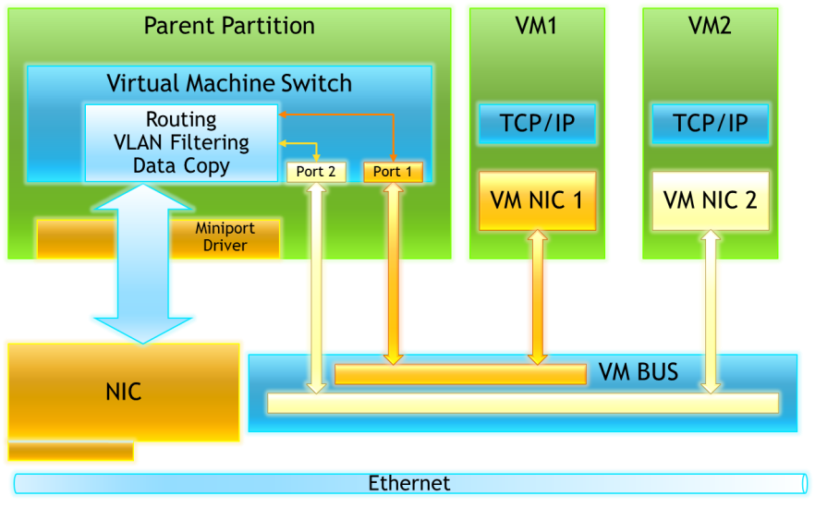
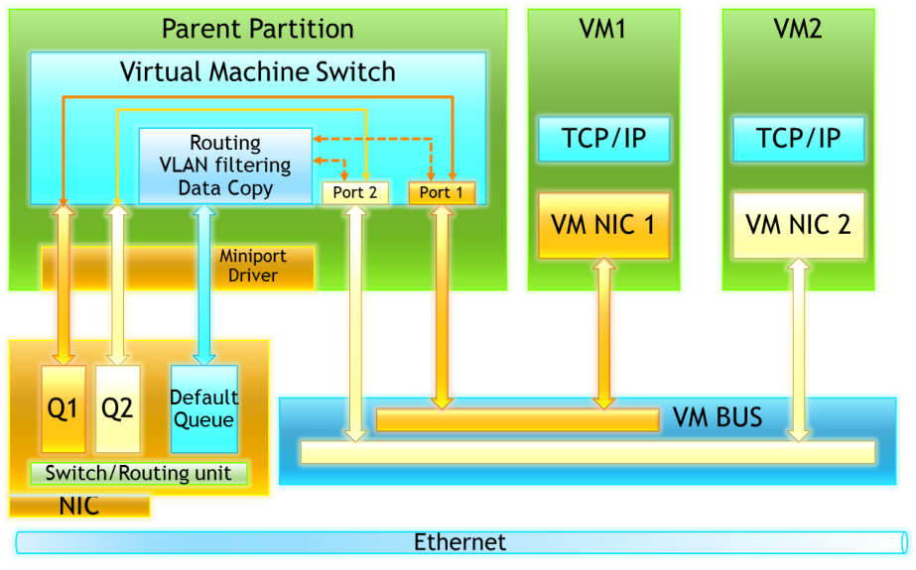
Host Scaling: Dynamic Virtual Machine Queues
Network IO path without VMQ
Network IO path with VMQ
Windows Server 2008 R2: Offloading routing and filtering of network packets to the network card (enabled by hardware-based receive queues) to reduce host overhead
New in Windows Server 8: Dynamically distributing incoming network traffic processing to host processors (based on processor utilization and network load)
LEARN
MORE
Session 437: A Deep Dive into Hyper-V Networking

Slide 21
Performance Features
Scalability
Virtualization
Networking
File Server

Slide 22
Networking: Low Latency Programming
Winsock User Mode
Registered IO (RIO) helps “pin” Application memory which results in:
Access to memory that is “close” to the user thread
Less CPU cycles processing each message
Improved scalability by having dedicated buffers
Predictability with message latency (jitter)
User thread receive queue
buffers
user
R
I
O
kernel
AFD
TCP/IP
NDIS
LEARN
MORE
Session 593: New Techniques to Develop Low Latency Network Apps

Slide 23
Networking: Receive Side Scaling (RSS)
New RSS profiles improve scalability on multi-node servers by distributing TCP/UDP receive traffic across nodes
New Power Shell functionality for Administrators to set things like maximum CPU number for RSS and which K-GROUP an RSS NIC sends traffic to
Administrators can also change profiles based on their workload characteristics. Here is how:
Node 0
Node 1
Node 2
Node 3
queues
0
1
2
3
0
1
2
3
Incoming Packets
NIC with 8 RSS queues
Static
Dynamic
PS C:\cim> Set-NetAdapterRss -?
PS C:\cim> Set-NetAdapterRss InterfaceDescription <String[]> -Profile <UInt32> -Confirm
NUMA aware
Profile 3
(default)
Profile 2
New
Non
NUMA
Profile 0
(like WS08 R2)
Profile 0
(like WS08 R2)
Profile 1
Profile 0
(like WS08 R2)

Slide 24
Networking: More Improvements
Receive Segment Coalescing (RSC)
Similar to Large Segment Offload (LSO) but on the receiver side
Reduces CPU by coalescing multiple inbound packets into a larger buffer
Preliminary data showing up to a 20% reduction in CPU cycles needed for processing networking I/O
RSC: Multiple Inbound Packets
Coalesced to reduce CPU load
LEARN
MORE
Session 433: Network Acceleration and Other NIC Technologies for the Datacenter

Slide 25
Performance Features
Scalability
Virtualization
Networking
File Server

Slide 26
File Server Optimizations
Large I/O
Improved disk efficiency by reducing the number of I/O and seeks
Enabled by default on Windows 8 client systems
Reduced Memory Footprint
Less pre-allocation of data structures
Reduction in non-paged pool usage
Directory Leasing in SMB 2.2
Allows client to cache more information
Longer duration for directory information (10sec to 10min)
Reduced round trips
Helps most over WAN links

Slide 27
Workloads and Results

Slide 28
Hyper-V Host Scaling
1.8x scaling from 40VMs on 80 LPs to 80VMs on 160 LPs with dynamic VMQ
Hardware: 160LPs, 8 NUMA nodes,
10Gigabit NIC, 512GB RAM
Workload: 2VPs/VM mixed Web scenario
Scenarios: Web Hosters
Throughput
80LPs
160LPs
Larger is better

Slide 29
Hyper-V Guest Scaling
1.9x scaling from 8VPs to 16VPs
1.7x scaling from 16VPs to 32VPs
Hardware: 80LPs, 4 NUMA nodes,
10Gigabit NIC, 256GBs RAM
Workload: SQL OLTP
Throughput
8VPs
16VPs
32VPs
Larger is better

Slide 30
Registered IO and UDP Throughput
IOCP
Max Theoretical Rate is 10M with 128Byte Messages
Registered IO (RIO) demonstrates significant improvement over I/O Completion Ports (IOCP) by receiving at several times the traditional rates before the NIC drops packets.

Slide 31
Web Scalability Improvements
Single Process
Multiple Processes (2 and 4)
Hardware: 40LPs, 4 NUMA nodes , 10GigE, 128GB RAM
Workload: mixed Web scenario
Note: Measurements reflect release defaults except as stated.
208%
178%
Throughput
Throughput
71%
58%
Overall Web Server Scalability Improvements
New K-Group awareness in the IIS thread pool
Partitioning network I/O processing by K-Groups when using multiple NICs
RSS NUMA profiles distribute network I/O processing across NUMA nodes

Slide 32
File Server Scalability
Scenario: File Server hosting shares for many users scenarios that include browsing, reading, editing, and deleting files
Windows Server 8 improves scalability by up to 25% compared to WS08R2/Win7 combination
SMB 2.2 requires both Windows 8 Clients and Windows Server 8
Server is disk bound for this case
Up to 40% throughput improvement on a 4-socket system
2-Socket, 12-core
24Gb Memory
10Gbps Network adapter

Slide 33
Storage I/O Performance
Solid State Disks (SSD) offer lower access times, more throughput, and decreased latency, accommodating increased computing demands
In a File Server workload, SSDs provide 150% more throughput than SATA at 7200 RPM
The workload tested has a 50-50 Read/Write ratio
Random I/O
Average I/O size: 195KB
Higher throughput while lower power consumption

Slide 34
New Performance Features
SMB2 Direct
Uses Kernel Mode Direct Memory Access (KRDMA) for transferring data
Increases scalability
Reduces path for network requests
Reduces Power usage
Multi-channel
Multiple TCP connections per SMB session
Enables use of multiple network adapters
Ability to use more RSS Queues
Improves server to server performance by allowing higher network utilization
Load Balancing (LBFO)
Mix and match NICs
Runs in native or virtualized environments
Easy to manage with seamless failover characteristics

Slide 35
Resources
K-Groups
Supporting Systems That Have More Than 64 Processors: http://msdn.microsoft.com/en-us/windows/hardware/gg463349.aspx
Processor Groups: http://msdn.microsoft.com/en-us/library/dd405503%28VS.85%29.aspx
How to manually configure K-Group assignment on multi processor machines: http://support.microsoft.com/kb/2506384
NUMA Documentation
NUMA Support: http://msdn.microsoft.com/en-us/library/aa363804(v=VS.85).aspx
Multiple Processors: http://msdn.microsoft.com/en-us/library/ms684251(v=VS.85).aspx
Server Performance Advisor (SPA)
Updated: 8/11/11
Includes IIS performance section
http://msdn.microsoft.com/en-us/windows/hardware/hh367834/
ETW instrumentation
Expanded and improved
New diagnostic features
http://msdn.microsoft.com/msdnmag/issues/07/04/ETW/default.aspx
Windows Server Performance Blog
Server Performance considerations, articles, tools and information.
http://blogs.technet.com/winserverperformance/
CONTACT: atalat@microsoft.com

Slide 36
Related Sessions
September 14th
SAC-437T: A deep dive into Hyper-V networking
SAC-559T: Extending the Hyper-V switch
SAC-661T: Reduce costs using new power efficiencies in Windows Server 8
September 15th
Designing Systems for Continuous Availability -
SAC-444T: Designing systems for continuous availability - multi-node with remote file storage
SAC-446T: Designing systems for continuous availability and scalability
SAC-450T: Multi-Node with Block Storage
SAC-433T: Network acceleration and other NIC technologies for the data center
September 16th
SAC-593T: New techniques to develop low-latency network apps
SAC-819T: IIS sand-boxing and scalability for hosting on modern hardware
SAC-870T: Building scalable web apps with Windows Azure

Slide 37
Delivering outstanding results on commodity servers for common scenarios Providing applications and drivers with the information they need to scale well on the latest hardware Designed to meet the most demanding virtualization requirements

Slide 38
thank you
Feedback and questions http://forums.dev.windows.com
Session feedback http://bldw.in/SessionFeedback

Slide 39
© 2011 Microsoft Corporation. All rights reserved. Microsoft, Windows, Windows Vista and other product names are or may be registered trademarks and/or trademarks in the U.S. and/or other countries.
The information herein is for informational purposes only and represents the current view of Microsoft Corporation as of the date of this presentation. Because Microsoft must respond to changing market conditions, it should not be interpreted to be a commitment on the part of Microsoft, and Microsoft cannot guarantee the accuracy of any information provided after the date of this presentation. MICROSOFT MAKES NO WARRANTIES, EXPRESS, IMPLIED OR STATUTORY, AS TO THE INFORMATION IN THIS PRESENTATION.

