Slide 1
Building security auditing solutions for compliance and forensic analysis
SAC-425T
Jay Dave
Dave McPherson
Program Manager
Security & Identity
Microsoft Corporation

Slide 2
Target Audience
Developers creating products that consume audit events and help with:
Regulatory compliance reporting
Forensic analysis
User activity tracking
IT Pros who use security auditing in their enterprises
Security enthusiasts interested in learning about security auditing enhancements

Slide 3
Agenda
Introduction to Dynamic access control and audit policies
Opportunities for developers
Partner demos
Deep dive: Extracting data classification information from File Access events
Key takeaways
Understand the enhancements made in security auditing
Understand opportunities to participate in the end-to-end customer story

Slide 4
Dynamic Access Control

Slide 5
Dynamic Access Control in a nutshell
Identify data
Manual tagging by content owners
Automatic classification (tagging)
Control access
Central access policies targeted based on file tags
Expression based access conditions using user claims, device claims and file tags
Audit access
Expression based audit conditions using user claims, device claims and file tags
Protect data
Automatic RMS protection for Office documents based on file tags
Application based tagging
Access denied remediation
Central audit policies that can be applied across multiple file servers
Policy staging audits to simulate policy changes in a real environment
Near real time protection soon after the file is tagged
Extensibility for non Office RMS protectors

Slide 6
Expression-based access control policy
User claims
User.Department = Finance
User.Clearance = High
Device claims
Device.Department = Finance
Device.Managed = True
Resource properties
Resource.Department = Finance
Resource.Impact = High
Central Access Rule
Applies to: @Resource.Impact == High
Allow | Read, Write | if (@User.Clearance == High) AND (@Device.Managed == True)

Slide 7
Key changes for Dynamic Access Control
Policies based on resource properties and user/device claims
Enhanced ACL language to support expressions
User/Device Claims available in user tokens
Central access policies stored in AD

Slide 8
Dynamic Access Control on File Servers
Identify data
Manual tagging by content owners
Automatic classification (tagging)
Control access
Central access policies targeted based on file tags
Expression based access conditions using user claims, device claims and file tags
Audit access
Expression based audit conditions using user claims, device claims and file tags
Protect data
Automatic RMS protection for Office documents based on file tags
Application based tagging
Access denied remediation
Central audit policies that can be applied across multiple file servers
Policy staging audits to simulate policy changes in a real environment
Near real time protection soon after the file is tagged
Extensibility for non Office RMS protectors

Slide 9
Auditing

Slide 10
Audit is trustworthy logging of security-relevant events by a software component responsible for making security decisions

Slide 11
How file access auditing works in Windows?
Policy management app
1
Event monitoring applications
1
Local security authority (LSASS.exe)
User-mode
2
Kernel
File System
Windows logging service (Crimson)
2
Audit policy store
4
5
AccessCheckAndAudit
Object manager
3
Security log

Slide 12
Applications of auditing
Regulatory compliance reporting
Forensic analysis
User activity monitoring
Troubleshooting

Slide 13
Consider this use case…
Someone leaked the IP of your company, you need to investigate the incident and identify the culprit
Event collector
Scope search to certain file servers
Filter events related to leaked data
Identify the culprit
Look for anomalies
Scope based on time

Slide 14
Challenges
Difficult to control volume of audits
Cannot create targeted audit policies centrally
Difficult to get contextual information from audit events

Slide 15
Flexible Audit policies

Slide 16
Our focus for this release
Make it easier to translate intent into policy and further control audit volume
Enable creation and maintenance of targeted audit policies centrally
Get more contextual information from audits events

Slide 17
Flexible Audit policies in action
demo
Create an expression-based audit policy to monitor access to High impact data scattered across multiple file servers

Slide 18
Infrastructure setup
Active Directory
File server
User claims
Clearance = High | Med | Low
Status = Fulltime | Contract
Resource properties
Department = Finance | HR | Engg
Impact = High | Med | Low
Central audit policy for HBI data
Audit | Read, Write | if (@Resource.Impact == High) AND (@User.Status != Fulltime)

Slide 19
Improved File Access reporting with HP ArcSight™
demo
Get to the most relevant audit events quickly

Slide 20
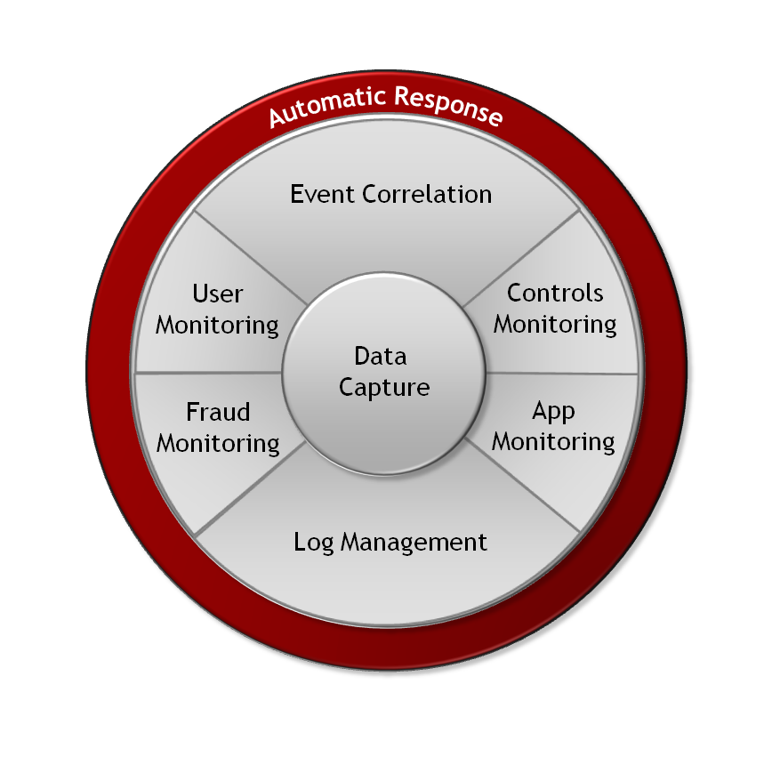
ArcSight SIEM Platform
Security Information and Event Management Platform
A comprehensive platform for monitoring modern threats and risks
Capture any data from any system
Manage and store every event
Analyze events in real time
Identify unusual behavior
Respond quickly to prevent loss
Automatic Response

Slide 21
Scenario: Theft of Confidential Information
1. Alice submits resignation with a 2 week notice
5. The leak is all over news
2. Alice logs in during after hours
Event Logs
4. File access logged – among million other events
3. Alice accesses financial statements (Impact=High)

Slide 22
Deep dive:
Extracting resource properties from file access events

Slide 23
Closer look at file access audit events
Event ID: 4663 – File access event
An attempt was made to access an object. Subject: Security ID: CONTOSODOM\joey Account Name: joey Account Domain: CONTOSODOM Logon ID: 0x3e7 Object: Object Server: Security Object Type: File Handle ID: 0x8e4 Resource Attributes: S:AI(RA;;;;;WD;("Impact_A123B",TS,0x0,"High"))(RA;;;;;WD;(“Department_23AFE",TS,0x0,“Finance"))
Object Name: C:\Finance Document Share\FinancialStatements\MarchStmt.xls

Slide 24
Parsing resource attribute string
S:AI(RA;;;;;WD;("Impact_A123B",TS,0x0,"High"))(RA;;;;;WD;(“Department_23AFE",TS,0x0,“Finance"))
S:AI(RA;;;;;WD;("Impact_A123B",TS,0x0,"High"))(RA;;;;;WD;(“Department_23AFE",TS,0x0,“Finance"))
S:AI(RA;;;;;WD;("Impact_A123B",TS,0x0,"High"))(RA;;;;;WD;(“Department_23AFE",TS,0x0,“Finance"))
Finance
S:AI(RA;;;;;WD;("Impact_A123B",TS,0x0,"High"))(RA;;;;;WD;(“Department_23AFE",TS,0x0,“Finance"))
S:AI(RA;;;;;WD;("Impact_A123B",TS,0x0,"High"))(RA;;;;;WD;(“Department_23AFE",TS,0x0,“Finance"))
Department_23AFE
TS
0x0
Property ID
Property Type
Flag
Property Value

Slide 25
Developer opportunity Security Audit reporting for compliance and forensic analysis

Slide 26
Dynamic Access Control policy change events
Claim dictionary
Users/Devices
CAP/CAR
Classification rule
@Resource.PCI == True
If doc contains pattern (xxx-xx-xxxx)
Resource attribute
Name: Impact Type: Integer
Values: High, Med, Low
Central Access Rule
Name: Access to High impact data
Applies to: @Resource.Impact == “High”
User claim
Name: Clearance Type: String
Values: High, Med, Low
Active Directory
File server
AnnualFinanceReport.docx
@User.Clearance = “High”
@Resource.Impact = “High”
CAP = EnterpriseAccessPolicy
Define user/device claims
Assign claim to users/devices
Define resource attributes
Define Central Access Policies
Define classification rules
Classify data
Assign CAP to data
Access data

Slide 27
Dynamic Access Control
Policy staging

Slide 28
Applying Central Access Policy
Active directory
1
2
3
Define Central Access Rules (CARs)
Define Central Access Policies (CAPs)
Apply CAPs on File Servers
High Impact policy
Applies To: Resource.Impact == High
Access conditions:
User.Clearance = High AND Device.IsManaged = True
Corporate file servers
Standard organization policy
Secrecy Policy
Personal Information Policy
Personal Information
Applies To: Resource.PII == True
Access conditions:
Allow MemberOf( PIIAdministrators )
Finance department policy
Secrecy Policy
Personal Information Policy
Information wall policy
User folders
Finance folders
“Information wall” policy
Applies To: Exists Resource.Department
Access conditions:
User.Department any_of Resource.Department

Slide 29
Policy change risk aversion
Centrally managed policy – across many servers?
What if there’s a mistake in the policy?
How can we be sure?

Slide 30
Access policy staging
Test proposed changes on real data to central access Policies without enforcing it
Each central access rule can have a proposed policy
New audit event and sub-category introduced for staging

Slide 31
Proposed policy
Central Access Policy (CAP)
Name: Enterprise Policy
Central Access Rule (CAR)
Name: HBI Rule
Applies to: @Resource.Impact == High
Current policy
Purpose: HBI data should be accessible by full-time employees only
Condition: Allow | Read, Write | if @User.Status == “Fulltime”
Proposed policy
Purpose: HBI data should be accessible by full-time employees with High security clearance
Condition: Allow | Read,Write | if @User.Status == “Fulltime” AND @User.Clearance == “High”

Slide 32
Sample staging event (4818)
Proposed Central Access Policy does not grant the same access permissions as the current Central Access Policy Subject: Security ID: CONTOSODOM\alice Account Name: alice Account Domain: CONTOSODOM Object: Object Server: Security Object Type: File Object Name: C:\FileShare\Finance\FinanceReports\FinanceReport.xls Current Central Access Policy results: Access Reasons: READ_CONTROL: Granted by Ownership ReadAttributes: Granted by D:(A;ID;FA;;;BA) Proposed Central Access Policy results that differ from the current Central Access Policy results: Access Reasons: READ_CONTROL: NOT Granted by CAR “HBI Rule” ReadAttributes: NOT Granted by CAR “HBI Rule”

Slide 33
Developer opportunity
Reporting and analysis of central access policy staging events

Slide 34
Secure Vantage™ Access policy staging report
sample
Analyzing staging events generated by proposed access policy change

Slide 35
About Secure Vantage Technologies
Founded in 2005, headquartered in Houston, TX
300+ customers globally
40+ partners
Founding Member – System Center Alliance
Software Solution Provider, Microsoft Technology Centers
Focus: IT GRC
Key differentiators
Fast and simplified security monitoring & audit compliance reporting
Extends Microsoft System Center

Slide 36
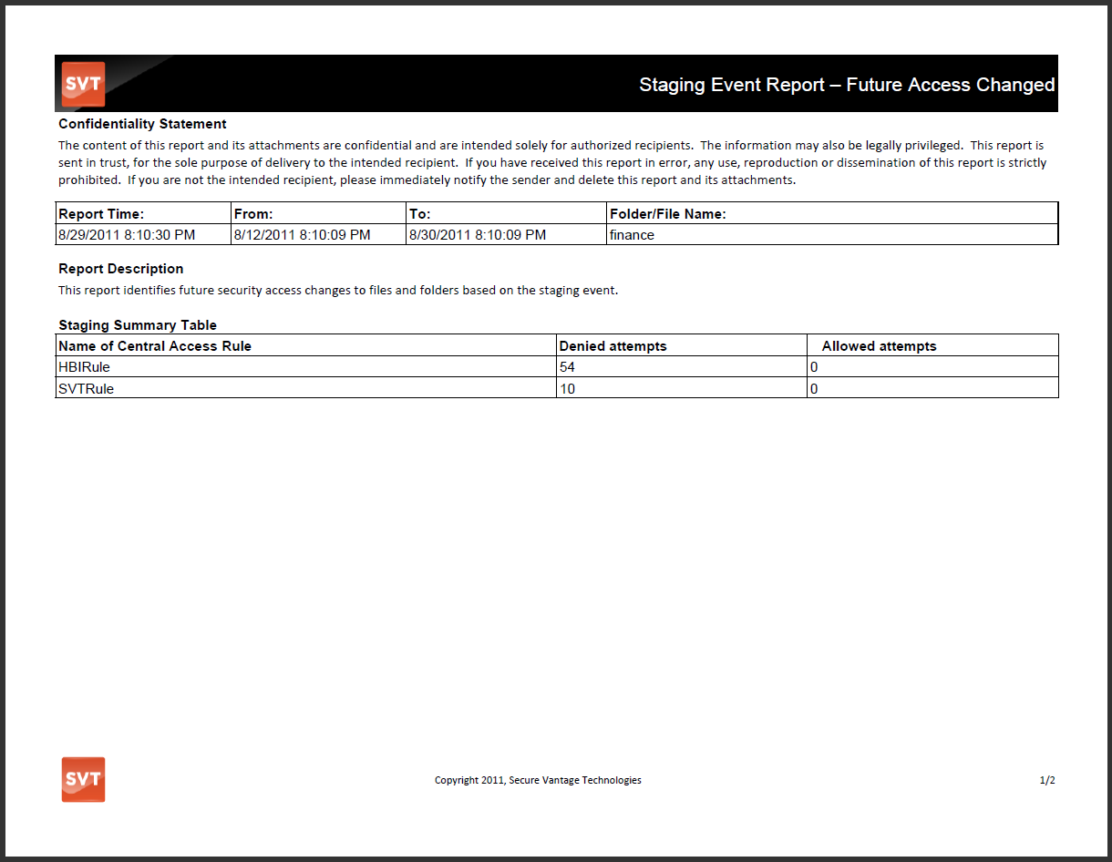

Slide 37
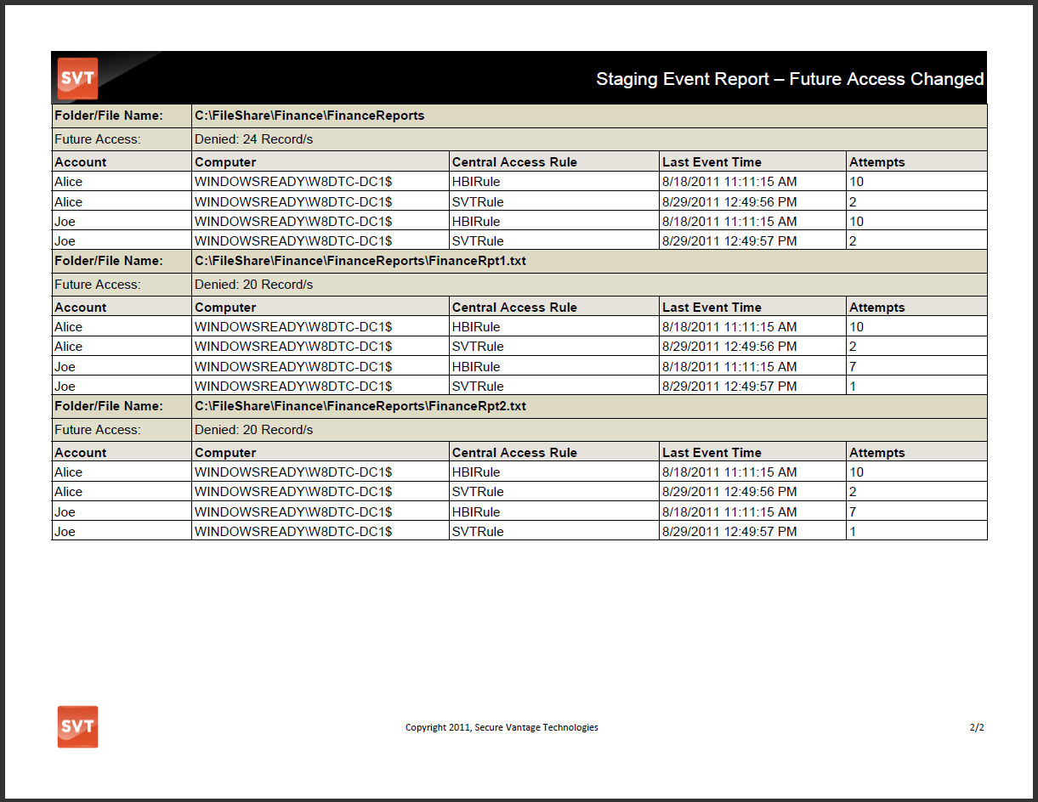

Slide 38
In conclusion…

Slide 39
Expression-based audit policies make it easier to create targeted audit policies; help reduce audit volume; can be managed centrally

Slide 40
Central access policy staging makes it possible to test the effect of your policy change before enforcing it

Slide 41
Dynamic access control provides developers opportunities to innovate and create rich reporting and analysis applications

Slide 42
For more information
RELATED SESSIONS
SAC-422T – Using claims-based access control for compliance and information governance
SAC-426T – Using classification for access control and compliance
SAC-858T – Identity and access management for Windows Azure apps

Slide 43
Thank you!

Slide 44
thank you
Feedback and questions http://forums.dev.windows.com
Session feedback http://bldw.in/SessionFeedback

Slide 45
© 2011 Microsoft Corporation. All rights reserved. Microsoft, Windows, Windows Vista and other product names are or may be registered trademarks and/or trademarks in the U.S. and/or other countries.
The information herein is for informational purposes only and represents the current view of Microsoft Corporation as of the date of this presentation. Because Microsoft must respond to changing market conditions, it should not be interpreted to be a commitment on the part of Microsoft, and Microsoft cannot guarantee the accuracy of any information provided after the date of this presentation. MICROSOFT MAKES NO WARRANTIES, EXPRESS, IMPLIED OR STATUTORY, AS TO THE INFORMATION IN THIS PRESENTATION.

