Slide 1
Designing systems for continuous availability and scalability
SAC-446T
Jim Pinkerton
Architect
Microsoft Corporation
Mallikarjun Chadalapaka
Senior Program Manager
Microsoft Corporation
Surendra Verma
Development Manager
Microsoft Corporation

Slide 2
Agenda
OEMs
System Integrators
Network IHVs
Storage ISVs
Storage IHVs
Server Application Developers
Define the “Continuously Available Platform”
Network Fault Tolerance and Scaling
NIC Teaming
File Access Related Scalability
NTFS enhancements for availability
Cost-effective business critical storage solutions
Storage Spaces
An Understanding of the Continuously Available Platform hardware and software features
Windows 8 Enables Partners To Deliver Differentiated, Continuously Available, Scalable, Cost-Effective Storage Solutions
Pointers to other talks for more detail
WHO WILL BENEFIT FROM THIS TALK
TOPICS
WHAT YOU’LL LEAVE WITH

Slide 3
Starting with the Basics
Goal: Enable industry standard servers to be continuously available
Secondary Goal: improve industry standard servers for better scale and failover time for continuously available services
Continuously available software and hardware platforms are designed to support transparent failover without data loss
Transparent failover is the ability to survive planned moves or unplanned failures – without errors visible to the user, without losing data, and while performing well at scale

Slide 4
What is a Continuously Available Platform?
Single Node
Scale-Out
Single Node
Single Node
HBA
Preferred Deployment:
Multiple HBAs for fault tolerance and scale
Choice of External Storage Array or External JBOD
HBA
NIC
NIC
Preferred Deployment:
Multiple NICs for fault tolerance and scale
RDMA NICs for cluster interconnect and File Server deployments
HBA
NIC
Preferred Deployment:
Clustered with at least 2 nodes for fault tolerance
RDMA NICs for Cluster Interconnect

Slide 5
Continuously Available Platforms
Capability | Single Node | Multi-Node
Redundant storage, storage serviceable with system running | ✓ | ✓
Multiple network connections with transparent failover | ✓* | ✓*
Multiple storage connections with transparent failover | ✓* | ✓*
Shared data storage accessible from all nodes |  | ✓
Transparent failover between nodes without data loss |  | ✓
Redundant hardware components, serviceable with system running | ✓* | ✓*
*for price points that allow it

Slide 6
Windows Server 8 E-to-E Storage Features, with File Server
Scalable Cluster Management
Multi-Machine Management
PowerShell based management
Standards based management
Easy Deployment
Scalable Cluster Interconnect
Ethernet (RDMA opt.)
InfiniBand (RDMA)
Node N
Node 2
Node N
Internet &
Data Center
Node 1
Hyper-V
Shared JBOD
Node 2
Node 1
VM
Platform Storage
Data Management
Clustering
Mgmt OS
File Server & NetworkingStack
VM
HBA
NIC
NIC
VSwitch
External Storage Arrays
HBA
NIC
NIC
VM
VMBus
Local I/O
VM
Local I/O Access
File Server & Networking Stack
For Shared JBOD Storage Devices
Logo program for Storage Spaces-compatible hardware
Validation program for Clustered RAID Controllers
For External Storage Arrays
Optional Logo Req. for Thin Provisioning (Trim/Unmap) & Offloaded Data Transfer (ODX)
Platform Storage
File System (NTFS)
64 TB Volumes
Online Repair
ODX, Trim
Deduplication
Integrity on SATA
Storage Mgmt.
Native VHD mnt GUI
Unified Storage Man. API, SMI-S
Virtualized Storage (Storage Spaces)
Thin Provisioning,
Resiliency, scale
Pools
Data Mgmt.
Continuous and manual classification
Central access and audit control
Automatic RMS protection
Access Denied Remediation
Clustering
Cluster Aware Updates
Fast failover
Distributed NetNames
Intelligent VM placement & priority
Bitlocker support
Cluster Shared Volumes v2
Single namespace
Windows Caching integration
Transparent repair
Spaces Integration
Remote Storage Access
Network & Server transparent failover
Active-Active
SMB2 Direct /RDMA
SMB2 Multichannel
VSS for SMB2 File Share
Heterogeneous Access
NFSv3, NFSv4.1, iSCSI
Branch - Directory Leases
Branch - Folder Redirection “always offline” w/ sync
Support for ODX , Trim, BranchCachev2
FS Admin Console
Networking
NIC Teaming
Better SLA enforcement (DCB, QOS)
Network Virtualization
Hyper-V Extensible Switch
SRIOV to guest
BranchCachev2
Network Device Capabilities
RDMA
RSC
GRE
DCB
InfiniBand
Dynamic VMQ
IPsec Task Offload support from VMs
Hyper-V
Remote File Server VHDs
Online Storage Migration
Guest Clustering for Fibre Channel with Synthetic FC
Integrated with ODX, Trim, cluster client failover
DR – Hyper-V Replica
New VHD format (VHDX)
Remote I/O
Too much for one talk!
Local I/O

Slide 7
What We’ve Covered So Far …
Business and Partnering Opportunities: “Windows Server 8” Continuous Availability ✓
Session 443
Platform Storage Evolved ✓
Designing Systems for Continuous Availability – Multi-node with Block Storage
Building Continuously Available Systems with Hyper-V
Session 474
Session 450
Session 451
Designing Systems for Continuous Availability and Scalability
Designing Systems for Continuous Availability – Multi-node with Remote File Storage
Building Continuously Available File Server NAS Appliances
Session 446
Session 444
Session 449

Slide 8
Windows Server 8 Continuously Available Platform: New Device Capabilities
Node N
Scale-Out
Shared JBOD
Node 2
Node 1
Hyper-V
Platform Storage
Data Management
Clustering
VM
Mgmt OS
VM
External Storage Arrays
HBA
VMBus
HBA
VSwitch
VM
VM
Storage Devices
New virtualized storage: Spaces
New external storage choice: Shared JBOD
New type of HBA: Clustered RAID Controller
New capabilities for External Storage Arrays:
Offloaded data transfer, Trim, TP Notifications
Network Devices for Converged Networks
New Network Fabric Support
InfiniBand (IB) support, with inbox program
New Network Device Capabilities
Multiple forms of new offloads, virtualization
Used for cluster interconnect & for File Server
LEARN
MORE
[433,437] “Windows Server 8” Networking

Slide 9
“Windows Server 8” Continuously Available Platform with File Server
Node N
Scale-Out
Node 2
Node N
Scale-Out
Node 1
Hyper-V
Shared JBOD
Node 2
Node 1
VM
Platform Storage
Data Management
Clustering
Mgmt OS
File Server & NetworkingStack
VM
HBA
NIC
NIC
VSwitch
External Storage Arrays
NIC
NIC
HBA
VM
VMBus
VM
Storage Devices
New virtualized storage: Spaces
New external storage choice: Shared JBOD
New type of HBA: Clustered RAID Controller
New capabilities for External Storage Arrays:
Offloaded data transfer, Trim, TP Notifications
Network Devices for Converged Networks
New Network Fabric Support
InfiniBand (IB) support, with inbox program
New Network Device Capabilities
Multiple forms of new offloads, virtualization
Used for cluster interconnect & for File Server
LEARN
MORE
[433,437] “Windows Server 8” Networking

Slide 10
Network Fault Tolerance and Scale
NIC Teaming (LBFO)
File Access Related Scalability
SMB 2.2 Multichannel
SMB 2.2 RDMA

Slide 11
Network Interface Card (NIC) Teaming
Hyper-V Extensible Switch
Built into Windows Server 8
Transparent Failover
Link-by-link failure detection (w/ switch support) causes transparent failover
Throughput
Active-active or active-passive load balancing
A single TCP connection will go on a single NIC
LBFO Admin GUI
LBFO Provider
Frame distribution/aggregation
Failure detection
Control protocol implementation
WMI
LBFO Configuration DLL
IOCTL
Virtual miniport 1
Port 1
Port 2
Port 3
IM Mux
Protocol edge
User mode
Kernel mode
NIC 1
NIC 2
NIC 3
Network switch
LEARN
MORE
[433] Acceleration & Other NIC Technologies for the Data Center

Slide 12
SMB 2.2 Multichannel
Multiple TCP streams for one SMB 2.2 session
Single NIC – with RSS enables more CPUs to process traffic
Multiple NICs, with NIC Teaming – SMB 2.2 can use a single IP address per team
Multiple NICs, Without NIC Teaming – each NIC must have a unique IP addresses (Required for RDMA NICs)
Failover
SMB 2.2 Multichannel implements end-to-end failure detection
Fully leverages NIC teaming failover but does not require it
Throughput
Bandwidth aggregation with multiple NICs
Multiple CPUs to process network interrupts with single RSS-capable NIC or multiple NICs
Automatic Configuration
SMB 2.2 detects and uses multiple network paths
Sample Configurations
Multiple 1GbE NICs
Multiple 10GbE or InfiniBand
SMB 2.2 Client
SMB 2.2 Client
NIC
1GbE
NIC
1GbE
NIC
10GbE/IB
NIC
10GbE/IB
Switch
1GbE
Switch
1GbE
Switch
10GbE/IB
Switch
10GbE/IB
SMB 2.2 Server
SMB 2.2 Server
NIC
1GbE
NIC
1GbE
NIC
10GbE/IB
NIC
10GbE/IB

Slide 13
SMB 2.2 Multichannel Performance
Preliminary data shows linear bandwidth scaling for up to 4 interfaces
1 – 1150 MB/sec
2 – 2330 MB/sec
3 – 3320 MB/sec
4 – 4300 MB/sec
Receive Side Scaling support in the NIC is critical
BW at small I/Os is bottlenecked on CPU
Data is all the way to persistent storage
//BUILD whitepaper provides full details
http://go.microsoft.com/fwlink/p/?LinkId=227841

Slide 14
Scaling Network Traffic
New Network offloads that improve scalability
Receive Side Coalescing (RSC), IPsec Task Offload support from VMs
New network features for Virt. w/ Continuous Availability
GRE, Dynamic VMQ
What is left to solve?
CPU Utilization and throughput concerns
Large I/Os – CPU utilization at high data rates (throughput is great)
Small I/Os – CPU utilization and network throughput at high data rates
Solution: Remote Direct Memory Access (RDMA)
LEARN
MORE
[437] A Deep Dive into Hyper-V Networking

Slide 15
SMB2 Direct (SMB2 over RDMA)
RDMA is “Remote Direct Memory Access” – a secure way to enable a DMA engine to transfer buffers between two machines across the network
Used by File Server and Clustered Shared Volumes (CSV version 2) for storage communication within a cluster
Advantages
Scalable, fast and efficient storage access
Minimal CPU utilization for I/O processing
High throughput with low latency
Required hardware
RDMA-capable network interface (R-NIC)
Can leverage SMB2 Multichannel for load balancing and failover
SMB 2.2 Client
SMB 2.2 Server
Application
User
Kernel
SMB 2.2 Client
SMB 2.2 Server
Network w/ RDMA support
Network w/ RDMA support
NTFS SCSI
R-NIC
R-NIC
Disk

Slide 16
SMB 2.2 Direct Performance
Windows Server 8 supports all standards based RDMA networks
Ethernet based protocols
iWARP – RDMA on top of TCP/IP
IETF standard over TCP/IP – http://www.ietf.org
Only routable RDMA protocol
ROCE (RDMA Over Converged Ethernet) - InfiniBand protocols on Ethernet
IBTA standard – http://infinibandta.org
Requires switches to support Data Center Bridging (DCB)
InfiniBand based protocols
InfiniBand protocols on an InfiniBand network (32 gbits/sec, 56 gbits/sec…)
InfiniBand Preliminary 512 KB I/O Results:
Client: ~20% of 4 cores, or 80% of one core
3100 MBytes/sec
Bandwidth
CPU
Server: ~12% of 12 cores, or 140% of one core
Bandwidth
CPU
LEARN
MORE
[433] Acceleration & Other NIC Technologies for the Data Center

Slide 17
NTFS enhancements for availability
Improved NTFS integrity with industry standard storage
Maximized file system availability

Slide 18
Improved NTFS Integrity Usage of flush v/s force-unit-access
NTFS will flush disk cache to ensure ordered writes
Reduces possibility of corruption on power loss
Allows the disk to cache data for as long as safely possible
Delivers better reliability on industry standard SATA storage

Slide 19
Maximized File System Availability NTFS – Online scan and repair
Confidently deploy 64TB NTFS volumes with Windows 8
Prioritized volume availability for service uptime
Online repair
Online scan & corruption logging
Minimal downtime
Scheduled repair
Downtime proportional only to # logged corruptions
Failover Clustering & CSV integration
Better manageability
File system health via Action Center, PowerShell, Server Manager

Slide 20
Maximized File System Availability Online scan & repair: execution flow
Detect Corruption
NTFS detects a perceived anomaly in file system metadata
Online Verification
NTFS will validate whether issue is transient or genuine – volume remains online
If not transient, NTFS will attempt to rapidly self-heal – volume remains online
Online Self-Healing
Identify & Log
If not self-healed, NTFS will identify and log corrective actions
Precise & Rapid Correction
At the next maintenance window, volume can be taken offline and logged corruptions are corrected in seconds
For virtualized deployments on CSV, VM I/O is transparently paused for rapid correction and subsequently automatically resumed.
Administrator will be notified
Volume continues to remain online.

Slide 21
Maximized File System Availability An illustrative example
Volume downtime to handle one corruption
Minutes
In this benchmark, “Windows Server 8”
execution time <8 seconds

Slide 22
The New CHKDSK - Enabling Continuous Availability
demo

Slide 23
Cost-effective Business Critical Storage – Storage Spaces

Slide 24
Windows 8 is the most cost-effective platform for continuously available and highly scalable data access

Slide 25
Cost-Effective Business Critical Storage Storage Spaces
Powerful new platform abstractions
Storage Pools – Units of Aggregation, Administration & Isolation
Storage Spaces (virtual disks): Resiliency, Provisioning & Performance
Target design point
Industry standard interconnects: SATA or (Shared) SAS
Industry standard storage: JBODs
Storage Spaces enable partners to deliver a new category of highly capable storage solutions to all Windows customer segments at dramatically lower price-points & maximized operational simplicity

Slide 26
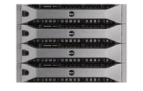
Storage Spaces Physical Deployment Topologies
Direct-Attached
Shared – Availability & Scale
SATA or SAS
Shared SAS
OR

Slide 27
Storage Spaces - Ease Of Provisioning
demo

Slide 28
Storage Spaces Capabilities
Optimized storage utilization
Resiliency & application-driven error correction
High-availability & scale-out with Failover Clustering & Cluster Shared Volumes
Operational simplicity
Delegated administration & isolation for multi-tenant deployments
Workload optimized performance via heterogeneous media support

Slide 29
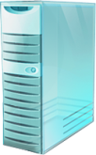
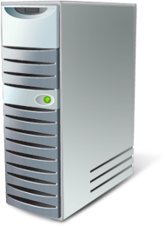
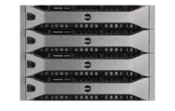
Storage Spaces Optimized & flexible utilization
VM
Hyper-V
On-demand provisioning with trim support
For use by NTFS, Hyper-V, and other applications e.g. SQL
Elastic capacity expansion
Simply add more physical drives
NTFS
Filters
Thinly-provisioned Spaces contained within Pools
64TB
Space
64TB
Space
64TB
Space
20TB
Pool
64TB
Space
64TB
Space
64TB
Space
20TB
Pool
Company A Pool
Company B Pool
Industry standard physical storage
Storage Space
40 TB physical storage
Contoso Hosting Company

Slide 30
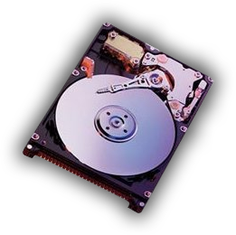
Storage Spaces Resiliency & error correction
Redundant storage
Mirrored Spaces and Parity Spaces with integrated journaling
Rapid Recovery – per pool hot spare support
Application driven intelligent error correction
Resilient Spaces contained within a Pool
Mirrored
Space
Parity
Space
Mirrored
Space
Mirrored
Space
Parity
Space
Mirrored
Space
Mirrored
Space
Parity
Space
Industry standard physical storage
Hot Spare

Slide 31
Storage Spaces - Resiliency
demo

Slide 32
Intelligent Error Correction – Mark Handle
// Change the handle info to read from a copy
MARK_HANDLE_INFO HandleInfo;
ZeroMemory( &HandleInfo, sizeof(MARK_HANDLE_INFO) );
HandleInfo.HandleInfo = MARK_HANDLE_READ_COPY;
HandleInfo.CopyNumber = 1; /* or 0, 1, ... */
Success = DeviceIoControl(NonCachedFileHandle, FSCTL_MARK_HANDLE, &HandleInfo,
sizeof(MARK_HANDLE_INFO), NULL, 0, NULL);
// Normal read file call
Success = ReadFile( NonCachedFileHandle, Buffer, BytesToRead, &BytesRead, Overlapped);

Slide 33
Intelligent Error Correction – Perform Repair
// Repair call
union {
REPAIR_COPIES_INPUT RepairInput;
UCHAR RepairInputBuffer[FIELD_OFFSET(REPAIR_COPIES_INPUT, RepairCopies) + sizeof(ULONG) * 2];
};
REPAIR_COPIES_OUTPUT RepairOutput;
ZeroMemory( &RepairInput, sizeof(RepairInputBuffer) );
RepairInput.Flags = 0;
RepairInput.FileOffset = 0x1000;
RepairInput.Length = 0x4000;
RepairInput.SourceCopy = 1;
RepairInput.NumberOfRepairCopies = 2;
RepairInput.RepairCopies[0] = 0;
RepairInput.RepairCopies[1] = 2;
Success = DeviceIoControl(FileHandle, FSCTL_REPAIR_COPIES, &RepairInput,
sizeof(RepairInputBuffer), &RepairOutput,
sizeof(REPAIR_COPIES_OUTPUT), NULL);

Slide 34
Storage Spaces Operational simplicity
Managed via Windows Storage Management API
Flexible & granular administrative control with self-service agility & tenant isolation
Granular Access Control
Workload Admin
Space
Space
Tenant Admin
Workload Admin
Space
Space
Tenant Admin
Company A Pool
Company B Pool
Multi-tenant deployment
Contoso Hosting Company
Hoster Admin

Slide 35
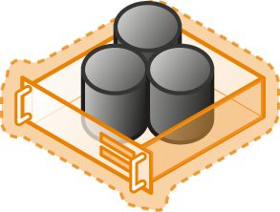
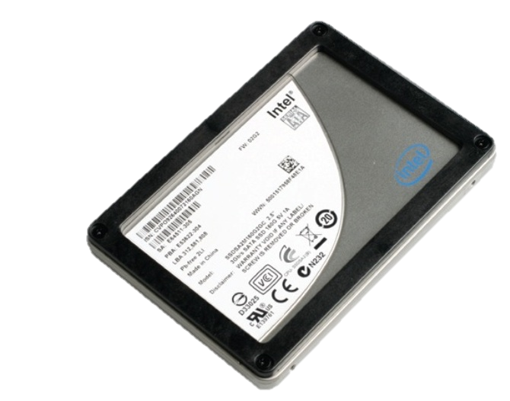
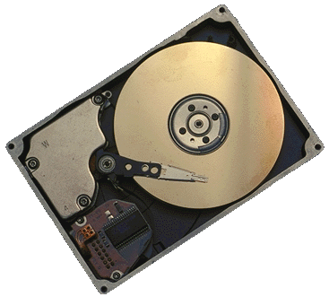
Storage Spaces Effectively utilize hardware investment
Supports deployment requirements
Utilize both SSD and HDD media types
Control placement at Space granularity
Gold
Finance
Silver
Home Directories
Bronze
Archive
Thinly-provisioned Spaces contained within a Pool
Finance
Finance
Home Dir
Backup
Archive
Space
Space
Space
Space
Industry standard physical storage
Solid-state drives
15K RPM HDDs
Near-line HDDs

Slide 36
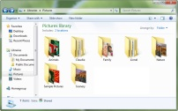
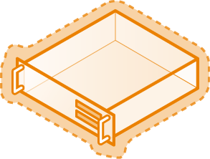
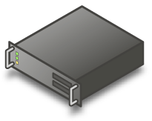
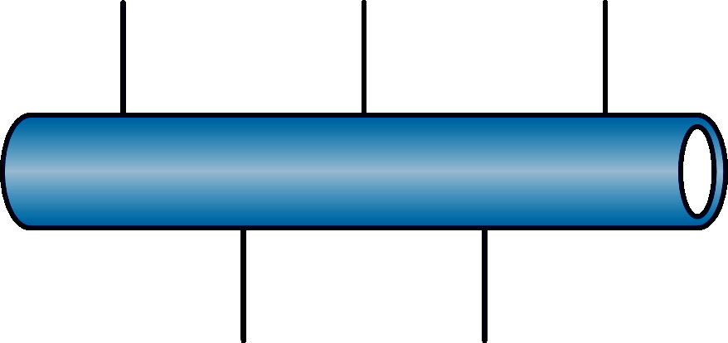
Clustered Storage Spaces Scalable & continuously available workload deployments
VMs
Logical View
.\db
.\VHDs
.\Home
Enterprise Workload
Enterprise Workload
Continuously available file server
Unified Cluster Shared Volume namespace
.\Finance
.\CRM
.\File-Shares
Clustered Pools & Spaces
64TB
Space
64TB
Space
64TB
Space
64TB
Space
64TB
Space
64TB
Space
64TB
Space
64TB
Space
64TB
Space
64TB
Space
64TB
Space
64TB
Space
64TB
Space
64TB
Space
64TB
Space
…
…
4x Blades
Physical View
Storage
Deployable elements

Slide 37
Summary
Partners opportunity to build new options for reliable storage
ODM, SI, & OEM opportunity to deliver new cost-effective solutions
Application developer opportunity to optimize and manage storage
IHV opportunity to deliver against new storage capabilities – follow certification requirements. For additional information contact:
sfsquestions@microsoft.com for storage platform questions
AskWinCAHW@microsoft.com for Validation Program for Clustered RAID Controllers
Design systems for continuous availability and scalability
Lowest Cost Systems, use clustering with redundant hardware optional except for shared storage with data redundancy
Scalable Systems, use clustering, multiple NICs, multiple storage controllers, and redundant storage for improved SLA and better scalability

Slide 38
For more information
RELATED SESSIONS
Continuously Available Platform Talks
LEARN
MORE
SAC-443T – Business and partnering opportunities: Windows Server 8 continuous availability
SAC-474T – Platform storage evolved
SAC-446T – Designing systems for continuous availability and scalability
SAC-450T – Designing systems for continuous availability - multi-node with block storage – multi-node with block storage
SAC-444T – Designing systems for continuous availability - multi-node with remote file storage - multi-node with remote file storage
SAC-451T – Building continuously available systems with Hyper-V
SAC-449T – Building continuously available file server NAS appliances
Related Windows Server 8 Talks
LEARN
MORE
SAC-430T – Designing the building blocks for a Windows Server 8 cloud
SAC-433T – Network acceleration and other NIC technologies for the data center
SAC-437T – A deep dive into Hyper-V networking
SAC-439T – Enabling multi-tenancy and converged fabric for the cloud using QoS

Slide 39
thank you
Feedback and Questions: http://forums.dev.windows.com
Session Feedback: http://bldw.in/SessionFeedback

Slide 40
© 2011 Microsoft Corporation. All rights reserved. Microsoft, Windows, Windows Vista and other product names are or may be registered trademarks and/or trademarks in the U.S. and/or other countries.
The information herein is for informational purposes only and represents the current view of Microsoft Corporation as of the date of this presentation. Because Microsoft must respond to changing market conditions, it should not be interpreted to be a commitment on the part of Microsoft, and Microsoft cannot guarantee the accuracy of any information provided after the date of this presentation. MICROSOFT MAKES NO WARRANTIES, EXPRESS, IMPLIED OR STATUTORY, AS TO THE INFORMATION IN THIS PRESENTATION.

