Slide 1
Building continuously available file server NAS appliances
SAC-449T
Gene Chellis
Director of Program Management
Cristian Teodorescu
Development Manager
Microsoft Corporation

Slide 2
Welcome
System designers
System integrators
OEMs
ODMs
File server solution developers
Network IHVs
Storage ISVs
Storage IHVs
Summary of new Windows File Server capabilities
NAS role and requirements
Designing for continuously available storage appliances
Simplified out-of-box experience (OOBE) for Windows clustering
Customizing and extending the clustering OOBE
Understand what’s new for Windows File Server
Understand considerations for building Windows NAS appliances
Understand how to build a customized NAS experience
WHO WILL BENEFIT FROM THIS TALK
TOPICS
WHAT YOU’LL LEAVE WITH

Slide 3
What We’ve Covered So Far …
Business and Partnering Opportunities:
“Windows Server 8” Continuous Availability ✓
Session 443
Platform Storage Evolved ✓
Designing Systems for Continuous Availability – Multi-node with Block Storage ✓
Building Continuously Available Systems
with Hyper-V ✓
Session 474
Session 450
Session 451
Designing Systems for Continuous Availability and Scalability ✓
Designing systems for Continuous Availability – Multi-node with Remote File Storage ✓
Building Continuously Available File Server NAS Appliances
Session 446
Session 444
Session 449

Slide 4
Recap of What’s New in Windows File Server
Reliable, efficient storage for clients and server applications
Platform storage
  Improved NTFS integrity on SATA
  NTFS online scan and repair – 64TB volumes
  Windows virtualized storage (Storage Spaces)
  Storage management with SMI-S support
  Thin provisioning notifications
  Data deduplication
Continuously available file server
  Fast, transparent failover
  SMB multichannel network teaming
  SMBDirect (RDMA)
Directory oplocks
Remote VSS backup
Advanced networking
  Load balancing and failover
  Datacenter bridging (DCB)
Flexible file access control
  Claims-based authorization
  Access-denied remediation
  Integrated reporting and auditing
File server management
  Full PowerShell manageability
  Consolidated multi-server file server admin UI
  Cluster-aware updating
LEARN
MORE
See related sessions listed at end

Slide 5
Why NAS Appliances?
Customer preference
Simplified deployment
Supports virtualization
and private cloud
Storage-optimized hardware
Sources: Gartner, IDC and Microsoft marketing research

Slide 6
Continuously available software and hardware platforms are designed to support transparent failover without data loss.

Slide 7
From File Server to NAS Appliance
Key requirements
Multi-protocol access (unified storage)
  Support heterogeneous environments (Windows, Unix and block)
  Support multiple workloads (client and server)
Hardware engineering
  Design for end-to-end storage performance
  Design for continuous availability
Appliance experience
  Integrated software, hardware, packaging
  Simplified setup, configuration and management

Slide 8
heterogeneous
iSCSI target continuous availability
NFS v3 server continuous availability
NFS 4.1 server
New for unified storage on Windows Server

Slide 9
Designing for E-to-E Storage Performance
Balancing performance end-to-end
 | NIC | PCIe | SAS | Disks | RAM
#1* | 2 x 1GbE | x4 PCIe 2.0 | 4 x 6Gb | 12 x 7200k | 8-16 GB
GB/s: | 0.23 | 1.7 | 2.3 | 1.5
#2* | 2 x 10GbE | x4 PCIe 2.0 | 8 x 6Gb | 24 x 7200k | 32-48 GB
GB/s: | 2.3 | 1.7 | 4.7 | 3.0
#3* | 2 x 32Gb IB | x8 PCIe 3.0 | 16 x 6Gb | 24 x 6Gb SSD | 48-96 GB
GB/s: | 8.0 | 6.8 | 9.3 | 12.0
*example components (per system);
these are illustrations only,
not recommendations
Identify and avoid bottlenecks
Balance for IOPs as well as bandwidth
Requirements also vary by workload

Slide 10
Transparent failover is the ability to survive planned moves or unplanned failures – without errors visible to the user, without losing data, and while performing well at scale

Slide 11
Designing Continuously Available Platforms
Surviving a range of failures and downtime events
Capability | Single Node | Multi-Node
Redundant storage, serviceable with system running |  | 
Multiple network connections with transparent failover |  | 
Multiple storage connections with transparent failover |  | 
Shared data storage accessible from all nodes |  | 
Transparent failover between nodes without data loss |  | 
Redundant hardware components, serviceable with system running |  | 
 Critical to continuous availability
 Use where price points allow
LEARN
MORE
446: Designing Systems for Continuous Availability and Scalability

Slide 12
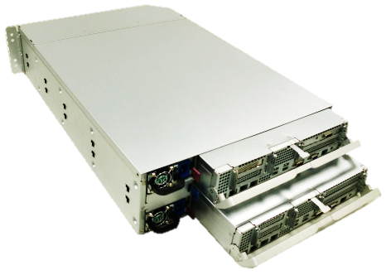
Delivering the Appliance Experience
The Importance of Packaging
Pre-packaged, pre-connected, reliable
  Multiple server nodes
  All nodes connected to storage
  (dual-ported disks or coherent cache)
  Avoid single points of failure
Wistron prototype
See examples in Expo and BitBar areas
LEARN
MORE
443: Business and Partnering Opportunities:
“Windows Server 8” Continuous Availability

Slide 13
Cluster-in-a-Box Design Considerations
10G E or Infiniband
10G E or Infiniband
At least one node and storage always available, despite failure or replacement of any component
Dual power domains
Internal interconnect between nodes, controllers
Flexible PCIe slot for LAN options
External SAS ports for JBOD expansion
Office-level power and acoustics for entry-level NAS
Network
Network
Server Enclosure
x8 PCIe
x8 PCIe
Server A
Server B
CPU
1/10G Ethernet cluster connect
CPU
x8 PCIe
x8 PCIe
Storage Controller
x4 SAS through midplane
Storage Controller
x4 SAS
x4 SAS through midplane
x4 SAS
SAS Expander
0
1
23
B ports
SAS Expander
A ports
…
External JBOD
SAS Expander
0
1
23
B ports
SAS Expander
A ports
…
Additional JBODs …

Slide 14
Out-of-Box Experience (OOBE)
for NAS Appliances
Cristian Teodorescu
Development Manager
Windows File Server

Slide 15
OOBE Vision
Fast, simple setup of clustered NAS appliance, using a single console, and extensible by OEMs
Requirements
Fast: Approximately 15 minutes from power-on to file sharing
Simple: Minimal set of setup steps with guided workflow
Single console: Single-pane-of-glass to configure appliance from only one node
Extensible: Customization framework to enable unique needs of appliance

Slide 16

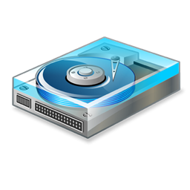
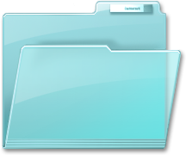
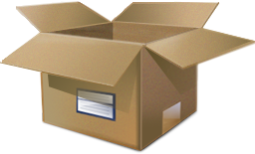
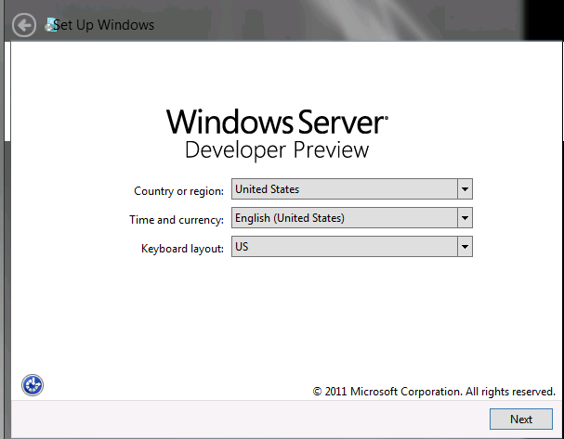
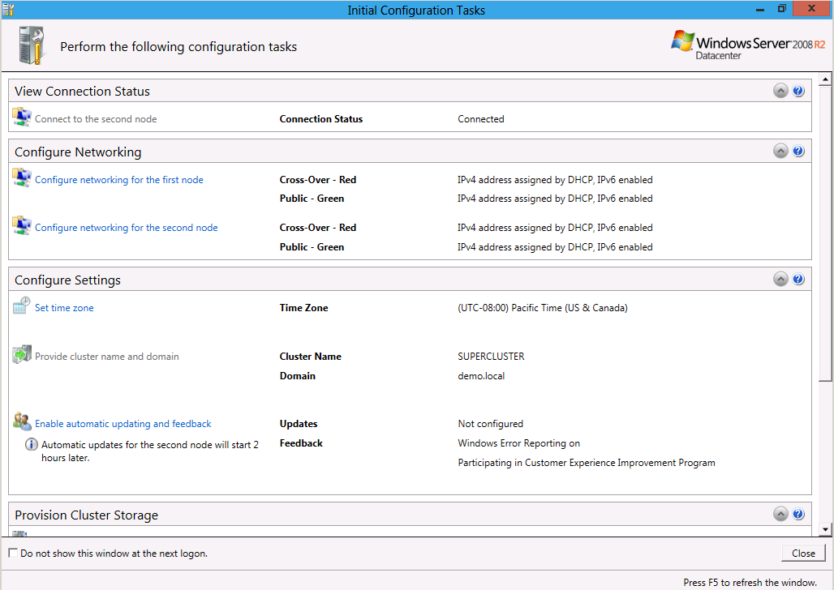

Overview: Factory → Customer
Factory Process
Prepare Windows NAS appliance image:
Set up Windows
Customize with solution-specific software
Brand & extend
Customer Set-up Experience
Power on
Setup
Use
Plug-in appliance
Windows startup
Configure appliance
Share storage

Slide 17
Fast, simple setup of clustered NAS appliance
demo

Slide 18
Preparing the NAS appliance image
Drivers
Server Roles/Features
Performance tuning
Discovery of cluster nodes
Label/identify NIC’s
Storage Spaces
or SMP or SMI-S
or Custom solution
Install Windows Server
Networking
Storage Management
Backup/DR
Security
Custom solution(s)…
Branding
Add/change workflows
SysPrep image
Customize unattended install
Install Optional Software
Customize ICT (Initial Config Tasks)
Prepare Master Image
Result: Golden image that can be used to deploy a Windows Appliance
Note: Full details provided in OEM Deployment Guide

Slide 19
Customizing the ICT (Initial Configuration Tasks)
ICT uses WPF-based extensible framework:
  Layout - OEMOOBE.xml
  PowerShell scripts
Extensibility points:
  Appliance Profile
  selection (optional)
  ICT window title and
  header
  Task groups
  Tasks
Window Header
Window Title
Task
Task Group

Slide 20
Customizing the ICT
demo

Slide 21
Building NAS with Windows File Server
The Windows Advantage
Continuously available access:
  SMB 2.2 with transparent failover
  NFS v3 + continuous availability
  iSCSI target + continuous availability
Highly competitive
  Performance
  Scalability
Storage virtualization
File deduplication
PowerShell automation
File data management:
  Extensible file classification
  Dynamic access control
and many more …

Slide 22
For more information
Continuously Available Platform Talks
LEARN
MORE
SAC-443T: Business and partnering opportunities: Windows Server 8 continuous availability
SAC-474T: Platform storage evolved
SAC-446T: Designing systems for continuous availability and scalability
SAC-450T: Designing systems for continuous availability - multi-node with block storage
SAC-444T: Designing systems for continuous availability - multi-node with remote file storage
SAC-451T: Building continuously available systems with Hyper-V
SAC-449T: Building continuously available file server NAS appliances
File Classification /Dynamic Access Control Talks
LEARN
MORE
SAC-422T: Using claims-based access control for compliance and information governance
SAC-425T: Building security auditing solutions for compliance and forensic analysis
SAC-426T: Using classification for access control and compliance
Other Related Windows Server 8 Talks
LEARN
MORE
SAC-430T: Designing the building blocks for a Windows Server 8 cloud
SAC-433T : Network acceleration and other NIC technologies for the data center
SAC-437T : A deep dive into Hyper-V networking
SAC-439T : Enabling multi-tenancy and converged fabric for the cloud using QoS

Slide 23
thank you
Feedback and questions http://forums.dev.windows.com
Session feedback
http://bldw.in/SessionFeedback

Slide 24

© 2011 Microsoft Corporation. All rights reserved. Microsoft, Windows, Windows Vista and other product names are or may be registered trademarks and/or trademarks in the U.S. and/or other countries.
The information herein is for informational purposes only and represents the current view of Microsoft Corporation as of the date of this presentation. Because Microsoft must respond to changing market conditions, it should not be interpreted to be a commitment on the part of Microsoft, and Microsoft cannot guarantee the accuracy of any information provided after the date of this presentation. MICROSOFT MAKES NO WARRANTIES, EXPRESS, IMPLIED OR STATUTORY, AS TO THE INFORMATION IN THIS PRESENTATION.

