Slide 1
Designing systems for continuous availability - multi-node with block storage
SAC-450T
Elden Christensen
Principal Program Manager Lead
Microsoft Corporation
Mallikarjun Chadalapaka
Senior Program Manager
Microsoft Corporation

Slide 2
What We’ve Covered So Far …
Business and Partnering Opportunities:
“Windows Server 8” Continuous Availability ✓
Session 443
Platform Storage Evolved ✓
Designing Systems for Continuous Availability – Multi-node with Block Storage
Building Continuously Available Systems
with Hyper-V
Session 474
Session 450
Session 451
Designing Systems for Continuous Availability and Scalability ✓
Designing Systems for Continuous Availability – Multi-node with Remote File Storage
Building Continuously Available File Server NAS Appliances
Session 446
Session 444
Session 449

Slide 3
Agenda
Server developers
Storage developers
Backup/Restore developers
Anti-virus developers
Replication developers
Subset of new availability features in “Windows Server 8”
Enhancements and Integration with Cluster Shared Volumes
Designing Storage Solutions for Failover Clusters
Backup Changes for CSV volumes
Understanding changes coming in “Windows Server 8” for Windows Server Failover Clustering
Breath of storage options to build continuously available systems
Integrating with Windows Failover Clustering
WHO WILL BENEFIT FROM THIS TALK
TOPICS
WHAT YOU’LL LEAVE WITH

Slide 4
Sneak Peak at New Failover Cluster Features in “Windows Server 8”
announcing

Slide 5



Failover Clustering in “Windows Server 8”
Infrastructure for the Private Cloud
Management of the private cloud
Hyper-V
Platform of the private cloud
Infrastructure of the private cloud

Slide 6
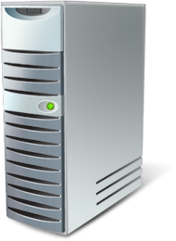




Increased Scalability
Highly scalable infrastructure for the private cloud
Increased scale up and scale out
  4x scale over Windows Server 2008 R2
    Scale up to 63-nodes
    Scale out to 4,000 VMs per cluster
Windows Server 8 supports an industry best 4,000 VMs per cluster and can now massively scale out to 63 nodes in a cluster
4,000 VM’s in a single cluster
Scale Up
Scale Out
. . .
63 nodes in a cluster
Robust management tools

Slide 7
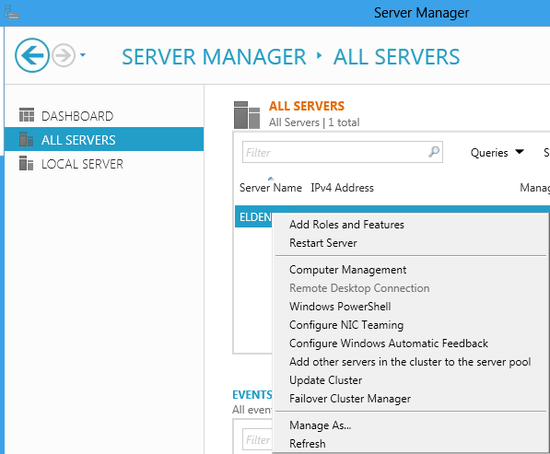
Multi-Machine Management with Server Manager
Cluster integration with new Server Manager
Remote multi-server management through Server Manager
  Server Groups to manage sets of machines (such as nodes in a cluster)
    Single-click action to add all nodes in the same cluster to a Server Group
  Simplifies managing sets of machines in a cluster
Integration with Server Manager to launch cluster administrative tools
  Right-click action on any clustered server to launch Failover Cluster Manager to manage that cluster
Remote Role and Feature installation
  Cluster wide Role and Feature installation

Slide 8



New Placement Policies
Virtual Machine Priority
Enhanced Failover Placement
Starting the most important VMs first
  Start backend before middle-tier before front-end
Ensure the most important VMs are running
  Preemption to shut down low priority VMs to free up resources for higher priority VMs to start
Each VM placed based on node with best available memory resources
Memory requirements evaluated on a per VM basis
  Non-Uniform Memory Access (NUMA) aware
High
Medium
Low

Slide 9




Cluster Integrated VM Mobility
Concurrent Live Migrations:
Multiple simultaneous LM’s for a given source or target
Live Migration Queuing:
In-box tools queue & manage large numbers of VMs
Storage Live Migration:
Moves VHD’s from one disk to another
VHD
VHD
Hyper-V Replica:
Point-in-time replication of VHD’s for disaster recovery

Slide 10
Cluster Management
demo

Slide 11




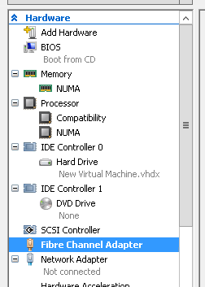
Guest Clustering – Increased Storage Support
Fibre Channel from the guest
Guest Clustering
  Cluster service runs inside a VM
  Apps and services inside the VM are managed by the cluster
  Apps move between clustered VMs
  Historically required iSCSI shared storage
New virtual “Fiber Channel Adapter”
  Up to four virtual HBAs assigned to each guest
  WWNs assigned to each virtual HBA
  NPIV utilized to surface guest ports on the host
Cluster
Fiber Channel

Slide 12

VM Monitoring
Application Health detection inside virtual machine
Clustering in the host identifies app failures and takes recovery action
  Application level recovery
    Service Control Manager (SCM) or event triggered
  Guest level HA recovery
    Failover Clustering Reboots VM
  Host level HA recovery
    Failover Clustering fails over VM to another node
Generic health monitoring for any application
  Monitor services through Service Control Manager
  Generation of specific Event ID’s
ISV opportunity to leverage GuestSetCriticalState() with to integrate
3rd party application monitoring solutions in the VM

Slide 13
VM Monitoring vs. Guest Clustering
Evaluating which is right for you
VM Monitoring is designed to be a light-weight solution to monitor applications running in VMs and integrated with the host
VM Monitoring is not a replacement for Guest Clustering
  Each has value for different scenarios
 | VM Monitoring | Guest Clustering
Application Health Monitoring |  | 
Application Mobility |  | 
Simplified Configuration | 
Event Monitoring | 

Slide 14

Automated Node Draining
Node Maintenance Mode
Simple single-click operation to drain all roles off a node
  Generic in-box infrastructure which was previously only available through SCVMM
  Simplifies maintenance and patching of cluster nodes
  Scriptable with PowerShell Suspend-ClusterNode -Drain
Supports all cluster roles and intelligent to the type of move supported
  Leverages live migration for VMs
    VMs can be configured to use Quick or Live migration based on priority
    Configured via NodeEvacuationMoveTypeThreshold private property of the Virtual Machine resource type
  Traditional move group for workloads like SQL or File Server
Draining a node
Node is paused to prevent any new groups from moving to that node
All groups are issued a move
VMs are queued up and live migrated off based on priority
Resuming a node
Resume-ClusterNode –Failback invokes failback policies to return groups to that node when it is brought out of Maintenance Mode

Slide 15
Cluster-Aware updating (CAU)
Mallikarjun Chadalapaka
Senior Program Manager

Slide 16
Cluster-Aware Updating (CAU)
What is it?
Prior to “Windows Server 8” server updating tools didn’t have cluster-awareness
  #1 customer ask
CAU updates all cluster nodes in an automated fashion without impacting service availability
CAU + Continuously Available workload features = Zero service impact while cluster is updated, e.g.,
  Hyper-V host cluster with Live Migration
  File Server cluster with SMB Continuous Availability

Slide 17







Cluster-Aware Updating
Orchestrated updating of clusters
Simple automated updating of clusters
Orchestrator updates nodes in the cluster
  Builds atop Windows Update Agent (WUA)
    3rd party plug-in extensibility
  Updates nodes without impacting cluster quorum
Workflow
  Scan nodes to identify appropriate updates needed
  Identify node with fewest workloads
  Place the node in Maintenance Mode to drain
  Call to WUA to update (which contacts WSUS or Windows Update)
  Verify success & move to the next node
Initiates
Check & Update
Admin
Update Cluster
(Orchestrator)
Windows Update
Cluster
Node Drained

Slide 18
CAU Developer Opportunities
Enhancing and improving the feature
System Management & Automation tools ISVs
IHVs & OEMs
Windows 8 computer
“Orchestrator”
Multi-cluster “Patch Tuesday” workflows
End-to-end data center provisioning workflows
CAU GUI & PS cmdlets
Public plug-in API
CAU Core
New custom plug-ins, e.g. Cluster NIC firmware updates, Cluster BIOS updates
Cluster-Aware Updating (CAU) PS cmdlets
Default WUA Plug-in
Custom Node Update Tool Plug-in
New automation solutions with CAU cmdlets
Cluster Node
Cluster Node
Clustered Workload
Service Desk and other ITIL automation workflows
Clustered Workload
Windows Server "8" Cluster
Clustering
Clustering
WUA
Custom Node Update Tool
WUA
Custom Node Update Tool

Slide 19
Cluster-Aware updating
demo
Mallikarjun Chadalapaka
Senior Program Manager

Slide 20
Cluster Shared Volumes (CSV)

Slide 21
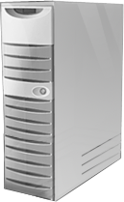

Cluster Shared Volumes (CSV) Overview
All nodes in the cluster have simultaneous access to the same file system
Metadata updates are orchestrated between servers to avoid I/O interruptions
Shared Storage
VHD
VHD
VHD

Slide 22
Next Generation Cluster Shared Volumes (CSV)
Primary motivation for CSV in “Windows Server 8”
  Improve Backup / Restore of CSV volumes
  Expand CSV to more roles
    Hyper-V / File Server / possibly more…
Scalability
  CSV scales up to 63 nodes
  Enables zero down time for planned and unplanned failures for SMB workloads
  Fast fault tolerant to network, storage and system failures
Provides interoperability with file system mini-filter drivers
  Better interoperability with anti-virus, backup, and replication software
Makes the best use of Win8 storage and network technologies
  Thin provisioning, RDMA/LBFO, synthetic FC, and Storage Spaces
  Integrates SMB direct and multi-channel
Integrated with new File System features
  Support for offloaded data transfer
  Spot-fixing integrated to do online correction
  Defrag of CSV volumes
No external authentication dependencies for improved performance and resiliency
Direct I/O for more scenarios
Multi-subnet support

Slide 23
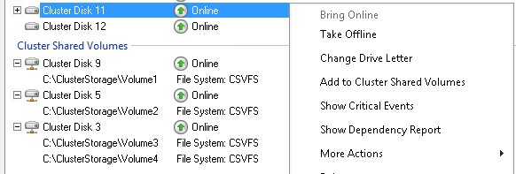
Simplified CSV Setup
Integrated into Failover Cluster Manager Storage view
  “Cluster Shared Volumes” container removed
Cluster Shared Volumes integrated into Failover Cluster core feature
  No longer a separate component that needs to be explicitly enabled
Simple right-click to enable a disk to be shared through CSV
  That’s it!

Slide 24
Configuring a shared CSV disk
demo

Slide 25
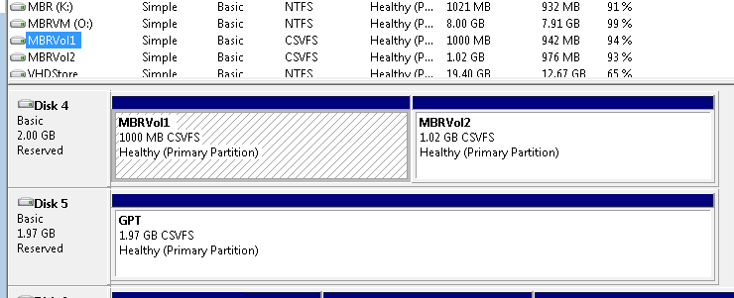
CSV Proxy File System
CSV enabled volumes now appear as “CSVFS”
  NTFS file system under the covers
  Volumes are still formatted with NTFS file system
Enables applications to be aware they are running on CSV and can ensure compatibility

Slide 26


Integrating Filters with CSV
CSV pseudo-file system enables filter drivers to insert themselves
  Anti-virus
  Continuous data protection
  Backup
  Replication
File system filters:
  File system mini-filters attached through Filter Manager
    FLT_FILESYSTEM_TYPE enumeration of FLT_FSTYPE_CSVFS
  No support for legacy filters
Volume filters:
  Volume filters attached to CSVvBus.sys
Coordinator Node
VM
Share
VM
Share
Node 1
Node 2
CSVFS
CSVFS.sys
SMB
SMB
CSVFLT.sys
CSV Proxy File System
NTFS
CSVvBUS.sys
Volume Manager
CSVvBUS.sys
Disk.sys
Disk.sys
Direct I/O
Shared Storage

Slide 27
High Speed CSV I/O Redirection
Redirected mode will have negligible impact
CSV is integrated with SMB multi-channel
  Allows streaming CSV traffic across multiple networks
  Delivers improved I/O performance when in redirected mode
CSV takes advantage of SMB2 Direct (SMB2 over RDMA)
VM with I/O being redirected
Coordinator Node
10.10.10.X
20.20.20.X
CSV Streaming I/O Across Multiple Networks
VHD

Slide 28


Increased Security
Encrypted cluster volumes
TPMs can be leveraged for the first time in server scenarios
BitLocker encrypted cluster disks
  Support for traditional failover disks
  Support for Cluster Shared Volumes
Cluster Name Object (CNO) identity used to lock and unlock Clustered volumes
Enables physical security for deployments outside of secure datacenters
  Branch office deployments
Volume level encryption for compliance requirements
LEARN
MORE
HW-462T – Hardware-based security is here: TPMs Unleashed

Slide 29
Cluster Shared Storage Requirements

Slide 30

Shared Storage Options
Flexible storage choices for building clusters
Shared Storage
Data Replication
FC
SAS RBOD
Spaces
RAID HBA
SMB
Hardware Replication
Software Replication
Application Replication
SAS JBOD
3rd party software replication solution
Example: Exchange
SQL AlwaysOn
iSCSI
FCoE
LEARN
MORE
SAC-444T – Designing Systems for Continuous Availability - Multi-Node with Remote File Storage

Slide 31
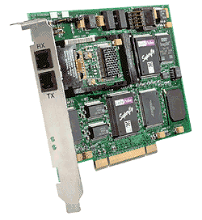
Shared Block Storage Requirements
Supported Block Access Protocols For Shared Storage
  Unsupported
    SATA does not support persistent reservations / multi-initiator
      Low cost SATA drives could reside in a SAS RAID enclosure
iSCSI
SAS
Serial Attached SCSI
Fibre Channel
FCoE
Fiber Channel over Ethernet

Slide 32
SCSI Command Requirements
Storage must support the following SCSI-3 SPC-3 compliant SCSI Commands:
  Device Identification VPD page 83h SCSI inquiry data
      EUI-64 based – IDENTIFIER TYPE 2h
      NAA – IDENTIFIER TYPE 3h
      SCSI name string – IDENTIFIER TYPE 8h
    SCSI inquiry support now Required (only change from Win2008 R2 requirements)
  Persistent Reservations
    PERSISTENT RESERVE IN Read Keys (00h)
    PERSISTENT RESERVE IN Read Reservation (01h)
    PERSISTENT RESERVE OUT Reserve (01h)
      Scope: LU_SCOPE (0h)
      Type: Write Exclusive – Registrants Only (5h)
    PERSISTENT RESERVE OUT Release (02h)
    PERSISTENT RESERVE OUT Clear (03h)
    PERSISTENT RESERVE OUT Preempt (04h)
    PERSISTENT RESERVE OUT Register AND Ignore Existing Key (06h)

Slide 33
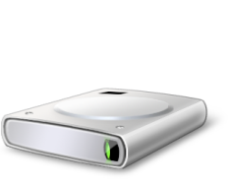

Cost-Effective Business Critical Storage
High Availability & Scale-Out via integration with Failover Clustering & Cluster Shared Volumes
  Provides Spaces-based storage virtualization on clustered disks
Tightly integrated into existing cluster Physical Disk resource
  Delivers a seamless experience to customers
Cluster Shared Volumes (CSV) integration
  Simple Space and Mirror Space
Spaces integrated
with Cluster
Cluster Physical Disk resource coordinates and orchestrates failover
Failover Clustering
Spaces-Based
Virtualized
Storage
Storage
Spaces
SAS
Physical
Storage
JBODS
LEARN
MORE
SAC-446T – Designing Systems for Continuous Availability and Scalability

Slide 34
Combining File & Block Based Storage Models
Consolidated cluster model
Hyper-V over CA SMB
Single Cluster CSV SMB Model
Two separate clusters
  Cluster to host VMs
  Cluster to host storage
Single cluster for app and data nodes
High Speed Block Level Redirected IO
Simplified management
  Single CSV namespace accessible on all nodes
  Unified security model
  Single cluster to manage
VMs can run anywhere
Hyper-V Cluster
SMB
SMB
File Server Cluster
Shared Block Storage
Shared Block Storage
LEARN
MORE
SAC-444T – Designing Systems for Continuous Availability - Multi-Node with Remote File Storage

Slide 35
CSV Backup

Slide 36
CSV Backup Key Wins in “Windows Server 8”
Support for Parallel Backups
  On same or different CSV volumes
  On same or different cluster nodes
Improved I/O performance
  Non-disruptive backups
  Direct I/O mode for snapshot and backup operations
CSV volume ownership does not change during backup
Improved support for filter drivers to enable incremental backups
Backup applications / requestors are not required to be ‘CSV aware’
  Fully compatible with Win2008 R2 Requestors
  Restore of Application / Volume / LUN should not required to be CSV aware

Slide 37




Distributed App Consistent VM Shadow Copies
Enables app consistent Shadow Copies of VMs across a cluster
  Primarily targeted for VMs hosted in the CSV cluster.
  All the VSS writers using that CSV volume “frozen” across the cluster
  Read-write volume for writer auto-recovery all cluster nodes
Backup
Requestor
App
Consistent
CSV Disk

Slide 38
CSV Backup Story Summary
 | Windows 2008 R2 | “Windows Server 8”
Interoperability | Backup application must be CSV Aware | No special logic necessary
IO Performance | Redirected I/O for the lifetime of a software Snapshot | No I/O redirection
Locality of CSV Volume | Volumes are moved to the node where the requestor initiates backup using ClusterPrepareSharedVolumeForBackup() | Snapshot can be created on remote volumes
Volume Mount Point API Support | Requires special cluster API’s ClusterIsPathOnSharedVolume() ClulsterGetVolumePathName() ClusterGetVolumeNameForVolumeMountPoint() | Standard Win32 APIs are supported GetVolumePathName() GetVolumeNameForVolumeMountPoint()
Complexity | Requestors responsibility to coordinate backup leveraging special cluster API’s ClusterPrepareSharedVolumeForBackup() ClusterClearBackupStateForSharedVolume() | No special logic needed in VSS Requestor to track CSV backup process Cluster coordinates the backup process

Slide 39
Developer Considerations

Slide 40
Developer Considerations Overview
In general cluster aware applications and resources that worked on Windows Server 2008 R2 should work on “Windows Server 8”
  No changes to fundamental cluster resource model
  No breakings changes to cluster API’s
While there was major enhancements to the infrastructure, the integration model remains consistent
There are a few minor exceptions…

Slide 41
Cluster Interface Changes for Developers
Programmatic Interfaces (API)
  Cluster API – Supported
  MSCluster WMI Provider – Supported
    Recommended management interface
  Cluster Automation Server (MSClus) COM API – Deprecated in Win2008
    Optional component (FailoverCluster-AutomationServer) which is not installed by default
User Interfaces (UI)
  Failover Cluster Manager snap-in – Supported
  Cluster PowerShell cmdlet’s – Supported
    Can also be used as a programmatic interface
  Cluster.exe – Deprecated in Win2008 R2
    Optional component (FailoverCluster-CmdInterface) which is not installed by default
New Items Deprecated in Windows Server 8
  32-bit cluster resource DLL support deprecated
    Update cluster resource DLL’s to 64-bit

Slide 42
Cluster Changes for Storage Developers
SCSI Command Requirements
  SCSI Inquiry data (page 83h) support changed from Recommended to Required
  The algorithm for how Persistent Reservation keys are generated has changed
    Moved from a per LUN key to a per Node key
Storage Class Resources
  Storage Class Resources will require support for new control codes to be compatible with GUI
    Such as: CLUSCTL_RESOURCE_TYPE_STORAGE_GET_RESOURCEID
Backup of Cluster Shared Volumes story has changed
Cluster Shared Volumes File System Identifier
  CSV volumes now appear as “CSVFS”, instead of NTFS
  CSVFS only supports file system mini-filter drivers (no legacy filter support)
Storage Replication Solutions
  Cluster resources are allowed in CSV resource groups to enable replication solutions
    Resource must support new CLUS_CHAR_COEXIST_IN_SHARED_VOLUME_GROUP characteristic

Slide 43
Summary
Failover Clustering is delivering the infrastructure for the Private Cloud
  Most scalable private cloud
  Flexible deployment choices
  Intelligent placement across the private cloud
  Next generation Cluster Shared Volumes (CSV)
There is much more to talk about than I could cover in a single session…
  If you are building solutions that integrate with Failover Clustering, come talk to me!!!
INFRASTRUCTURE
as a SERVICE

Slide 44
For more information
RELATED SESSIONS
SAC-443T - Business and partnering opportunities: Windows Server 8 continuous availability
SAC-444T - Designing systems for continuous availability - multi-node with remote file storage
SAC-451T- Building continuously available systems with Hyper-V
SAC-474T- Platform storage evolved

Slide 45
thank you
Feedback and questions http://forums.dev.windows.com
Session feedback
http://bldw.in/SessionFeedback

Slide 46

© 2011 Microsoft Corporation. All rights reserved. Microsoft, Windows, Windows Vista and other product names are or may be registered trademarks and/or trademarks in the U.S. and/or other countries.
The information herein is for informational purposes only and represents the current view of Microsoft Corporation as of the date of this presentation. Because Microsoft must respond to changing market conditions, it should not be interpreted to be a commitment on the part of Microsoft, and Microsoft cannot guarantee the accuracy of any information provided after the date of this presentation. MICROSOFT MAKES NO WARRANTIES, EXPRESS, IMPLIED OR STATUTORY, AS TO THE INFORMATION IN THIS PRESENTATION.

