Slide 1
Building real-time web apps with WebSockets using IIS, ASP.NET and WCF
SAC-807T
Paul Batum & Stefan Schackow
Microsoft Corporation

Slide 2
Agenda slide
WHO WILL BENEFIT FROM THIS TALK
TOPICS
WHAT YOU’LL LEAVE WITH
Windows 8 developers
Web developers
Middle-tier developers
Why WebSockets?
Standardization & browser support
Programming with WebSockets in ASP.NET and WCF
WebSockets is:
Securely enabling the real time web
For the browser and beyond
Use ASP.NET and WCF to develop WebSocket enabled websites and services

Slide 3
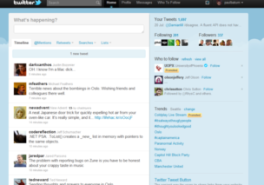
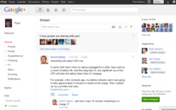
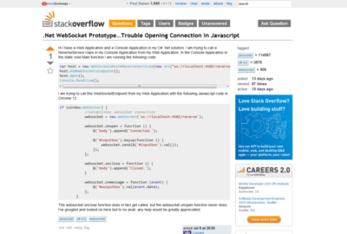
HTTP Limitations
HTTP is a request-reply protocol
Web applications today use workarounds to enable push

Slide 4
Current Programming Models
Periodic Polling
Server
Client
Polling interval
Browser uses XmlHttpRequest to periodically query the server

Slide 5
Current Programming Models
Long Polling
Server
Client
Server holds on to the HTTP request until there is data to return
Client sends a new request as soon as the previous request completes

Slide 6
Current Programming Models
Periodic and long polling work everywhere
However…
Periodic polling is high latency
Long polling programming model is unintuitive
Many scale out issues
Bandwidth overheads
Limited cross domain support (JSONP)
Can’t we just have the equivalent of a TCP socket?

Slide 7
WebSockets
New interoperable technology, undergoing standardization
Full duplex bidirectional socket
W3C JavaScript API
Secure (SSL)
High performance
Low latency
Low bandwidth overhead
Broad reach (port 80 & 443 by default)
Cross-domain connections

Slide 8
Applications
Rich web applications
Real-time applications and services (stock tickers, monitoring systems, etc)
Native connected applications (Windows 8, mobile, etc)
Online games
Business-to-business

Slide 9
WebSockets for: - Windows 8 - Internet Explorer 10 - .NET 4.5
announcing

Slide 10
WebSockets in IE, Windows & .NET
Implements hybi-10
IE 10
Windows 8 Runtime Client SDK
IIS 8.0
.NET 4.5 (WebSocket features are Windows 8 only)
ASP.NET
WCF
HttpListener

Slide 11
HTML5 WebSockets Game
demo

Slide 12
WebSocket protocol: how it works
Connection established using HTTP handshake
Data is sent over the underlying TCP connection
Binary or UTF8
Can traverse firewalls and proxies
Best results when tunneled over SSL
Load balancers
TCP (L4) ✓
HTTP (L7) ✗ (enhancement required)

Slide 13
Standardization
We are working closely with industry in the development of these standards
Significant progress over the last 6 months
Protocol spec beyond IETF last call
W3C JavaScript API spec is still in draft but consensus is approaching
Browser support
IE 10
Chrome 14
Firefox 7 (namespaced)

Slide 14
Getting Started with WebSockets in ASP.NET & WCF
demo

Slide 15
Server Architecture
Your code!
WCF high level abstractions
WCF WebSocket transport
ASP.NET high level abstractions
System.Net.WebSockets
ASP.NET HTTP Pipeline
HttpListener
IIS (iiswsock.dll)
http.sys

Slide 16
WebSockets in WCF
WebSocket transport for WCF
Traditional WCF running over WebSocket connections
<bindings>
<netHttpBinding>
<binding name="websocketBinding">
<webSocketSettings connectionMode="Required"
pingFrequency="00:01:00" />
</binding>
</netHttpBinding>
</bindings>

Slide 17
ASP.NET low-level API
Developer “agrees” to upgrade to a WebSocket connection
HttpContext.Current.AcceptWebSocketRequest(
Func<AspNetWebSocketContext,Task> myWebSocketApp,
AspNetWebSocketOptions optionalSetupInfo
);
Asynchronously receive and send messages
public async Task MyWebSocketApp(AspNetWebSocketContext context)
{
var socket = context.WebSocket;
…
var input = await socket.ReceiveAsync(buffer);
…
await socket.SendAsync(outputBuffer,…params…);
}

Slide 18
High-level Programming Abstractions
Simplified WebSockets “handler”
Low level buffer management and socket state management
Buffers and queues outbound messages
Automatically coalesces received messages
Exposes state machine as simple method overrides
WCF and ASP.NET APIs designed to be very similar

Slide 19
ASP.NET SignalR Library
Abstracts away the concept of a socket
Includes both server-side WebSocket support and a client-side Javascript library
Bridge to older non-HTML 5 clients with support for HTTP long-polling
Two SignalR coding approaches:
PersistentConnection message-oriented approach
Hubs RPC-style approach

Slide 20
SignalR: Chat
demo

Slide 21
SignalR Hubs: Shape Share
demo

Slide 22
WebSockets is: Securely enabling the real time web

Slide 23
WebSockets is: For the browser and beyond

Slide 24
Use ASP.NET and WCF to develop WebSocket enabled websites and services

Slide 25
For more information
RELATED SESSIONS
SAC-798T Building Web APIs in Windows Azure with WCF to reach any device
PLAT-580T Building Windows runtime sockets apps
SAC-804T Building IIS and ASP.NET apps with the power of async PLAT-373C Building real-time web apps with HTML5 WebSockets
CONTACT:
pbatum@microsoft.com
stefsch@microsoft.com

Slide 26
thank you
Feedback and questions http://forums.dev.windows.com
Session feedback http://bldw.in/SessionFeedback

Slide 27
© 2011 Microsoft Corporation. All rights reserved. Microsoft, Windows, Windows Vista and other product names are or may be registered trademarks and/or trademarks in the U.S. and/or other countries.
The information herein is for informational purposes only and represents the current view of Microsoft Corporation as of the date of this presentation. Because Microsoft must respond to changing market conditions, it should not be interpreted to be a commitment on the part of Microsoft, and Microsoft cannot guarantee the accuracy of any information provided after the date of this presentation. MICROSOFT MAKES NO WARRANTIES, EXPRESS, IMPLIED OR STATUTORY, AS TO THE INFORMATION IN THIS PRESENTATION.

