Slide 1
IIS sand-boxing and scalability for hosting on modern hardware
SAC-819T
Won Yoo
Senior Program Manager Lead
Microsoft Corporation

Slide 2
Agenda
Web Platform and Tools investments.
IIS in Windows Server 8.
Key hosting scenarios on scalability and sand-boxing.
Maximize modern hardware.
You’ll leave with examples of how to
Manage resources for each hosted site.
Scale up and achieve high site density on Windows.

Slide 3
Web Platform & Tools Investments
Customers look for solutions that span the Application Lifecycle.
Definition
Operations
Design
Application
Life-Cycle
Deployment
Development
Testing

Slide 4
Web Platform & Tools Investments
Microsoft is delivering solutions in Windows and on the Web at a rapid pace.
More than a dozen IIS Extensions have been shipped since IIS 7.0 in Windows Server 2008.
Definition
WebFarmFramework
AppGallery
Operations
WebPI
SEO
AdminPack
Design
Application
Life-Cycle
URLRewrite
ARR
Deployment
WebDeploy
Development
WebMatrix
Visual Studio
Testing
IIS Express

Slide 5
Microsoft Web Stack: Web Platform Installer
Simple discovery and acquisition of the Microsoft Web Stack.
Automates installation of the most popular ASP.NET and PHP apps via Web Application Gallery.
Works on every version of Windows, including Windows Server 8.

Slide 6
IIS In Windows Server 8

Slide 7
What We Heard From Our Customers
Scalability:
I want Windows Server 8 to scale better with my hardware.
I want to consolidate tenants and increase density and security.
As I upgrade my hardware, I expect increased performance.
Manageability:
I want my management experience to scale and be simple.
As my solution grows, keep concepts simple and seamless.

Slide 8
Configuration Scalability

Slide 9
Configuration Scalability
Customer scenarios:
As I consolidate servers, I want to increase tenant density.
As tenant density increases, I want the same rapid response time.
Management complexity should not grow as I scale.

Slide 10
Configuration Scalability
With a typical hosting configuration (5,000 sites)
WS08 R2: Config mem usage: 1,400MB
Windows Server 8: Config mem usage: 402MB
+3.5x
Less memory than R2!
166x
faster

Slide 11
SSL Scalability and Manageability

Slide 12
SSL Scalability and Manageability
demo

Slide 13
IIS Sand-boxing

Slide 14
IIS Sand-boxing via CPU Throttling
demo

Slide 15
NUMA Scalability

Slide 16
NUMA Scalability
Basic commodity server in 2014:
16 to 64 logical cores.
NUMA architecture.
64GB RAM.
40Gbit NIC.
$300-$1500 w/o OS.
High end server:
256 or 512 logical cores.

Slide 17
NUMA Scalability
-20% from 32 cores

Slide 18
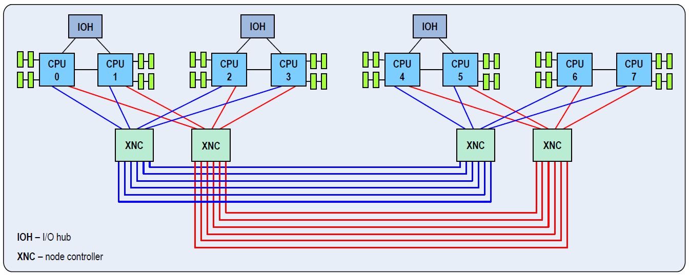
NUMA Scalability
1
IP is assigned to NIC.
2
RSS queue is affinitized to a CPU socket.
3
IIS w3wp for site with this IP is affinitized to NUMA node on this socket.
This one.
Not this one.
Not this one.
Not just any CPU socket – but the one that is on the same I/O hub.

Slide 19
NUMA Scalability
Scenario | Description
Baseline: Default IIS configuration | Out-of-box experience. 1 appPool and 1 worker process.
WAS affinity (web garden): Large enterprise application | Intelligently affinitize worker process to NUMA node. 1 appPool and multiple worker processes. 1 worker process / NUMA node.
WAS affinity (multiple appPool): Large multi-tenant/hosted solution | Intelligently affinitize worker process to NUMA node. Multiple appPools and 1 worker process per appPool. 1 worker process / NUMA node.
Manual affinity (multiple appPool): Custom tuned to a workload | Manual configuration to support beyond 64 cores. Multiple appPools and 1 worker process per appPool. 1 worker process / NUMA node.

Slide 20
NUMA Scalability
+52% from 32 cores
-20% from 32 cores

Slide 21
For more information
RELATED SESSIONS
DOCUMENTATION & ARTICLES
Your WebSites can run much faster with ASP.NET and IIS8 Optimization features.
Building real-time web applications with WebSockets using IIS, ASP.net and WCF.
Building IIS and ASP.net Applications with the Power of Async.
http://www.iis.net/

Slide 22
thank you
Feedback and questions http://forums.dev.windows.com
Session feedback http://bldw.in/SessionFeedback

Slide 23
© 2011 Microsoft Corporation. All rights reserved. Microsoft, Windows, Windows Vista and other product names are or may be registered trademarks and/or trademarks in the U.S. and/or other countries.
The information herein is for informational purposes only and represents the current view of Microsoft Corporation as of the date of this presentation. Because Microsoft must respond to changing market conditions, it should not be interpreted to be a commitment on the part of Microsoft, and Microsoft cannot guarantee the accuracy of any information provided after the date of this presentation. MICROSOFT MAKES NO WARRANTIES, EXPRESS, IMPLIED OR STATUTORY, AS TO THE INFORMATION IN THIS PRESENTATION.

