Slide 1
Your Devices + OData + Azure = ☺
SAC-836T
Mike Flasko
Senior Program Manager Lead
Microsoft Corporation

Slide 2
Agenda
What is OData?
Demo
Building services to power experiences across devices
Consuming from any device
Roadmap

Slide 3
What is OData?
A REST-based set of patterns for accessing information via services
Ordering, Paging, Filtering, Navigation, CRUD, etc
Data Model
Formats (Atom, JSON)
Metadata
Updates
Query
More…
Addressing

Slide 4
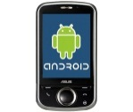
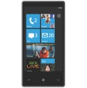
Demo: Jogging Tracker
Windows Azure Marketplace
OData Svc
(Web Role)
SQL Azure
ACS
Blob Storage
Google
Live ID
Yahoo!

Slide 5
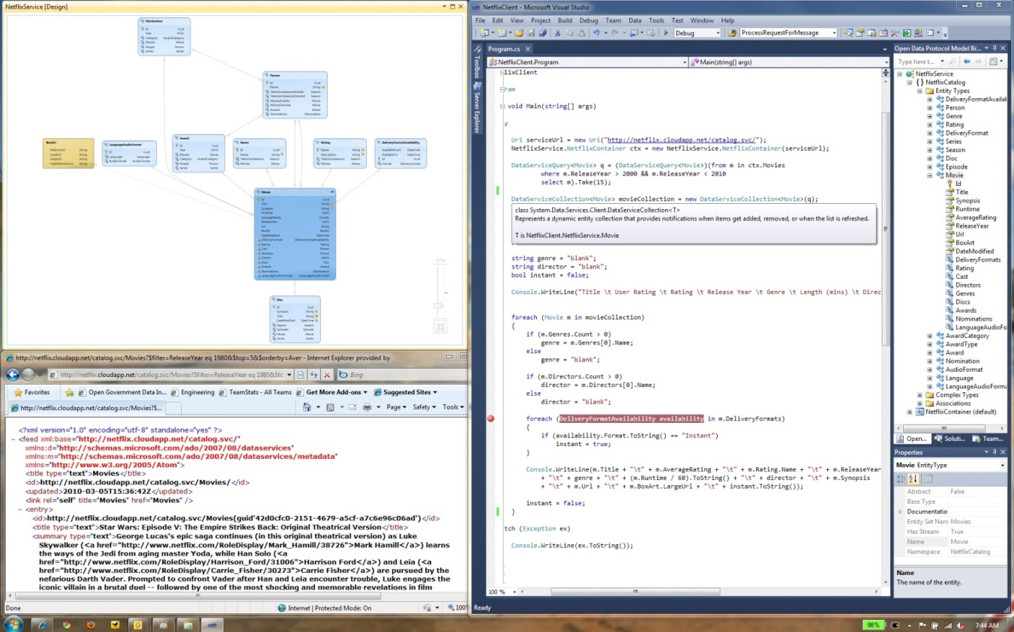
Creating Services for Any Device
Create your own
Hosted Services
More at http://odata.org/producers

Slide 6
Creating Services for Any Device
Create your own
Hosted Services
More at http://odata.org/producers

Slide 7
Demo: Jogging Tracker
Windows Azure Marketplace
OData Svc
(Web Role)
SQL Azure
ACS
Blob Storage
Google
Live ID
Yahoo!

Slide 8
Consuming OData Services
Devices
Web
BI, Reports, …
PowerPivot
Excel 2010
LINQPad
More at http://odata.org/consumers

Slide 9
Developer Considerations
Use the community:
odata.org/consumers & odata.org/producers
Javascript: http://datajs.codeplex.com
Android: http://code.google.com/p/odata4j/
Toolkits for mobile: http://bit.ly/qkcxvO
F# 3.0
Control bandwidth use:
$select, $filter, $top, $skip, $count
Reduce roundtrips:
$expand
More on the way…

Slide 10
Roadmap
OData Protocol
New version draft by end of 2011
Open source OData validation service (odatavalidator.codeplex.com/)
WCF Data Services
New release in Q1 2012, covering most of next OData draft
Windows Azure Data Market
OAuth is supported now!
Bing data as a namespace in your app

Slide 11
Device Features On The Way…
OData VNext
Spatial data will be first class
Lean & mean JSON
Richer Queries
Top community feedback points
Full hierarchy support
Containment
Up Next: “OData Futures: Building the Web of Data”

Slide 12
For more information
RELATED SESSIONS
DOCUMENTATION & ARTICLES
Building data-driven HTML5 Applications with WCF RIA Services
OData Futures: Creating the Web of Data
F#: Data, Web, Cloud Services
Building Device and Cloud Apps
Create Immersive Data Experiences with the Entity Framework
OData
http://odata.org
WCF Data Services
http://msdn.microsoft.com/odata
http://dataservices.mswish.net (feature voting)
Phone Toolkits
http://watoolkitwp7.codeplex.com/
Windows Azure
http://windowsazure.com
CONTACT
email: mike.flasko@microsoft.com
twitter: @mflasko

Slide 13
thank you
Feedback and questions http://forums.dev.windows.com
Session feedback http://bldw.in/SessionFeedback

Slide 14
© 2011 Microsoft Corporation. All rights reserved. Microsoft, Windows, Windows Vista and other product names are or may be registered trademarks and/or trademarks in the U.S. and/or other countries.
The information herein is for informational purposes only and represents the current view of Microsoft Corporation as of the date of this presentation. Because Microsoft must respond to changing market conditions, it should not be interpreted to be a commitment on the part of Microsoft, and Microsoft cannot guarantee the accuracy of any information provided after the date of this presentation. MICROSOFT MAKES NO WARRANTIES, EXPRESS, IMPLIED OR STATUTORY, AS TO THE INFORMATION IN THIS PRESENTATION.

