Slide 1
Inside Windows Azure: the cloud operating system
SAC-853T
Mark Russinovich
Technical Fellow
Microsoft Corporation

Slide 2
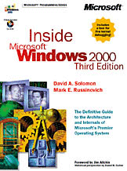
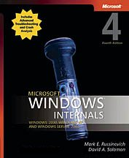
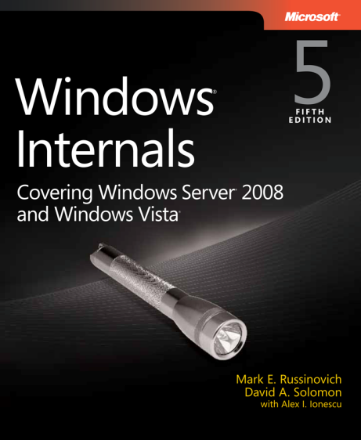
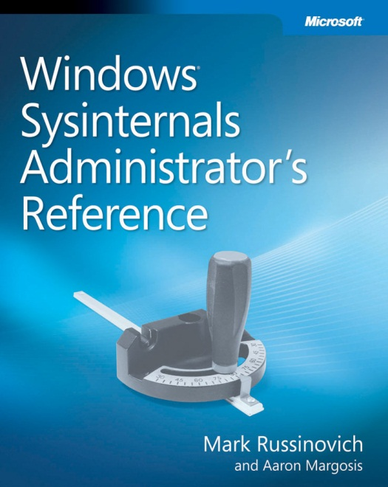
About Me
Technical Fellow, Windows Azure, Microsoft
Author of Windows Sysinternals tools
Coauthor of Windows Internals book series
With Dave Solomon and Alex Ionescu
Coauthor of Sysinternals Administrator’s Reference
With Aaron Margosis
Author of Zero Day: A Novel

Slide 3
Agenda
Windows Azure Datacenter Architecture
Deploying Services
Maintaining Service Health
Developing and Operating Windows Azure

Slide 4
Windows Azure Datacenter Architecture

Slide 5
Datacenter Architecture
Datacenter Routers
Aggregation Routers and
Load Balancers
Agg
Agg
Agg
Agg
Agg
Agg
LB
LB
LB
LB
LB
LB
LB
LB
LB
LB
LB
LB
Top of Rack
Switches
TOR
TOR
TOR
TOR
TOR
TOR
TOR
TOR
TOR
TOR
TOR
TOR
TOR
TOR
TOR
Racks
Nodes
Nodes
…
Nodes
Nodes
…
…
…
…
Nodes
Nodes
…
Nodes
Nodes
Nodes
Nodes
Nodes
Nodes
Nodes
Nodes
Nodes
PDU
PDU
PDU
PDU
PDU
PDU
PDU
PDU
PDU
PDU
PDU
PDU
PDU
PDU
PDU
Power Distribution Units

Slide 6
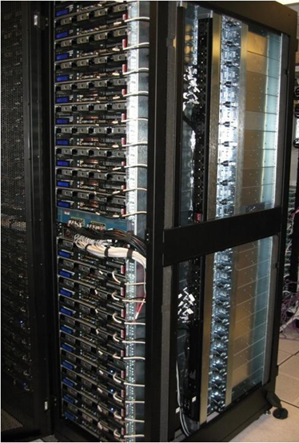
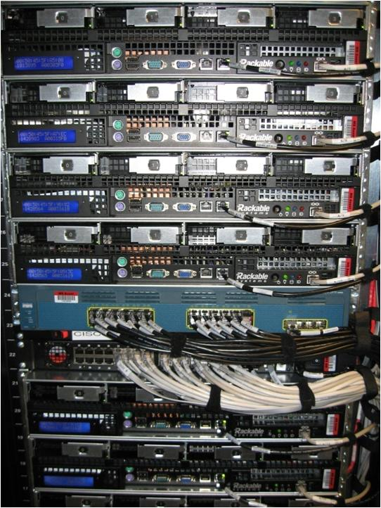
Windows Azure Datacenters

Slide 7
Datacenter Clusters
Datacenters are divided into “clusters”
Approximately 1000 rack-mounted server (we call them “nodes”)
Provides a unit of fault isolation
Each cluster is managed by a Fabric Controller (FC)
FC is responsible for:
Blade provisioning
Blade management
Service deployment and lifecycle
Datacenter network
FC
FC
FC
Cluster
1
Cluster
2
…
Cluster
n

Slide 8
The Fabric Controller (FC)
The “kernel” of the cloud operating system
Manages datacenter hardware
Manages Windows Azure services
Four main responsibilities:
Datacenter resource allocation
Datacenter resource provisioning
Service lifecycle management
Service health management
Inputs:
Description of the hardware and network resources it will control
Service model and binaries for cloud applications
Server
Kernel
Process
Datacenter
Fabric Controller
Service
Word
SQL Server
Exchange
Online
SQL Azure
Windows Kernel
Fabric Controller
Server
Datacenter

Slide 9
Cluster Resource Description
The Fabric Controller is bootstrapped with a Utility Fabric Controller (UFC)
Single-instance FC
Used for bootstrap and FC updates
UFC feeds FC a description of the cluster physical and logical resources in Datacenter.xml
Server IP addresses
Pool of network IP addresses to assign services
Network hardware and Power Distribution Unit addresses

Slide 10
Inside a Cluster
FC is a distributed, stateful application running on nodes (servers) spread across fault domains
Top blades are reserved for FC
One FC instance is the primary and all others keep view of world in sync
Supports rolling upgrade, and services continue to run even if FC fails entirely
LB
AGG
LB
LB
LB
LB
TOR
TOR
TOR
TOR
TOR
FC1
FC2
FC3
Nodes
FC3
FC4
FC5
…
…
…
…
…
…
…
…
…
…
Rack

Slide 11
Provisioning a Node
Fabric Controller
Power on node
PXE-boot Maintenance OS
Agent formats disk and downloads Host OS via Windows Deployment Services (WDS)
Host OS boots, runs Sysprep /specialize, reboots
FC connects with the “Host Agent”
Image Repository
Windows
Deployment
Server
Maintenance OS
Windows Azure
OS
Maintenance OS
Parent
OS
Role
Images
Role
Images
Role
Images
Role
Images
PXE
Server
Node
Windows
Azure
OS
FC Host Agent
Windows Azure Hypervisor

Slide 12
Deploying Services

Slide 13
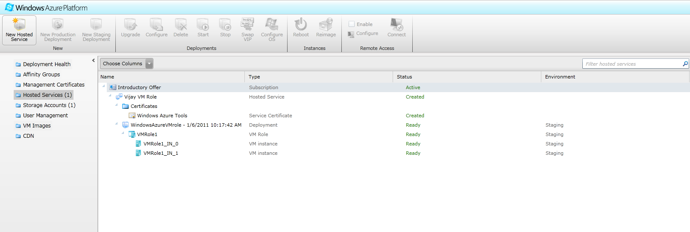
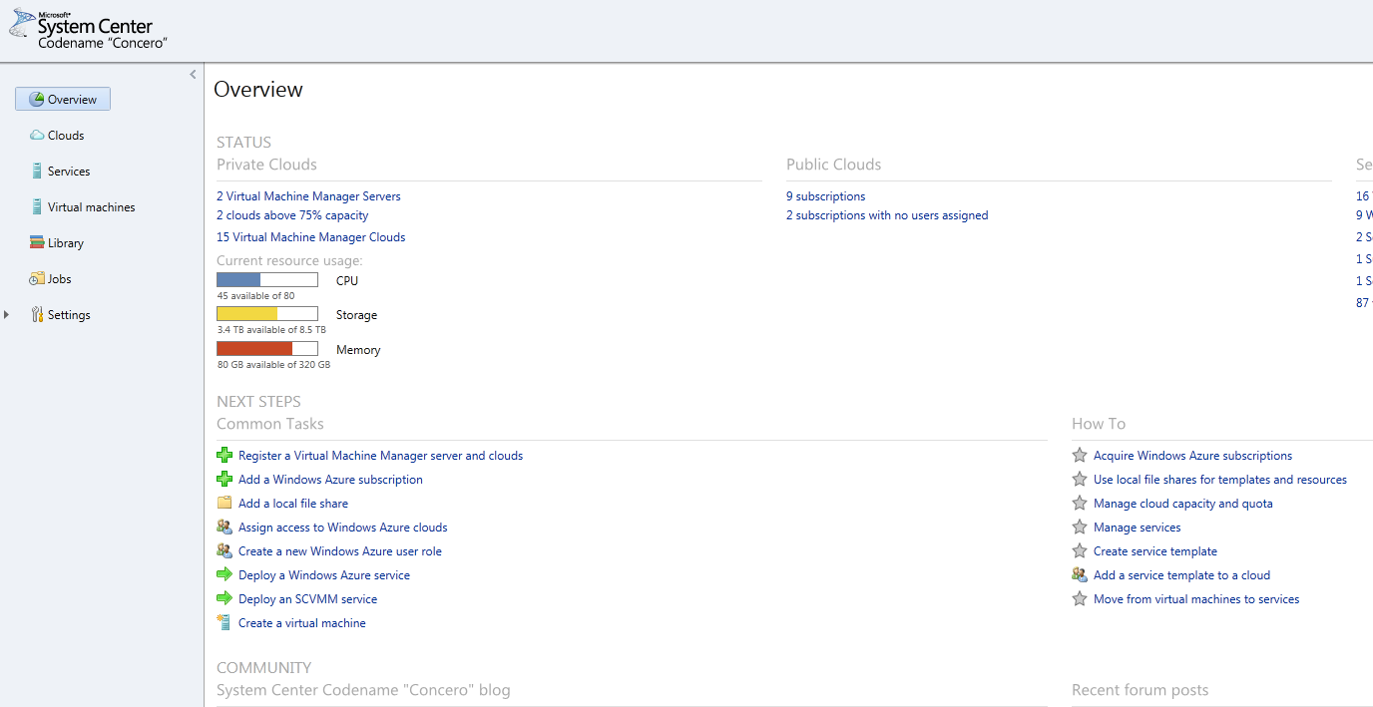
Deploying a Service to the Cloud: The 10,000 foot view
Service
System Center AppManager
Package upload to portal
System Center Concero provides IT Pro upload experience
Windows Azure portal provides developer upload experience
Service package passed to RDFE
RDFE sends service to a Fabric Controller (FC) based on target region and affinity group
FC stores image in repository and deploys service
Windows Azure Portal
RDFE
Service
US-North Central Datacenter
Fabric Controller

Slide 14
RDFE
RDFE serves as the front end for all Windows Azure services
Subscription management
Billing
User access
Service management
RDFE is responsible for picking clusters to deploy services and storage accounts
First datacenter region
Then affinity group or cluster load
Normalized VIP and core utilization
A(h, g) = C(h, g) / $∑\left\{C\left(h,g^{′}\right):g^{′}∈G\right\}$
$$X\left(g\right)=\min_{h∈H}A(h,g)$$

Slide 15
The Several Service Models of Windows Azure
Service Model undergoes several translations on the way to a node
.CSDEF/.CSCFG deployed to RDFE
SDK schema for external use
Internal schema for infrastructure services (more Update Domains, Fault Domains, early access to features)
RDFE converts .CSDEF to .WAZ
Includes advanced service concepts
Native hardware
Role colocation
RDFE then converts .WAZ to .SVD/.TRD
Fabric Controller internal model

Slide 16
Service Deployment Steps
Process service model files
Determine resource requirements
Create role images
Allocate compute and network resources
Prepare nodes
Place role images on nodes
Create virtual machines
Start virtual machines and roles
Configure networking
Dynamic IP addresses (DIPs) assigned to blades
Virtual IP addresses (VIPs) + ports allocated and mapped to sets of DIPs
Configure packet filter for VM to VM traffic
Programs load balancers to allow traffic

Slide 17
Service Resource Allocation
Goal: allocate service components to available resources while satisfying all hard constraints
HW requirements: CPU, Memory, Storage, Network
Fault domains
Secondary goal: Satisfy soft constraints
Prefer allocations which will simplify servicing the host OS/hypervisor
Optimize network proximity: pack nodes
Service allocation produces the goal state for the resources assigned to the service components
Node and VM configuration (OS, hosting environment)
Images and configuration files to deploy
Processes to start
Assign and configure network resources such as LB and VIPs

Slide 18
Deploying a Service
Role A
Web Role
(Front End)
Count: 3
Update Domains: 3
Size: Large
Role B
Worker Role
Count: 2
Update Domains: 2
Size: Medium
www.mycloudapp.net
www.mycloudapp.net
Load
Balancer
10.100.0.36
10.100.0.185
10.100.0.122

Slide 19
Mapping Instances to Update/Fault Domains
Algorithm must round-robin across two axes: fault domains and update domains
APIs return FD and UD for an instance, but the mapping is invariant
 | FD0 | FD1 | FD2
UD0
UD1
UD2
IN_0
IN_3
IN_6
IN_7
IN_1
IN_4
IN_5
IN_8
IN_2

Slide 20
Inside a Deployed Node
Physical Node
Guest Partition
Guest Partition
Guest Partition
Guest Partition
Trust boundary
Role Instance
Role Instance
Role Instance
Role Instance
Guest Agent
Guest Agent
Guest Agent
Guest Agent
Host Partition
FC Host Agent
Image Repository (OS VHDs, role ZIP files)
Fabric Controller (Primary)
Fabric Controller (Replica)
Fabric Controller (Replica)
…

Slide 21
Deploying a Role Instance
FC pushes role files and configuration information to target node host agent
Host agent creates three VHDs:
Differencing VHD for OS image (D:\)
Host agent injects FC guest agent into VHD for Web/Worker roles
Resource VHD for temporary files (C:\)
Role VHD for role files (first available drive letter e.g. E:\, F:\)
Host agent creates VM, attaches VHDs, and starts VM
Guest agent starts role host, which calls role entry point
Starts health heartbeat to and gets commands from host agent
Load balancer only routes to external endpoint when it responds to simple HTTP GET (LB probe)

Slide 22
Role Instance VHDs
Role Virtual Machine
C:\
Resource Disk
D:\
Windows Differencing Disk
E:\ or F:\
Role Image Differencing Disk
Windows VHD
Role VHD

Slide 23
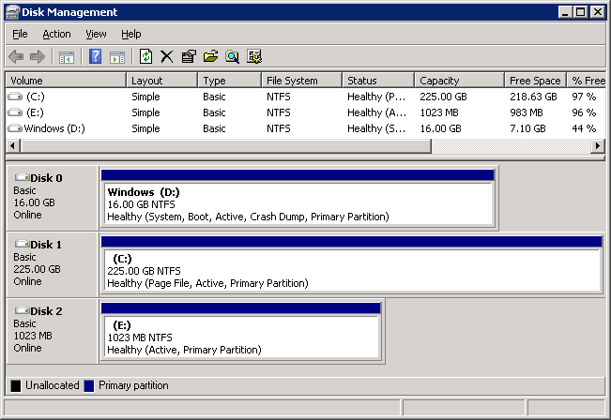
Inside a Role VM
OS Volume
Resource Volume
Role Volume
Guest Agent
Role Host
Role Entry Point

Slide 24
Performance Improvements: JBOD
Today: blade disks are striped
VM VHDs share the multi-disk volume
I/O contention can be high during boot of multiple VMs
Failure of one disk affects all VMs
Improvement: create one volume per disk
VHDs span volumes only if necessary
Leads to higher I/O isolation
Failure of a disk affects only VMs hosted on that disk
VHD1
VHD2
VHD1
VHD2
Volume
Volume 1
Volume 2
Volume 3
Disk 1
Disk 2
Disk 3
Disk 1
Disk 2
Disk 3
Striping
JBOD

Slide 25
Performance Improvements: Preallocation and Prefetching
Today: Differencing VHDs expanded on demand
Causes seeks and zero-filling for expansion
Volume becomes fragmented over time
Improvement: Preallocate and prefetch VHDs
Differencing and dynamic VHDs preallocated and demand zero-filled
OS VHD prefetched from lab-generated prefetch file
VHD1
VHD2
Dynamic Allocation
Preallocation

Slide 26
Updating the Host OS
Initiated by the Windows Azure team
Typically no more than once per month
Goal: update all machines as quickly as possible
Constraint: must not violate service SLA
Service needs at least two update domains and role instances for SLA
Can’t allow more than one update domain of any service to be offline at a time
Essentially a graph coloring problem
Edges exist between vertices (nodes) if the two nodes host instances of the same service role in different update domains
Nodes that don’t have edges between them can update in parallel
Note: your role instance keeps the same VM and VHDs, preserving cached data in the resource volume

Slide 27
Allocation Constraints
Host OS upgrade rollout is 2x faster with allocation 1
Both allocations are valid from the service’s point of view
Allocation 1 allows for 2 nodes rebooting simultaneously
Allocation 2 allows only one node to be down at any time
Allocation algorithm:
Prefer nodes hosting same UD as role instance’s UD
Service A
Role A-1
UD 1
Service B
Role A-1
UD 1
Service A
Role A-1
UD 2
Service B
Role A-1
UD 2
Service A
Role B-1
UD 1
Service B
Role B-1
UD 1
Service A
Role B-2
UD 2
Service B
Role B-2
UD 2
Allocation 1
Service A
Role A-1
UD 1
Service B
Role A-1
UD 2
Service A
Role A-1
UD 2
Service B
Role B-1
UD 1
Service A
Role B-1
UD 1
Service B
Role A-1
UD 1
Service A
Role B-2
UD 2
Service B
Role B-2
UD 2
Allocation 2

Slide 28
Updating a Cluster: The Long Tail
Cluster Host OS updates can take many hours because of the “long tail”
Some services have many UDs, serializing server updates
Because of utilization, sometimes UDs from different services must be placed on the same server, forcing serialization
Worst case: servers must be updated one-by-one
Number of Servers Updated
0
3
6
9
12
Hours

Slide 29
Maintaining Service Health

Slide 30
Node and Role Health Maintenance
FC maintains service availability by monitoring the software and hardware health
Based primarily on heartbeats
Automatically “heals” affected roles
Problem | Fabric Detection | Fabric Response
Role instance crashes | FC guest agent monitors role termination | FC restarts role
Guest VM or agent crashes | FC host agent notices missing guest agent heartbeats | FC restarts VM and hosted role
Host OS or agent crashes | FC notices missing host agent heartbeat | Tries to recover node FC reallocates roles to other nodes
Detected node hardware issue | Host agent informs FC | FC migrates roles to other nodes Marks node “out for repair”

Slide 31
Hardware Issue Breakdown
Most hardware issues as clusters age are disk related
SMART errors are crucial to catching them before customers are affected
JBOD is more important as number of disks in a server increase
Memory errors are DIMM related and can be detected at boot by mismatch of available RAM and configured RAM
System must diagnose and recover from hardware issues automatically
Hardware Issue by Month | Disk % | Memory % | Other %
Jan | 28 | 21 | 51
Feb | 25 | 24 | 51
March | 41 | 15 | 44
April | 42 | 19 | 39
May | 34 | 17 | 49
June | 40 | 14 | 46
July | 46 | 16 | 38

Slide 32
Moving a Role Instance (Service Healing)
Moving a role instance is similar to a service update
On source node:
Role instances stopped
VMs stopped
Node reprovisioned
On destination node:
Same steps as initial role instance deployment
Warning: Resource VHD is not moved

Slide 33
Service Healing
Role A – V2
VM Role
(Front End)
Count: 3
Update Domains: 3
Size: Large
Role B
Worker Role
Count: 2
Update Domains: 2
Size: Medium
www.mycloudapp.net
www.mycloudapp.net
Load
Balancer
10.100.0.36
10.100.0.185
10.100.0.122
10.100.0.191

Slide 34
Developing and Operating Windows Azure

Slide 35
Windows Azure Service Development
Multiple teams in Windows Azure develop infrastructure services
Fabric Controller
Storage Location Service (XLS) and Storage
Monitor and Diagnostic Service (MDS)
Sydney Management (Windows Azure Connect)
Portal
…
Each team releases on its own cadence
Every day there’s at least one team deploying
Releases go through three stages: INT, STAGE, PROD
Stop for a few days to a week at each

Slide 36
Windows Azure Monitoring
All services emit events to Monitoring and Diagnostics (MDS) tables
MDS analysis tasks constantly aggregate and scan events
Some events trigger alarms and/or actions
MDS logs allow us to analyze performance and availability
Core Infrastructure
Alarming
Monitoring Data Store
(Windows Azure Tables
Reporting
Analysis Service

Slide 37
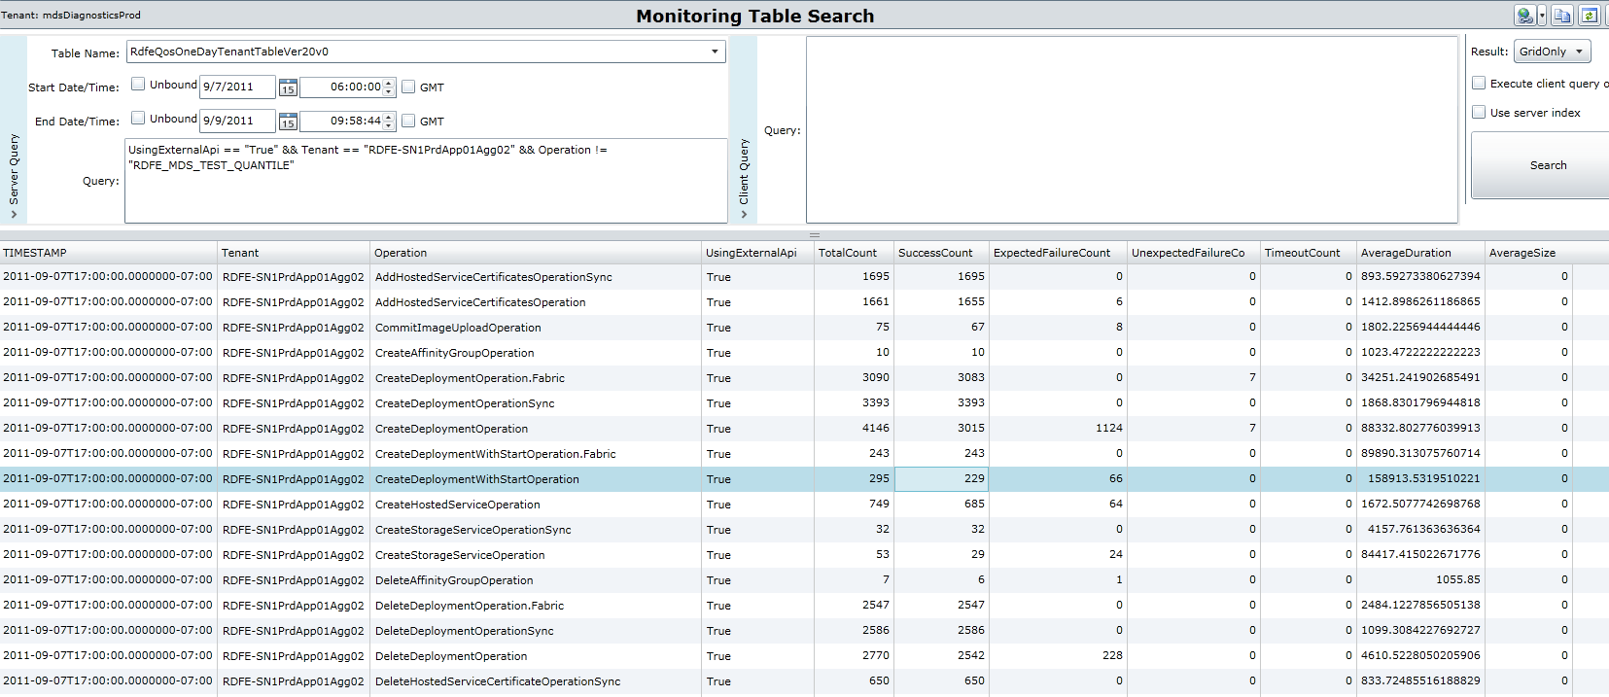
Monitoring API Performance (RDFE)
MDS log analysis of RDFE Deployment operation performance:

Slide 38
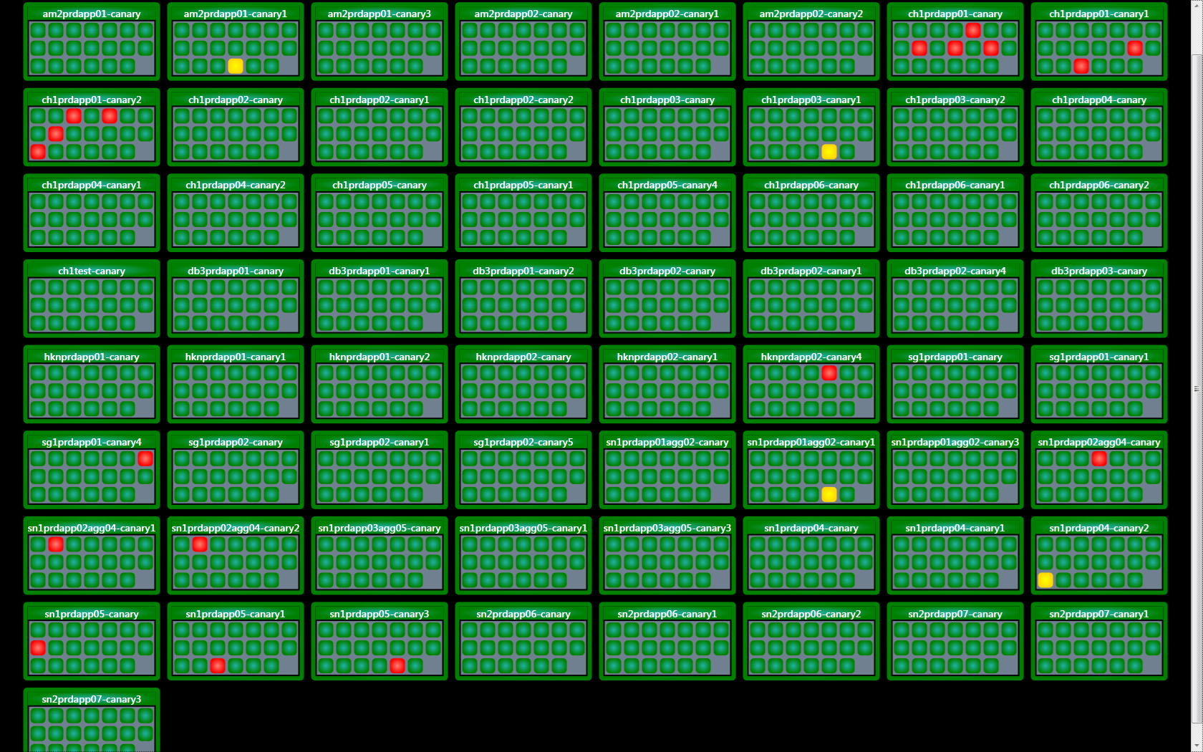
Canary Display
Canary display provides a realtime view of Canary health and status
Red instances are instances being upgraded

Slide 39
Conclusion
Platform as a Service is all about reducing management and operations overhead
The Windows Azure Fabric Controller is the foundation for Windows Azure’s PaaS
Provisions machines
Deploys services
Configures hardware for services
Monitors service and hardware health
The Fabric Controller continues to evolve and improve

Slide 40
thank you
Feedback and questions http://forums.dev.windows.com
Session feedback http://bldw.in/SessionFeedback

Slide 41
© 2011 Microsoft Corporation. All rights reserved. Microsoft, Windows, Windows Vista and other product names are or may be registered trademarks and/or trademarks in the U.S. and/or other countries.
The information herein is for informational purposes only and represents the current view of Microsoft Corporation as of the date of this presentation. Because Microsoft must respond to changing market conditions, it should not be interpreted to be a commitment on the part of Microsoft, and Microsoft cannot guarantee the accuracy of any information provided after the date of this presentation. MICROSOFT MAKES NO WARRANTIES, EXPRESS, IMPLIED OR STATUTORY, AS TO THE INFORMATION IN THIS PRESENTATION.

