Slide 1
Identity and Access Management for Windows Azure Applications
SAC-858T
Vittorio Bertocci
Principal Program Manager
Microsoft Corporation

Slide 2
ACS can simplify things for you.
Identity can be complicated.
Your cloud applications need identity.

Slide 3
Your Cloud Applications Need Identity
They are worth protecting
They live outside of your infrastructure
Others need access to them

Slide 4
Identity can Be Complicated
Finding Your Way Through Protocols and Formats

Slide 5
Identity Is Complicated. Why?
Intrinsically
Hard Problem
Self-Inflicted Complexity
Techniques & Scenarios
Often Mismatched

Slide 6
It’s All About Your User …And a Bit About Your App, Too

Slide 7
Authentication Flows Get Token, Use Token, Handle Sessions

Slide 8
Abstracting Details Away From Your App

Slide 9
ACS Can Simplify Things For You
Web Single Sign On

Slide 10
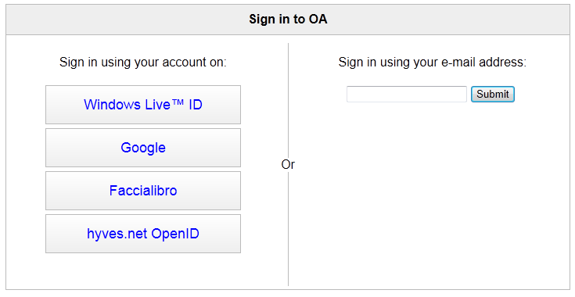
SSO for Web Applications

Slide 11
Basic authentication externalization
demo
Use WIF to outsource authentication to ACS, then use the ACS settings to enable multiple scenarios

Slide 12
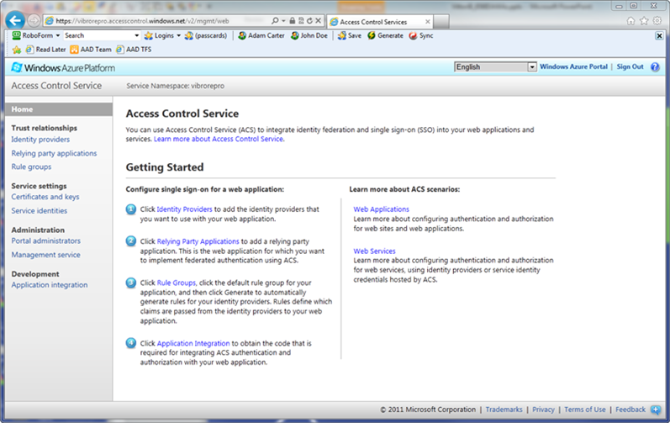
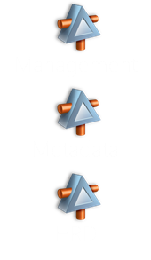
Access Control Service

Slide 13
ACS Can Simplify Things For You
Metro Style Apps

Slide 14
Rich Apps and Identity

Slide 15
Using ACS From a Metro Style Application
demo
Authenticating via WebAuthenticationBroker,
Saving tokens via PasswordVault,
Authenticating calls via OAuth2

Slide 16
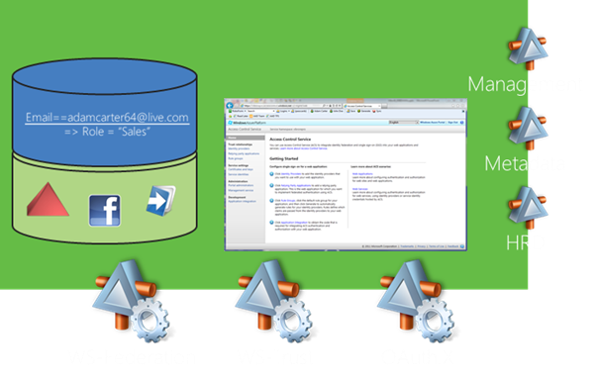
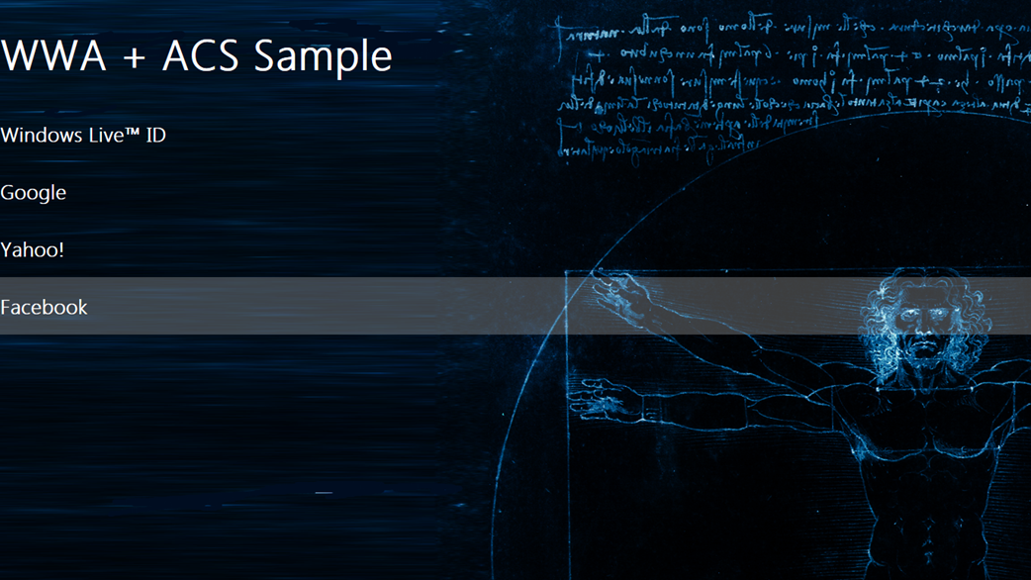
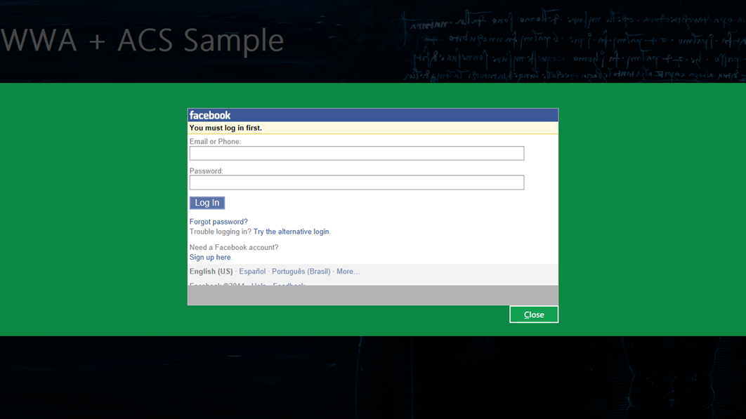
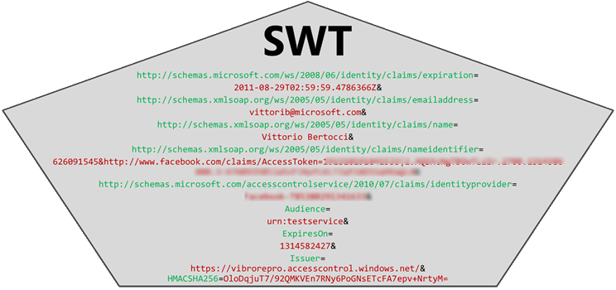
Metro Style Apps and ACS

Slide 17
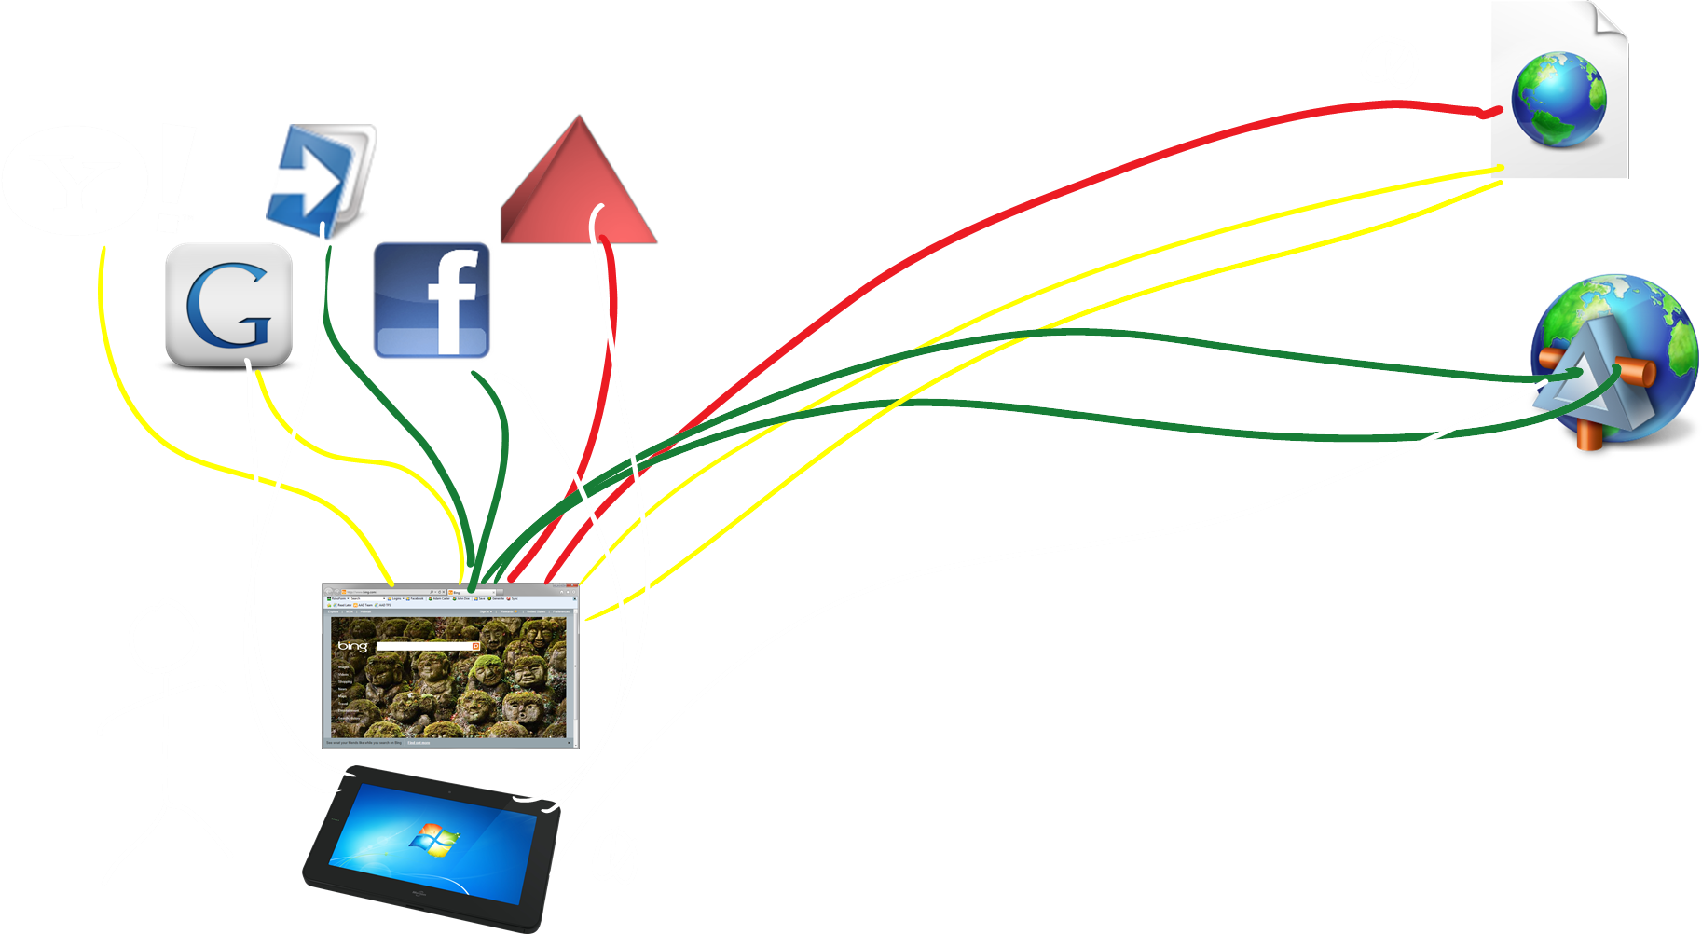
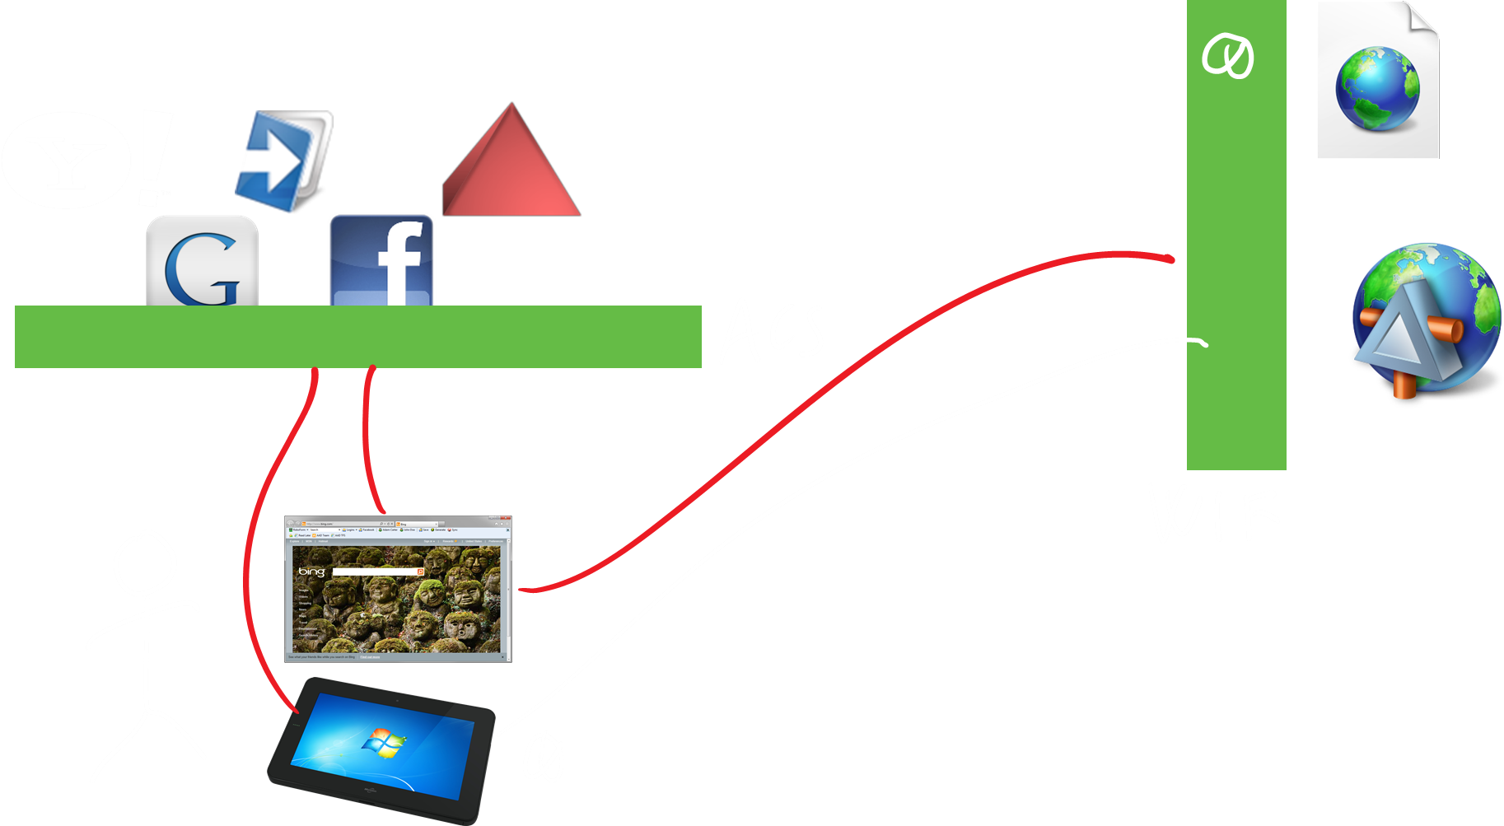
ACS can simplify things for you.
Identity can be complicated.
Your cloud applications need identity.

Slide 18
© 2011 Microsoft Corporation. All rights reserved. Microsoft, Windows, Windows Vista and other product names are or may be registered trademarks and/or trademarks in the U.S. and/or other countries.
The information herein is for informational purposes only and represents the current view of Microsoft Corporation as of the date of this presentation. Because Microsoft must respond to changing market conditions, it should not be interpreted to be a commitment on the part of Microsoft, and Microsoft cannot guarantee the accuracy of any information provided after the date of this presentation. MICROSOFT MAKES NO WARRANTIES, EXPRESS, IMPLIED OR STATUTORY, AS TO THE INFORMATION IN THIS PRESENTATION.

Slide 19
Handling Home Realm Discovery for the App
function GetIPsList() {
var ipsFeed = "https://...accesscontrol.windows.net:443/v2/metadata/...";
var request = new XMLHttpRequest();
request.open("GET", ipsFeed, false);
request.send(null);
var jsonString = request.responseText;
ipList = JSON.parse(jsonString);
return ipList;
}

Slide 20
Using the WebAuthenticationBroker with ACS (1/2)
function GetTokenFromACS(acsURL) {
try {
var callbackURL ="http://cloudidentity.cloudapp.net/Bouncer.aspx";
var startURI = new Windows.Foundation.Uri(acsURL);
var endURI = new Windows.Foundation.Uri(callbackURL);
Windows.Security.Authentication.Web.WebAuthenticationBroker.authenticateAsync(
Windows.Security.Authentication.Web.WebAuthenticationOptions.n,
startURI,
endURI).then(callbackACSAuth, callbackACSAuthError);
} catch (err) {
ShowDialog("Error launching WebAuth for " + acsURL + "<br>" + err);
return;
}
}

Slide 21
Using the WebAuthenticationBroker with ACS (2/2)
function callbackACSAuth(result) {
var status = result.responseStatus;
if (status == 0) {
var data = result.responseData;
var vault = new Windows.Security.Credentials.PasswordVault();
var cred = new Windows.Security.Credentials.PasswordCredential(
"cloudidentity.cloudapp.net",
"tempusername",
data.substring(data.indexOf("=", 0) + 1, data.length));
vault.add(cred);
id("tokenText").innerText = cred.password;
} else {
ShowDialog("Status returned by WebAuth broker: " + status +
"\r\n" + "data: " + data + "\r\n" + "text: " + result.responseText);
}
}

Slide 22
Invoking a Service with OAuth2
function InvokeService(token, serverUrl) {
var authHeader = "OAuth " + token;
var request = new XMLHttpRequest();
request.open("GET", serverUrl, false);
request.setRequestHeader("Authorization", authHeader);
request.send();
return request.responseText
}

