Slide 1
Delivering notifications with the Windows Push Notification Service and Windows Azure
SAC-863T
Darren Louie, Nick Harris
Program Manager, Technical Evangelist
Microsoft Corporation

Slide 2
Agenda
Review of Live Tiles.
A deeper look at using the Windows Push Notification Service.
Introduction to the Windows Azure Toolkit for Windows 8.
You’ll leave with examples of how to
Enable push notifications for your service.
Build a push enabled service using Windows Azure.

Slide 3
Live Tiles on Start
demo

Slide 4
Live Tiles with Push Notifications

Slide 5
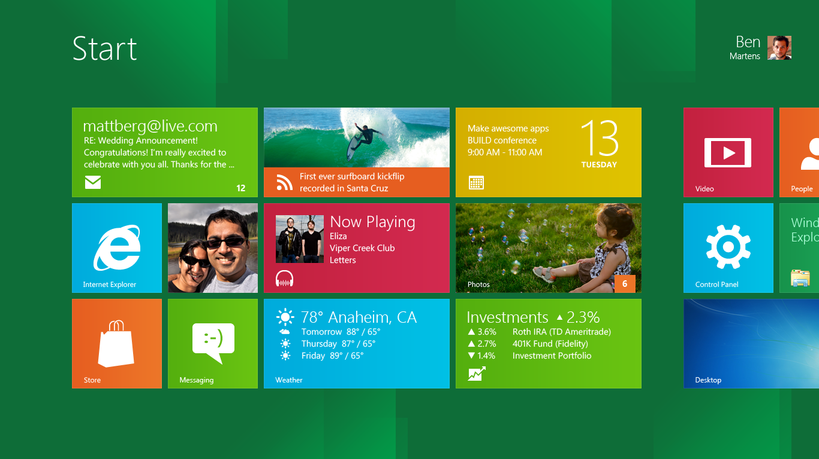
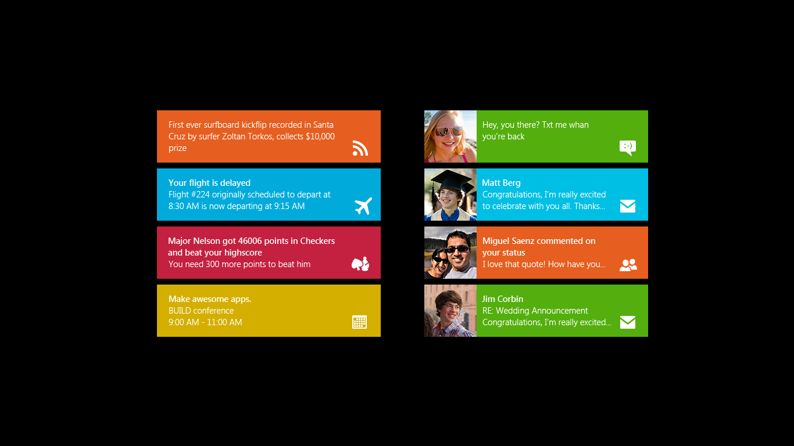

Slide 6
Windows Push Notification Service
(WNS)

Slide 7
Push Notification Overview
Windows 8
Cloud Service
Metro Style App
2
Request Channel URI
Register with your Cloud Service
Authenticate & Push Notification
3
1
Windows Push Notification Service
Notification
Client Platform
3

Slide 8
1. Request a Channel URI
Windows 8
Cloud Service
Each tile has a unique Channel URI.
Requested by App on each run. URI can change.
Generated by WNS
Opaque to the app.
Metro Style App
2
3
1
Windows Push Notification Service
Notification
Client Platform
3

Slide 9
1. Request Channel URI
var push = Windows.Networking.PushNotifications;
var promise = push.PushNotificationChannelManager .createPushNotificationChannelForApplicationAsync();
https://db3.notify.windows.com/?token=AQI8iP%2OtQE%3d
promise.then(function (ch) {
var uri = ch.uri;
var expiry = ch.expirationTime;
updateChannelUri(uri, expiry);
});

Slide 10
2. Register with your Cloud Service
Windows 8
Windows 8
Cloud Service
Cloud Service
Register your app with your own Cloud Service.
  Should be authenticated and secure.
Store Channel URI and associate it with any app specific context.
Create your business logic for sending notifications.
Metro App
Metro Style App
2
1
1
Windows Push Notification Service
Windows Push Notification Service
Notification
Client Platform
Notification
Client Platform

Slide 11
2. Register with your Cloud Service
function updateChannelUri(channel, channelExpiration) {
if (channel) {
var serverUrl = "https://mysampleapp.cloudapp.net/register";
var payload = { Expiry: channelExpiration.toString(),
URI: channel };
var xhr = new WinJS.xhr({
type: "POST",
url: serverUrl,
headers: { "Content-Type": "application/json; charset=utf-8" },
data: JSON.stringify(payload)
}).then(function (req) { … });
}
}

Slide 12
3. Authenticate & Send Notification
Windows 8
Cloud Service
Metro Style App
2
OAuth 2 Authentication.
HTTP POST to Channel URI.
XML notification payload.
3
Windows Push Notification Service
Notification
Client Platform
3

Slide 13
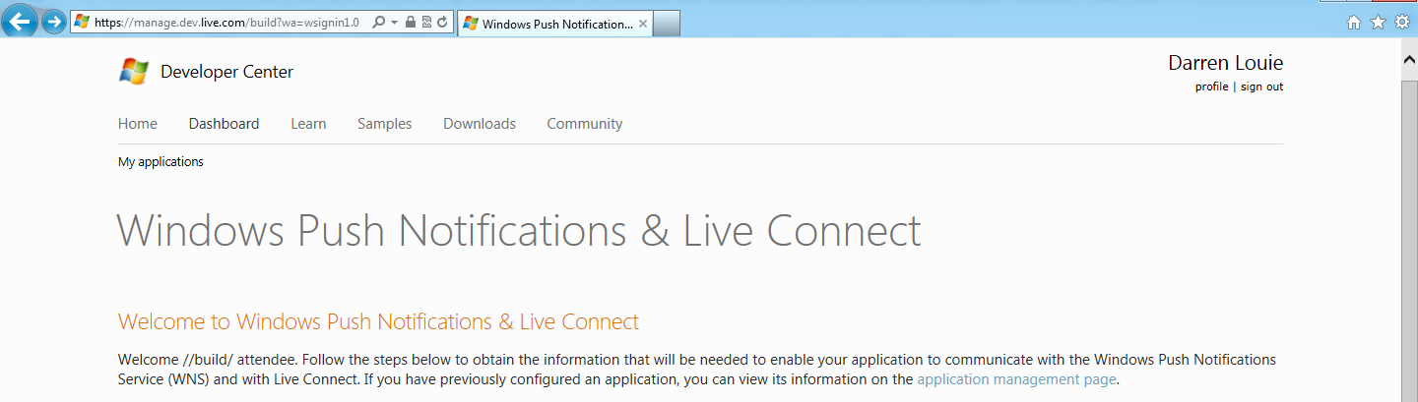
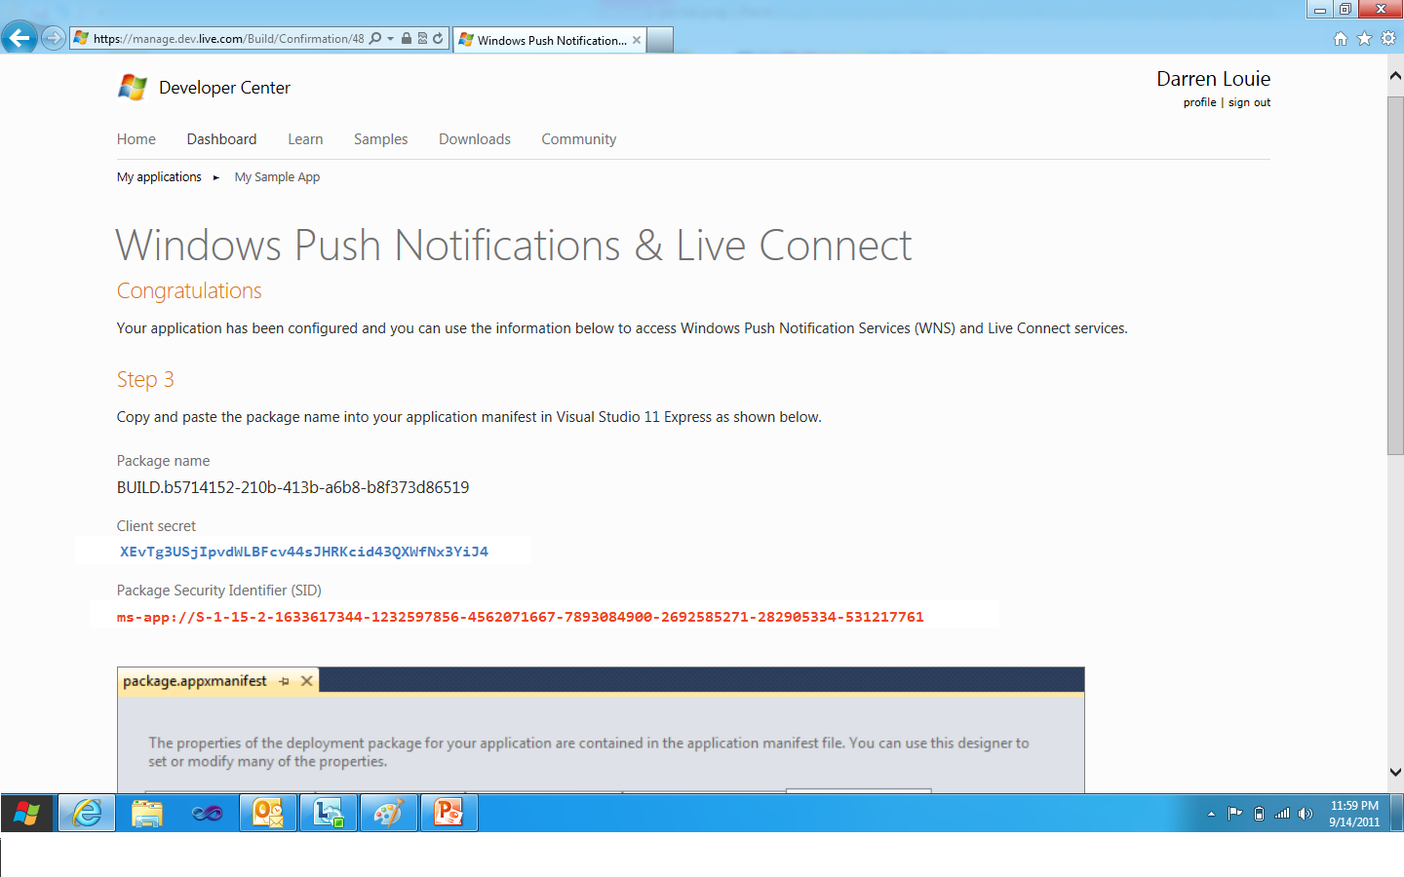
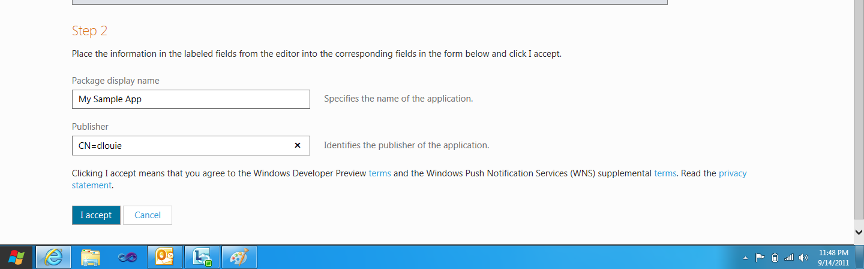
3. Register your App

Slide 14
3. Authentication HTTP Request
POST https://login.live.com/accesstoken.srf HTTP/1.1
Content-Type: application/x-www-form-urlencoded
Host: login.live.com
Content-Length: 221
grant_type=client_credentials&client_id=ms-app%3A%2F%2FS-1-15-2-1633617344-1232597856-4562071667-7893084900-2692585271-282905334-531217761&client_secret=XEvTg3USjIpvdWLBFcv44sJHRKcid43QXWfNx3YiJ4g&scope=notify.windows.com

Slide 15
3. Authentication HTTP Response
HTTP/1.1 200 OK
Cache-Control: no-store
Content-Length: 422
Content-Type: application/json
Connection: close
{
"access_token":"EgAcAQMAAAAg/RBw++jdA1MzM0LTUzMTIxNzc2MQA=", "token_type":"bearer"
}

Slide 16
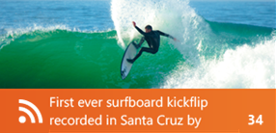

3. Push Notification HTTP Request
POST https://db3.notify.windows.com/?token=AQI8iP%2OtQE%3d HTTP/1.1
Content-Type: text/xml
Host: db3.notify.windows.com
X-WNS-Type: wns/badge
Authorization: Bearer EgAcAQMAAAAg/RBw++jdA1MzM0LTUzMTIxNzc2MQA=
Content-Length: 58
<?xml version="1.0" encoding="utf-8"?>
<badge value="34"/>

Slide 17
3. Push Notification HTTP Response
HTTP/1.1 200 OK
Content-Length: 0
X-WNS-NOTIFICATIONSTATUS: received
X-WNS-MSG-ID: 1ACD59E4683FE4BF
X-WNS-DEBUG-TRACE: DB3WNS4011434
Important Notes
Device can be offline or disconnected. Success indicates that the request was successfully received by WNS; not necessarily that the user saw it.
Additional headers in the response for notification and device status.

Slide 18
Windows Push Notification Recipe
announcing

Slide 19
Authentication Code
using Windows.Recipes.Push.Notifications.Security;
…
// Constructor takes your Package SID and secret key
IAccessTokenProvider _tokenProvider = new WNSAccessTokenProvider( "ms-app%3A%2F%2FS-1-15-2-1633617344-1232597856-4562071667-7893084900-2692585271-282905334-531217761", "XEvTg3USjIpvdWLBFcv44sJHRKcid43QXWfNx3YiJ4g");

Slide 20
Push Notification Code
using Windows.Recipes.Push.Notifications;
…
var toast = new ToastNotification(_tokenProvider);
toast.ChannelUrl = "https://db3.notify.windows.com/?token=AQI8iP%2OtQE%3d";
toast.ToastType = ToastType.ToastImageAndText02;
toast.Image = "https://demosa.blob.core.windows.net/toastImg1.png";
toast.Text = new List<string> {"Miguel Saenz comment on your status", "I love that quote! How have you …"};
NotificationSendResult result = toast.Send();

Slide 21
Push Notification Overview
Building a Cloud Service with Window Azure
Windows 8
Cloud Service
What a service needs to support
How do I do that with Windows Azure?
Metro Style App
Windows Azure Compute
  Web Role
    Full IIS support
    WCF REST and ASP.NET MVC
Windows Azure Storage
  Table Storage
  Blob Storage
Secure, web based API for channel URI registration.
Persistent storage of channel URI.
Storage for tile and toast images.
2
Request Channel URI
Register with your Cloud Service
Authenticate & Push Notification
3
1
Windows Push Notification Service
Notification
Client Platform
3

Slide 22
Windows Azure Toolkit for Windows 8
announcing

Slide 23
Windows Azure provides the resources to scale your services as your app grows.

Slide 24
Windows Azure Services
Core Services:
  Windows Azure Compute
  Windows Azure Storage
    Table Storage
    Blob Storage
Services to Help Scale:
  Windows Azure Elastic Scale
  Windows Azure CDN
  Windows Azure Traffic Manager
  Windows Azure App Fabric Cache

Slide 25
Recap

Slide 26
Session Recap
There are 3 easy steps to implement push notifications:
    Request Channel URI
    Register with your Cloud Service
    Authenticate & Push
The Windows Push Notification Recipe helps you easily add push notifications to your service.
The Windows Azure Toolkit for Windows 8 is the best way to start building a service.
Windows Azure provides the resources to scale your services as your app grows.

Slide 27
Resources
Register your app
http://manage.dev.live.com/build
Download the Windows Azure Toolkit for Windows 8 http://WATWindows8.codeplex.com
Windows 8 Developer Documentation
http://dev.windows.com

Slide 28
Sessions
[APP-396T] Using tiles and notifications
[SAC-850T] Getting started with Windows Azure
[SAC-858T] Identity and access management for Windows Azure apps
[SAC-868T] Building device & cloud apps
[SAC-869T] Building global and highly-available services using Windows Azure
[SAC-870T] Building scalable web apps with Windows Azure
[SAC-871T] Building social games for Windows 8 with Windows Azure
[SAC-961T] Inside Windows Azure storage: what's new and under the hood deep dive

Slide 29
thank you
Feedback and questions http://forums.dev.windows.com
Session feedback
http://bldw.in/SessionFeedback

Slide 30

© 2011 Microsoft Corporation. All rights reserved. Microsoft, Windows, Windows Vista and other product names are or may be registered trademarks and/or trademarks in the U.S. and/or other countries.
The information herein is for informational purposes only and represents the current view of Microsoft Corporation as of the date of this presentation. Because Microsoft must respond to changing market conditions, it should not be interpreted to be a commitment on the part of Microsoft, and Microsoft cannot guarantee the accuracy of any information provided after the date of this presentation. MICROSOFT MAKES NO WARRANTIES, EXPRESS, IMPLIED OR STATUTORY, AS TO THE INFORMATION IN THIS PRESENTATION.

