Slide 1
Building device & cloud apps
SAC-868T
Wade Wegner
Technical Evangelist Lead
Microsoft Corporation

Slide 2
Agenda
This session is focused on building device applications with Windows Azure
We’ll talk about storage, identity, communications, platform services, and tools
I’ll show demos for Windows 8, Windows Phone, iOS, and Android
You’ll leave with an …
… understanding of how storage, identity, and communications work on devices with Windows Azure

Slide 3
What exactly do I mean?

Slide 4
BabelCam
demo
Windows Phone application leveraging Windows Azure

Slide 5
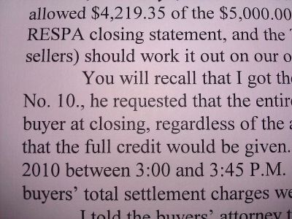
WAZ Storage
Any pictures?
Windows Azure
SAS
Process Image
Store Image in Windows Azure Blob Storage
User Authentication
Send Notification
Process Image
Authenticate
Access Token
Access Token
Shared Access Signature
Send Image
Translated Text
Translated Text
Translated Text
Microsoft Push Notification Service
Hawaii OCR & Bing Translator

Slide 6
What did we just see?
Storage
Identity
Communications
Platform Services

Slide 7
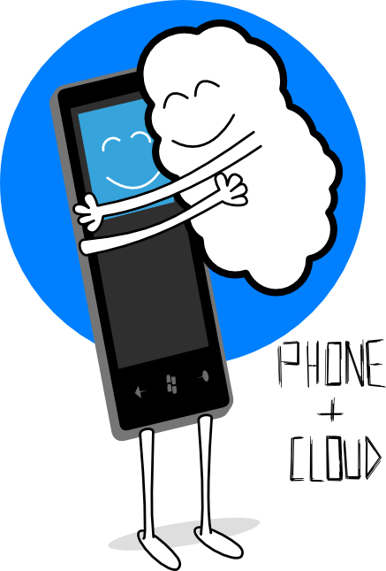
Why Device + Cloud?
The cloud levels the playing field
The cloud provides a larger pool of resources from which to pull
The cloud provides a way to reach across device platforms

Slide 8
Why Windows Azure?
PaaS: you built it, Windows Azure runs it
Automatic O/S patching
Elasticity and scale
Utility billing
Higher-level services
ACS, Traffic Manager, Caching, CDN
Getting started with Windows Azure
Brian Prince
SAC-850T
September 15, 2011 from 9:00AM to 10:00AM

Slide 9
Storage

Slide 10
Storage: What are our options?
Windows Azure Tables
Non-relational structured storage
Massive scale-out
OData
Windows Azure Blobs
Big files
REST
Windows Azure Queues
Persistent Async Messaging
Enqueue, Dequeue
Inside Windows Azure storage
Brad Calder
SAC-961T
September 14, 2011 from 5:00PM to 6:00PM

Slide 11
Storage: What are our options?
SQL Azure
Relational database
Highly available
Managed for you as a service

Slide 12
Storage: Secrets
Windows Azure
Storage name
Storage key
SQL Azure
Username
Password
Once your share your secret, it’s no longer secret

Slide 13
Storage: How do we keep secrets secret?
Proxy the requests
Client sends data to web role
Web role sends data to storage
(2)
Web
Role
(1)

Slide 14
Storage: What are the options?
Choices | Direct | Proxy | Other
Blob (private) | x | x | x (SAS)
Blob (public) | x | x (write) | x (read-only)
Table | x | x
Queue | x | x
Database |  | x

Slide 15
Storage: Using Shared Access Signatures
Client makes request of Web Role for SAS
Web Role sends client SAS
Client makes request
Client gets response
Web
Role
(3)
(4)
(2)
(1)

Slide 16
Storage: SQL Azure
Client sends request to proxy
Proxy makes SQL call against SQL Azure
SQL Azure returns a response
Proxy returns response to device
(2)
Web
Role
(3)
(4)
(1)

Slide 17
Storage: Metadata
Helpful operations on the REST API for WA Blobs
Get Container Metadata
Set Container Metadata
Get Blob Metadata
Set Blob Metadata
Not available for WA Queues
Service Bus Queues

Slide 18
Storage: Offloading work through queues
Client writes a message to a queue
Worker role is polling the queue
Worker role finds the message
Worker Role
(2)
(3)
(1)

Slide 19
Identity

Slide 20
Identity: What are the options?
Create your own
Username + password, token, etc.
ASP.NET Membership Providers
Use a single existing identity system
Live Id, Facebook, etc.
Develop directly against IdP protocol
Outsource identity management
Access Control Service
Identity & access management for Windows Azure apps
Vittorio Bertocci
SAC-858T
September 15, 2011 from 2:30PM to 3:30PM

Slide 21
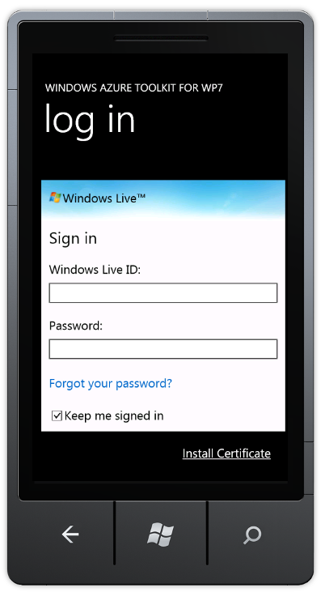
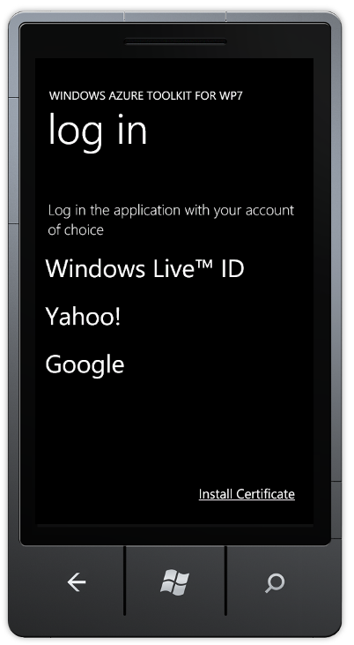
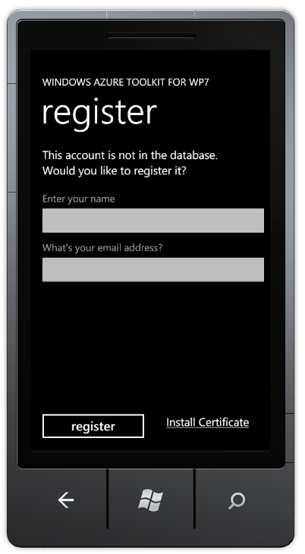
Identity: Authenticating Users with ACS
Web
Role
Access Control Service

Slide 22
Using ACS from an iOS app
demo

Slide 23
What’s Unique in Windows 8
Windows Web Authentication Broker
Windows.Security.Authentication.Web
Securely and consistently handle authentication
Asynchronous authentication operation
Password Vault
A vault of credentials
Secure
Roams

Slide 24
Using ACS from a Metro style app
demo

Slide 25
Communications

Slide 26
Communications
Two forms of communication with devices
Device-initiated
Cloud-initiated

Slide 27
Communications: Device-initiated
Device-initiated options
HTTP-based, request/response
Framework choices (WCF, OData, WebRequest, etc.)
Wire format choices (SOAP, JSON, POX, etc.)

Slide 28
Communications: Cloud-initiated
Push Notifications
Single connecting between the device and the notification service
Bandwidth- and battery-friendly
No guarantee of delivery

Slide 29
Communications: Subscribing to Push
Device requests a channel
*NS returns channel
Device sends URL to cloud
Channel URL is stored in cloud
Cloud sends notification
*NS pushes to device
Web
Role
*NS

Slide 30
Communications: Cloud-initiated to device?
Common pattern
Use cloud-initiated push to tell the device to call to a service
Cloud sends notification
Notification services pushes to device
Device receives message and calls to a service
Web Role sense a response
Web
Role
*NS

Slide 31
Notifications: Different services
Windows 8: Windows Push Notification Service (WNS)
Windows Phone: Microsoft Push Notification Service (MPNS)
iOS: Apple Push Notification Service (APNS)
Android: Cloud To Device Messaging (C2DM)
…
Delivering notifications with the WNS and Windows Azure
Darren Louie, Nick Harris
SAC-863T
September 15, 2011 from 2:30PM to 3:30PM

Slide 32
Pushing messages to a device with WNS
demo

Slide 33
Platform Services

Slide 34
Platform Services
Traffic Manager
Content Delivery Network (CDN)
SQL Azure Data Sync
SQL Azure
WA Storage
Caching
Building global and highly-available services using Windows Azure
David Aiken
SAC-869T
September 16, 2011 from 12:30PM to 1:30PM

Slide 35
Tools & Resources

Slide 36
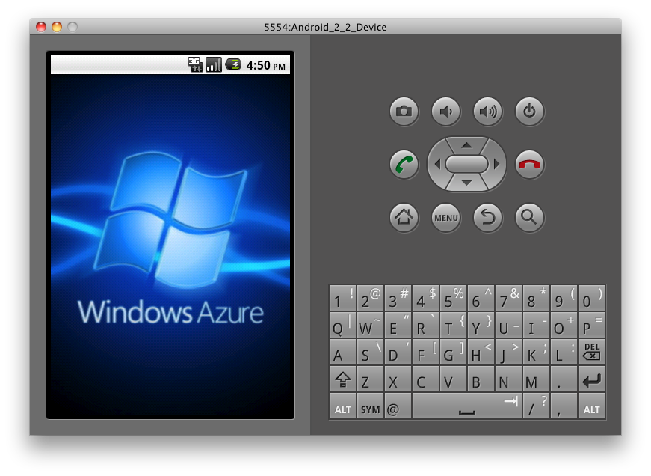
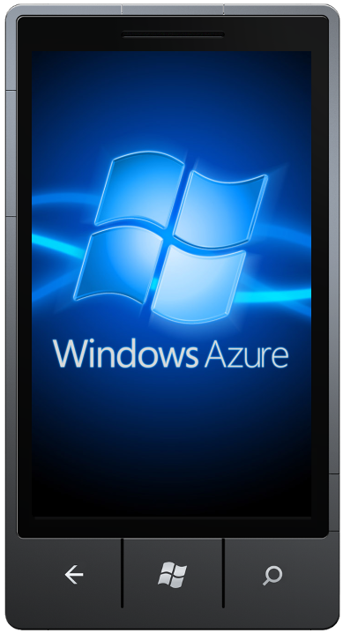
Windows Azure Toolkits for Devices
Easier for device developers to use Windows Azure
Windows Phone: http://bit.ly/watwp7
iOS: http://bit.ly/watios
Android: http://bit.ly/watandroid
Toolkits include:
Native libraries (e.g. .NET, Objective-C)
Samples
Project templates
Documentation

Slide 37
Windows Azure Toolkit for Windows 8
Deliver a Push Notification Cloud Service with ease.
VS 2010 Project Template for Windows Azure
Dev 11 Project for Client
Samples:
ACS Metro Style App
Margie’s Travel
Push Notification Worker
Documentation
Download at: http://watwindows8.codeplex.com/

Slide 38
Show how the toolkits work
demo

Slide 39
Related sessions
[SAC-850T] Getting started with Windows Azure
[SAC-858T] Identity and access management for Windows Azure apps
[SAC-863T] Delivering notifications with the Windows Push Notification Service and Windows Azure
[SAC-869T] Building global and highly-available services using Windows Azure
[SAC-870T] Building scalable web apps with Windows Azure
[SAC-871T] Building social games for Windows 8 with Windows Azure
[SAC-961T] Inside Windows Azure storage: what's new and under the hood deep dive

Slide 40
thank you
Feedback and questions http://forums.dev.windows.com
Session feedback http://bldw.in/SessionFeedback

Slide 41
© 2011 Microsoft Corporation. All rights reserved. Microsoft, Windows, Windows Vista and other product names are or may be registered trademarks and/or trademarks in the U.S. and/or other countries.
The information herein is for informational purposes only and represents the current view of Microsoft Corporation as of the date of this presentation. Because Microsoft must respond to changing market conditions, it should not be interpreted to be a commitment on the part of Microsoft, and Microsoft cannot guarantee the accuracy of any information provided after the date of this presentation. MICROSOFT MAKES NO WARRANTIES, EXPRESS, IMPLIED OR STATUTORY, AS TO THE INFORMATION IN THIS PRESENTATION.

