Slide 1
Building Social Games for Windows 8 with Windows Azure
SAC-871T
Nathan Totten
Technical Evangelist
Microsoft Corporation

Slide 2
Agenda slide
WHO WILL BENEFIT FROM THIS TALK
TOPICS
WHAT YOU’LL LEAVE WITH
Developers
Interested in HTML5 Games
Interested in Windows Azure
Interested in Game Development
Games on Multiple Devices
Architecture of Games
Data
Communication
Handling Scale
Windows 8 Games
Understanding of Cloud-based Casual Gaming architectures

Slide 3
Context
Building for a Rich Ecosystem
Not locked into a particular device
Best Experience for targeted device
High Resolution for Windows 8
Scaled down for mobile

Slide 4
Features of Connected Games
Authentication
User Settings
State Storage
Real-Time Communication
Game Services: i.e. Leaderboard & Achievements

Slide 5
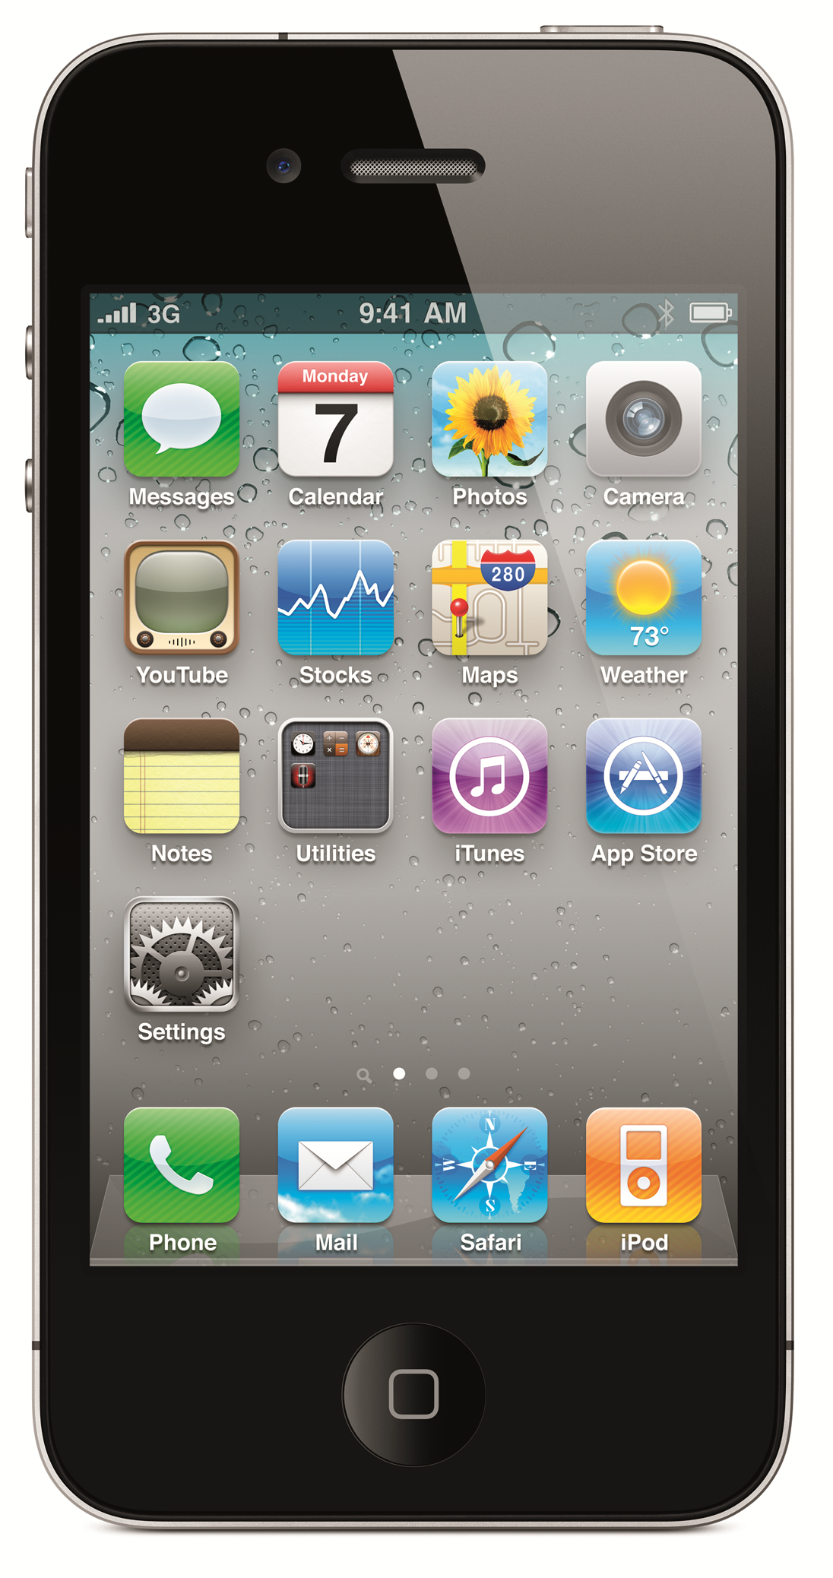
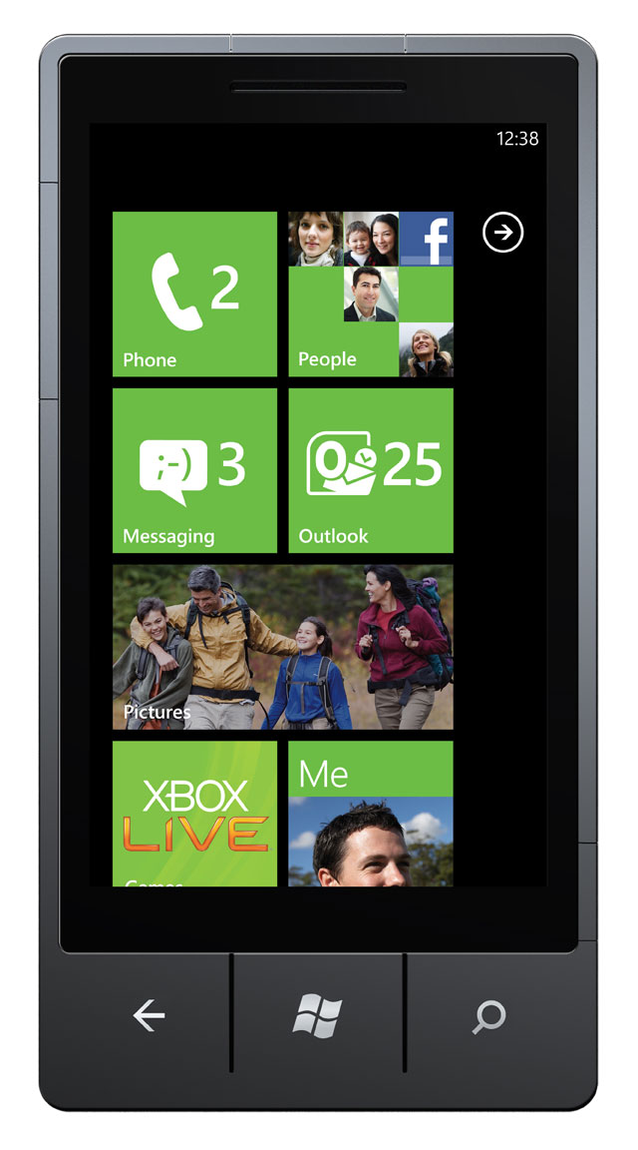
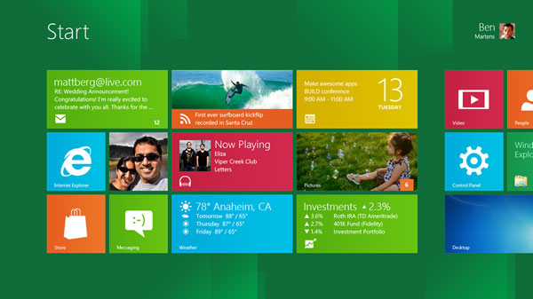
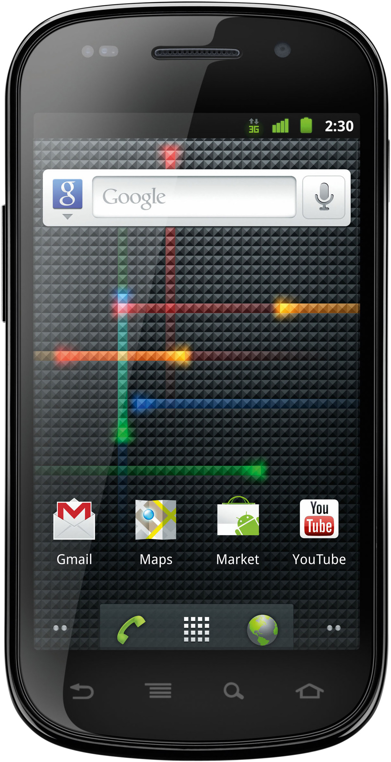
Casual Gaming Ecosystem

Slide 6
Tankster
demo…

Slide 7
//Architecture

Slide 8
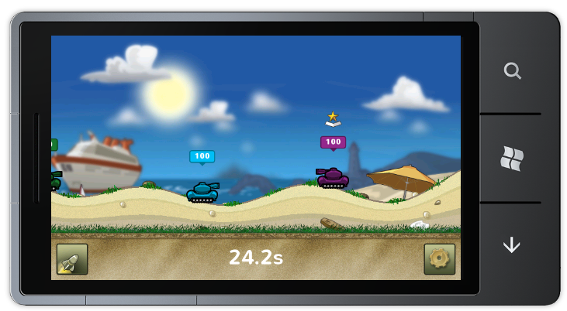
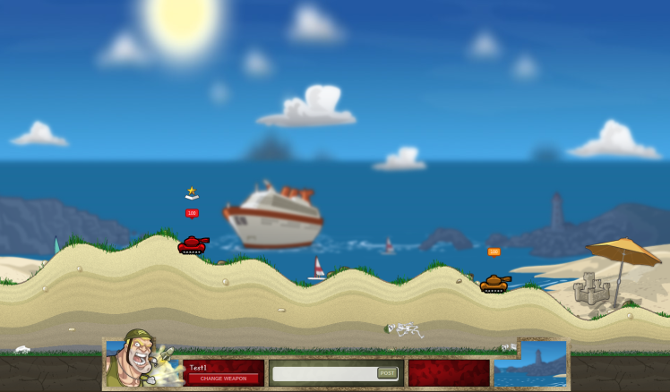
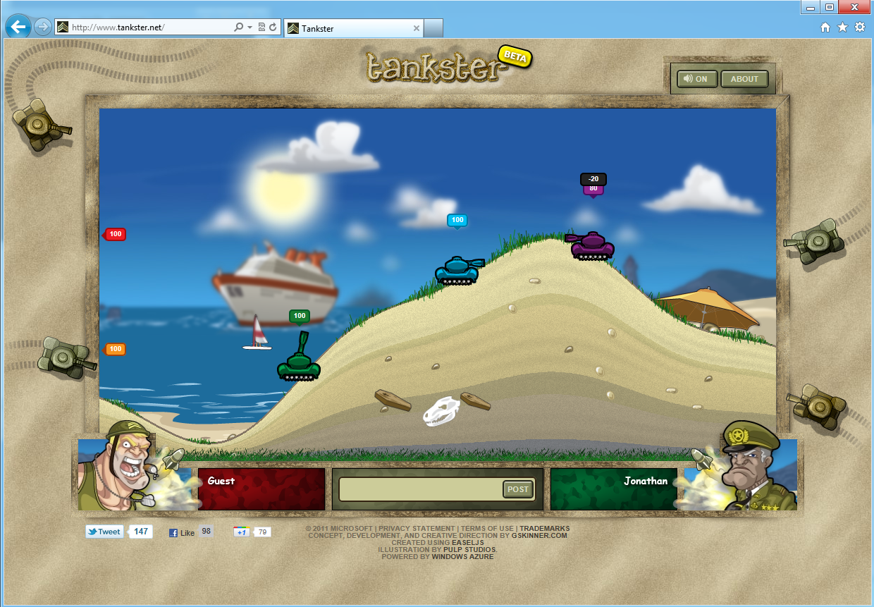
Three Versions of Tankster

Slide 9
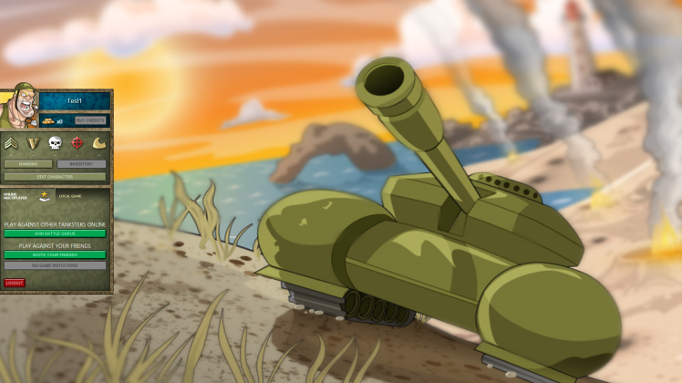
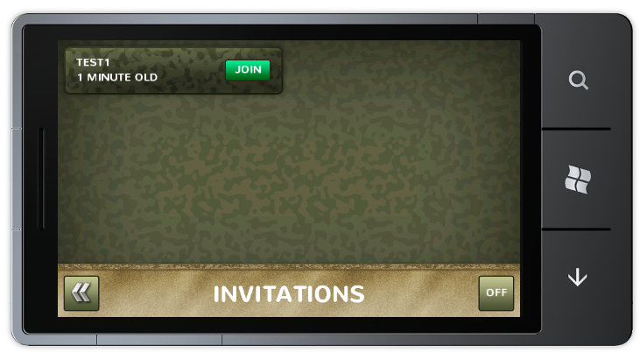
Start A Game
Game Services
Worker
WAZ Storage

Slide 10
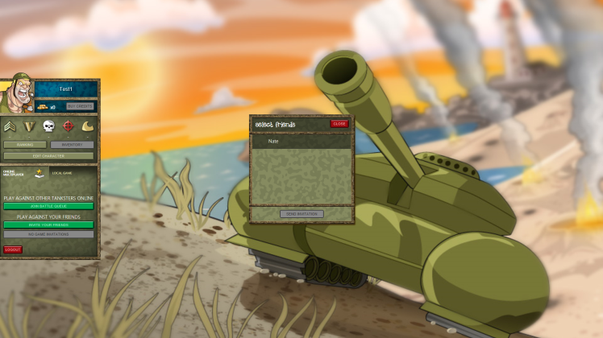
Invite to Play
Game Services
Worker
WAZ Storage
Notification Services

Slide 11
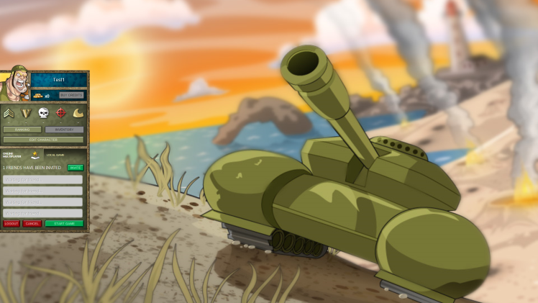
Accept a Game Invite
Game Services
Worker
WAZ Storage

Slide 12
Begin Playing a Game
Game Services
Worker
WAZ Storage

Slide 13
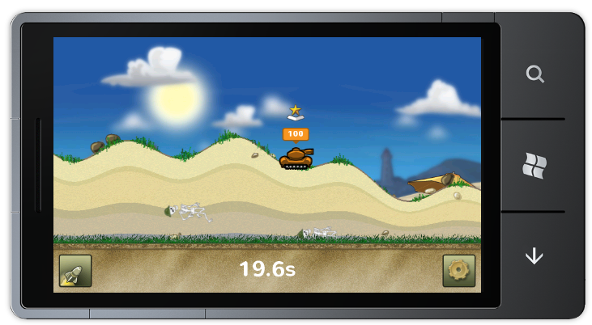
Connect to the Socket Server
Socket Server
Worker
WAZ Storage

Slide 14
Connect to the Socket Server
Socket Server
Worker
WAZ Storage

Slide 15
Patterns
Command – Query Separation
Reliance on Windows Azure Storage
Queues
Blobs
Rest Services
Sockets + Web Sockets

Slide 16
//Scale

Slide 17
Decoupled Systems
Many Independent Systems
Scale parts not the entire application
Rely on cloud services

Slide 18
Command – Query Separation
Send a command to the web server
Web server enqueues the command’s message
Worker role reads message from queue and acts on message

Slide 19
Architectural Diagram
Game Services
Worker
WAZ Storage

Slide 20
Javascript Start Game
GameService.prototype.startGame = function (queueId, success, error) {
this.serverInterface.sendAjaxPost(this.apiURL + "game/start/" + queueId,
{ gameType: "invitation" }, success, error);
};
ServerInterface.prototype.sendAjaxJsonCommand = function (type, url, data, success, error) {
$.ajax({
type: type,
url: url,
dataType: "json",
data: data,
success: success,
error: (error != null ? error : this.onAjaxPostError)
});
};

Slide 21
Send Game Command
public HttpResponseMessage SendCommand(GameCommand gameCommand)
{
var queueClient = account.CreateCloudQueueClient();
var queue = queueClient.GetQueueReference("gameCommands");
var serializer = new JavaScriptSerializer();
var json = serializer.Serialize(gameCommand);
try
{
queue.AddMessage(new CloudQueueMessage(json));
}
catch
{
return new HttpResponseMessage(HttpStatusCode.InternalServerError,
"error sending game command. try again.");
}
return new HttpResponseMessage(HttpStatusCode.OK, null);
}

Slide 22
Process Game Command
public void ProcessCommands()
{
var queueClient = account.CreateCloudQueueClient();
var queue = queueClient.GetQueueReference("gameCommands");
while (true)
{
var message = queue.GetMessage();
if (message != null)
{
var serializer = new JavaScriptSerializer();
var gameCommand = serializer.Deserialize<GameCommand>(message.AsString);
gameCommandService.DoSomething(gameCommand);
}
}
}

Slide 23
//Communication

Slide 24
Two Communication Methods
Push
Pull

Slide 25
Push Communication
Real-Time
Requires More Compute Instances
More Cost Effective for fast paced games

Slide 26
Push Technology
WebSockets
SignalR
Somewhat limited compatibility on browsers/devices/platforms

Slide 27
Push Communication Architecture
Socket Server

Slide 28
Pull Communication
Slight delay in game commands
Less compute instances
Increased storage costs
More cost effective for slow paced games

Slide 29
Pull Technology
Blob Storage
Http Requests
Compatible on every browser/device/platform

Slide 30
Pull Communication Architecture
WAZ Storage

Slide 31
Push or Pull?
Speed
Scale

Slide 32
Migrating Tankster to Windows 8
demo…
HTML5 Web to Windows 8 Metro Style

Slide 33
//Toolkit

Slide 34
What is the Toolkit for Social Games?
Samples
Tools
Guidance
Tankster
Server APIs
Docs
Architecture
Client Scripts
Windows 8
HTML5
Simple Games
Tic-Tac-Toe
Connect Four
Test Client
EaselJS
Game Commands

Slide 35
Server APIs
Weapons
Gifts
Achievements
User Profiles
Notifications
Real-Time Communication
User Sessions
Leaderboards
Game Play Commands

Slide 36
Generic Server APIs
Web
HTML
Mobile
Windows Phone
iOS
Android
Mac
PC
Windows

Slide 37
Additional Resources
Windows Azure Toolkit for Social Games – watgames.codeplex.com
Nathan Totten’s Blog – ntotten.com

Slide 38
Conclustion
Tankster
Patterns of Cloud Connected Games
Data
Scale
Communication

Slide 39
© 2011 Microsoft Corporation. All rights reserved. Microsoft, Windows, Windows Vista and other product names are or may be registered trademarks and/or trademarks in the U.S. and/or other countries.
The information herein is for informational purposes only and represents the current view of Microsoft Corporation as of the date of this presentation. Because Microsoft must respond to changing market conditions, it should not be interpreted to be a commitment on the part of Microsoft, and Microsoft cannot guarantee the accuracy of any information provided after the date of this presentation. MICROSOFT MAKES NO WARRANTIES, EXPRESS, IMPLIED OR STATUTORY, AS TO THE INFORMATION IN THIS PRESENTATION.

