Slide 1
Bringing existing C++ code into Metro style apps
TOOL-789C
Ale Contenti
Principal Dev Manager, Visual C++
Microsoft Corporation

Slide 2
Agenda
Existing Apps / Libs / Your Code
Demos
This is your Chalk Talk
What do you want to know about C++?

Slide 3
Existing apps
Some existing apps will be hard to move as a whole
Think about how your app is componentized
Visual C++ helps you in two ways:
You can still leverage a large set of existing libraries to build your programs
You can easily add a WinRT layer to your components and reuse them from any Metro style app (JS, C++, C#/VB)

Slide 4
Windows SDK for Metro style apps
Metro style apps
Desktop apps
View
XAML
HTML / CSS
HTML
JavaScript
Model Controller
C
C++
C#
VB
JavaScript
(Chakra)
C
C++
C#
VB
WinRT APIs
System Services
Communication
& Data
Graphics & Media
Devices & Printing
Application Model
Internet Explorer
Win32
.NET / SL
Core
Windows Core OS Services

Slide 5
Windows SDK for Metro style apps
Windows 8 introduces the concept of “app container” broker
Access to a number of resources (files, devices, etc.) is controlled by the broker
A large number for Win32 APIs are replaced by the WinRT library
A good number of Win32 APIs will not be available
E.g. GDI, Registry, MessageBox, etc.
http://go.microsoft.com/fwlink/?LinkId=228532

Slide 6
Existing code
Desktop apps
Metro style apps
Standard C++ Libs
ppl (parallel patterns lib)
Win32
ATL
MFC
3rd party libs (boost, etc.)
your code
good
good
WinRT + Win32 subset
ATL subset
no
depends
depends
Microsoft Libraries

Slide 7
Existing 3rd party libraries
3rd party Libraries will need to review their usage of existing Win32 APIs
A few examples:
boost: low usage of APIs not part of Windows SDK for Metro style apps
Physics engines (e.g. Bullet): the core of the library have small usage of non-Metro style SDK APIs
Math libraries (e.g. Deal.II, SciMath, etc.): very little usage (if any) of non-Metro style SDK APIs

Slide 8
Your code
Basic steps to migrate your code to the Metro style environment
Make sure you remove or replace the usage of non-Metro style SDK APIs
Flagged by compiler errors #if WINAPI_FAMILY_PARTITION(WINAPI_PARTITION_DESKTOP)
Flagged by Logo Verification Toolkit
(if needed) Add a WinRT layer for smooth interoperability with any Metro style app

Slide 9
Button Drop Migrate a 3rd party physics engine Add a simple WinRT layer Interop with XAML UI
demo
Ale Contenti
Principal Dev Manager
Visual C++

Slide 10
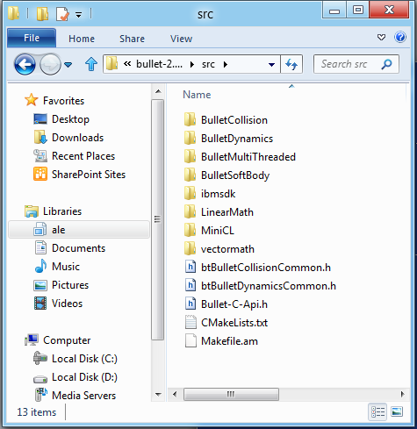
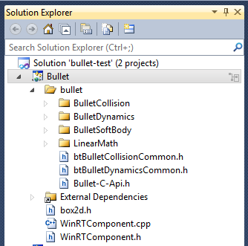
Import the 3rd party library code as a WinRT Component DLL

Slide 11
Add a simple WinRT layer
ButtonDrop.exe
Bullet.dll + Bullet.winmd
Demo App
WinRT layer
original Bullet lib code

Slide 12
Look inside the WinRT layer
WinRT layer
Demo App
original Bullet lib code
public ref class WorldFromCanvas sealed
{
public:
WorldFromCanvas(…);
void AddBox(…);
void StepSimulation(float32 delta);
void DrawShapes();
};

Slide 13
My Music Migrate a Win7 app Target Win32 API (WASAPI) from a Metro style app Replace usage of non-Metro style SDK APIs
demo
Ale Contenti
Principal Dev Manager
Visual C++

Slide 14
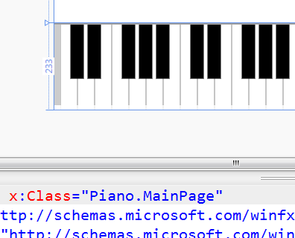
Adding listening capabilities to our piano app
Listen.exe (cmd-line Win7 app)
Piano.exe (Metro style app)
Listening...
[ F ]
[ C ]
[ F ]
[ C ]
[ F ]
[ C ]
[ C# ]
Add code to Metro style project
Recompile
Cannot use some Win32 APIs
Mix Metro style SDK APIs and Win32 WASAPI

Slide 15
Metro style SDK partitioning
// c:\Program Files (x86)\Windows Kits\8.0\Include\um\mmdeviceapi.h
#if WINAPI_FAMILY_PARTITION(WINAPI_PARTITION_APP)
// Metro style SDK APIs
#endif /* WINAPI_FAMILY_PARTITION(WINAPI_PARTITION_APP) */
#if WINAPI_FAMILY_PARTITION(WINAPI_PARTITION_DESKTOP)
// Desktop SDK APIs, not available for Metro style apps
#endif /* WINAPI_FAMILY_PARTITION(WINAPI_PARTITION_DESKTOP) */

Slide 16
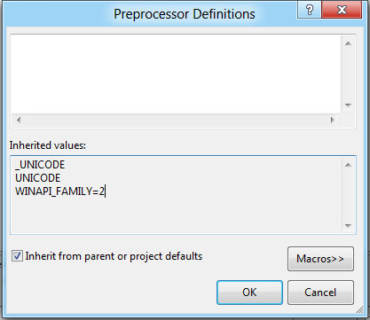
Partitions are driven by a specific #define

Slide 17
Summary
You have the entire power of C++ to build Metro style apps
Think about how your code is componentized
Move your code into Metro style apps or into WinRT component dlls
Fix the problems related to Win32 not-Metro style APIs
(if needed) Add a WinRT layer to your components for smooth interop with other Metro style apps
Go go go!!!! C++ rocks!!! ☺

Slide 18
Related sessions
[TOOL-479T] A lap around Visual Studio 11 Express for Metro style apps using C++
[TOOL-532T] Using the Windows Runtime from C++
[TOOL-690C] Under the covers with C++ for Metro style apps
[TOOL-761T] A lap around DirectX game development tools
[TOOL-845T] Tips and tricks for developing Metro style apps using C++
[TOOL-835T] Writing modern C++ code: how C++ has evolved over the years
[TOOL-802T] Taming GPU compute with C++ AMP
[TOOL-100T] Improving software quality using Visual Studio 11 C++ Code Analysis

Slide 19
For more information
Documents, articles, forums
http://blogs.msdn.com/b/vcblog/
http://channel9.msdn.com/Shows/C9-GoingNative
http://social.msdn.microsoft.com/Forums/en-US/winappswithnativecode

Slide 20
thank you
Feedback and questions http://forums.dev.windows.com
Session feedback http://bldw.in/SessionFeedback

Slide 21
© 2011 Microsoft Corporation. All rights reserved. Microsoft, Windows, Windows Vista and other product names are or may be registered trademarks and/or trademarks in the U.S. and/or other countries.
The information herein is for informational purposes only and represents the current view of Microsoft Corporation as of the date of this presentation. Because Microsoft must respond to changing market conditions, it should not be interpreted to be a commitment on the part of Microsoft, and Microsoft cannot guarantee the accuracy of any information provided after the date of this presentation. MICROSOFT MAKES NO WARRANTIES, EXPRESS, IMPLIED OR STATUTORY, AS TO THE INFORMATION IN THIS PRESENTATION.

