Slide 1
Advanced IntelliTrace in production with Visual Studio 11
TOOL-792T
Mark Groves Tracey Trewin
Group PM Director of PM
Microsoft Corporation

Slide 2
Agenda
WHO WILL BENEFIT FROM THIS TALK
TOPICS
WHAT YOU’LL LEAVE WITH
ASP.NET Web Developers
Using IntelliTrace in production environments.
Quickly finding those tricky problems.
Customizing Collection Plans.
Integrating IntelliTrace into the development lifecycle.
Be able to configure IntelliTrace within any environment.
Define a Collection Plan to focus on your code.
It’s easy to setup your environment to diagnose issues quickly.

Slide 3
Solving Production Problems are too difficult.
Developers don’t have access to the environments
Simulating production on your development machine is near impossible.
Logging solutions are helpful but require code changes and redeployment.

Slide 4
What’s New IntelliTrace in Visual Studio 11
Enable collection within production environments
Lightweight PowerShell experience – Operations friendly
Focus on ASP.NET applications

Slide 5
Configuring IntelliTrace for your production ASP.NET applications
demo

Slide 6
Configuring IntelliTrace on production machines is easy using PowerShell.

Slide 7
Finding tricky logic problems quickly
demo

Slide 8
Having IntelliTrace logs made it easy to find the problem quickly.

Slide 9
Customizing Collection for your application.
demo
Collect what is interesting in your application.

Slide 10
Defining a custom collection plan can help you find that tricky problem without changing your code.

Slide 11
Making IntelliTrace part of your development lifecycle
demo

Slide 12
Setting up a source and symbol server in TFS is simple and saves you time.

Slide 13
Wrap-up
WHO WILL BENEFIT FROM THIS TALK
TOPICS
WHAT YOU’LL LEAVE WITH
ASP.NET Web Developers
Using IntelliTrace in production environments.
Quickly finding those tricky problems.
Customizing Collection Plans.
Integrating IntelliTrace into the development lifecycle.
Be able to configure IntelliTrace within any environment.
Define a Collection Plan to focus on your code.
It’s easy to setup your environment to diagnose issues quickly.

Slide 14
TOOL-818T: Taking your Application Lifecycle Management to the cloud with the Team Foundation Service
Wednesday, 3:30-4:30 Marriott Platinum Ballroom 3-4
Doug Neumann

Slide 15
TOOL-793T: Working on an agile team with Visual Studio 11 and Team Foundation Server 11
Thursday, 9-10
Marriott Platinum Ballroom 1-2
Aaron Bjork
Peter Provost

Slide 16
TOOL-811T: Developer collaboration with Team Foundation Server 11
Friday, 9-10 Marriott Platinum Ballroom 7-8
Jamie Cool

Slide 17
TOOL-794T: Architectural discovery with Visual Studio 11
Friday, 2-3
Marriott Platinum Ballroom 7-8
Mark Groves
Tracey Trewin

Slide 18
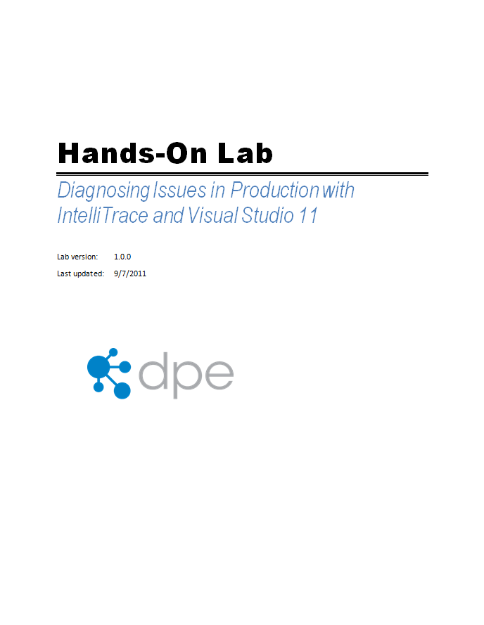
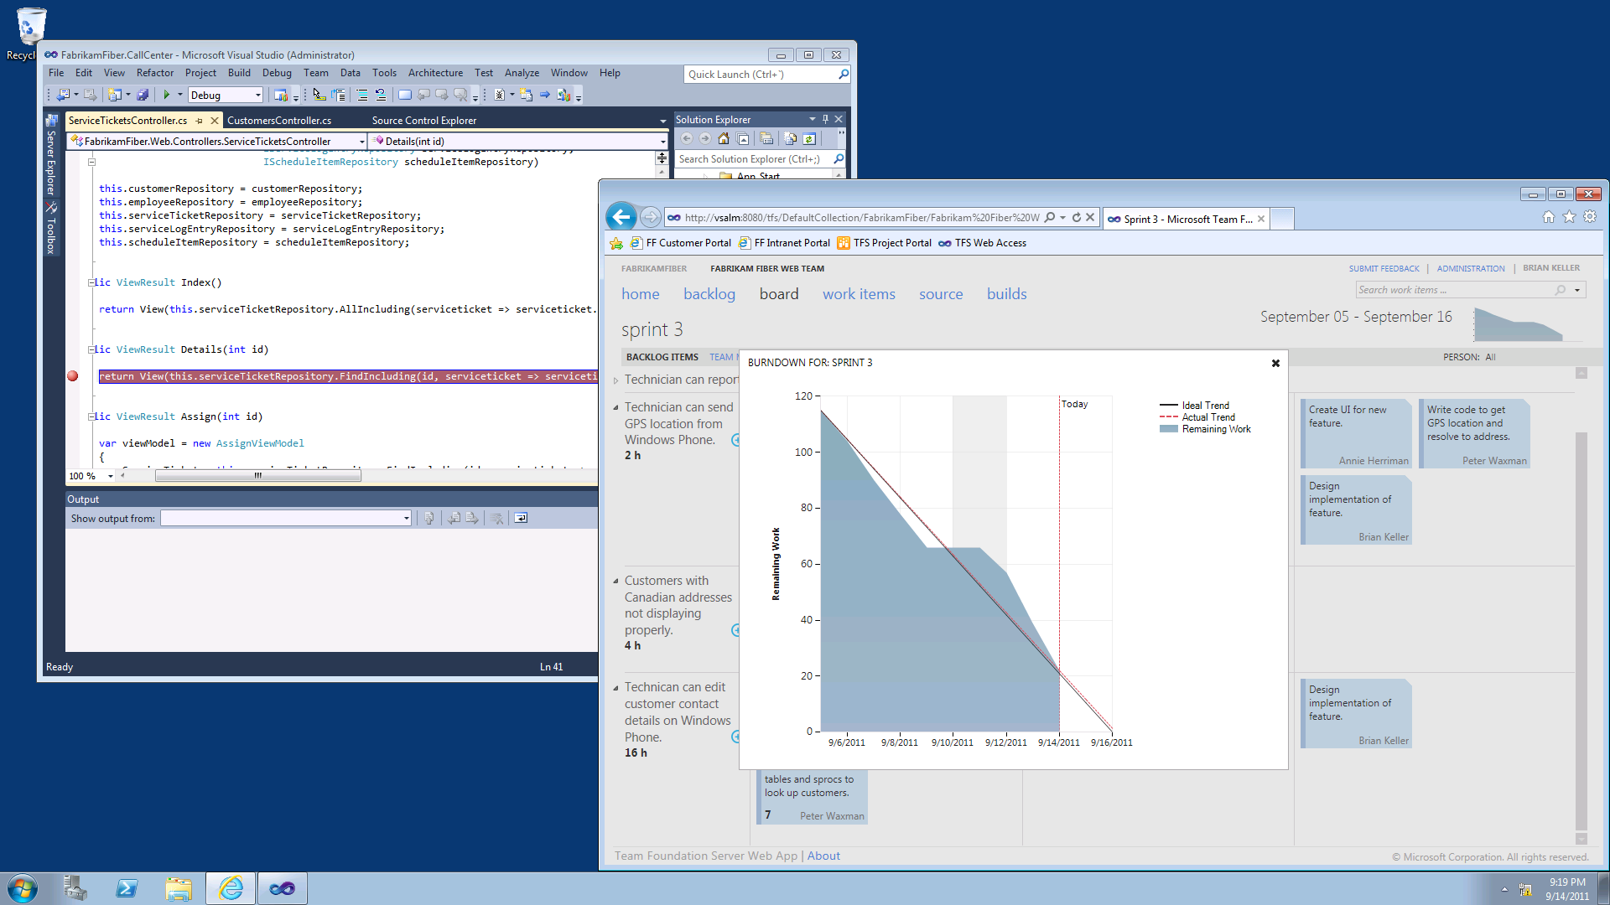
ALM Hands-On-Labs and Virtual Machine
6 ALM Hands-On-Labs + Hyper-V Virtual Machine
Available in HOL area and, starting Thursday, downloadable from http://aka.ms/VS11ALMVM

Slide 19
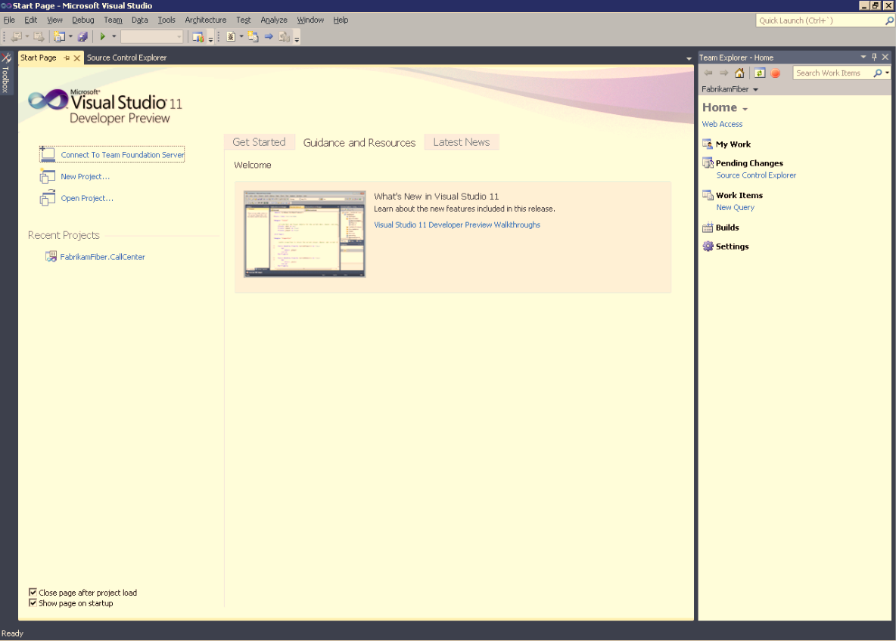
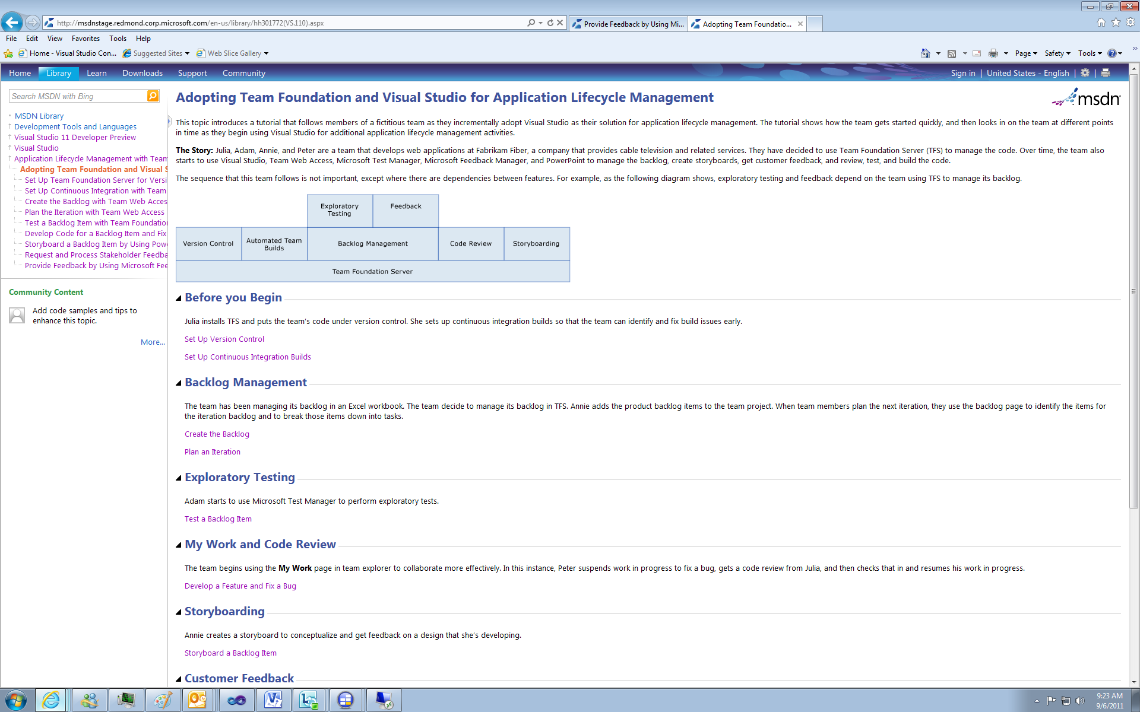
ALM End-to-End Documentation
Send doc feedback to applytfs@microsoft.com

Slide 20
thank you
Feedback and questions http://forums.dev.windows.com
Session feedback http://bldw.in/SessionFeedback

Slide 21
© 2011 Microsoft Corporation. All rights reserved. Microsoft, Windows, Windows Vista and other product names are or may be registered trademarks and/or trademarks in the U.S. and/or other countries.
The information herein is for informational purposes only and represents the current view of Microsoft Corporation as of the date of this presentation. Because Microsoft must respond to changing market conditions, it should not be interpreted to be a commitment on the part of Microsoft, and Microsoft cannot guarantee the accuracy of any information provided after the date of this presentation. MICROSOFT MAKES NO WARRANTIES, EXPRESS, IMPLIED OR STATUTORY, AS TO THE INFORMATION IN THIS PRESENTATION.

