Slide 1
It’s not a great phone App without ASP.NET services and push notifications
TOOL-797T
Erik Porter
Program Manager ASP.NET
Microsoft Corporation

Slide 2
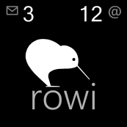
Introductions
Q: What do you do? A: I work on the ASP.NET team
Q: What do you know about phone apps?
A: A few things. ☺
Q: What is Rowi?
A: http://rowiapp.com

Slide 3
Agenda
WHO WILL BENEFIT FROM THIS TALK
TOPICS
WHAT YOU’LL LEAVE WITH
Native phone application developers (NOT just Windows Phone)
Web service developers
Push notifications service guidance
ASP.NET Membership usage in phone applications
Custom JSON services guidance
Easily add ASP.NET services to your application
It’s easy to connect phone applications to the web using ASP.NET

Slide 4
Why Do I Need Services?
Push notifications
Let your users know when data has changed
Keep track of your users and their data
State between releases
Time-based trials
Preferences
Other services
Analytics
Syncing services
Your own custom service here

Slide 5
Windows Phone Push Notifications Overview
Let your users know about updates when your app isn’t running
Live Tile
Toast
Raw
Simple HTTP API using XML payloads to send notifications on a user’s behalf
Supports secure notifications, but doesn’t require them

Slide 6
Yes Man!
demo

Slide 7
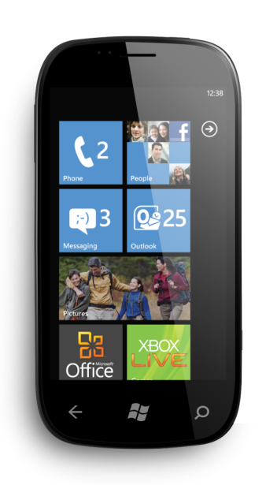
Push Notification Architecture
Cloud Service
Push URI to Cloud Service
4
Push enabled application
3
1
5
Push URI request/response
HTTP Post to URI with payload
Push client service
Push notification to device
6
Windows Phone 7
2
Push client/server negotiation
MPNS

Slide 8
ASP.NET Membership Overview for Phone Applications
Users, Roles, Profile
ASP.NET Membership Web Services
Adds REST API on top of ASP.NET Membership
Turn services on/off as needed
NuGet packages for easy discovery and installation
What can I do with it?
Authenticate your users
Keep track of their data

Slide 9
Custom Web Services with ASP.NET
Pick your format (*hint* JSON!)
Why JSON?
{ “reasons”: [ “less data over the wire”, “human readable” ] }
Other services standardizing on it
Works well with JavaScript (read: jQuery)

Slide 10
Custom JSON Service
MyServiceController.cs
public class MyServiceController : Controller {
public ActionResult Json() {
var data = GetData();
return Json(data, JsonRequestBehavior.AllowGet);
}
}
Note: This is just as easy and powerful in ASP.NET Web Pages, ASP.NET Web Forms and WCF Web API

Slide 11
Custom Web Services Using JSON
Keep it simple
Only send exactly what you need
In Web Pages only select the fields you need
In MVC use a ViewModel class
Versioning
Deploy your service to a number folder
i.e. /MyService/1
Data
Plan upfront
Harder to change later
Use JSON.NET

Slide 12
Hosting Your Service
Where can I host my service?
What about Windows Azure?
How much is it going to cost me?

Slide 13
Key Takeaways
Connecting your native phone applications to the web is…
A great way to make your user experience better
Easy to do
Push notification services are easy to build and enhance the experience of your app
NuGet packages make it easy to add Membership services to keep track of data for your users
When you need your own custom services, it’s easy to build with MVC or any of our web technologies

Slide 14
For more information
RELATED SESSIONS
DOCUMENTATION & ARTICLES
803 Progressively Enable the Mobile Web with ASP.NET MVC 4 and HTML5
828 Building Apps that use Live Tiles and Push Notifications
Get Started with Web Pages
http://asp.net/webpages
Get Started with MVC
http://asp.net/mvc
Push Notifications Quick Start
http://create.msdn.com/en-US/education/quickstarts/Push_Notifications
Windows Azure Toolkit for WP7
http://watwp.codeplex.com/
CONTACT: erik.porter@microsoft.com or @HumanCompiler

Slide 15
thank you
Feedback and questions http://forums.dev.windows.com
Session feedback http://bldw.in/SessionFeedback

Slide 16
© 2011 Microsoft Corporation. All rights reserved. Microsoft, Windows, Windows Vista and other product names are or may be registered trademarks and/or trademarks in the U.S. and/or other countries.
The information herein is for informational purposes only and represents the current view of Microsoft Corporation as of the date of this presentation. Because Microsoft must respond to changing market conditions, it should not be interpreted to be a commitment on the part of Microsoft, and Microsoft cannot guarantee the accuracy of any information provided after the date of this presentation. MICROSOFT MAKES NO WARRANTIES, EXPRESS, IMPLIED OR STATUTORY, AS TO THE INFORMATION IN THIS PRESENTATION.

