Slide 1
Taking your Application Lifecycle Management to the cloud with the Team Foundation Service
TOOL-818T
Doug Neumann
dougn@microsoft.com
Principle Lead Program Manager
Microsoft Corporation

Slide 2
Agenda
Team Foundation Server vs. Service
Details of the Team Foundation Service Preview
Getting Started, Getting Productive

Slide 3
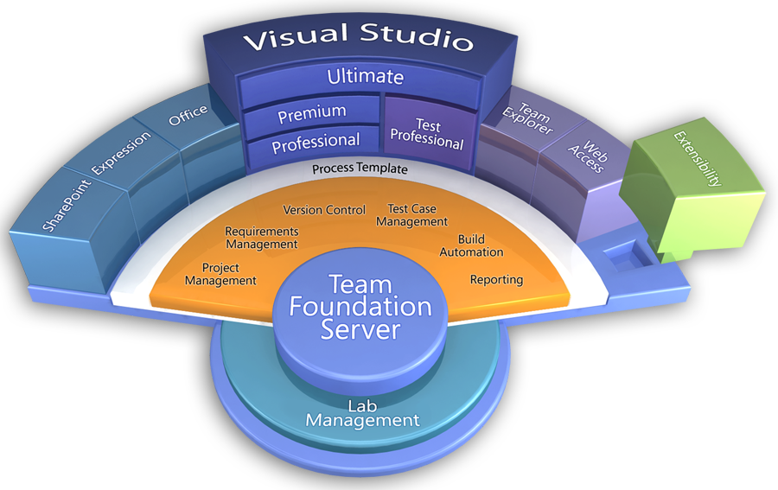

Slide 4
We aren’t your only hosted TFS option…
More Details Here.

Slide 5
The Team Foundation Service is another great way to get Team Foundation Server.

Slide 6
Server vs. Service
Server
Service
Work Items, Source Control, & Build
Agile Product/Project Management
Test Case Management
Heterogeneous Development
Near-zero setup and administration
Collaborate with anyone, from anywhere
Virtual Test Lab Management
Sharepoint Integration
Data Warehouse & Reporting

Slide 7
Setting up your own Team Foundation Service Preview account
demo

Slide 8
Terms of the TFS Preview
We provide the service, you provide the feedback
You can “go live” with VS 2010 clients
Support comes via the MSDN forums
We will upgrade your data to future releases
We will maximize uptime, but we’re learning
Someday, we may start charging for the service

Slide 9
Call to Action
Sign up for your account
Evaluate Visual Studio 11 with the Team Foundation Service
Tweet your friend code
Send us your feedback

Slide 10
TOOL-793T: Working on an agile team with Visual Studio 11 and Team Foundation Server 11
Thursday, 9-10
Marriott Platinum Ballroom 1-2
Aaron Bjork
Peter Provost

Slide 11
TOOL-811T: Developer collaboration with Team Foundation Server 11
Friday, 9-10 Marriott Platinum Ballroom 7-8
Jamie Cool

Slide 12
thank you
Feedback and questions http://forums.dev.windows.com
Session feedback http://bldw.in/SessionFeedback

Slide 13
© 2011 Microsoft Corporation. All rights reserved. Microsoft, Windows, Windows Vista and other product names are or may be registered trademarks and/or trademarks in the U.S. and/or other countries.
The information herein is for informational purposes only and represents the current view of Microsoft Corporation as of the date of this presentation. Because Microsoft must respond to changing market conditions, it should not be interpreted to be a commitment on the part of Microsoft, and Microsoft cannot guarantee the accuracy of any information provided after the date of this presentation. MICROSOFT MAKES NO WARRANTIES, EXPRESS, IMPLIED OR STATUTORY, AS TO THE INFORMATION IN THIS PRESENTATION.

