Slide 1
What's new in Visual Studio 11 for Application Lifecycle Management
TOOL-833T
Cameron Skinner
General Manager
Microsoft Corporation
Brian Keller
Sr. Technical Evangelist
Microsoft Corporation

Slide 2
Agenda
Demonstrate the investments Microsoft is making to Application Lifecycle Management tooling in Visual Studio 11
Set expectations about what’s in the Developer Preview bits
Suggest other ALM sessions for you to attend this week

Slide 3
DEVELOP
Product
Backlog
Requirements
OPERATE
Requirements
Sprint
Monitor
Monitor
Stakeholder
Feedback
Ops
Backlog
Working Software
Working Software

Slide 4
A Lap Around Application Lifecycle Management with Visual Studio 11
demo

Slide 5
DEVELOP
Product
Backlog
Requirements
OPERATE
Requirements
Sprint
Monitor
Monitor
Stakeholder
Feedback
Ops
Backlog
Working Software
Working Software

Slide 6
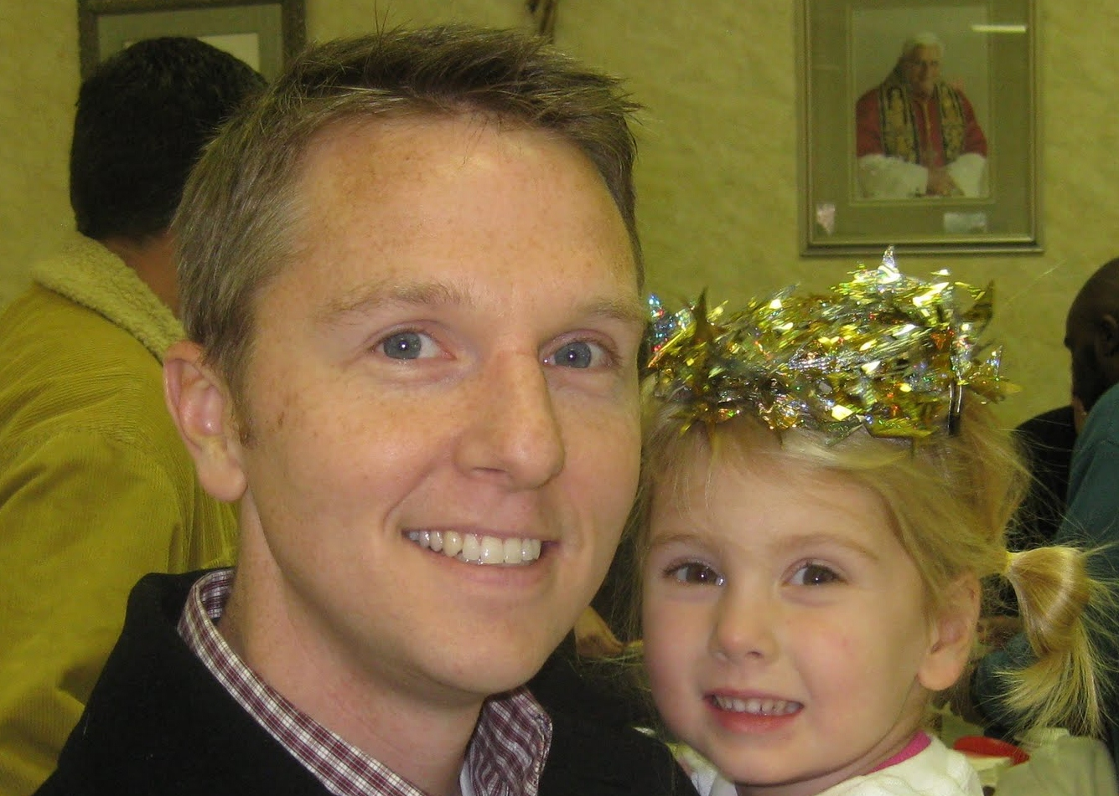
TOOL-818T: Taking your Application Lifecycle Management to the Cloud with the Team Foundation Service
Wednesday, 3:30-4:30 Marriott Platinum Ballroom 3-4
Doug Neumann

Slide 7
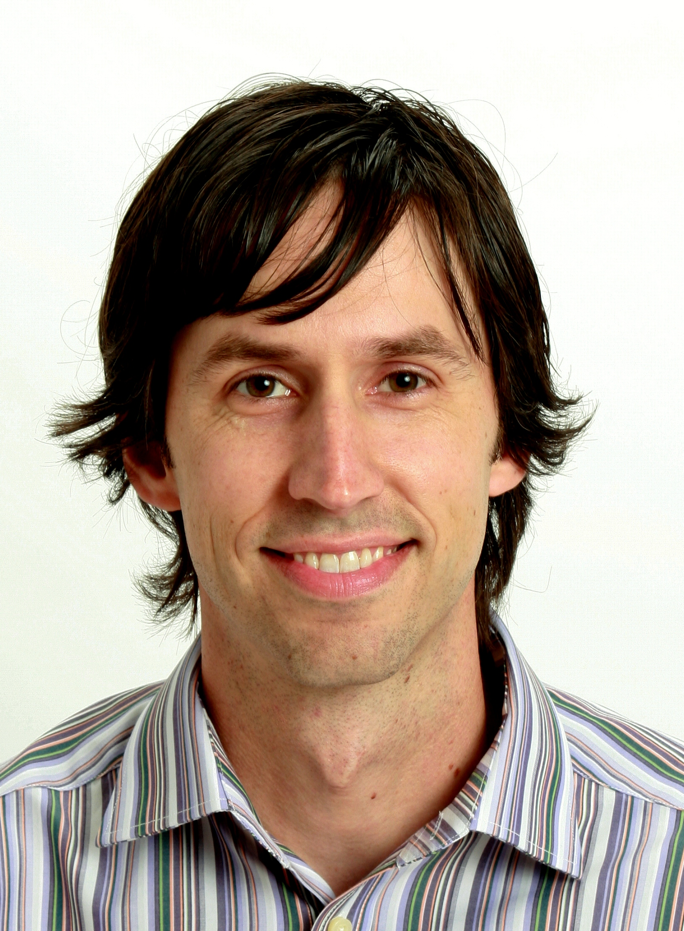
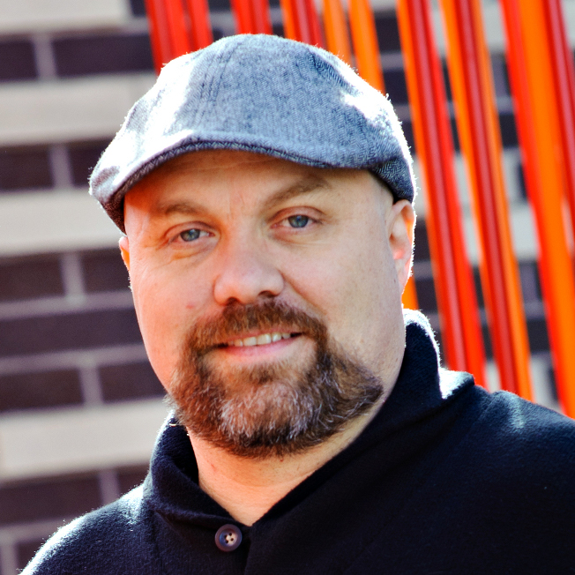
TOOL-793T: Working on an Agile Team with Visual Studio 11 and Team Foundation Server 11
Thursday, 9-10
Marriott Platinum Ballroom 1-2
Aaron Bjork
Peter Provost

Slide 8
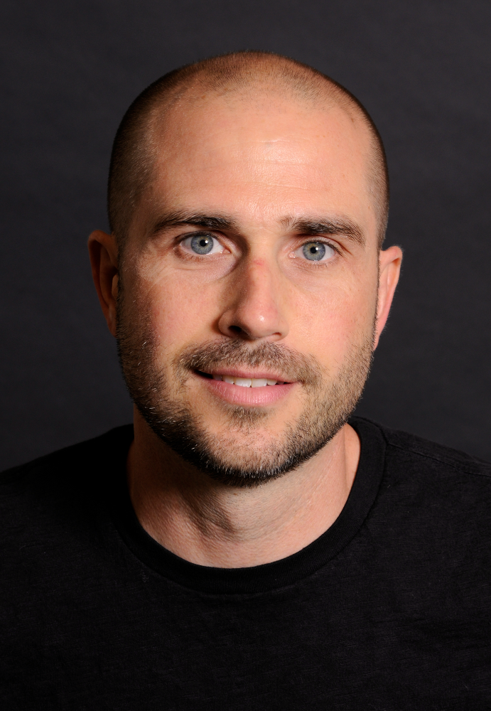
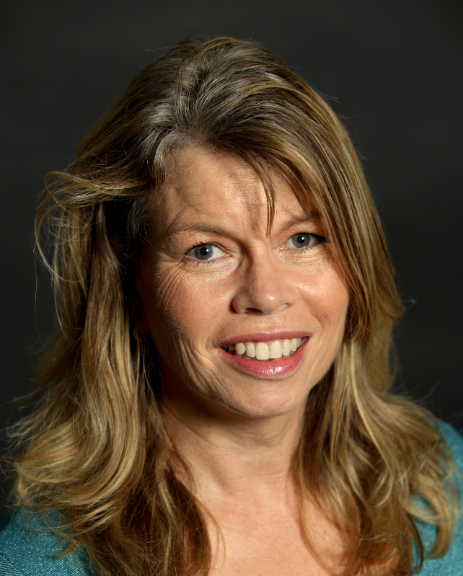
TOOL-792T: Advanced IntelliTrace and using IntelliTrace in Production with Visual Studio 11
Thursday, 4-5
Marriott Platinum Ballroom 5
Mark Groves
Tracey Trewin

Slide 9
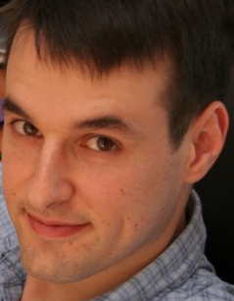
TOOL-811T: Developer Collaboration with Team Foundation Server 11
Friday, 9-10 Marriott Platinum Ballroom 7-8
Jamie Cool

Slide 10
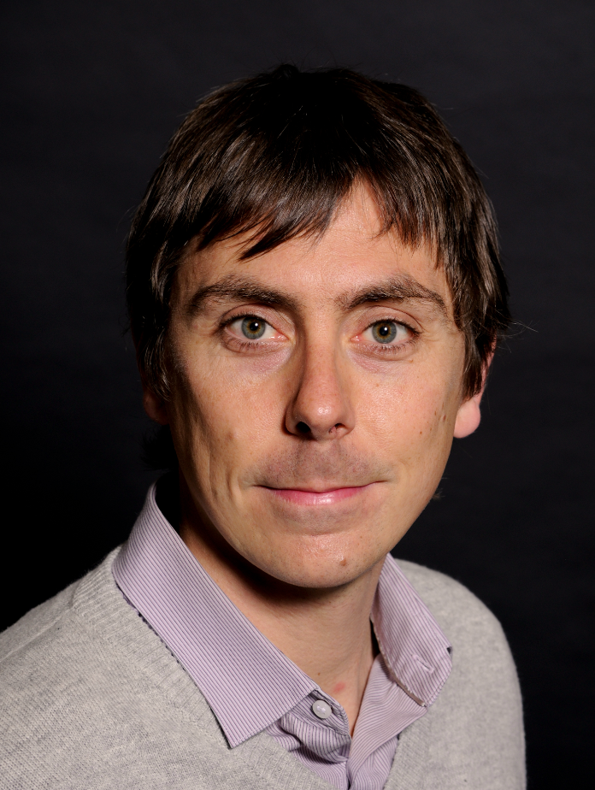
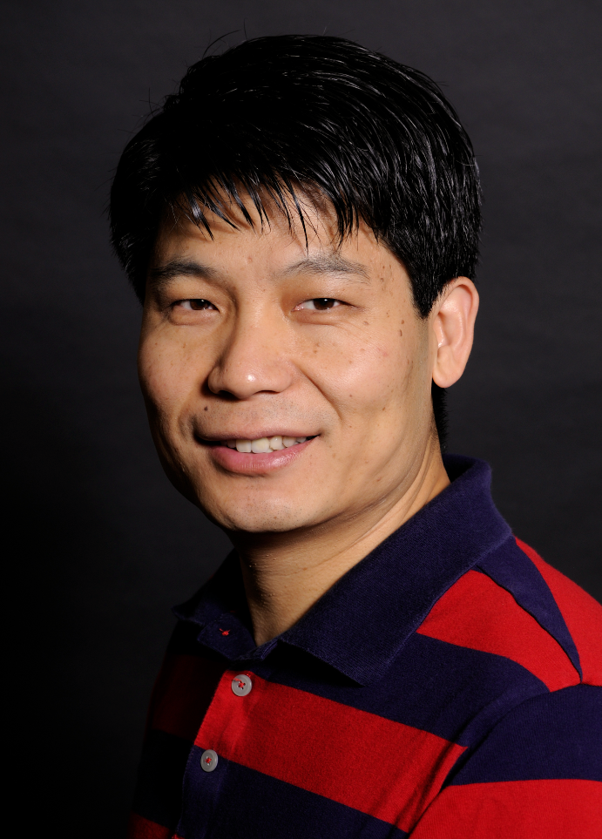
100: Improving Software Quality Using Visual Studio C++ Code Analysis
Friday, 9-10
Room 8: ACC 201 B
Vince Smith
Jason Yang

Slide 11
C++ Unit Testing
using namespace Microsoft::VisualStudio::CppUnitTestFramework;
namespace CalculatorServiceTest
{
TEST_CLASS(UnitTest1)
{
public: int expected, actual;
int a,b;
CalcService::CalcService calc;
TEST_METHOD_INITIALIZE(methodInitialize)
{
a = 8;
b = 3;
}
TEST_METHOD(AddTest)
{
expected = a+b;
actual = calc.add(a,b);
Assert::AreEqual(expected, actual);
}
…

Slide 12
ALM for C++
http://aka.ms/CPPALM

Slide 13
TOOL-794T: Architectural Discovery with Visual Studio 11
Friday, 2-3
Marriott Platinum Ballroom 7-8
Mark Groves
Tracey Trewin

Slide 14
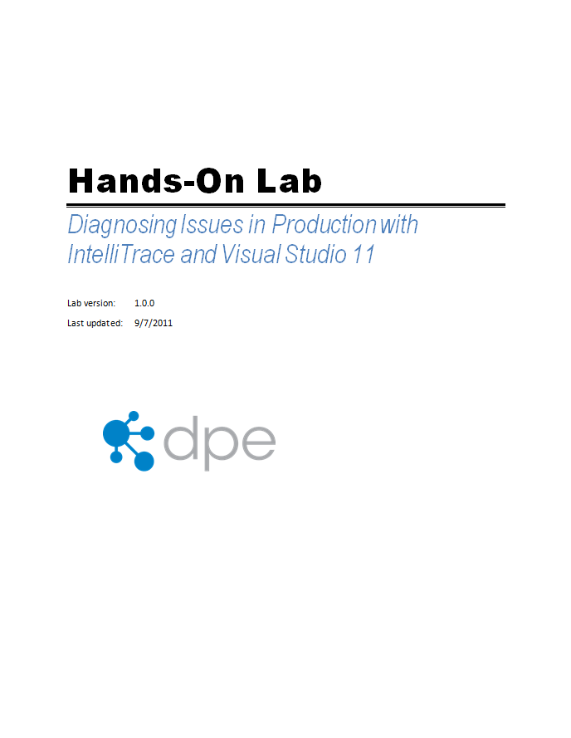
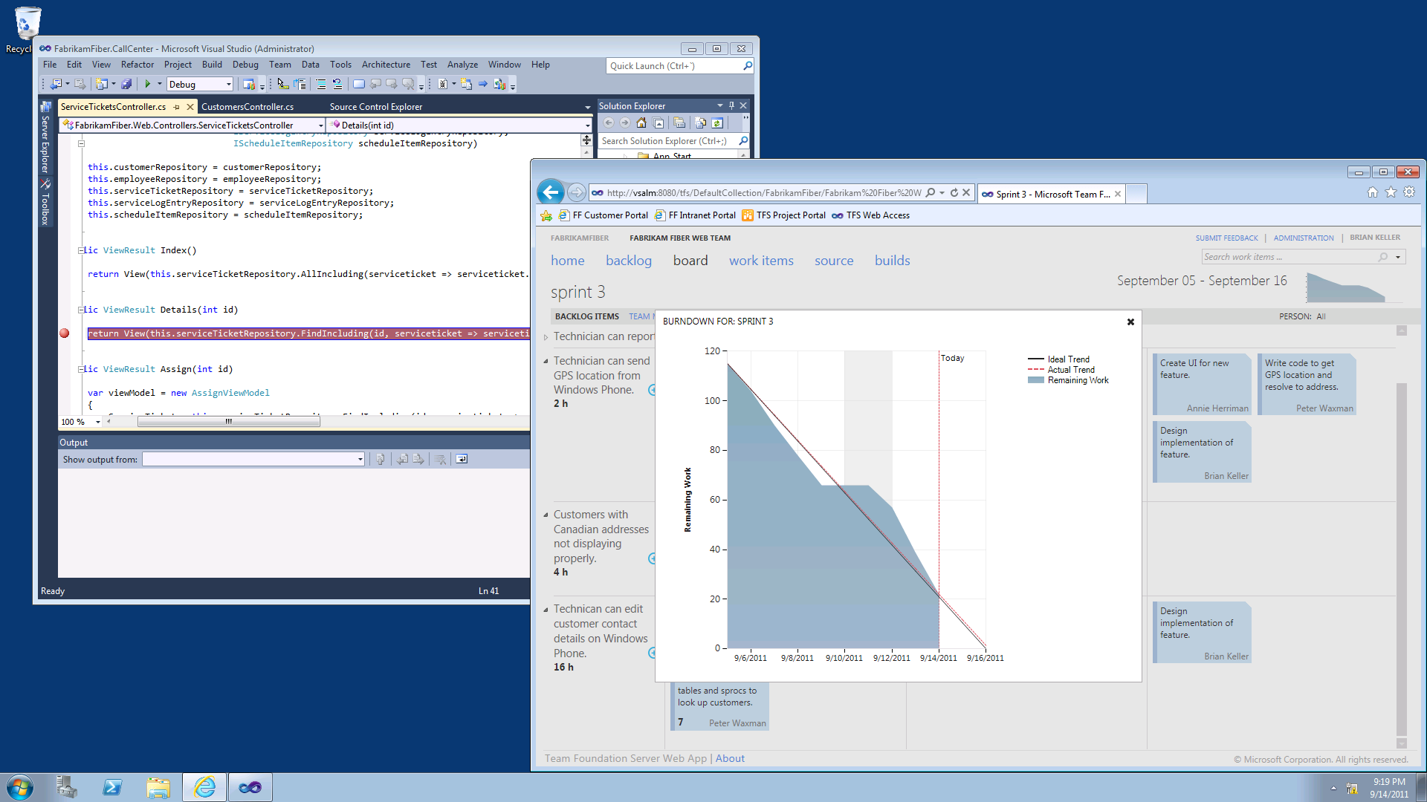
ALM Hands-On-Labs and Virtual Machine
6 ALM Hands-On-Labs + Hyper-V Virtual Machine
Available in HOL area and, starting Thursday, downloadable from http://aka.ms/VS11ALMVM

Slide 15
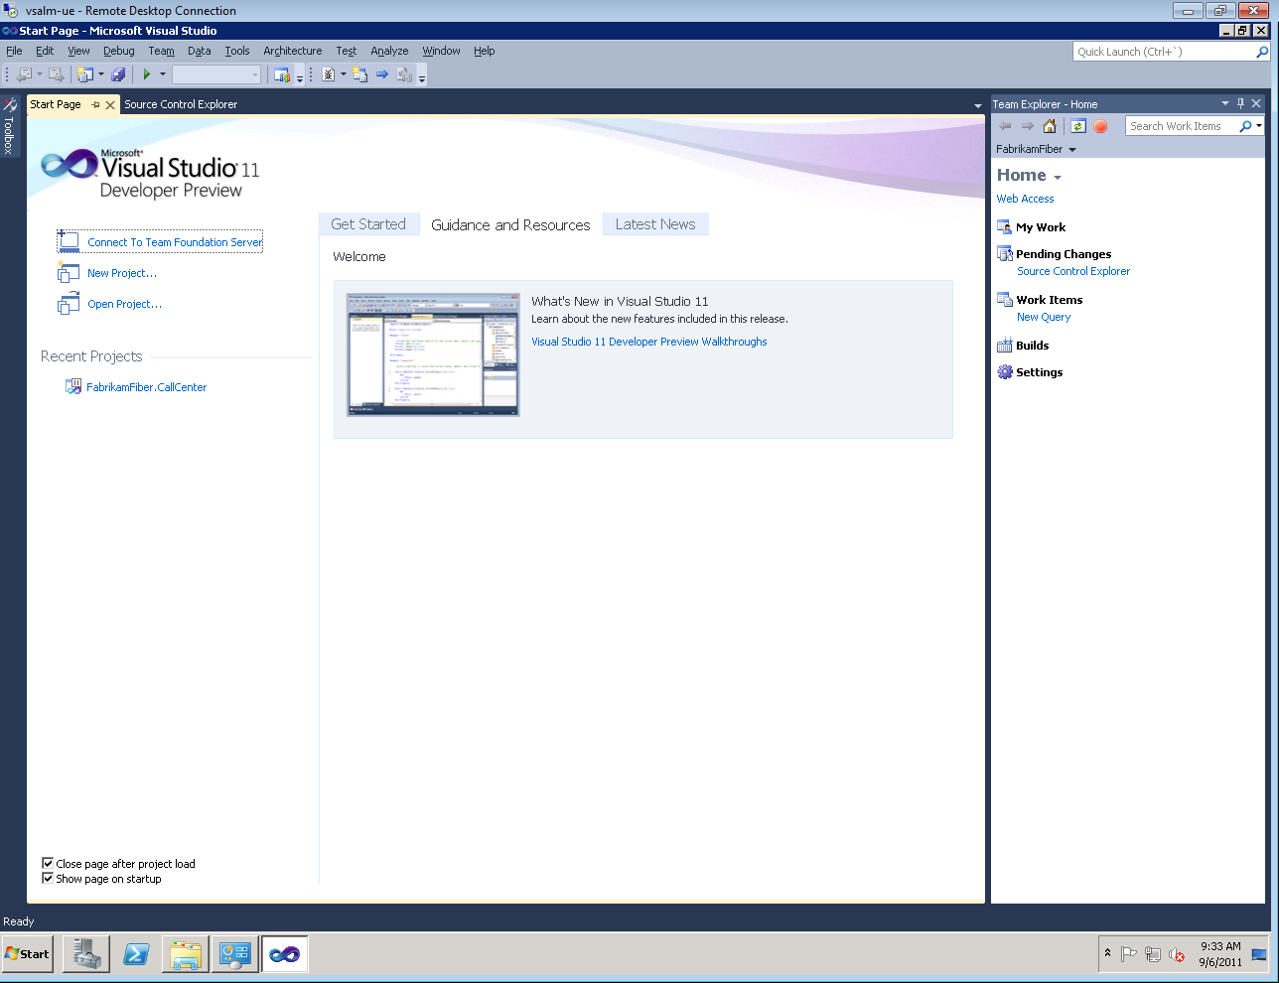
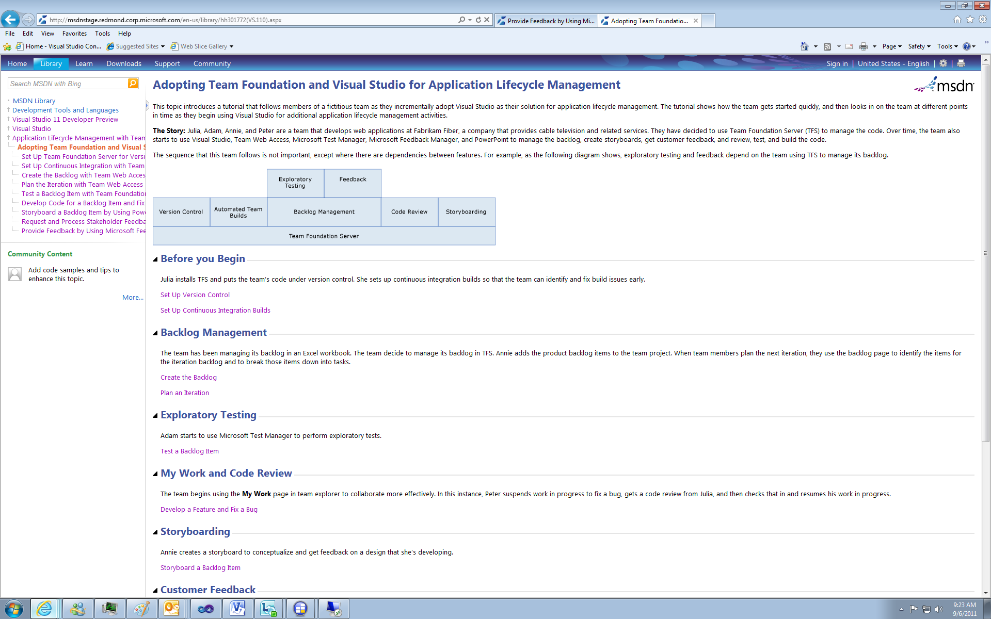
ALM End-to-End Documentation
Send doc feedback to applytfs@microsoft.com

Slide 16
thank you
Feedback and questions http://forums.dev.windows.com
Session feedback http://bldw.in/SessionFeedback

Slide 17
© 2011 Microsoft Corporation. All rights reserved. Microsoft, Windows, Windows Vista and other product names are or may be registered trademarks and/or trademarks in the U.S. and/or other countries.
The information herein is for informational purposes only and represents the current view of Microsoft Corporation as of the date of this presentation. Because Microsoft must respond to changing market conditions, it should not be interpreted to be a commitment on the part of Microsoft, and Microsoft cannot guarantee the accuracy of any information provided after the date of this presentation. MICROSOFT MAKES NO WARRANTIES, EXPRESS, IMPLIED OR STATUTORY, AS TO THE INFORMATION IN THIS PRESENTATION.

