Slide 1
A .NET Developer's View of Windows 8 Application Development
TOOL-930C
Krzysztof Cwalina
Principal Architect
Microsoft Corporation

Slide 2
Agenda slide
WHO WILL BENEFIT FROM THIS TALK
TOPICS
WHAT YOU’LL LEAVE WITH
Existing .NET developers who want to start developing Windows 8 Metro style apps
Overview of .NET Profile for Metro style apps
Design Principles
Portability
Better understanding how to use your .NET skills to develop Windows 8 Metro style apps

Slide 3
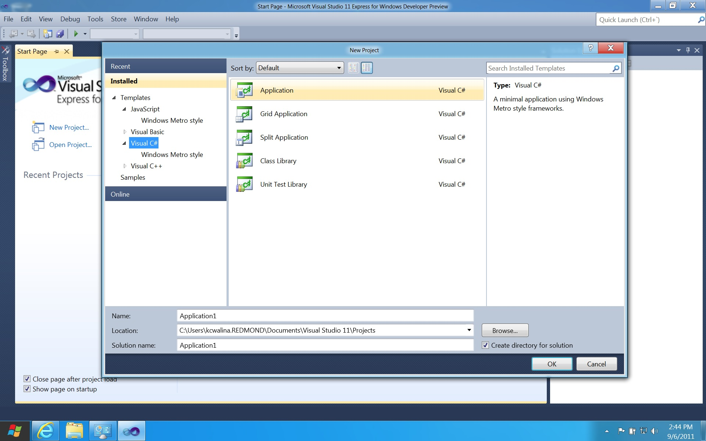

Slide 4
native namespace
native type
native method
using Windows.Storage;
using System;
using System.IO;
using System.Threading.Tasks;
class Sample {
static async Task WriteAsync(StorageFolder wrtfolder, string filename, string text) {
var wrtFile = await wrtFolder.CreateFileAsync(filename);
var wrtStream = await wrtFile.OpenAsync(FileAccessMode.ReadWrite);
using (Stream stream = wrtStream.OpenWrite()) {
using (var writer = new StreamWriter(stream)) {
writer.WriteLine(text);
}
}
}
}
C# feature
managed argument passed to native API
managed type returned from a seemingly native method

Slide 5
Windows Runtime Types
Managed Types
Mapped Types
Interop Helpers
99% of Windows* namespaces
Tuple, List<T>, XDocument, DataContract, etc.
Int32, String, Boolean, IEnumerable<T>, IList<T>, Uri, etc.
IBuffer / Byte[]
IAsync* / Task*
InputStream, OutputStream,

Slide 6
.NET Framework 4.5
Windows Phone 7
Silverlight 5
.NET Profile for Metro style apps

Slide 7
.NET Profile for Metro style apps
Provides simple and well-designed .NET APIs specifically tailored for development of Windows 8 Metro style apps

Slide 8
Design Requirements
Remove APIs not applicable to Metro style apps
e.g. Console, ASP.NET
Remove dangerous, obsolete, and legacy APIs
Remove duplication (within .NET APIs and with WRT APIs)
e.g. ArrayList (with List<T>) and XML DOM (with WR XML API)
Remove APIs that are OS API wrappers
e.g. EventLog, Performance Counters
Remove badly designed APIs
e.g. APIs that are confusing, don’t follow basic design guidelines, cause bad dependencies

Slide 9
Compatibility Requirements
Running existing .NET applications as-is on the .NET profile for Metro style apps is not an objective
Porting existing C# and VB code to the profile should be easy
Existing .NET developers should feel at home with this profile
Code compiled to the profile must be able to execute on .NET Framework 4.5
Code compiled to the portable subset needs to be compatible with this profile

Slide 10
Surface Area Statistics
 | .NET for Metro style apps | .NET 4.5 | Windows Phone 7
# of assemblies | 15* | 120 | 22
# of namespaces | 60 | 400 | 88
# of types | ~1K | ~14K | ~2K
# of members | ~10K | ~110K | ~14K
* Refers to implementation assemblies, not reference assemblies. More on this later.

Slide 11
.NET for Metro style apps
WCF
XML
MEF
HTTP
Serialization
BCL

Slide 12
.NET for Metro style apps
Windows.UI.Xaml
(UI Stack)
Windows.*
(OS Services)

Slide 13
Main Namespaces
System
System.Collections*
System.ComponentModel
System.ComponentModel.Composition*
System.Diagnostics*
System.Dynamic
System.Globalization
System.IO
System.Linq*
System.Net*
System.Reflection
System.Runtime.InteropServices*
System.Runtime.Serialization*
System.ServiceModel*
System.Text*
System.Threading
System.Threading.Tasks
System.Xml.*
System.Xml.Linq

Slide 14
System Namespace* Simplicity
Action
Action<...>
Activator
Array
ArraySegment<T>
AsyncCallback
Attribute
AttributeTargets
AttributeUsageAttribute
BitConverter
Boolean
Byte
Char
CLSCompliantAttribute
Convert
DateTime
DateTimeKind
DateTimeOffset
DayOfWeek
Decimal
Delegate
Double
Enum
Environment
EventArgs
EventHandler
EventHandler<T>
Exception
FlagsAttribute
Func<...>
GC
Guid
IAsyncResult
IComparable<T>
ICustomFormatter
IDisposable
IEquatable<T>
IFormatProvider
IFormattable
Int16
Int32
Int64
IntPtr
IObservable<T>
IObserver<T>
Lazy<T>
Math
MidpointRounding
MulticastDelegate
Nullable
Nullable<T>
Object
ObsoleteAttribute
ParamArrayAttribute
Predicate<T>
Random
RuntimeArgumentHandle
RuntimeFieldHandle
RuntimeMethodHandle
RuntimeTypeHandle
SByte
Single
String
StringComparer
StringComparison
StringSplitOptions
ThreadStaticAttribute
TimeSpan
TimeZoneInfo
Tuple
Tuple<...>
Type
TypedReference
UInt16
UInt32
UInt64
UIntPtr
Uri
UriBuilder
UriComponents
UriFormat
UriKind
ValueType
Version
Void
WeakReference
WeakReference<T>
* excluding exceptions

Slide 15
Removed, Replaced, and Changed
System.Web
System.Data
System.Runtime.Remoting
System.Reflection.Emit
Private reflection
Application Domains

Slide 16
Removed, Replaced, and Changed
Existing Technology | New Substitute
System.Windows | Windows.UI.Xaml
System.Security.IsolatedStorage | Windows.Storage.ApplicationData
System.Resources | Windows.ApplicationModel.Resources
System.Net.Sockets | Windows.Networking.Sockets
System.Net.WebClient | Windows.Networking.BackgroundTransfer and System.Net.HttpClient

Slide 17
Removed, Replaced, and Changed
Existing Technology | Changes
Serialization | Use Data Contract for general serialization needs Use XML serialization for fine control of the XML stream
Reflection | System.Type now represents a type reference System.Reflection.TypeInfo is the new System.Type
XML | XML Linq is the main XML parser Use XmlReader/Writer as a low level abstraction
Collections | Non generic collections gone New collection abstractions added: IReadOnlyList<T>
Threading | Synchronization primitives mainly unchanged Thread control in Windows.Foundation.Threading Task.Run is the new high level way of doing background processing
Async Model | !!!!

Slide 18
Porting Guide: Example Topic
Reflection
System.Type has become a type reference and only contains basic information. The majority of the reflection API's are now on System.Reflection.TypeInfo. You can get a TypeInfo from a Type by using the GetTypeInfo() extension method when you include a using statement for the System.Reflection namespace.
Existing .NET Code | Replacement Code | Notes
type.Assembly | type.GetTypeInfo().Assembly
type.GetMethods(BindingFlags.DeclaredOnly) | type.GetTypeInfo().DeclaredMethods
type.GetMethod("MethodName", BindingFlags.DeclaredOnly) | type.GetTypeInfo().GetDeclaredMethod("MethodName") | These samples are the same for Properties, Events, and Fields.
type.GetMethod("MethodName") | type.GetRuntimeMethod("MethodName") | GetRuntimeMethod API in Beta.
type.GetMethods() | type.GetRuntimeMethods() | GetRuntimeMethods() API in Beta.
type.GetMethods(BindingFlags.Instance|BindingFlags.Public) | type.GetRuntimeMethods().Where(m => !m.IsStatic && m.IsPublic) | GetRuntimeMethods() API in Beta.
BindingFlags.NonPublic | !member.IsPublic | You can also use member.IsAssembly => internal or member.IsFamily => protected for more flexibility
Look for more on the BCL team’s blog

Slide 19
☒DO NOT call APIs that are not part of the profile!

Slide 20
IBuffer Interop Helpers
// Windows.Security.Cryptography.DataProtection.winmd (Windows Runtime API)
public sealed class DataProtectionProvider {
public DataProtectionProtectOperation ProtectAsync(IBuffer Data);
public DataProtectionUnprotectOperation UnprotectAsync(IBuffer Data);
}
// Windows.Storage.Streams.winmd (Windows Runtime API)
public interface IBuffer {
uint Capacity { get; }
uint Length { get; set; }
}

Slide 21
IBuffer Interop Helpers
// Windows.Security.Cryptography.DataProtection.winmd (Windows Runtime API)
public sealed class DataProtectionProvider {
public DataProtectionProtectOperation ProtectAsync(IBuffer Data);
public DataProtectionUnprotectOperation UnprotectAsync(IBuffer Data);
}
// Windows.Storage.Streams.winmd (Windows Runtime API)
public interface IBuffer {
uint Capacity { get; }
uint Length { get; set; }
}
// System.Runtime.InteropServices.WindowsRuntime namespace
public static class WindowsRuntimeBufferExtensions {
public static IBuffer AsBuffer(this byte[] source);
…
}

Slide 22
IBuffer Interop Helpers
// Windows.Security.Cryptography.DataProtection.winmd (Windows Runtime API)
public sealed class DataProtectionProvider {
public DataProtectionProtectOperation ProtectAsync(IBuffer Data);
public DataProtectionUnprotectOperation UnprotectAsync(IBuffer Data);
}
// Windows.Storage.Streams.winmd (Windows Runtime API)
public interface IBuffer {
uint Capacity { get; }
uint Length { get; set; }
}
// System.Runtime.InteropServices.WindowsRuntime namespace
public static class WindowsRuntimeBufferExtensions {
public static IBuffer AsBuffer(this byte[] source);
…
}
// Your code
var dpp = new DataProtectionProvider();
await dpp.ProtectAsync(bytes.AsBuffer());
await dpp.UnprotectAsync(bytes.AsBuffer());

Slide 23
Async Interop Helpers
// Windows.Storage.winmd (Windows Runtime API)
public sealed class StorageFolder {
public StorageFileViewOperation GetFilesAsync();
…
}

Slide 24
Async Interop Helpers
// Windows.Storage.winmd (Windows Runtime API)
public sealed class StorageFolder {
public StorageFileViewOperation GetFilesAsync();
…
}
// Your code
IReadOnlyList<IStorageFile> files = await folder.GetFilesAsync();

Slide 25
Async Interop Helpers
// Windows.Storage.winmd (Windows Runtime API)
public sealed class StorageFolder {
public StorageFileViewOperation GetFilesAsync();
…
}
// Your code
IReadOnlyList<IStorageFile> files = await folder.GetFilesAsync();
// Compiler Generates
awaiter = WindowsRuntimeSystemExtensions.GetAwaiter<IReadOnlyList<IStorageFile>>(this.folder.GetFilesAsync());

Slide 26
Async Interop Helpers
// Windows.Storage.winmd (Windows Runtime API)
public sealed class StorageFolder {
public StorageFileViewOperation GetFilesAsync();
…
}
// Your code
IReadOnlyList<IStorageFile> files = await folder.GetFilesAsync();
// Compiler Generates
awaiter = WindowsRuntimeSystemExtensions.GetAwaiter<IReadOnlyList<IStorageFile>>(this.folder.GetFilesAsync());
// System.Runtime.WindowsRuntime.dll (.NET API)
public static class WindowsRuntimeSystemExtensions {
public TaskAwaiter<TResult> GetAwaiter<TResult>(this IAsyncOperation<TResult> source);
…
}

Slide 27
Stream Interop Helpers
// Code you would like to write
public async Task ProcessXml(StorageFile file) {
IInputStream wrtStream = await file.OpenForReadAsync();
XDocument xml = XDocument.Load(wrtStream);
… // process xml here
}

Slide 28
Stream Interop Helpers
// Code you would like to write
public async Task ProcessXml(StorageFile file) {
IInputStream wrtStream = await file.OpenForReadAsync();
XDocument xml = XDocument.Load(wrtStream); // Compilation ERROR!
… // process xml here
}

Slide 29
Stream Interop Helpers
// Code you would like to write
public async Task ProcessXml(StorageFile file) {
IInputStream wrtStream = await file.OpenForReadAsync();
XDocument xml = XDocument.Load(wrtStream); // Compilation ERROR!
… // process xml here
}
// System.Xml.Linq namespace
class XDocument : XContainer {
public static XDocument Load(Stream stream);
…
}

Slide 30
Stream Interop Helpers
// Code you would like to write
public async Task ProcessXml(StorageFile file) {
IInputStream wrtStream = await file.OpenForReadAsync();
XDocument xml = XDocument.Load(wrtStream); // Compilation ERROR!
… // process xml here
}
// System.Xml.Linq namespace
class XDocument : XContainer {
public static XDocument Load(Stream stream);
…
}
// System.IO namespace; System.Runtime.WindowsRuntime.dll
public static class WindowsRuntimeStreamExtensions {
public static Stream AsStream(this IInputStream source);
…
}

Slide 31
Stream Interop Helpers
// Code you can write
public async Task ProcessXml(StorageFile file) {
IInputStream wrtStream = await file.OpenForReadAsync();
XDocument xml = XDocument.Load(wrtStream.AsStream()); // AsStream() makes this work!
… // process xml here
}
// System.Xml.Linq namespace
class XDocument : XContainer {
public static XDocument Load(Stream stream);
…
}
// System.IO namespace; System.Runtime.WindowsRuntime.dll
public static class WindowsRuntimeStreamExtensions {
public static Stream AsStream(this IInputStream source);
…
}

Slide 32
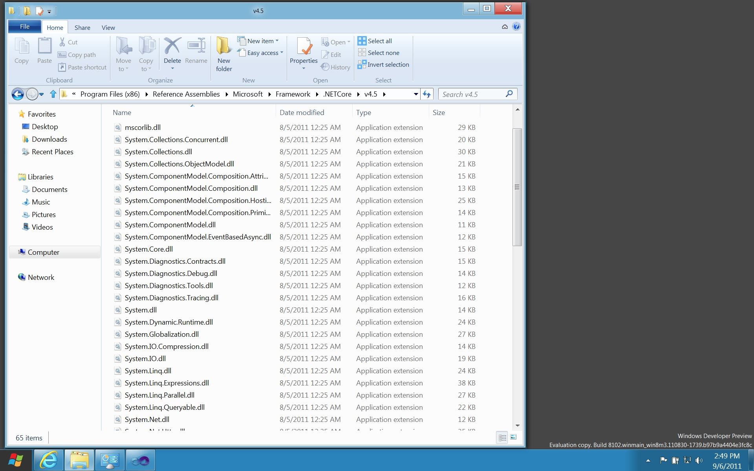

Slide 33
mscorlib.dll

Slide 34
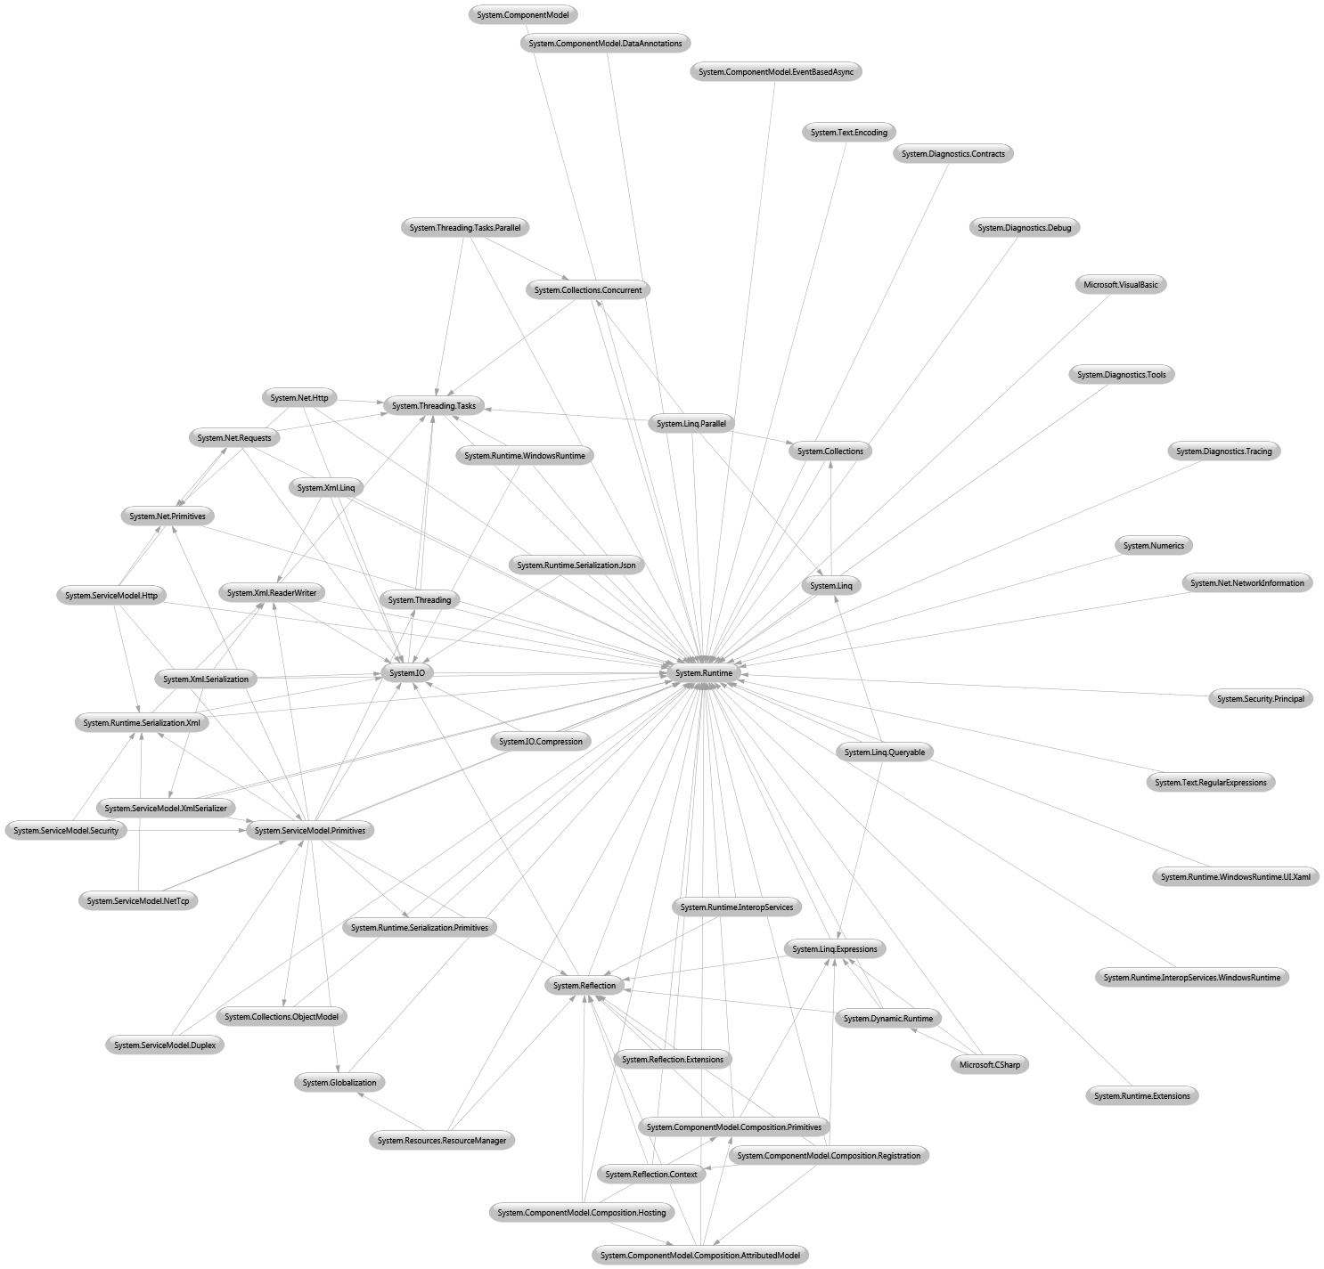
System.Runtime.dll
System.Reflection.dll

Slide 35
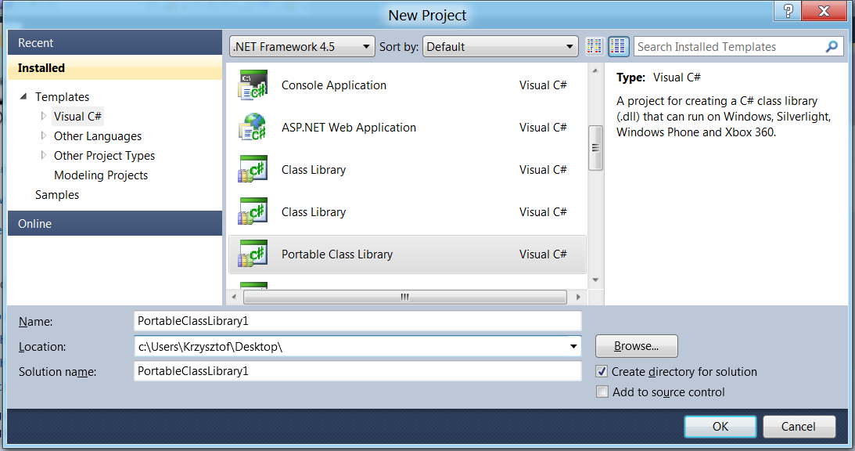
Portable Project

Slide 36
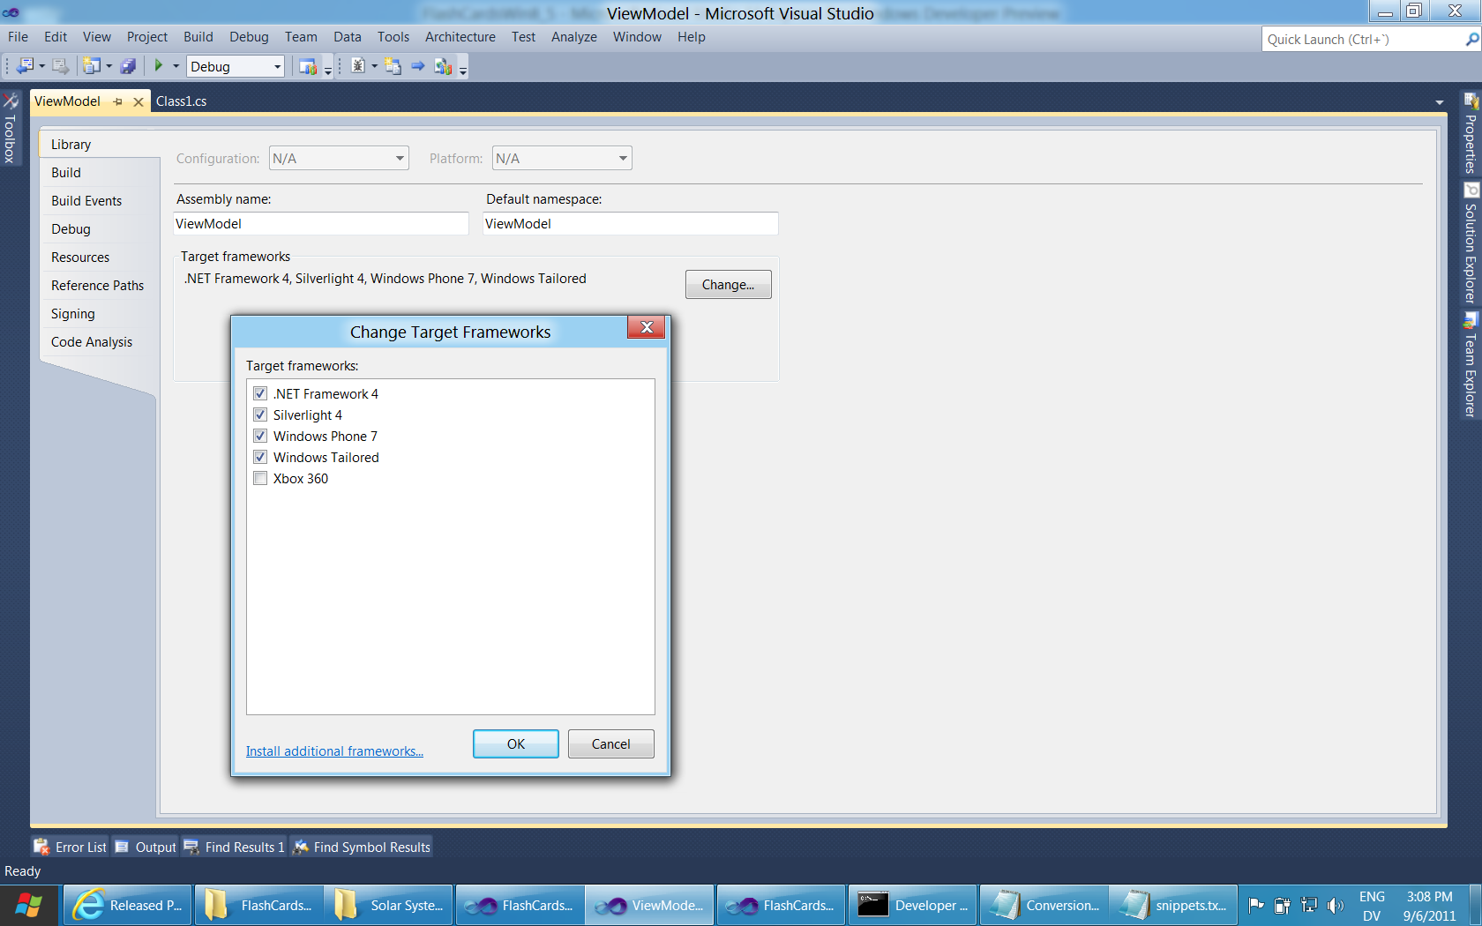

Slide 37
For More Information
RELATED SESSIONS
TOOL-810T: Async made simple in Windows 8, with C# and Visual Basic
TOOL-531T: Using the Windows Runtime from C# and Visual Basic
APP-737T: Metro style apps using XAML: what you need to know
PLAT-876T: Lessons learned designing the Windows Runtime
SAC-824T: OData Futures: creating the web of data
PLAT-581T: Making apps social and connected with HTTP services
DOCUMENTATION & ARTICLES
BCL Blog: http://blogs.msdn.com/b/bclteam/

Slide 38
thank you
Feedback and questions http://forums.dev.windows.com
Session feedback http://bldw.in/SessionFeedback

Slide 39
© 2011 Microsoft Corporation. All rights reserved. Microsoft, Windows, Windows Vista and other product names are or may be registered trademarks and/or trademarks in the U.S. and/or other countries.
The information herein is for informational purposes only and represents the current view of Microsoft Corporation as of the date of this presentation. Because Microsoft must respond to changing market conditions, it should not be interpreted to be a commitment on the part of Microsoft, and Microsoft cannot guarantee the accuracy of any information provided after the date of this presentation. MICROSOFT MAKES NO WARRANTIES, EXPRESS, IMPLIED OR STATUTORY, AS TO THE INFORMATION IN THIS PRESENTATION.

