Slide 1
Developing Continuous Services: Real world experiences of the Team Foundation Service engineering team
Buck Hodges
Director of Development, TFS and MSDN
2-004

Slide 2
Buck Hodges
buckh@Microsoft.com
@tfsbuck
http://blogs.msdn.com/buckh

Slide 3
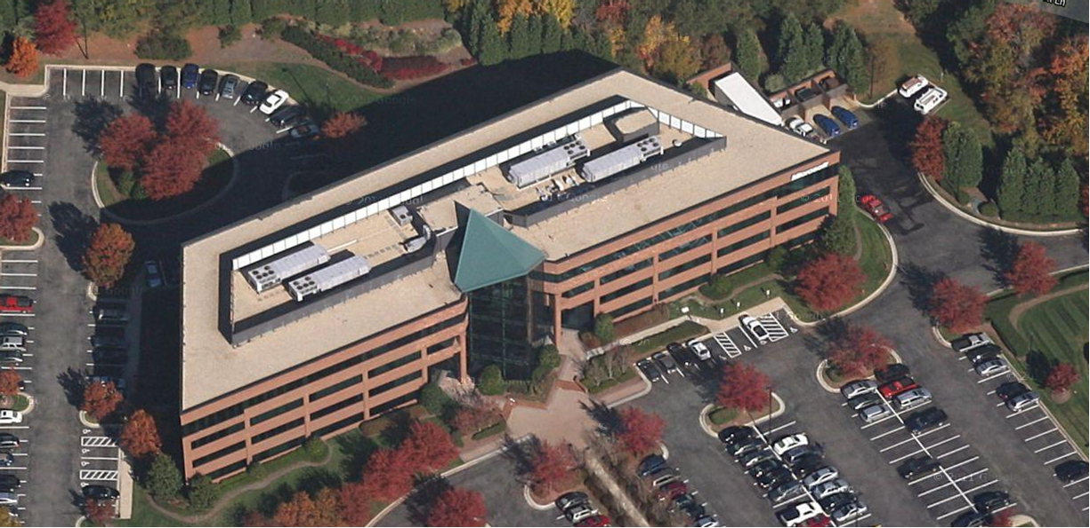

Slide 4

Agenda
The Box and the Service
Planning
Scrum
Cadence
Engineering system
Wrap up

Slide 5
The Box

Slide 6
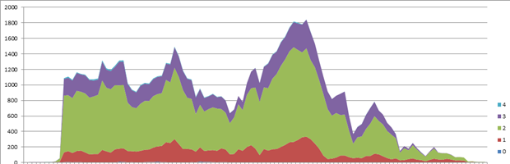
The Box
Multi-year cycles
Milestones and stabilizations
Debt

Slide 7
Team Foundation Service http://tfspreview.com

Slide 8
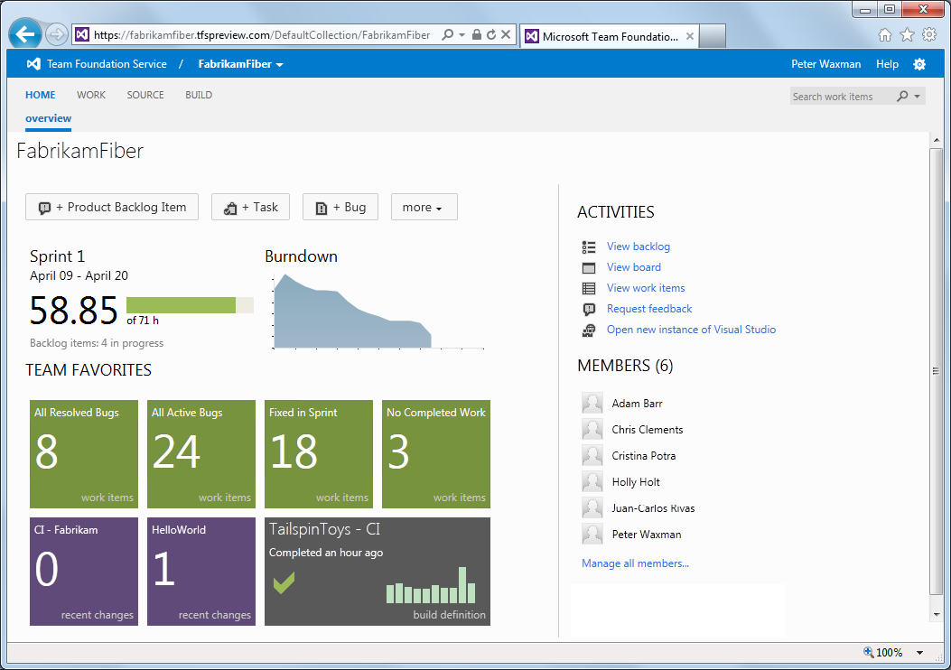

Slide 9
Planning

Slide 10
Planning great experiences
High-level storyboard of 18-month vision
Six month thematic plans, aligned with Azure
Feature teams own backlogs for their areas
Feature flags: separating engineering from marketing

Slide 11
Scrum

Slide 12
Adopting Scrum
Why?
    Deliver features incrementally
    Work like our customers
    Build a great Scrum experience
Team
    130 people
    Feature team: 6 devs, 5 testers, and 1 or 2 PMs
Three-week sprints

Slide 13
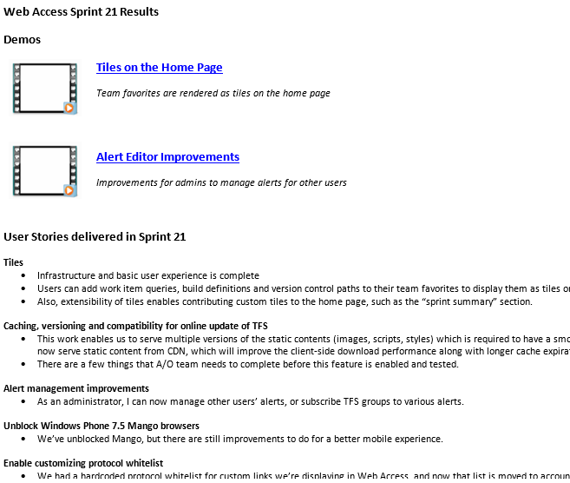
Sprint Email

Slide 14
Cadence

Slide 15
Box thinking for a service
Updates were large
Months apart
Lots of problems!
Do updates more frequently

Slide 16

Ship Every Sprint
Work is done or disabled at the end of sprints
Verification week (not stabilization!)
Deploy to production!

Slide 17
Engineering

Slide 18
The service and the box
Same code base used for both
Work in a single branch
    Gated checkin only builds
    Rolling test system, including upgrade tests
Disruptive changes integrated at the beginning of a sprint
Merge to production branch, quarterly update CTPs

Slide 19
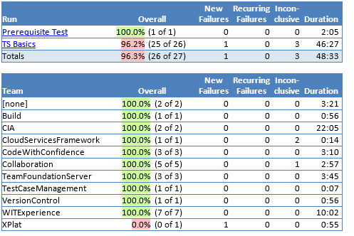
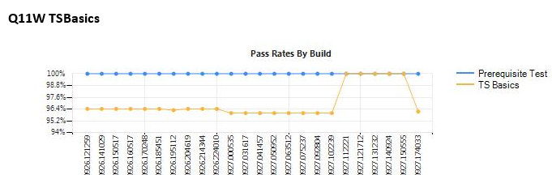
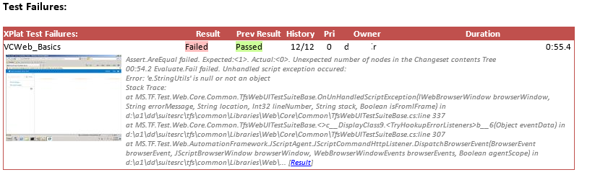
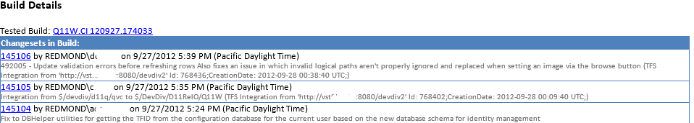
Rolling Tests

Slide 20
Differences
Service scales differently
Need cost model
    Multi-tenant database
    All content goes to Azure Blob Storage

Slide 21
Differences
Tight loop with support
Online upgrades
Automated deployment
No down time between cycles – engineering backlog

Slide 22
Monitoring and Diagnostics
Cultural change
Extensive tracing
Alerting based on activity log, event log, and tracing
External monitoring

Slide 23
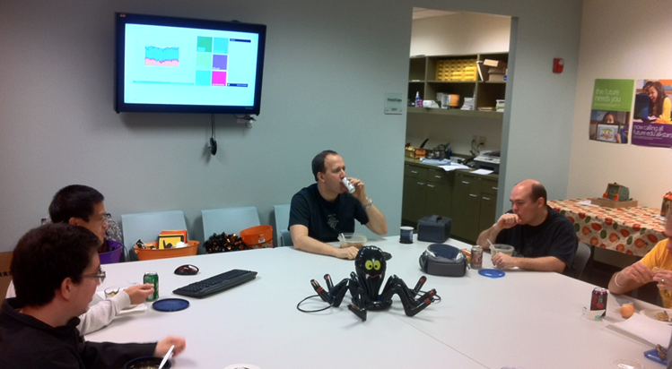
Dashboard

Slide 24
VS Connectivity Issues
Incident Date |  |  |  | Severity |  |  |  | Error Introduced by |  |  |  |  | Impacted Services
10/15/2012 |  |  |  | 2 |  |  |  | Code |  |  |  |  | TFS
TTD (Detect) |  |  |  | TTE (Escalate) |  |  |  | TTM (Mitigate) |  |  |  |  | Cust. Imp. Duration
9 | h | 0 | m | 3 | h | 0 | m | 9 | h | 0 |  | m | 21 | h |  | 0 | m
Customer Impact |  |  |  |  |  | Root Cause |  |  |  |  |  |  | Detection Method
This impacted customers logged into the service from VS. After 24 hours, their session would timeout and not automatically reset, and they would get an error. N customers hit the error. Workaround: restart VS |  |  |  |  |  | A change was made for Napa in our patch on Monday that introduced this regression. We added a check which allowed you to not specify a host in the url, since Napa doesn’t use url routing – that check ended up being a case-sensitive check instead of a case insensitive. When re-logging in, VS sends a lower case URL, which the server didn’t recognize and returned a 404 page not found error. |  |  |  |  |  |  | Manual: customer from twitter Manual: internal from the dashboard error counts
 |  |  |  |  |  |  |  |  |  |  |  |  | Repeat?
 |  |  |  |  |  |  |  |  |  |  |  |  | No
Mitigation Steps
Communicated to customers the workaround on blog, forums, Twitter
Prevention |  |  |  |  |  |  |  | Owner |  |  | ETA |  |  |  | Work Item ID
We need monitoring improvements to enable us to alert on an unusually high number of a particular kind of error. |  |  |  |  |  |  |  | xxx |  |  | Sprint 41 |  |  |  | 985178
Fix VS so it doesn’t require a restart when this happens |  |  |  |  |  |  |  | yyy |  |  | Sprint 39 |  |  |  | 984154
Add an automated test to cover the VS timeout scenario. |  |  |  |  |  |  |  | zzz |  |  | Sprint 40 |  |  |  | 895608
UTS# TFS#
Slide Owner: Ed Glas

Slide 25
Wrapping up
Ship frequently!
Cultural change
Test the tools

Slide 26
Q&A

Slide 27
Related Sessions
10/31/2012 1:45 - B33 McKinley - Application Lifecycle Management: It’s a Team Sport (Brian Keller)
11/1/2012 12:00 - B92 Nexus/Normandy - Developer Productivity with Visual Studio & TFS 2012 (Jamie Cool)
11/1/2012 10:15 - B92 Trident/Thunder - DevOps: Integrating development and operations for last mile velocity (Larry Guger)

Slide 28
Team Foundation Service
http://tfspreview.com

Slide 30
Verification and deployment
Upgrade Pioneer
Email list for ship room approval of fixes
Gated checkin and rolling test for the deployment branch
Final gated checkin build is the production build
Test signs off on an upgrade of the “golden” instance
Upgrade pre-production
Upgrade production
Retrospective

Slide 31
Engineering improvements
Upgrade always works
One set of tests used by dev and test
Reduced UI test automation
Test beneath the UI using model-view patterns
Cut duplication
Make tests robust
End to end scenario walkthrough

Slide 32
Results for the box
TFS 2010 peak was 1800 bugs
TFS 2012 peak was 1000 bugs
Stabilization period between milestones
Bugs pushed out
Cause: Not shipping at the end of a sprint!
Let’s change…

Slide 33
Wrapping up
Plan in progressive increments
Feature flags to control disclosure
Ship frequently!
Cultural change

Slide 34
Wrapping up
Services scale differently
Cost model is important
Automation
Online upgrade
Engineering backlog
Test monitoring and dashboard
Still learning!

