Slide 1
Building Lenses for the Windows Phone 8 Camera
Eric P. Bennett
Senior Lead Program Manager
Windows Phone Camera
2-018

Slide 2
Agenda
The Windows Phone 8 Camera
Building a Lens
New Camera APIs
Sharing and Editing

Slide 3
Camera and Lenses Demo
Camera App and Photosynth Lens

Slide 4
The Windows Phone 8 Camera
The everyday camera solution
Fast pocket-to-picture times
Dedicated camera button for a point-and-shoot experience
New UI elements Pinch-to-zoom UI Lens Picker button

Slide 5
Windows Phone Lenses
Viewfinder-driven experiences
Appear inside Camera & Photo apps
Create, view, & edit photos + rich media
Access new camera APIs and extensibility points
Purchased through the Store

Slide 6
Let’s cut to the chase: Your new camera app should be a Lens on Windows Phone 8

Slide 7
Inside Lenses

Slide 8
Lens Workflow
//Build Demo Lens
//Build Demo Lens

Slide 9
Key Lens Components
Lenses start with an <Extension> but also feature …
Viewfinder entry point
Lens-specific UX flow
Rich media
Custom tile iconography
Built with …
XAML with C# for UI
Access to C++

Slide 10
Lens Requirements
In WMAppManifest.xml <Extensions> add “Camera_Capture_App” Extension
DeepLink URI contains “ViewfinderLaunch”
For Lens Icons:
Resolution | Icon size | Folder | File name
WVGA | 173 × 173 px | /Assets/ | Lens.Screen-WVGA.png
720p | 259 × 259 px | /Assets/ | Lens.Screen-720p.png
WXGA | 277 × 277 px | /Assets/ | Lens.Screen-WXGA.png

Slide 11
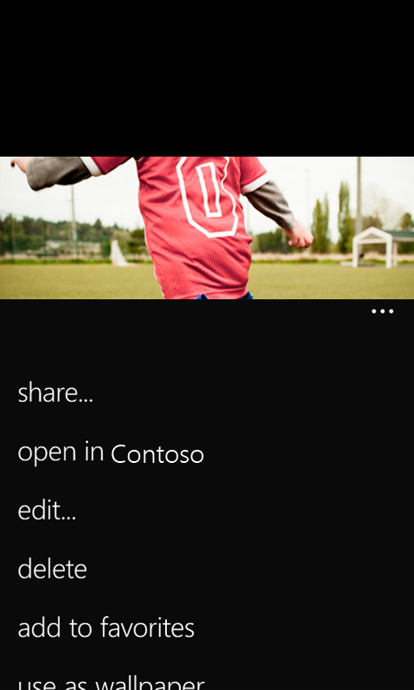
Rich Media
Lenses can capture more than JPEGs
Interactive panorama capture
Non-destructive editors
Link camera roll JPEGs to a lens and content stored in the Local Folder
“Photos_Rich_Media_Edit” <Extension>
Launches with a DeepLink URI containing “RichMediaEdit” and a file token for identification

Slide 12
Making Great Lenses
Guidelines to make your Lens intuitive and fun.
The full UX guidelines are on MSDN
“Consistent” capture experience
Controls, Gestures, & Animations
In-lens camera roll
With Rich Media and without
App flow / back buttons
View/Edit-Only Mode

Slide 13
Coding a Lens: Part I Lens Infrastructure
Registering as a Lens, Lens Tile Icons, Lens Capabilities, Lens DeepLink URIs

Slide 14
New Camera APIs

Slide 15
Windows Phone 8 Imaging Platform
Windows Runtime Camera APIs
(Don’t worry, 7.5’s managed APIs are still there too)
Deeper sensor control across devices
CaptureSequence image capture model
Preview and video stream access
… all on a new MediaFoundation core
… and with C++ for existing image processing code

Slide 16
Windows.Phone.Media.Capture
Native Interfaces
IAudioVideoCaptureDevice
ICameraCaptureNativeDevice
CameraCaptureFrame
ICameraCapturePreviewSink
ICameraCaptureSampleSink
CameraCaptureSequence
Camera Sensor Properties
KnownCameraGeneralProperties
PhotoCaptureDevice
AudioVideoCaptureDevice
KnownCameraAudioVideoProperties
ICameraCaptureDevice
KnownCameraPhotoProperties

Slide 17
Consistent Control Across Devices
Common Photographic Properties
Immediate sensor changes with PhotoCaptureDevice
SetProperty( property,
value)
GetSupportedPropertyRange(
sensorLocation,
property)
GetSupportedPropertyValues(
sensorLocation,
property)
Property | Units
ExposureCompensation | 1/6 EV
ExposureTime | Microseconds
ISO | ISO Sensitivity
WhiteBalance | Degrees Kelvin
WhiteBalancePreset | Enum
SceneMode | Enum
FlashMode | Enum
FlashPower | Range

Slide 18
Capture Sequences
Open
PhotoCaptureDevice.OpenAsync()
High-performance imaging
Specify frame properties to be applied at time of capture
Optimizes for fast capture on shutter button press and asynchronous UX
Other considerations
Reset pipeline with SetProperty()
Half-press focus/touch focus
Create
PhotoCaptureDevice.CreateCaptureSequence()
Specify
CameraCaptureFrame.DesiredProperties[]
Prepare
PhotoCaptureDevice.PrepareCaptureSequenceAsync()
User Presses Shutter
Capture CameraCaptureSequence.StartCaptureAsync()
FrameAcquired Event
Process
CameraCaptureFrame.CaptureStream
Save
MediaLibrary.SavePictureToCameraRoll()

Slide 19
Coding a Lens: Part II Capture
Initialize the camera with Windows Runtime APIs, Configure the sensor, Take a picture

Slide 20
Preview and Audio/Video APIs
Live Preview Pixels from Photo/AudioVideoCaptureDevice
GetPreviewBufferArgb(), GetPreviewBufferY(), GetPreviewBufferYCbCr()
Formatted as NV12 Data
Notification through PreviewFrameAvailable Event
Native preview access through COM APIs
AudioVideoCaptureDevice Capture/Streaming
H.264 Video with AAC Audio in an .MP4 Container
Configurable with KnownCameraAudioVideoProperties
Access to VideoTorch properties
Native stream and frame pixel access through COM APIs

Slide 21
Sharing and Editing

Slide 22
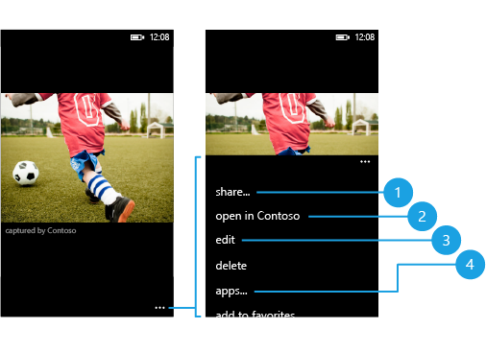
More Photo Gallery <Extension> Points
Share Menu
Rich Media
Edit Menu
Legacy-only
Plus, you can now launch a ShareMediaTask from your Lens

Slide 23
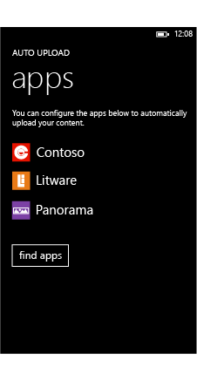
Auto-Upload Background Agents
Upload photos to your cloud service in the background over Wi-Fi
Implemented as a ResourceIntensiveTask
Device settings menu for configuration
“Photos_Auto_Upload” <Extension>
DeepURI Link Contains “ConfigurePhotosUploadSettings”

Slide 24
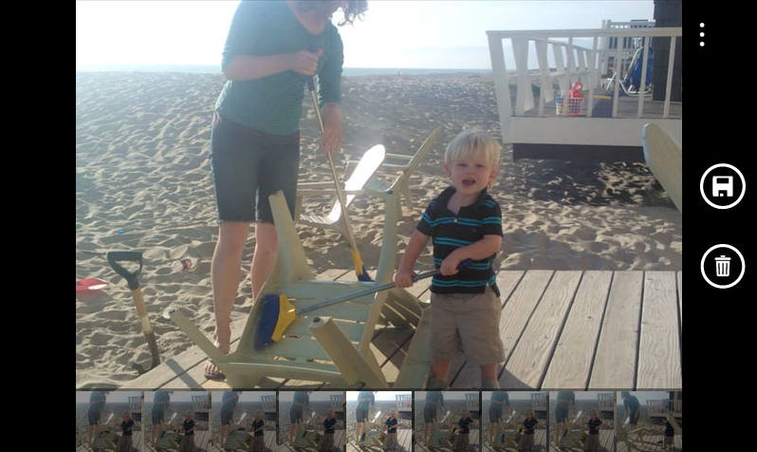
Additional Resources
Documentation
Sample Code on MSDN
BasicLensWP8CS
MediaViewerSample
Emulator development

Slide 25
The Opportunity of Lenses
Great for photo apps … but, the door is now open to new experiences only possible with Rich Media
Users will look to the Store for Lenses that enable their camera to do amazing things

