Slide 1
WP8 XAML App Development
Shawn Oster
Senior Program Manager
2-021

Slide 2
Agenda
Overview
Building WP8 apps
What about WP7 apps
Q&A

Slide 3
Overview

Slide 4
What is XAML?
eXtensible Application
Markup
Language
A declarative, markup-based language to define your user experience
The way to write apps for Windows Phone
Aligns with Windows 8

Slide 5
Windows Phone 8 app models
Direct3D App
C++
XAML App
C# / VB
Direct3D
Interop
C++
Reuse
Windows Phone 8 API Set
Graphics
Audio
Media
Common
.NET FX
File System
Networking
Input
CoreCLR
Commerce
Base Types
Sensors

Slide 6
Building WP8 apps

Slide 7
New XAML app features
What’s covered during this talk
Project infrastructure and design
Templates, localization, multiple resolutions
Building Blocks
Panorama, Pivot, LongListSelector, Map, WebBrowser, Pinch + Stretch, ViewportControl
.NET
async/await, threading, event timing

Slide 8
Project infrastructure and design
File | New

Slide 9
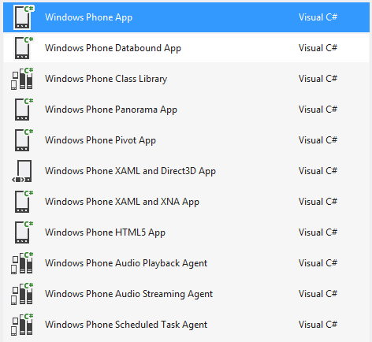
Project templates
New and Updated Project Templates
HTML5, Localization Support, Alignment Grid

Slide 10
Localization
Global reach
Use resource strings from the start, both code-behind and XAML
FlowDirection controls UI mirroring
LeftToRight, RightToLeft (RTL)
Full support for RTL, bi-directional text
WP8 XAML text stack uses DWrite

Slide 11
Multiple resolutions
“You look marvelous!”
Multiple resolutions
WVGA (480 x 800)
720p (720 x 1280) – 1.5 scaled
WXGA (768 x 1280) – 1.6 scaled
Layout is in logical vs. physical pixels
Assets will be scaled so always use highest resolution
DecodePixelWidth/DecodePixelHeight to save memory

Slide 12
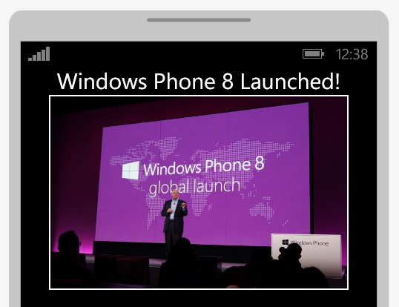
WVGA
480x800
1.0 Scale
WXGA
768x1280
1.6 Scale
720p
720x1280
1.5 Scale
400 Logical
400 Physical
400 Logical
640 Physical
400 Logical
600 Physical
2 Logical
2 Physical
2 Logical
3 Physical (Rounded)
2 Logical
3 Physical
30 Logical
30 Physical
30 Logical
48 Physical
30 Logical
45 Physical
Think about layouts in WVGA pixels
Think about graphics / videos in WXGA

Slide 13
Walk-thru: Project infrastructure
New templates, improvements, design help, localization, multiple resolutions, decoding pixels

Slide 14
Building blocks
Controls

Slide 15
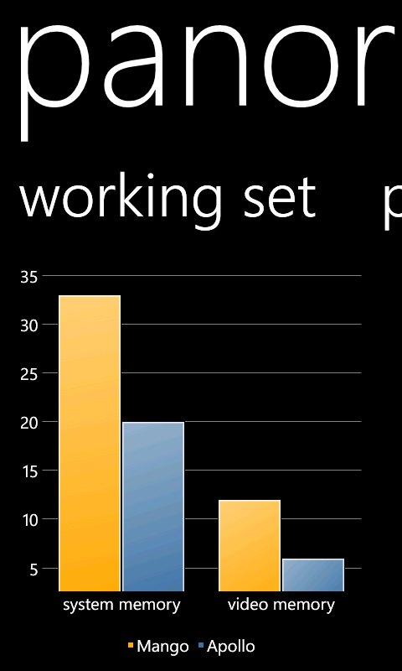
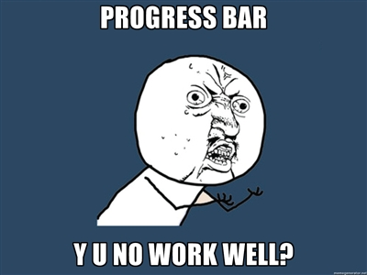
Control Improvements
ProgressBar animates off-thread
Panorama, Pivot & LongListSelector all in ROM
Reduced Panorama memory usage
Improved “first touch” experience for signature controls

Slide 16
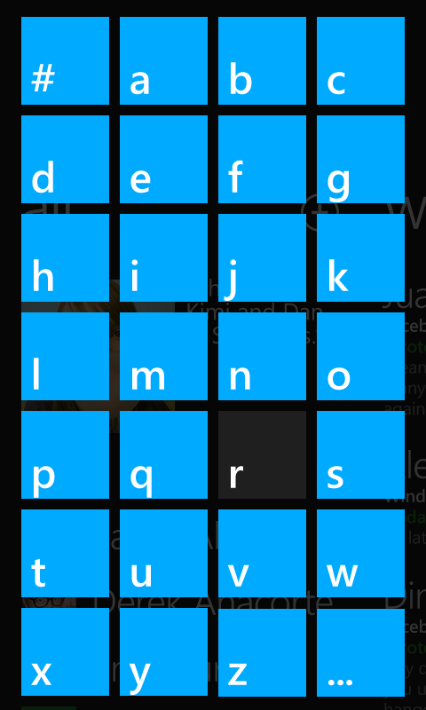
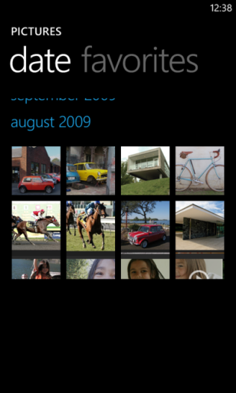
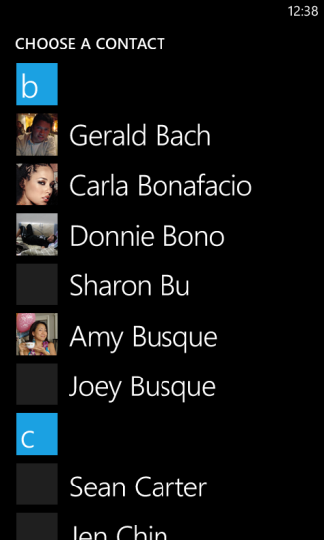
LongListSelector
JumpList
Grid View
Sticky Headers

Slide 17
Demo: LongListSelector
Converting a ListBox, styles, locale-aware grouping, grid view

Slide 18
LongListSelector
Always know where you are
Grouping requires an IList of IList
Does UI virtualization
ItemRealized is the key to infinite scrolling
Remember to set IsGroupingEnabled

Slide 19
Maps
Always know where you are, thanks Nokia!
Interactivity
Off-thread input, panning, fluid pinch+stretch
Overlay layers
UIElement position and scale transforms no longer updated on UI thread
Vector-based
Render from vector data, readable labels, perspective view
Offline maps
Common cache across all applications

Slide 20
WebBrowser
A more beautiful web, in your apps
IE10-based
Supports HTML5 features
Local storage, CSS3
Supports gestures
Mango apps run in IE9 compatibility mode

Slide 21
Pinch + Stretch
Completing the gesture story
Extends the ManipulationDeltaEventArgs class
PinchManipulation property
Provides center point for the original and current gesture

Slide 22
ViewportControl
A new primitive for controls
More “primitive” than ScrollViewer
Able to update bounds dynamically
Designed specifically for touch-specific scenarios
Base-control for LongListSelector
Input is off-thread

Slide 23
Toolkit
Where are the “rest” of the controls?
Renamed to “Windows Phone toolkit”
Moved to http://phone.codeplex.com

Slide 24
Creating an image zoom control
Demo
Handling pinch + stretch using the ViewportControl

Slide 25
CoreCLR
More than just keywords (but there are some pretty great keywords too)
Same CLR as Windows 8
Compile in the Cloud
Portable Libraries
New APIs
async/await for easier asynchronous programming, CallerMemberName

Slide 26
Simplify your code
Demo
async/await, CallerMemberName

Slide 27
What about WP7 code?

Slide 28
Application compatibility
Migrating your app from WP7 to WP8
Massive effort on making sure the top apps and API are compatible
Tools can target both 7.1 and 8.0
Binary vs. Source compat
Light Up
Code sharing

Slide 29
WP8 at BUILD
Tuesday 10/30
11:45 – 12:45 | WP8 Application Model | 92 Nexus/Normandy
02:15 – 03:15 | WP8 Native C/C++ Game Development | 92 Magellan
04:00 – 0:500 | How to Leverage your code across WP8 and Windows 8 | 92 Nexus/Normandy
04:00 – 0:500 | WP8 XAML Application Development | 92 Magellan
05:45 – 06:45 | WP8 In App Purchase & Developer Center | 92 Nexus/Normandy

Slide 30
WP8 at BUILD
Wednesday 10/31
11:15 – 12:15 | WP8 Critical Dev Practices | 92 Magellan
01:45 – 02:45 | WP8 Networking, Bluetooth, NFC | 92 Nexus/Normandy
03:30 – 04:30 | WP8 Making Money with your Application | 92 Magellan
05:15 – 06:15 | WP8 HTML5/IE10 for Developers | 92 Magellan

Slide 31
WP8 at BUILD
Thursday 11/1
08:30 - 09:30 | WP8 Maps, Location & Background | 92 Magellan
10:15 – 11:15 | WP8 Performance & Optimization | 92 Magellan
12:00 – 01:00 | WP8 Photo & Lens Apps | 92 Magellan
02:30 – 03:30 | How to Leverage your code across WP8 and Win 8 | 33 McKinley
02:30 – 03:30 | WP8 Tiles, Lock and Notifications | 92 Magellan
04:15 – 0:515 | WP8 Native C/C++ Game Development | 33 McKinley
04:15 – 05:15 | WP8 Using C++ in your Applications | 92 Magellan

Slide 32
WP8 at BUILD
Friday 11/2
08:30 – 09:30 | WP8 Using C++ in your Applications | 33 McKinley
08:30 – 09:30 | WP8 Using the Speech API | 92 Magellan
10:15 – 11:15 | WP8 Wallet and Deals | 92 Magellan
12:45 – 01:45 | WP8 App to App Communication | 92 Magellan
02:30 – 03:30 | WP8 Enterprise Development | 92 Magellan

Slide 33
Resources
Windows Phone Dev Center
http://dev.windowsphone.com/en-us
Windows Phone Toolkit
http://phone.codeplex.com
Blog
http://shawnoster.com

Slide 34
Thank You!
Questions
Answers
(Please do your eval!)

