Slide 1
Delivering applications with RemoteFX in Windows Server 2012
Shanmugam Kulandaivel
Senior Program Manager
2-025

Slide 2
Agenda
Overview of the new Remote Desktop experience
RemoteApp
Remote Desktop Windows store app
Improved graphics remoting
Support for a wide range of networks
Demos!

Slide 3
Remote Desktop in Windows 7
Windows desktops and applications in LAN environment
Windows 7 – RDP 7.0
Media redirection
True multi-monitor support
Aero Glass desktop
Improved experience via enhanced bitmap codecs
Windows 7 SP1 – RDP 7.1
RemoteFX – Enables rich desktop remoting within corporate network/LAN

Slide 4
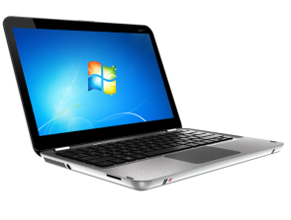
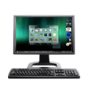
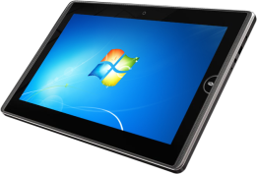
Windows 8: rich experience everywhere
RemoteFX delivers a consistently rich user experience to users over LAN or WAN (irrespective of deployment model)
RemoteFX
Hardware and Software GPUs
Rich multimedia
USB Redirection
Corporate LAN
Multi-touch
WAN acceleration
Single sign on
Internet or WAN

Slide 5
RemoteFX is the name for the full fidelity remote experience in Windows 8 and Windows Server 2012

Slide 6
IT-provisioned applications

Slide 7
IT-provisioned RemoteApp and desktop experience
Seamless user experience
End users just need to know their e-mail ID to subscribe
Start screen integration
Full single-sign on
Reconnect feature makes it easy to move between devices

Slide 8
RemoteApp
Local like remote applications
Applications delivered anywhere
Taskbar integration
Language bar support
Best way to serve out desktop apps to Windows RT slate users

Slide 9
Windows store Remote Desktop app and RemoteApp
Demo

Slide 10
Multi-touch and graphics

Slide 11
Multi-touch and graphics experience
Fast and fluid experience
Full multi-touch experience
Touch friendly app UI
Enhancements such as touch pointer
Multi-touch and gesture remoting
Full fidelity graphics
Adaptive encoding
Progressive rendering

Slide 12
RemoteFX graphics architecture overview
Windows 8 UI and applications (HTML, XAML, native, etc..)
Apps and desktop
RemoteFX intelligent caching
RemoteFX adaptive graphics
RemoteFX media remoting
RemoteFX progressive rendering
RemoteFX
optimized text codecs
RemoteFX
Calista codec
RemoteFX protocol encoding
RemoteFX for WAN transports
RemoteFX for WAN

Slide 13
RemoteFX in Windows 8 dynamically adapts to changing network conditions and optimizes encoding to the content

Slide 14
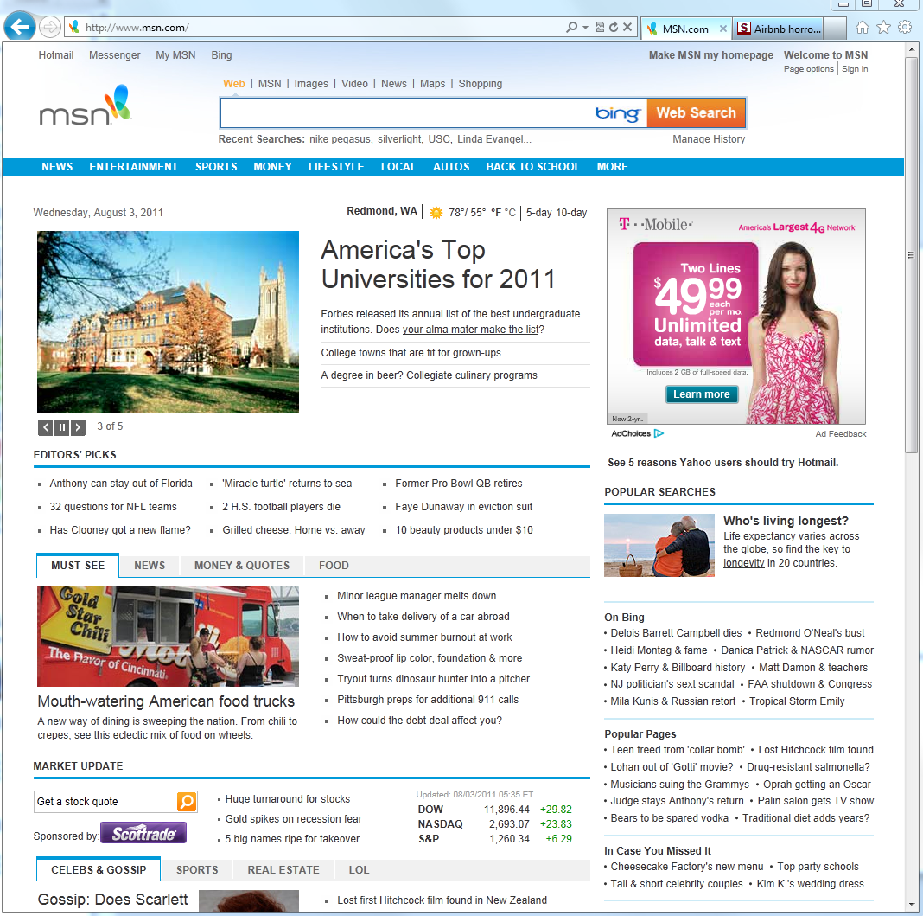
RemoteFX adaptive graphics
Text content
Image content
Video/animations

Slide 15
RemoteFX progressive rendering

Slide 16
RemoteFX progressive rendering
Text remains clear while images are progressively refined/rendered

Slide 17
Multi-touch and graphics
Demo

Slide 18
WAN experience

Slide 19
Factors affecting remoting on WAN
Latency
Packet loss
Limited bandwidth
End-to-end delay/ping (e.g., 100ms)
Burst or random
E.g., <2 Mbps vs. 100Mbps for LAN

Slide 20
RemoteFX for WAN
Great experience even on WAN
Intelligent transport
Automatic choice of TCP or secure UDP transport
Dynamically auto detects and tunes graphics to network
Integrated with Remote Desktop Gateway
Goal: deliver a great UX
Branch offices, wireless devices, work from home, androaming users with 3g/4g

Slide 21
RemoteFX media streaming
Quality audio, good FPS video with A/V sync, even on WAN
Server-side video detection for all media types
Flash, Silverlight, QuickTime, HTML5, etc.
Audio and video use dynamic bit-rate codecs
Up to 90% drop in bandwidth consumption
Windows media redirection support for WMV

Slide 22
WAN experience
Demo

Slide 23
RemoteFX vGPU

Slide 24
RemoteFX vGPU
Power for GPU in virtualized desktops
Virtualized DX11 GPU for VDI
3D graphics-intensive applications (games, engineering design apps)
Animations and transitions
Applications that use GPU for computation ( e.g., Compute Shader)
Best application compatibility, running as a console session in VM
Key enhancements
Full DX11 support
Up to 2560 X 1440 resolution (1920 x 1200 in WS08 R2 SP1)
Up to 8 monitors at 1024 x 768 (4 monitors at 1024 x 768 in WSO8 R2 SP1)

Slide 25
vGPU experience
Demo

Slide 26
Lync 2013: full audio/video support

Slide 27
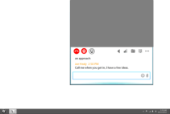
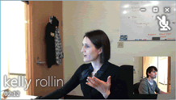
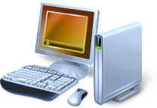
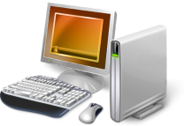
Lync 2010 in VDI
Poor user experience
High data center bandwidth usage
Limited supported
Data center
Virtual desktop
Lync IM, app sharing, call control, etc.
Infrastructure
Lync audio & video
Users
RDP traffic
Lync user 1 on local PC
Lync user 2 on a Remote Desktop Client

Slide 28
Lync 2013 in VDI
Local like user experience
Improved server scale
Reduced bandwidth usage in and out of data center
Data center
Virtual desktop
Lync IM, app sharing, call control, etc.
Infrastructure
Users
RDP traffic
Peer-to-peer AV traffic
Lync audio & video
Lync user 1 on local PC
Lync user 2 on a Remote Desktop Client

Slide 29
RemoteFX media redirection API
Integrate your VoIP applications with RemoteFX
Video region geometry tracking
Client side video composition
Dynamic virtual channels for client server communication

Slide 30
Lync 2013 in VDI
Demo

Slide 31
USB redirection

Slide 32
RemoteFX USB redirection
Local devices in remote session
Use with all scenarios
Physical, virtual, or session desktop
No RemoteFX vGPU needed
Secure
Devices are isolated to the user’s session!
Broad support
Use a wide variety of USB peripherals including isochronous

Slide 33
USB Redirection
Demo

Slide 34
RemoteFX ecosystem

Slide 35
RemoteFX rich ecosystem
Servers
GPUs
RemoreFX clients
Semiconductors
RemoteFX client software

Slide 36
RemoteFX thin client logo
Performance
Compatibility
Robustness
Versatility

Slide 37
Summary
RemoteFX for WAN
RemoteFX adaptive graphics
RemoteFX media remoting
Customer Value
Fast and fluid remoting of the full Windows 8 style UI across a wide range of networks
RemoteFX multi-touch
RemoteFX USB redirection
Remote Desktop Windows Store app
Choice of software or physical GPU, vGPU for VM
Available for sessions, VM’s and physical machines
Broad range of clients supported
Choice of deployment options

Slide 38
Resources Comprehensive resources to both understand and develop for RemoteFX
RemoteFX protocol documentation
RemoteFX DVC and media redirection API documentation on MSDN
RemoteFX logo program
Remote Desktop Services team blog
http://blogs.msdn.com/b/rds/
Please submit session evals on the Build Windows 8 App or at http://aka.ms/BuildSessions

Slide 39
Questions

Slide 40
Resources
Follow us on Twitter @WindowsAzure
Get Started: www.windowsazure.com/build
Please submit session evals on the Build Windows 8 App or at http://aka.ms/BuildSessions

