Slide 1
Kinect UI Design Considerations
Jay Kapur
Principal Lead Program Manager, Kinect for Windows
Kinect Design Considerations
2-029

Slide 2
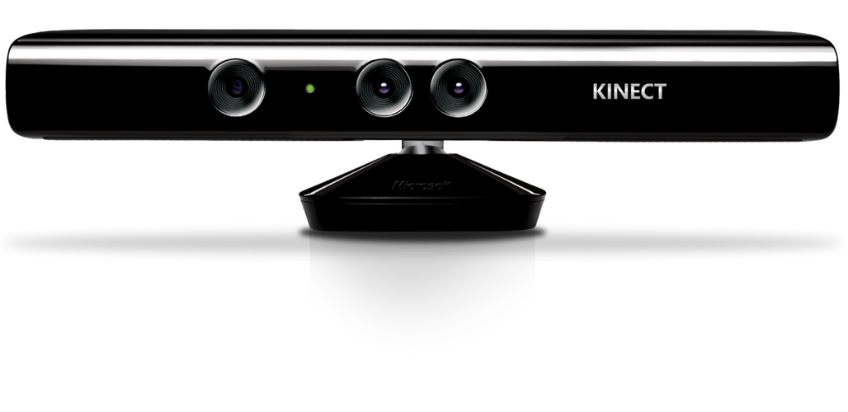
Agenda
Spheres of interaction/every input is best and worst at something
What Kinect is great for
What Kinect is not
What problems we are addressing with K4W interactions
Design methodology
Demos

Slide 3
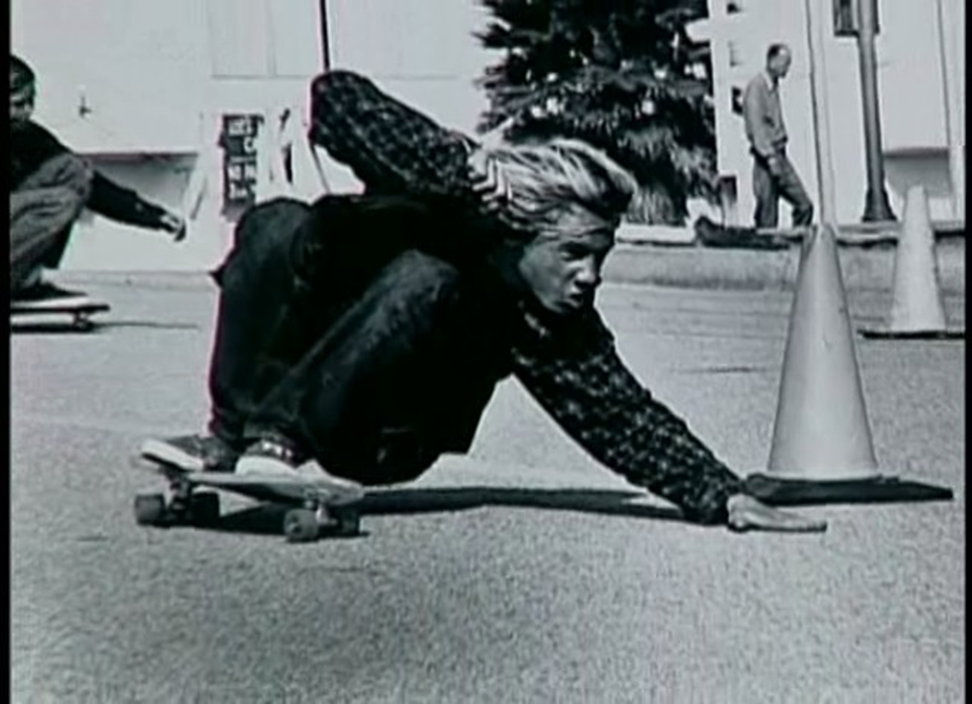

Slide 4
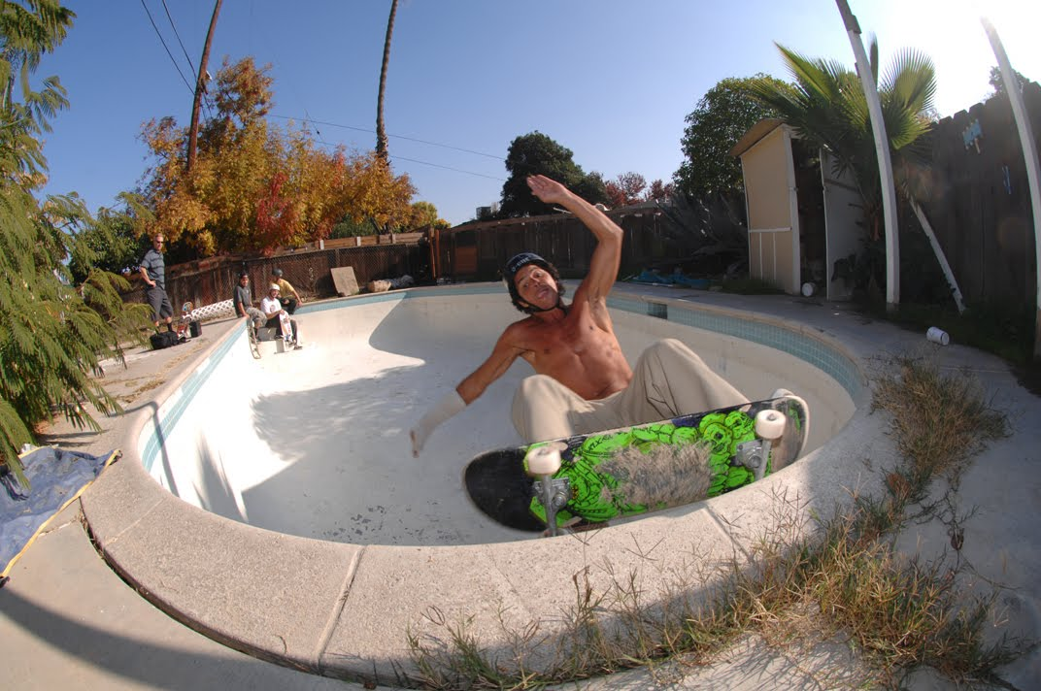

Slide 6
We’re still learning how to augment interfaces with Kinect input
Some advancement will come through providing standard methods of Kinect interaction
Other advancements will come through improved technology that can more closely identify human actions
Kinect UI is in the early stages of evolution and progression

Slide 7
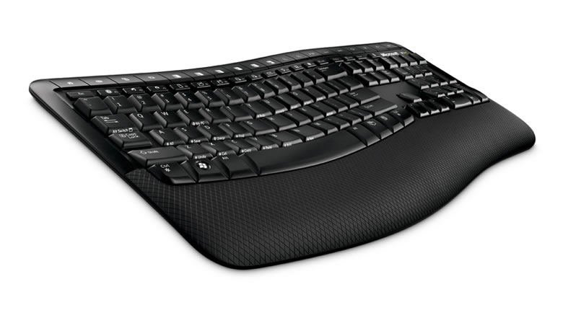
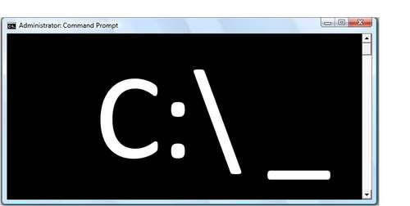
Inputs impact the design of interfaces

Slide 8
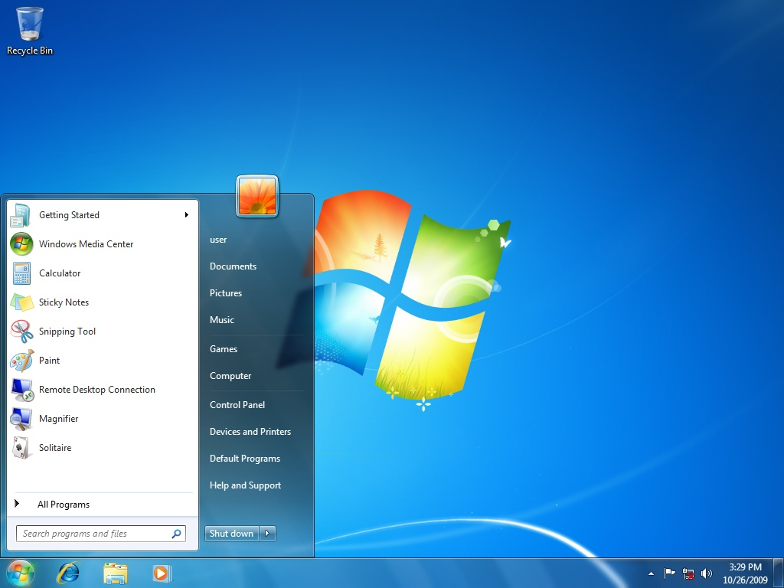
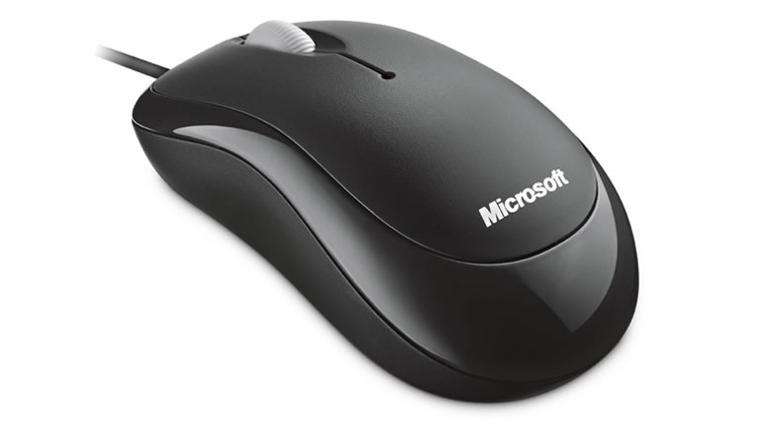
Inputs impact the design of interfaces

Slide 9
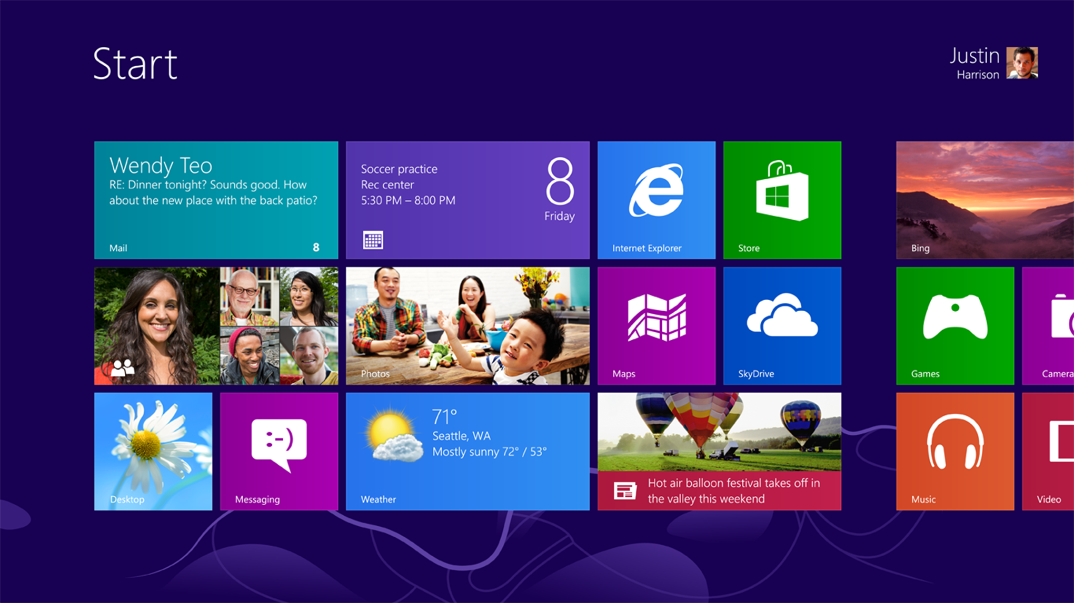
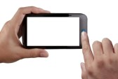
Inputs impact the design of interfaces

Slide 10
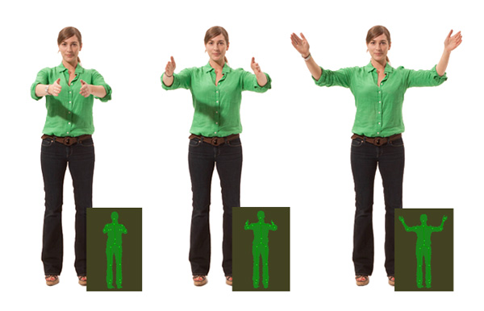
Inputs impact the design of interfaces
?

Slide 11
We see interactions that are effortless, transparent, and contextual
We see fluid communication between users and technology
One to one, one to many, many to many
With seamless ease, we see vision, voice, gesture, and touch together
We see interactions that are as natural as human beings themselves

Slide 13
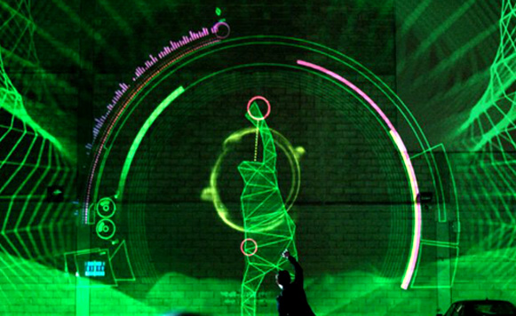

Slide 14
Kinect UI needs to consider a range of modes of interaction
FAR
GESTURES
VOICE
A/V
LARGE
LOOKING AWAY
STANDING
VOICE
AUDIO
GESTURES
TACTILE
VOICE
A/V
SMALL
SEATED
GESTURES
TACTILE
VOICE
A/V
SMALL

Slide 15
Kinect UI needs to determine user intent when there isn’t an explicit interface
TRACKING
ENGAGED
ENGAGED
ENGAGED
NOT ENGAGED
NOT ENGAGED

Slide 16
What we want to do with Kinect for Windows
Provide common Kinect UI interactions to developers so that they can easily build Kinect apps
Solve the most common app tasks and UI requirements
E.g., engagement, targeting and selection, X/Y navigation
Ensure that K4W interactions and controls are intuitive and delightful for end users
Advance the capabilities of Kinect
Show progression!

Slide 17
Kinect interactions Kinect for Windows Prototype controls
Demo

Slide 18
Related Session
3-055 Kinect for Windows Programming Deep Dive
November 1, 8:30, B92 Trident/Thunder

