Slide 1
DirectX graphics development with Visual Studio 2012
Rong Lu
Program Manager, Visual C++ team
2-032

Slide 2
Agenda
Build DirectX apps for Windows 8
Visual Studio 2012 for DX developers
Demos
Windows Phone 8 DX development
Q&A

Slide 3
Windows 8 for developers
Windows Store style apps
Desktop apps
View
DX
XAML
HTML/CSS
HTML
JavaScript
C
C++
C#
VB
Model Controller
C
C++
C#
VB
JavaScript
WinRT APIs
System Services
Communication
& Data
Graphics & Media
Devices & Printing
Application Model
Internet Explorer
Win32
.NET SL
Windows Kernel Services
Kernel

Slide 4
Why use DirectX?
Customer Contacts
Network Traffic
Maps
Games
Paint

Slide 5
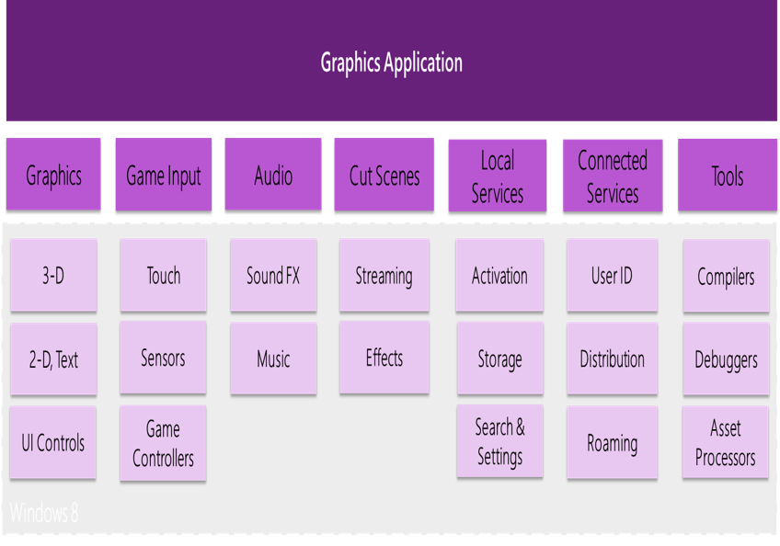
Windows 8 for DirectX developers
Windows 8 DirectX app scenarios
Map mashups, visualization, data-mining, medical imaging, games…
Build DirectX app for Windows 8
Everything you need to create amazing apps
Direct3D 11.1 is fully supported in Windows Store style apps and desktop apps
Visual Studio tooling

Slide 6
First glance at a D3D app in
Visual Studio 2012
Demo

Slide 7
Project/item template
Project template
Direct3D App
Direct2D App (XAML)
Item template
Compute shader
Domain shader
Geometry shader
Hull shader
Pixel shader
Vertex shader
HLSL Header
3D Scene (.fbx)
Visual Shader Graph (.dgsl)

Slide 8
HLSL editor and compilation
HLSL editor keyword colorization
HLSL compilation built into VS
Shader property setting in VS

Slide 9
Explore and debug a DirectX app with Visual Studio 2012
Demo

Slide 10
Image/texture editor
32-bit!
Channels!
Paint tools
Filters
Modern image formats
PNG, JPG, GIF, BMP, TIFF
Direct Draw Surface (DDS)
MIP maps

Slide 11
Model/mesher viewer
Inspect models
FBX, X, OBJ
Camera controls
Experiment & learn
Create Basic shapes
Transforms (e.g., scale)

Slide 12
Graphics debugger
D3D10/D3D11/D3D11.1
Event history
Pixel history
Call stack
Object table
Object visualization
Custom events

Slide 13
Design a pixel shader visually using Shader designer
Demo

Slide 14
Shader designer
Visual designer
Intermediate rendering
Real-time rendering
Apply to models
Export to HLSL

Slide 15
Interoperate to innovate and inspire
XAML app with DirectX surface
SurfaceImageSource
Large scale DirectX graphics
VirtaulSurfaceImageSource
DirectX app with XAML controls
SwapChainBackgroundPanel

Slide 16
Windows Phone 8 DX development
Direct3D is a key scenario on Windows Phone 8
Visual Studio DX development for Phone
New Templates
D3D App, D3D with XAML app
Mesh Viewer
Texture editor
HLSL editor
Shader designer
Direct3D App
C++
XAML App
C# / VB
Direct3D
Interop
C++
Reuse
Windows Phone 8 API Set
Graphics
Audio
Media
Common
.NET FX
File System
Networking
Input
CoreCLR
Commerce
Base Types
Sensors

Slide 17
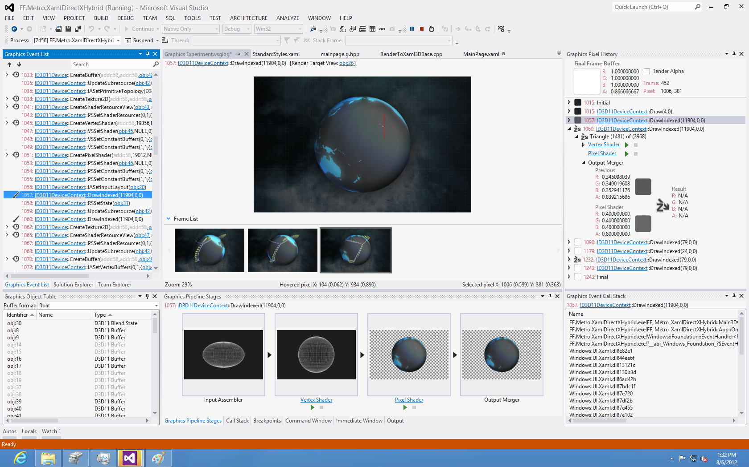
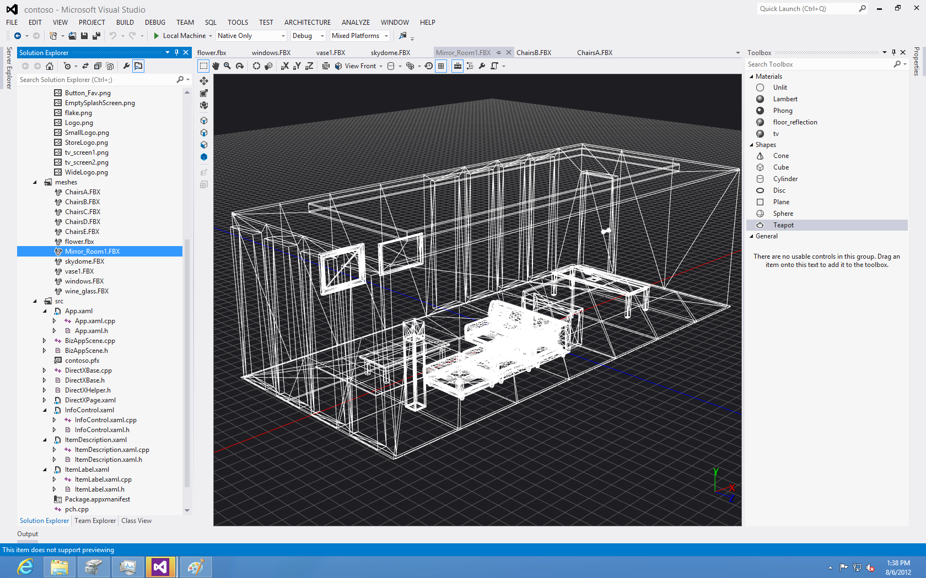
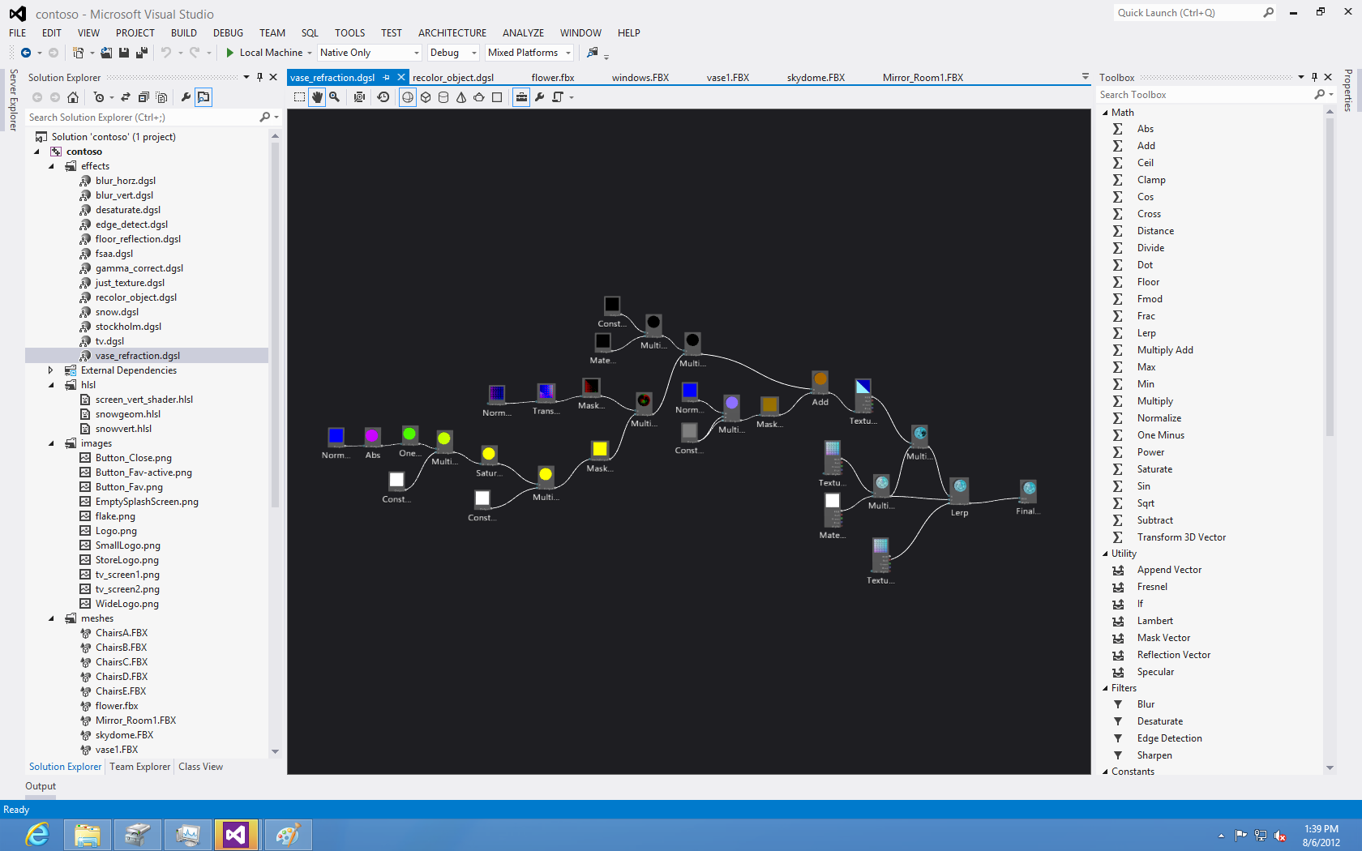
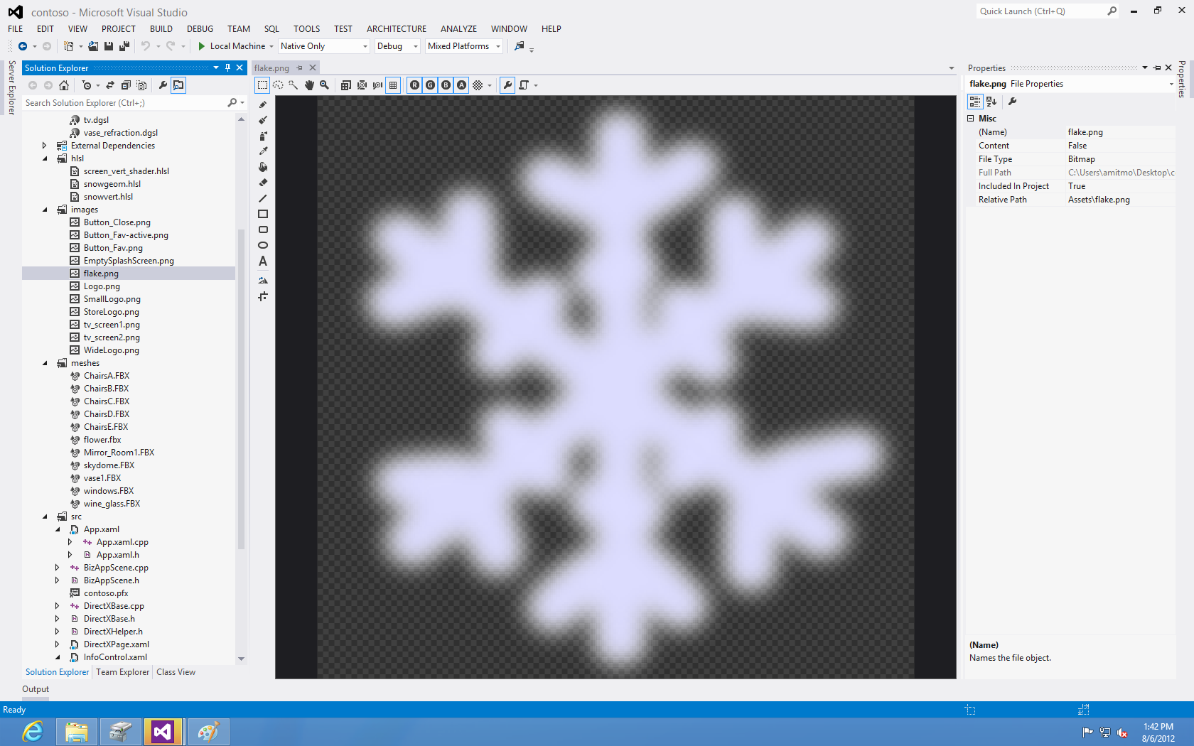
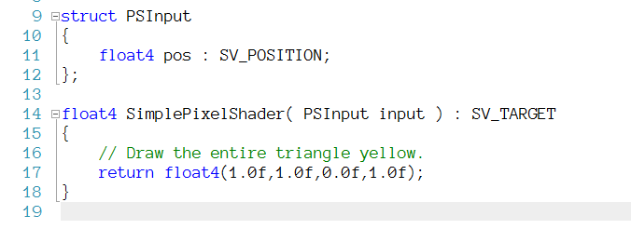
Summary: Visual Studio 2012 for DX developers
Models/mesh viewer
Design Pixel Shaders
Graphics debugging
Image/texture Editor
HLSL editor

Slide 18
Q&A
Send mail: ronglu@Microsoft.com
Find me at Visual Studio booth
Today after the session until 6pm
Thur 3-5:15 PM / Friday 2-3:30 PM

Slide 19
Related Sessions
10/31, 11:15–12:15 > 3-013 It’s all about performance: Using Visual C++ 2012 to make the best use of your hardware (Jim Radigan, Don McCrady)
10/31, 11:45–12:45 > GIA1 Key Technologies for Graphics-Intensive Apps & Case Study 1 (Shai Hintz)
10/31, 15:30–16:30 >2-006 What’s new in VS2012 (Orville McDonald)
10/31, 15:30–16:30 > GIA2 Key Technologies for Graphics-Intensive Apps & Case Study 2 (Phil Napieralski)
11/1, 8:30–9:30 > FUN26 Performance in Windows Store apps built using DX and C++ (Max McMullen)
11/1, 14:30–15:30 > GIA4 Chalk Talk–Gaming and Graphics-Intensive Apps (many speakers..)
11/1, 16:15 – 17:15: WP310 Native C/C++ Game Development (Sam George)

Slide 20
Resources
DirectX Contact dxbuildqa@microsoft.com
Docs to read
Create your first Windows Store app using DirectX
How to set up your DirectX Windows Store app to display a view
Developing Marble Maze, a Windows Store game in C++ and DirectX
DirectX and XAML interop (Windows Store apps using C++ and DirectX)
Debugging and testing apps
Please submit session evals on the Build Windows 8 App or at http://aka.ms/BuildSessions

Slide 21
Got Feedback?
If you have used Visual Studio 2012 to write apps in C++, we would like to learn about your experience and get your feedback.
Please Come to: Bldg. 92, Conference Room 2021 (Contact Reception) on
Wednesday, Oct. 31st, 3PM - 6PM
Thursday, Nov. 1st, 3PM – 6PM
Contact
Sumit.Kumar@Microsoft.com

