Slide 1
Analytics For Windows 8
Roger Woods, Peter Fransen
Adobe
Richard Fricks
Program Manager
Scenario Adoption Team
2-102

Slide 2
Analytics is about providing you with information about your application—information that will help you make customer-focused, data-driven decisions.

Slide 3
Agenda: Windows Store Analytics
Know your customer base
Improve customer satisfaction
Increase reliability of app
Find new opportunities
Other Analytic options

Slide 4
Analytics / Telemetry
Analytics refers to the data we collect from the Windows Store.
Telemetry refers to the data we collect about your app when running on a customer’s computer.

Slide 5
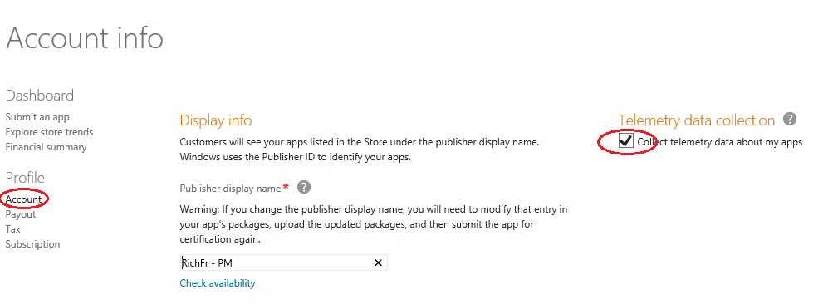
Enabling Telemetry

Slide 6
Windows Store Analytics
Adoption
Ratings
Quality
Store Trends

Slide 7
Windows Store Analytics
Adoption
Ratings
Quality
Store Trends
Know your customer base
Improve customer satisfaction
Increase reliability of app
Find new opportunities

Slide 8
Using Adoption reports to know your customers.
Conversion
Referrers
Downloads
In-app Purchases
Usage
Adoption reports provide analytic data to help you understand your customers both actual and potential.

Slide 9
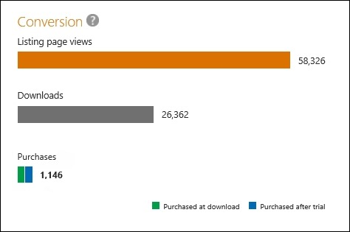
Adoption
Conversion
Referrers
Downloads
In-app Purchases
Usage

Slide 10
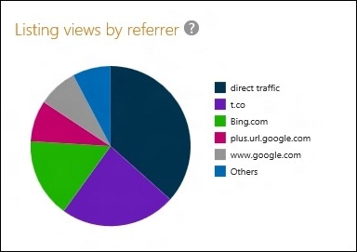
Adoption
Conversion
Referrers
Downloads
In-app Purchases
Usage

Slide 11
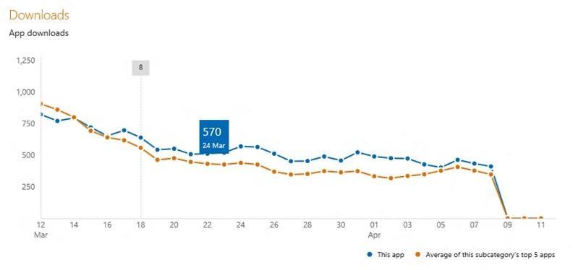
Adoption
Conversion
Referrers
Downloads
In-app Purchases
Usage

Slide 12
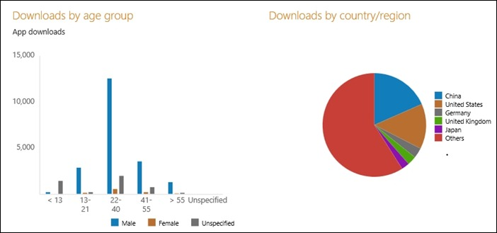
Who are my Customers?

Slide 13
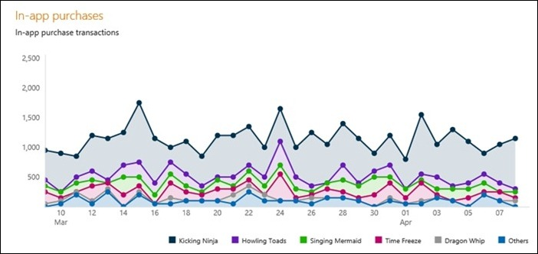
Adoption
Conversion
Referrers
Downloads
In-app Purchases
Usage

Slide 14
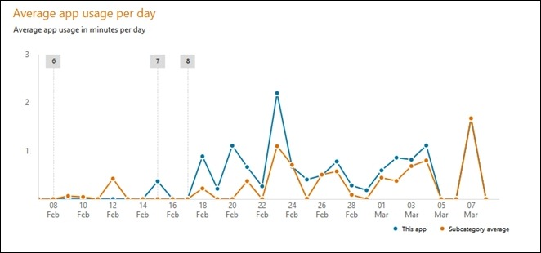
Adoption
Conversion
Referrers
Downloads
In-app Purchases
Usage

Slide 15
Using Ratings reports to Improve Customer Satisfaction
Ratings reports provide analytic data to help you understand what customers are saying about your application.
Market
Ratings
Reviews

Slide 16
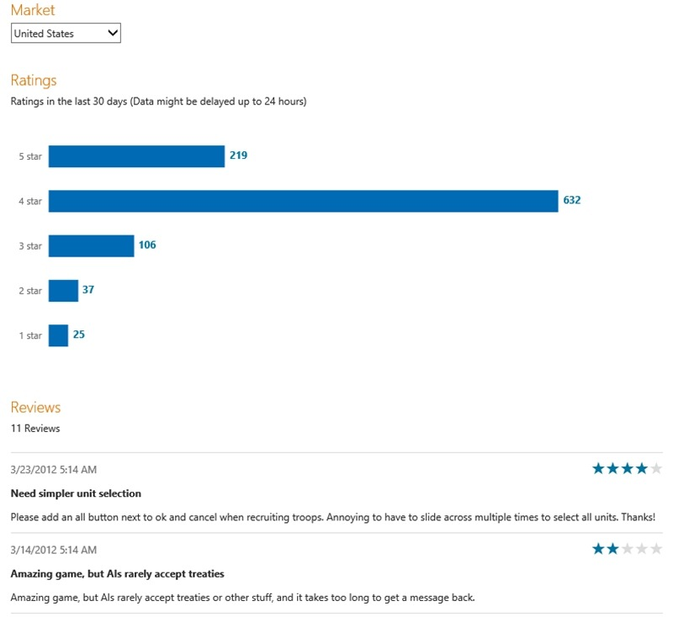
Ratings
Market
Ratings
Reviews

Slide 17
Ratings
Market
Ratings
Reviews

Slide 18
Ratings
Market
Ratings
Reviews

Slide 19
Using Quality Reports to Improve Application Reliability
Quality reports provide analytic data based on your app’s reliability as experienced by your customers.
JavaScript Exception Rate
Crash rate
App unresponsive rate

Slide 20
Using Quality Reports to Improve Application Reliability
Heuristics
Telemetry must be enabled
Quality Panel >= 500 Machines
Tabulated during first 15 Minutes of Active Usage
Outliers removed to prevent skew

Slide 21
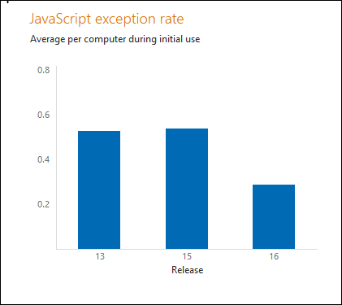
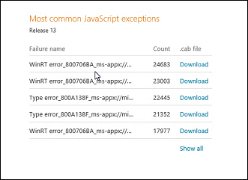
Quality
Exception rate
Crash rate
App unresponsive rate

Slide 22
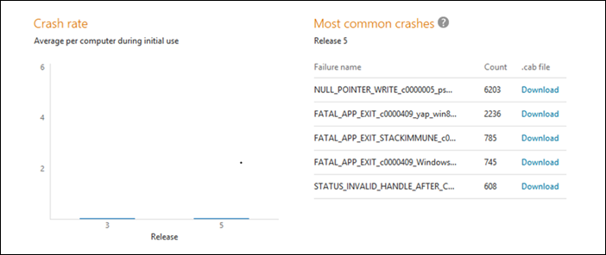
Quality
Exception rate
Crash rate
App unresponsive rate

Slide 23
Quality
Exception rate
Crash rate
App unresponsive rate

Slide 24
Demo: Crash Analysis

Slide 25
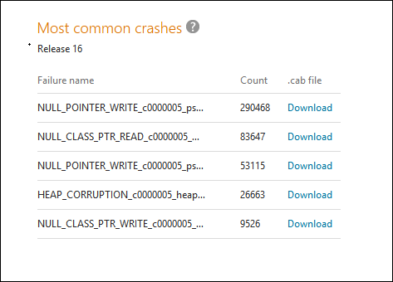

Slide 26
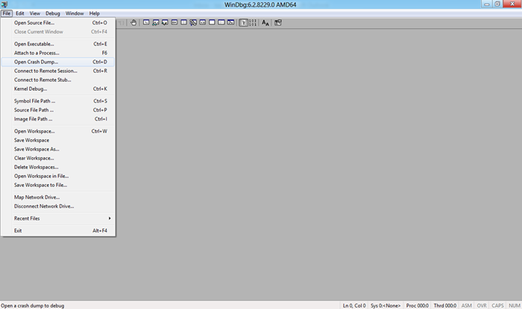

Slide 27
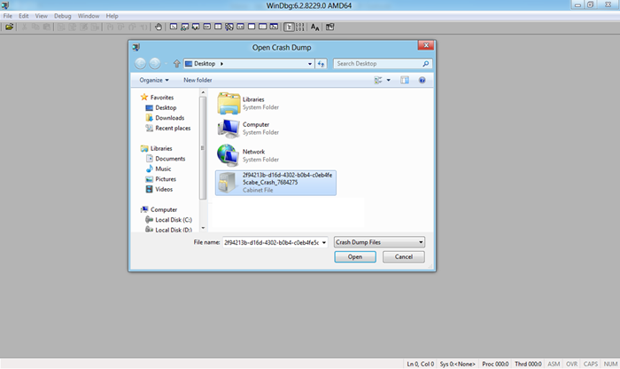

Slide 28
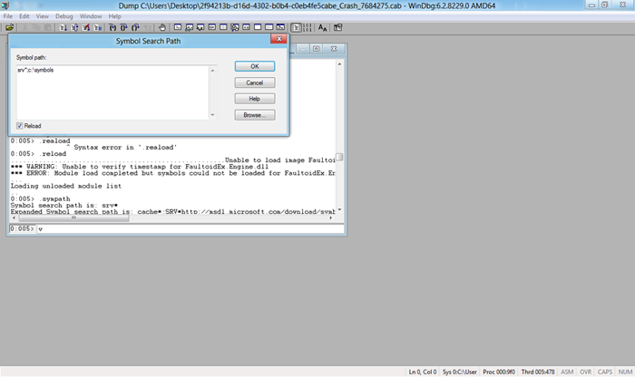

Slide 29
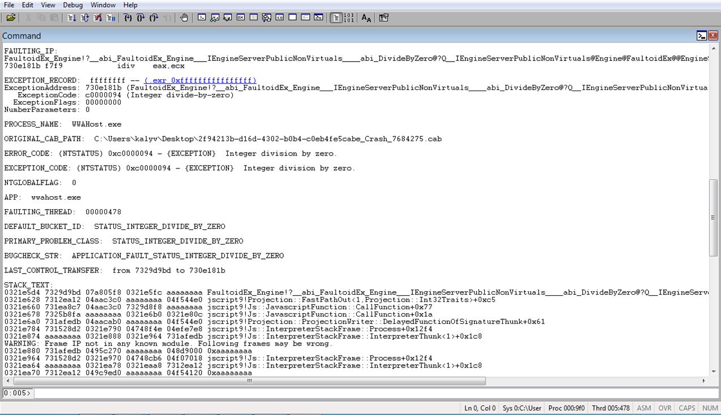

Slide 30
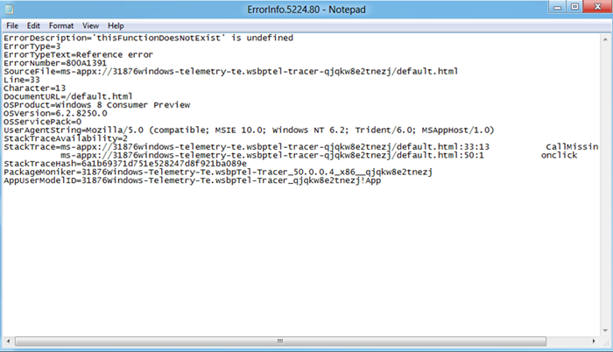

Slide 31
Using Trend Reports to Find New Opportunities
See download trends by
Application Category
Demographics
Store Trend reports provide analytic data to help you decide what type of app to develop next and which customer segment to target.

Slide 32
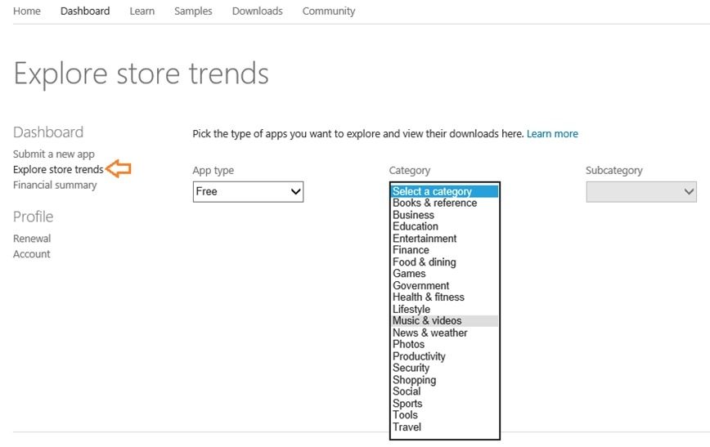
Using Trend Reports to Find New Opportunities

Slide 33
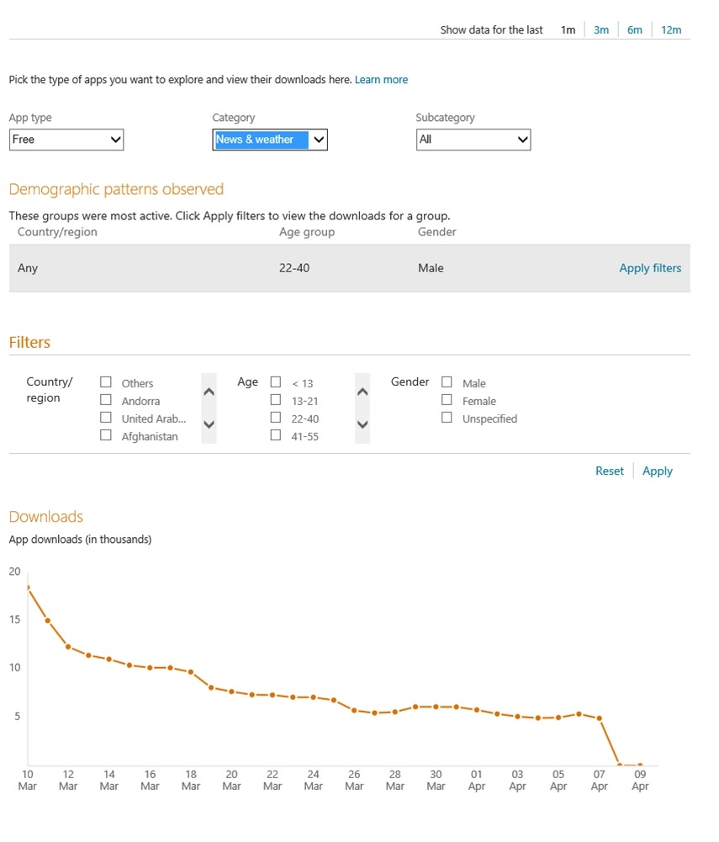
Using Trend Reports to Find New Opportunities
Type of Application
Application Category
Application Subcategory
Filtering
Time
Demography

Slide 34
Other Analytic Options for Windows 8
Microsoft Media Platform: Player Framework
Additional 3rd party Options

Slide 35
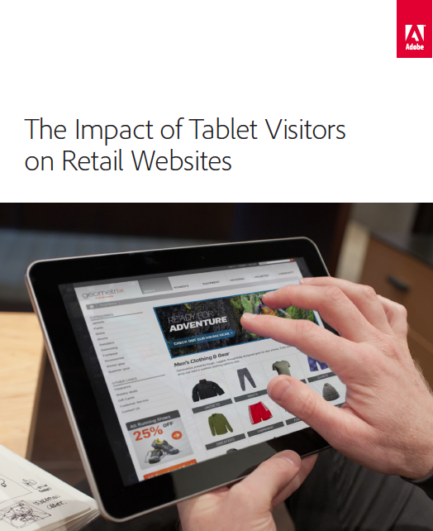
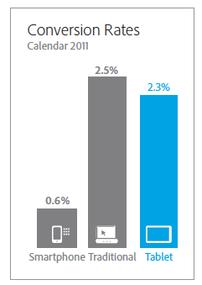
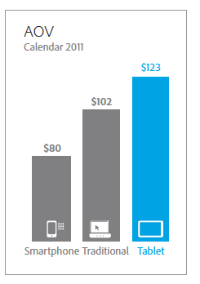
Industry Trends: Tablets & Shopping
Tablets Convert 3x Better Than Smartphones
Average Order Value For Tablets 20% > Desktop
Source: Adobe Digital Marketing Insights “Impact of Tablet Visitors on Retail”, Jan. 2012

Slide 36
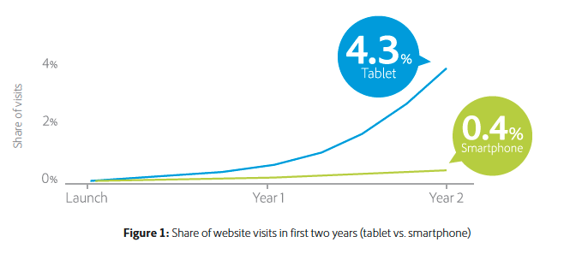
Industry Trends: Tablets and Mobile Websites
Tablet share of website traffic grew 10X faster than Smartphones
Source: Adobe Digital Index “How tablets are catalyzing the mobile web”, May 2012

Slide 37
Industry Trends: Tablet Engagement
Tablet engagement rate very close to PC/desktop
Source: Adobe Digital Index “How tablets are catalyzing the mobile web”, May 2012

Slide 38
Demo: Developer Connections

Slide 39
Demo: Adding App Analytics & Bloodhound

Slide 40
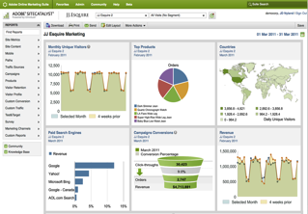
Measurement & Reporting
Usage
Conversion
Engagement
App Performance
Technology
Pathing
Custom
One Place
to Analyze All Channels
Measure
Any Content & Device

Slide 41
Lifecycle Reporting
Essentials
Metrics (Events) | Dimensions (eVars)
App Install | App Title & Version
App Launch | App Install Date
App View | Days Since First Use
App Crash | Days Since Last Use
Monthly Engaged User | Engaged Days-Lifetime
Daily Engaged User | Engaged Days-Month
App Upgrade | App Launch #-Lifetime
 | App Launch #-Last Upgrade
 | Engaged Days-Last Upgrade
 | Days Since Last Upgrade
Engagement
Effectiveness of Upgrades

Slide 42
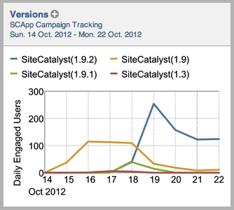
User & Usage
Active Users
Sessions
Time Spent
Upgrades
Retention
Engagement
Location

Slide 43
User & Usage
Active Users
Sessions
Time Spent
Upgrades
Retention
Engagement
Location
Bench Warmers
Cut List
Bench
Warmers
Cut List
?
Days Since Last Use
Rookies
All-Stars
Rookies
All-Stars
?
0
Days Since First Use

Slide 44
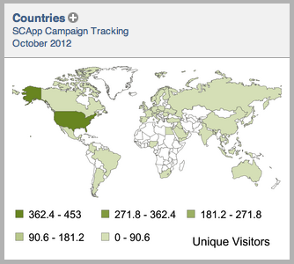
User & Usage
Active Users
Sessions
Time Spent
Upgrades
Retention
Engagement
Location

Slide 45
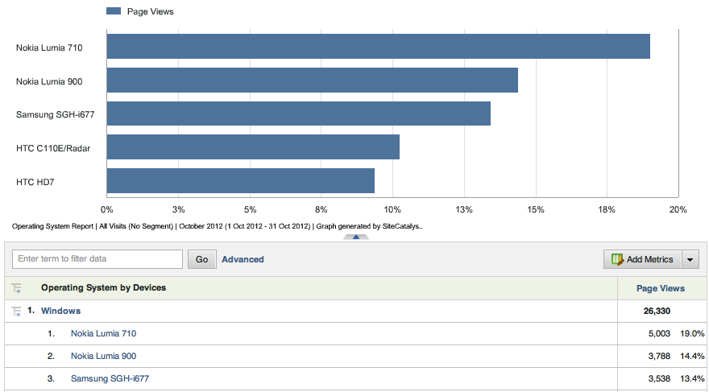
Technology
Device
Device Type
Manufacturer
OS
Screen Attributes
Connection Type
Carrier

Slide 46
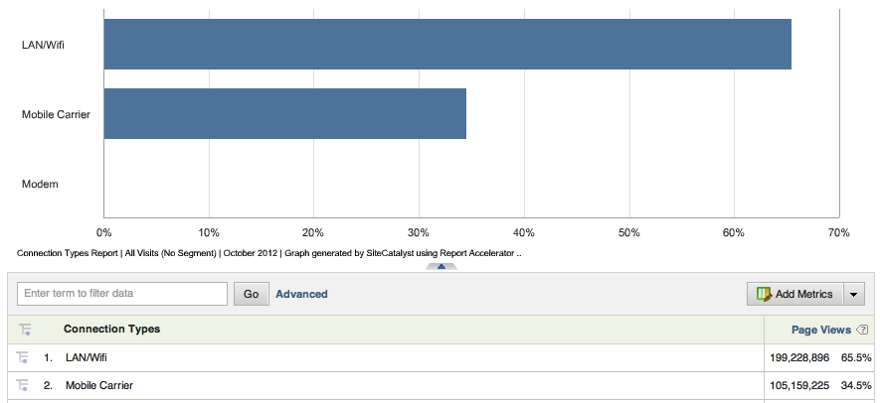
Technology
Device
Device Type
Manufacturer
OS
Screen Attributes
Connection Type
Carrier

Slide 47
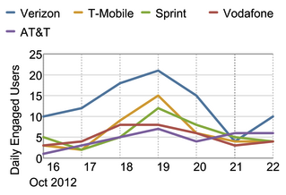
Technology
Device
Device Type
Manufacturer
OS
Screen size, height, width
Connection Type
Carrier

Slide 48
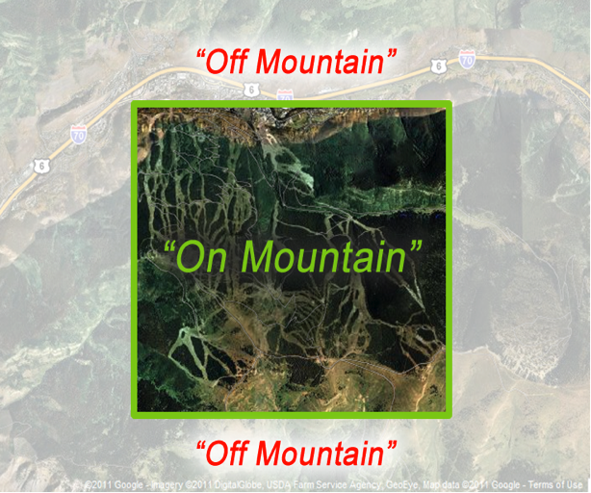
Custom
Touch Gestures
Orientation
Latitude/Longitude
Custom User ID
Dashboards
Custom Events

Slide 49
Custom
Touch Gestures
Orientation
Latitude/Longitude
Custom User ID
Dashboards
Custom Events

Slide 50
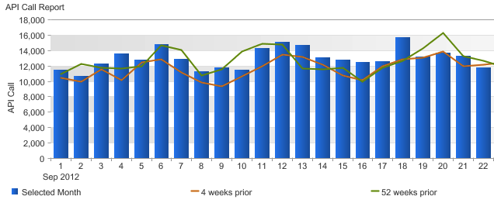
Custom
Touch Gestures
Orientation
Latitude/Longitude
Custom User ID
Dashboards
Custom Events

Slide 51
Target Platform & Device Identification
Measurement & Optimization Strategy
Conversion Funnel Analysis
Interactions on Standard Web
Device Attributes
Data Capture
Data Reporting
Opportunity Analysis
Mobile Value Segmentation
Visitor Interactions
Interactions on Tablet Web
Geo-Segmentation
Interactions on Native Apps
Application Performance
Actionable
Conclusions
Create Tablet-Optimized Platforms
Test/Optimize Tablet Platforms & Experiences
Refine Tablet Advertising Strategies & Tactics
Push Geo-Based Promotions

Slide 52
Resources
Blogs:
http://blogs.msdn.com/b/windowsstore/archive/2012/06/27/improving-apps-with-quality-reports.aspx
http://blogs.msdn.com/b/windowsstore/archive/2012/05/10/making-customer-focused-decisions-with-adoption-reports.aspx
http://blogs.msdn.com/b/windowsstore/
Please submit session evals by using the Build Windows 8 app
or at http://aka.ms/BuildSessions

Slide 53
Resources
Develop: http://msdn.microsoft.com/en-US/windows/apps/br229512
Design: http://design.windows.com/
Samples: http://code.msdn.microsoft.com/windowsapps/Windows-8-Modern-Style-App-Samples
Videos: http://channel9.msdn.com/Windows
Please submit session evals by using the Build Windows 8 app
or at http://aka.ms/BuildSessions

