Slide 1
Designing rich media scenarios in your Windows Store app
Todd Landstad,
Sr. Program Manager Lead, Windows
Lora Heiny
Sr. Program Manager, Windows
2-108

Slide 2
Engaging with rich media—whether watching a movie, video chatting, or playing music—is one of the most prevalent and enjoyable things we do on our PCs today.

Slide 3
Video and audio playback is a part of many app categories!
News clips
Shopping product reviews
Training videos
Games
Communications

Slide 4
Design and development guidance
Tiles and notifications
Content library optimization
Video playback
Audio considerations
App activation and process lifetime
Views and visual guidance
Contracts

Slide 5
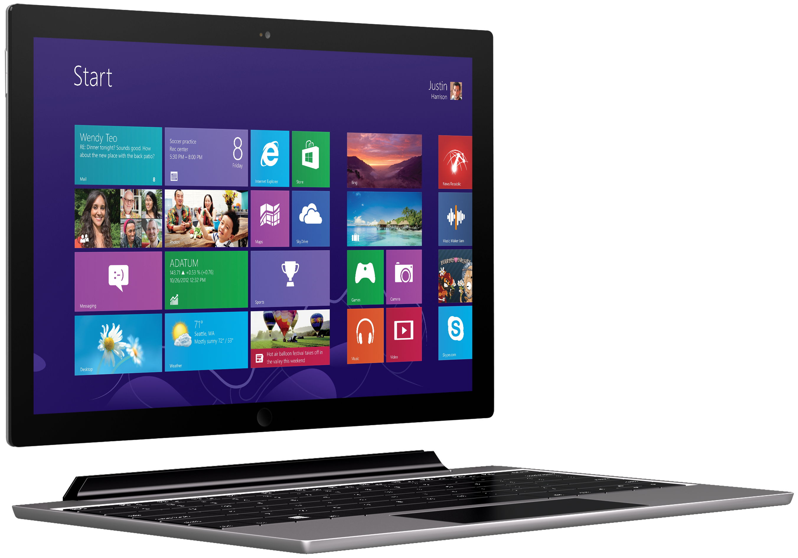
Tiles and notifications
Tailored to your content
Fresh and relevant information
Drives re-engagement
Personalized updates/pinning

Slide 6
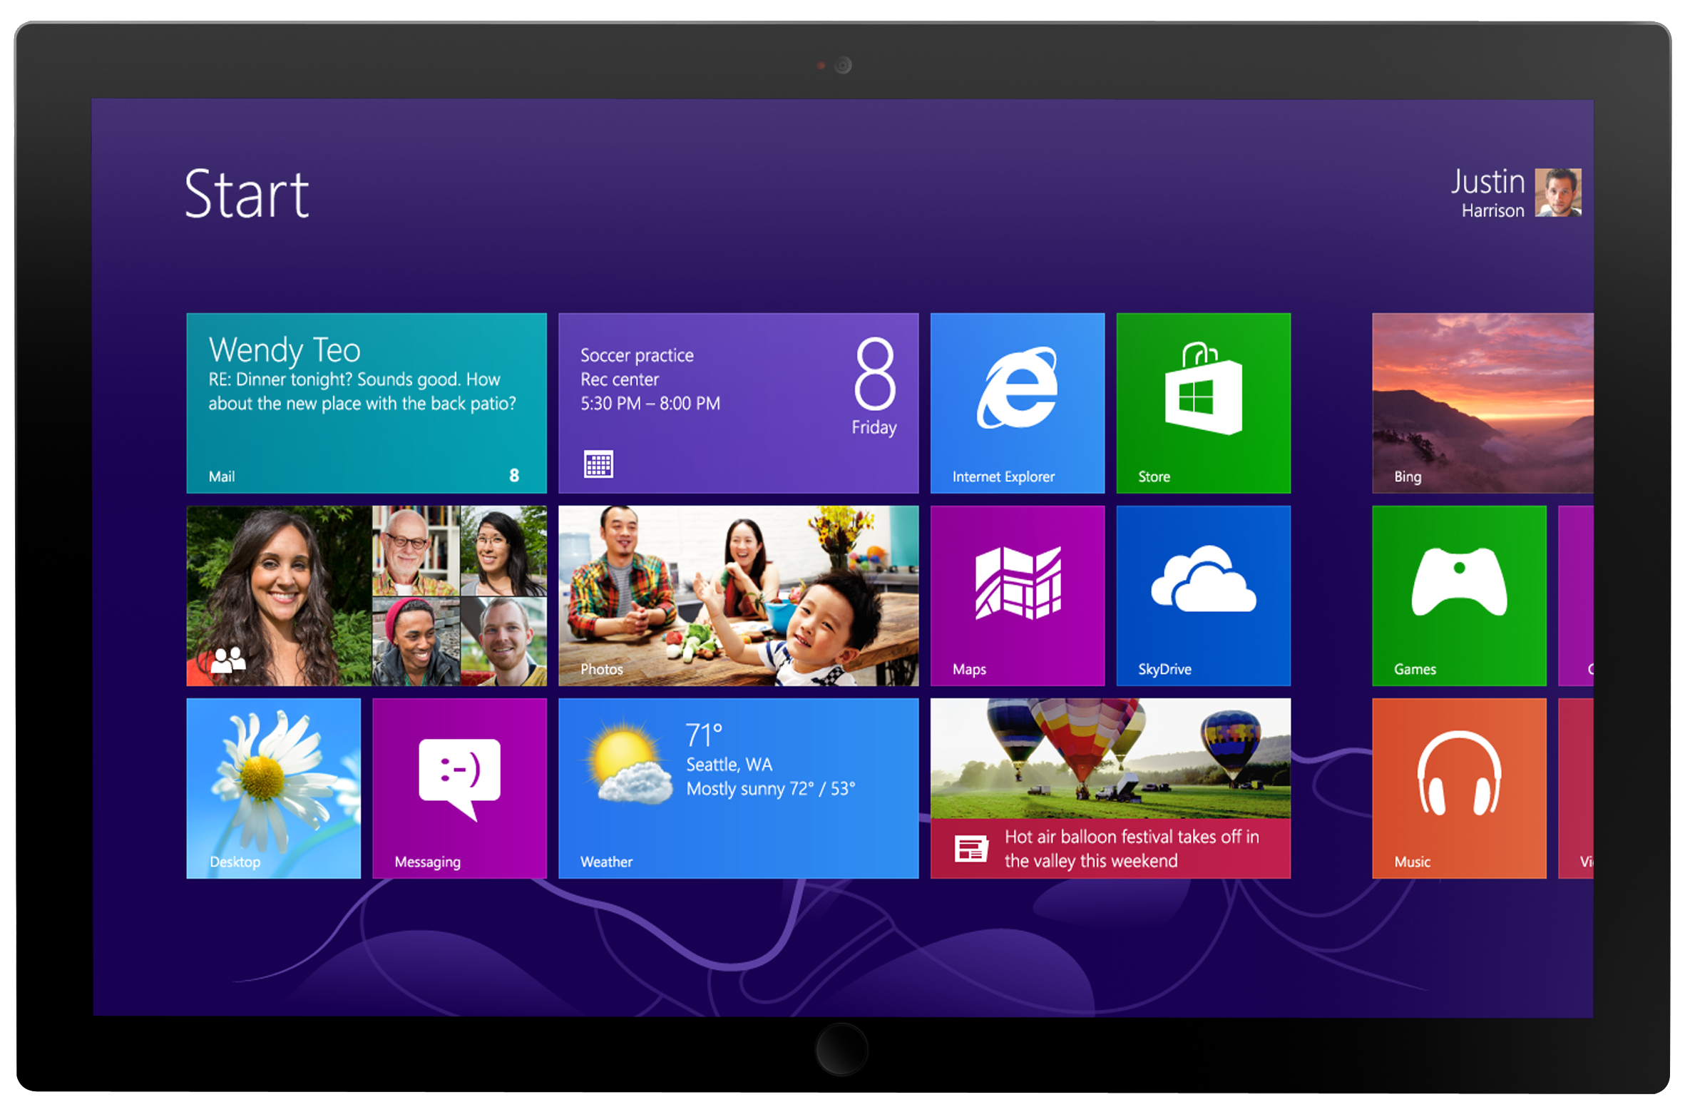
Content library patterns
Visual variation
Navigate through content
Typography ramps
Rendering performance

Slide 7
Media app demo

Slide 8
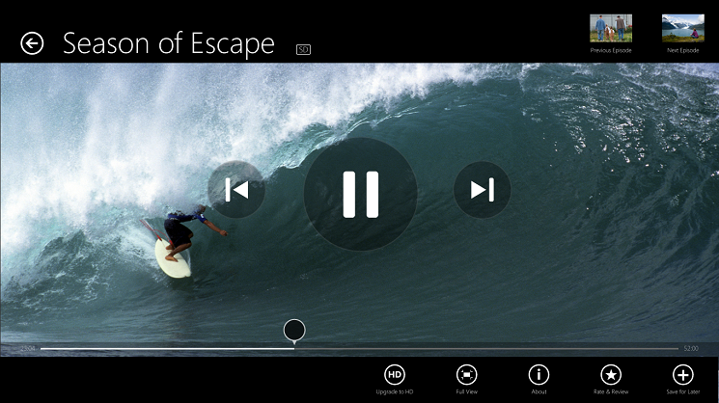
Video playback
Full-screen playback
Customized playback controls
Playback performance
GPU offloading
DisplayRequest.RequestActive

Slide 9
Video playback demo

Slide 12
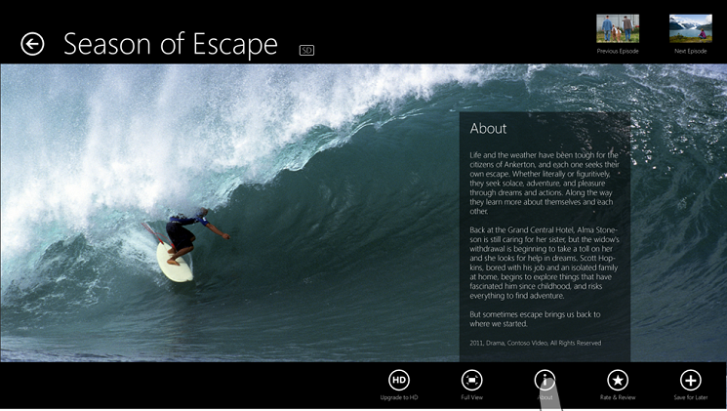

Slide 13
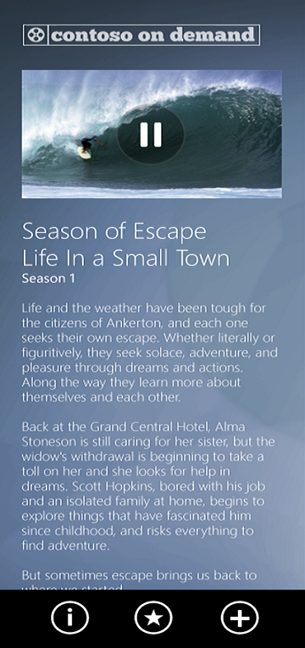
Views and visual guidance
Snapped view
Inline video
Maintain context

Slide 14
Audio playback
Transport controls
Audio categories
SoundLevel notifications
Background playback

Slide 15
Audio playback demo

Slide 16
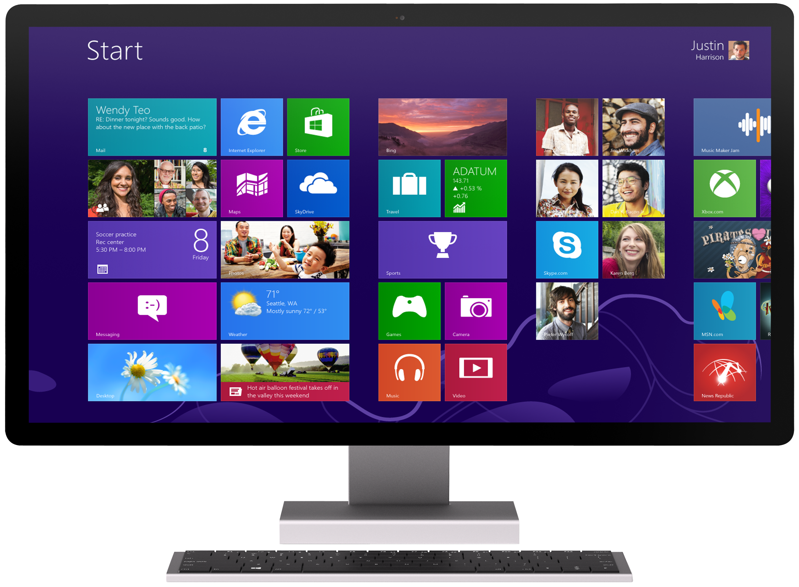
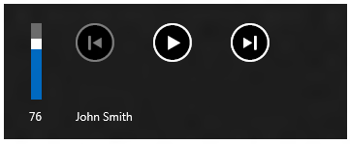
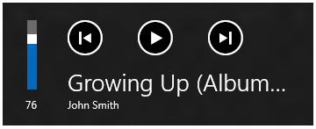
Transport controls

Slide 17
msAudioCategory
Stream Type | Purpose
ForegroundOnlyMedia | Specifies media, such as music or streaming audio. Background playback not required.
BackgroundCapableMedia | Specifies media, such as music or streaming audio, that requires background playback.
Communications | Specifies communication media, such as Voice over IP and real time chat, that requires background audio capabilities.
Alert | Media such as alerts and ring tones which will mute or attenuate the current audio.
SoundEffects | Short duration sound effects in the foreground which will mix with background audio.
GameEffects | Short duration sound effects in the foreground which will mix with background audio.
GameMedia | Background audio in a game, such as music or other non-effects game sounds.
Other | Specifies all media that does not need background playback capabilities. Default value.

Slide 18
SoundLevel notifications
SoundLevel notification | Recommended action
Full | Resume playback
Muted | Pause playback
Low | Nothing unless Communications app

Slide 19
Background audio
Add Audio declaration to app manifest
Set msAudioCategory attribute to BackgroundCapabaleMedia
Register for media transport controls
Handle hardware events for at least Play, Pause, and Play/Pause.

Slide 20
Background audio with low power
Enable low-power audio in connected standby
Follow background audio steps
Ensure network assets can be accessed:
a. Background transfer API
b. Custom Media Extension

Slide 21
App activation considerations
App activation: Search/Share
Handling suspend and resume
Handling roaming state
Credential Locker

Slide 22
Use the right contract
Use Share, Search, Devices, and Settings charms
Use the edge to invoke charms and avoid additional entry points from app UI
Think about:
Sharing can include files
How do you make search great? There will be competition.
Can users print?
Play To
About, account management, help, privacy policy, and contact go in Settings

Slide 23
Contracts demo

Slide 24
Website considerations
Bridge from website
Protocol handler for deep links
Large resolution icon

Slide 25
Advanced playback scenarios
Custom sources
Adaptive bitrate streaming
DRM
Ad delivery
Analytics
Closed captioning

Slide 26
Related sessions
4-104 Using media extensions to build great video playback apps
3-117 Key technologies for building advanced media apps
3-122 Media app case studies
3-106 Chalk Talk: Media apps

Slide 27
Resources
UX Guidelines
windowsuserexperiencetraining.com
PlayReady & Smooth Streaming SDKs
Player Framework CodePlex project
Entertainment apps guidance
Windowsstore.com

Slide 28
Resources
Develop: http://msdn.microsoft.com/en-US/windows/apps/br229512
Design: http://design.windows.com/
Samples: http://code.msdn.microsoft.com/windowsapps/Windows-8-Modern-Style-App-Samples
Videos: http://channel9.msdn.com/Windows
Please submit session evals by using the Build Windows 8 app
or at http://aka.ms/BuildSessions

