Slide 1
The principles of Microsoft design
Will Tschumy
Principal User Experience Advisor
2-116

Slide 2
or

Slide 3
Why I joined Microsoft

Slide 4
Beginning in 2003, Microsoft made a strategic investment in design

Slide 6
And the results? The fastest selling, most critically acclaimed version of Office...

Slide 7
…at least until Office 2010 launched

Slide 8
Put another way, with Office 2007, Microsoft made and won a $20 billion/year bet on design

Slide 9
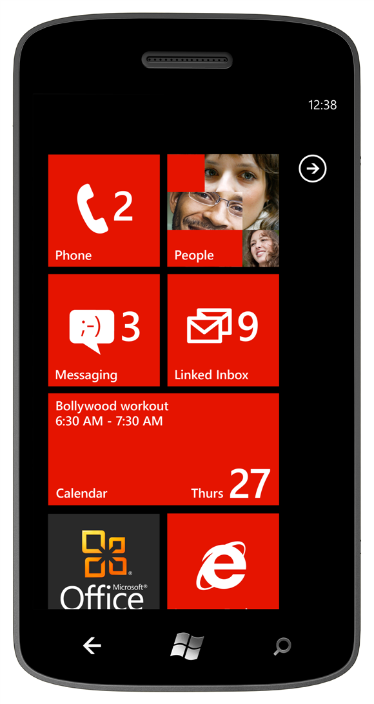
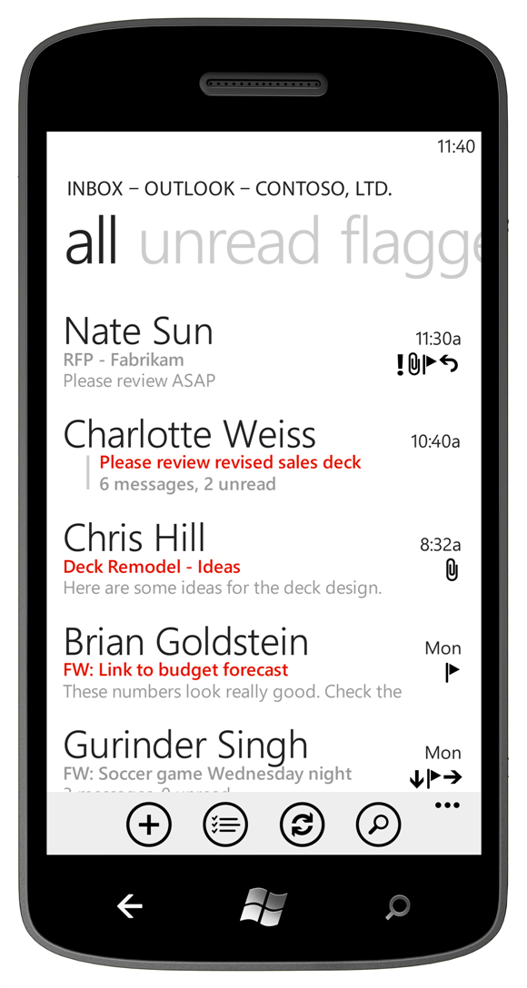
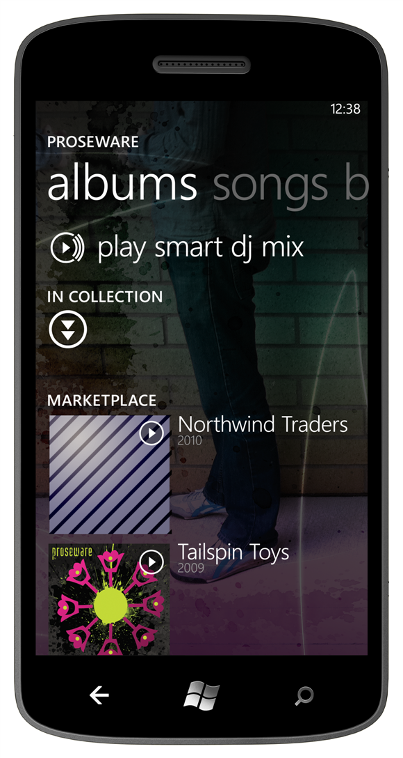

Slide 11
“The next Windows Phone: It’s pretty great… It’s almost like the phone is happy to be alive. Which kind of makes you feel happy to use it.”
— Matt Buchannan Gizmodo
“While Mango catches up with the other major smartphone OS’, it still manages to remain true to itself. It’s different… but Microsoft OS is beautiful, fast and powerful…”
— Michael Oryl MobileBurn
“Windows Phone 7 takes a genuinely different approach to communication than its main rivals.”
— Sascha Segan PC World
“Make no mistake, Microsoft isn’t playing coy in the smartphone market any longer. The folks in Redmond are making a significant jump forward…”
— Brad Molen Engadget
“As anticipation builds [for Windows Phone Mango], Microsoft continues to add features to make this platform even better than what was expected.”
— Jordon Crook TechCrunch
“The OS is a mix of elegance and whimsy that’s a treat to use. Mango is sprinkled with delightful animations on nearly every screen.”
— Katherine Boehret All Things Digital

Slide 12
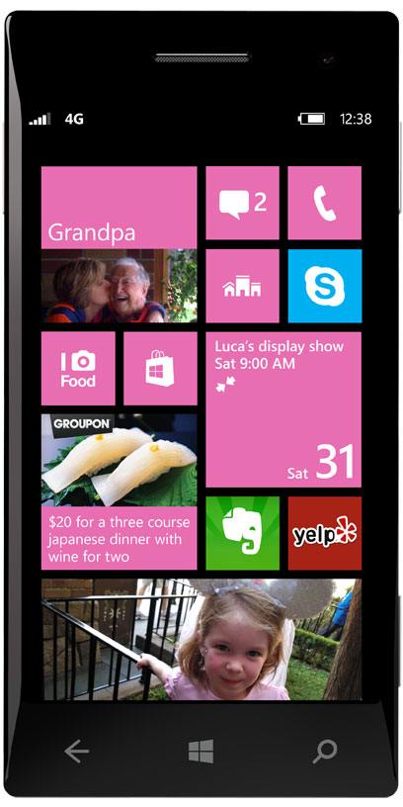
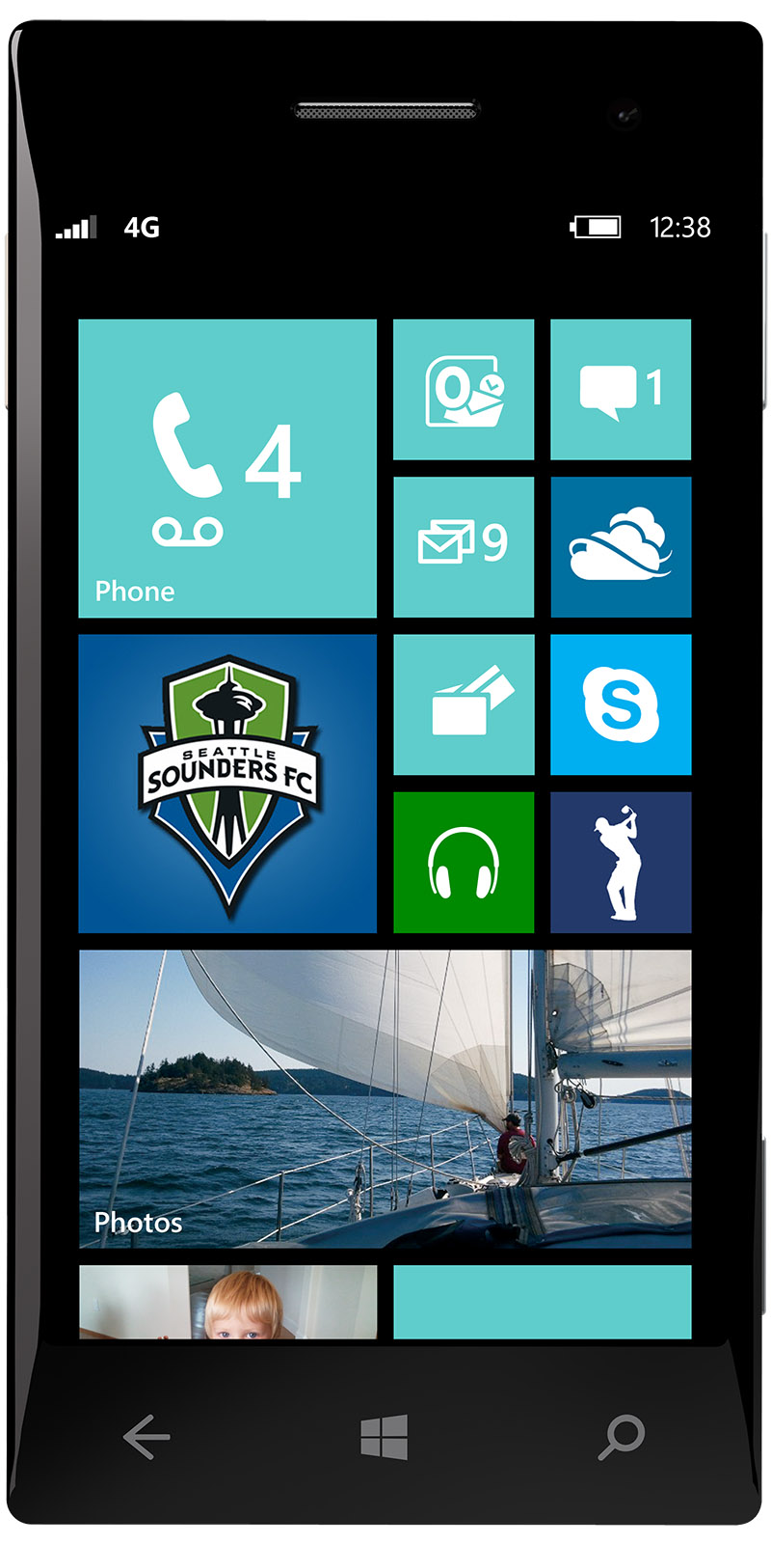
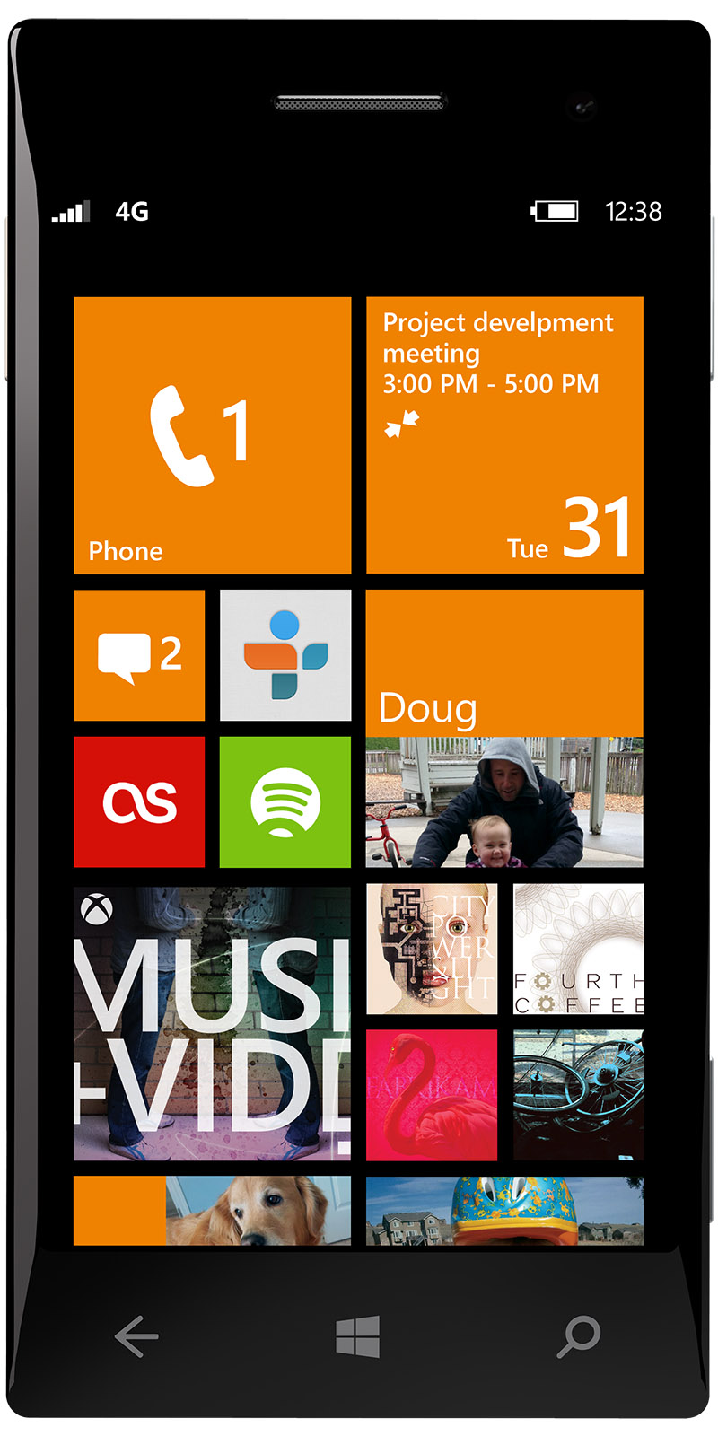

Slide 13
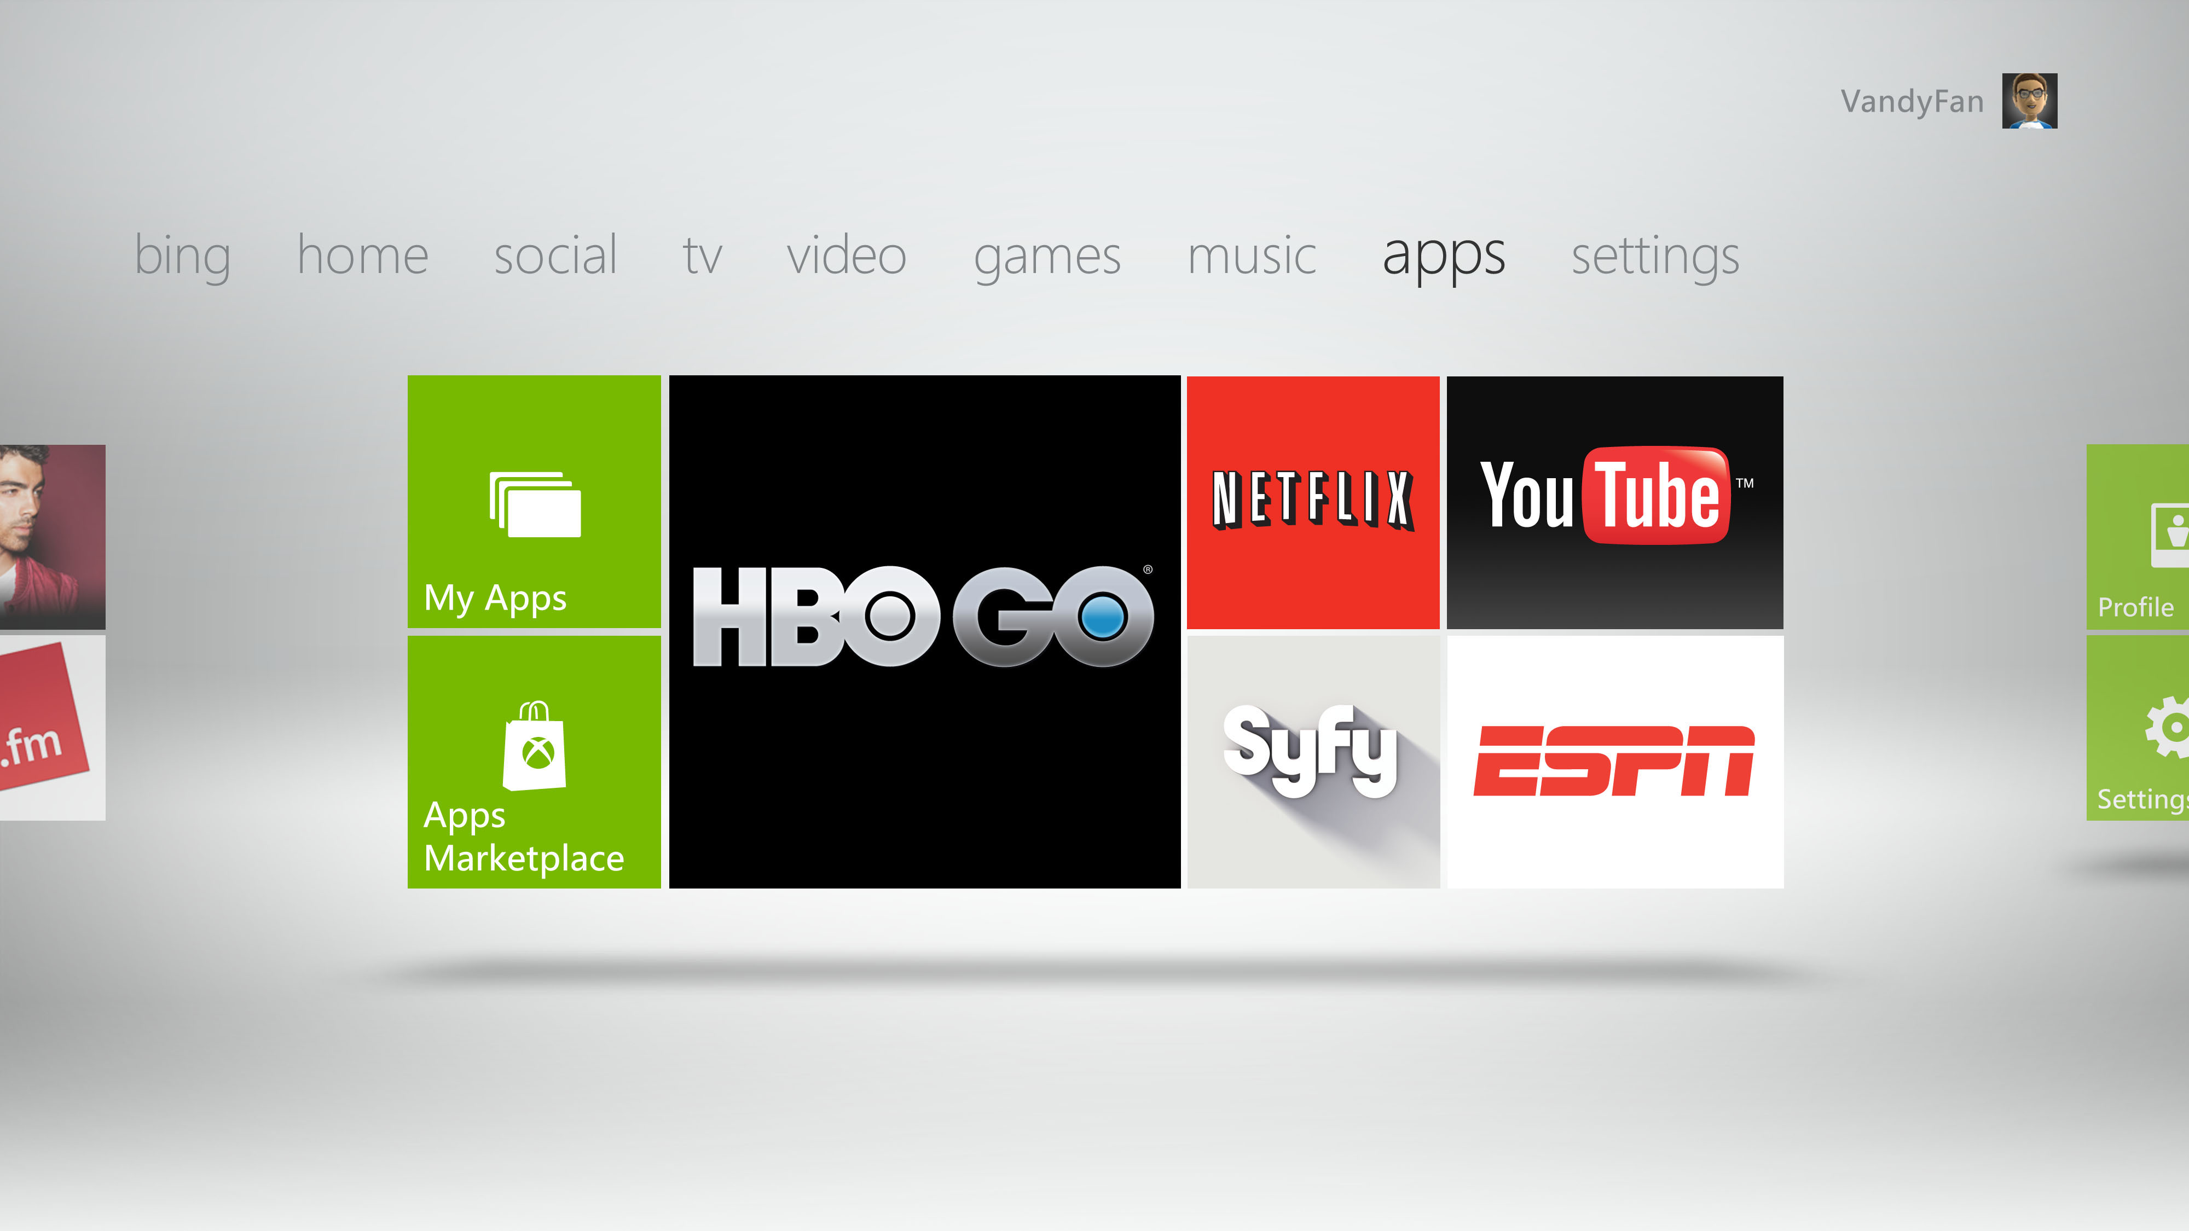

Slide 14
Microsoft is the only organization with a…

Slide 15
…single, consistent design language across each screen we touch

Slide 16
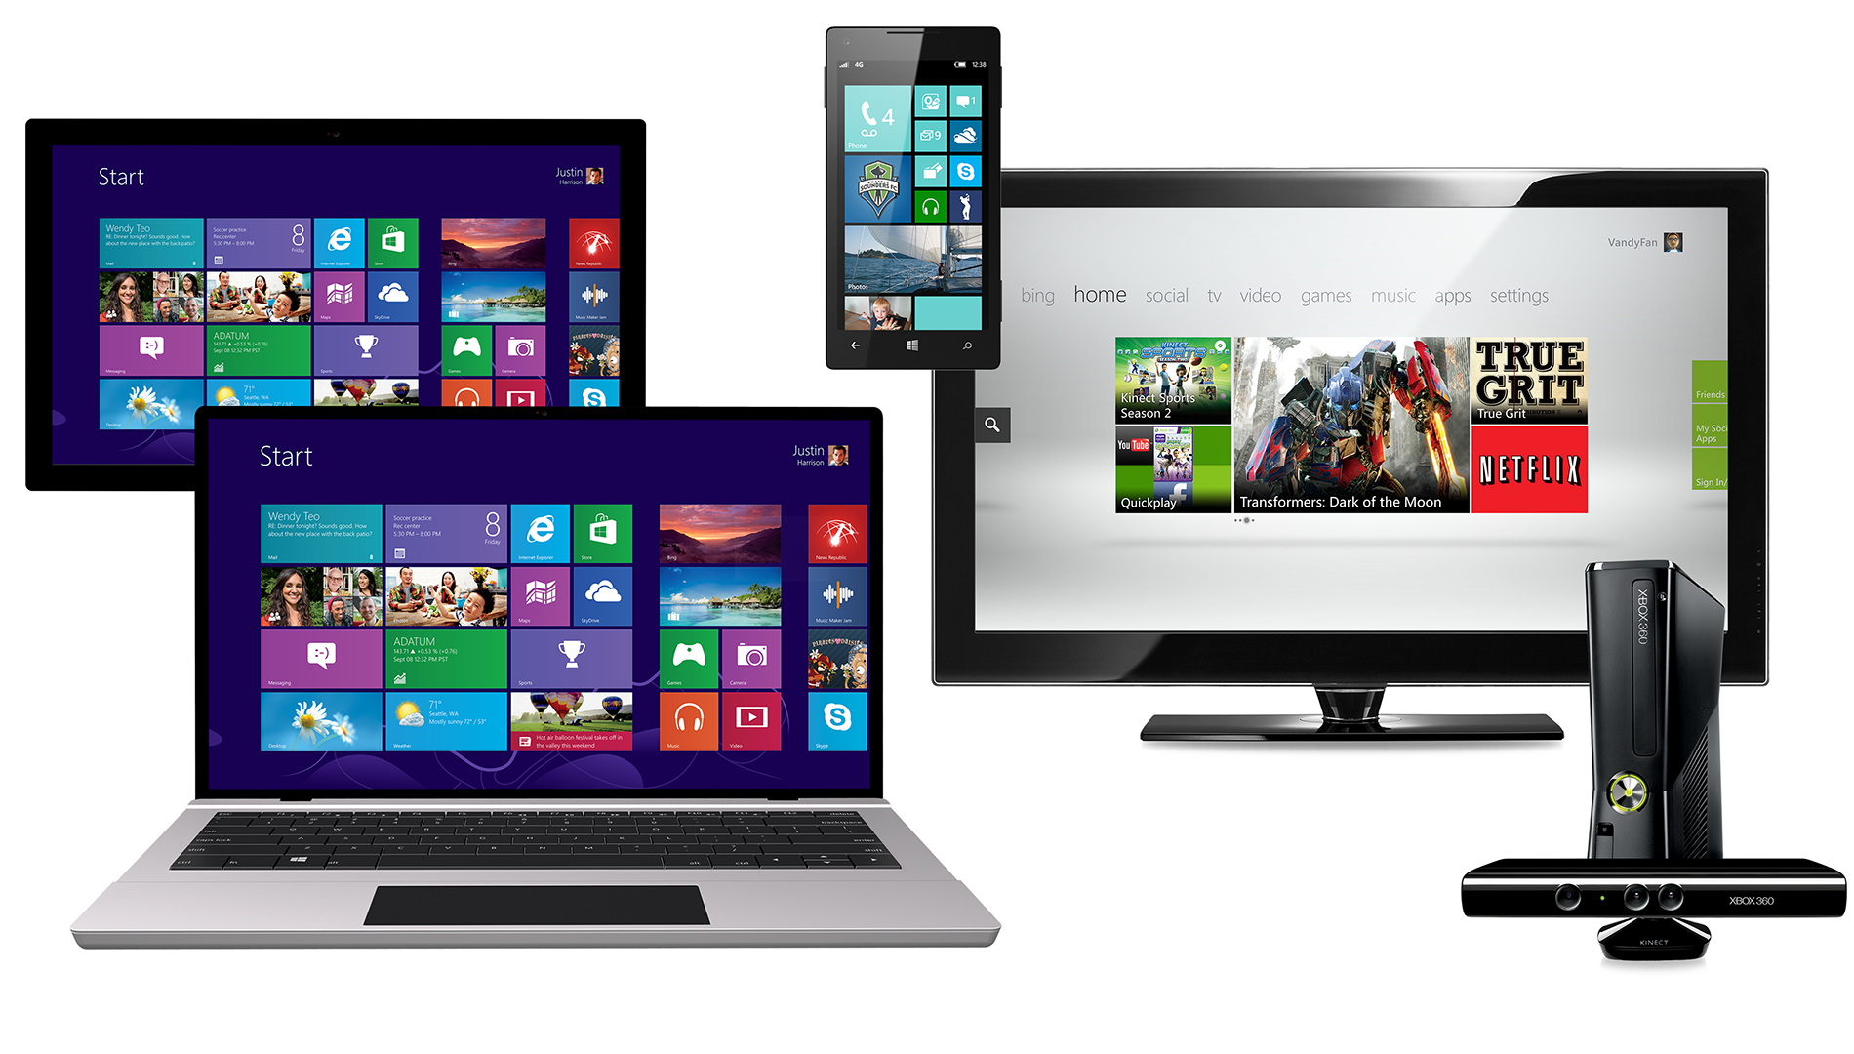

Slide 17
For Microsoft, our design principles are the language for our experiences
For customers, the language creates confidence, comfort, and familiarity
It brings us together

Slide 18
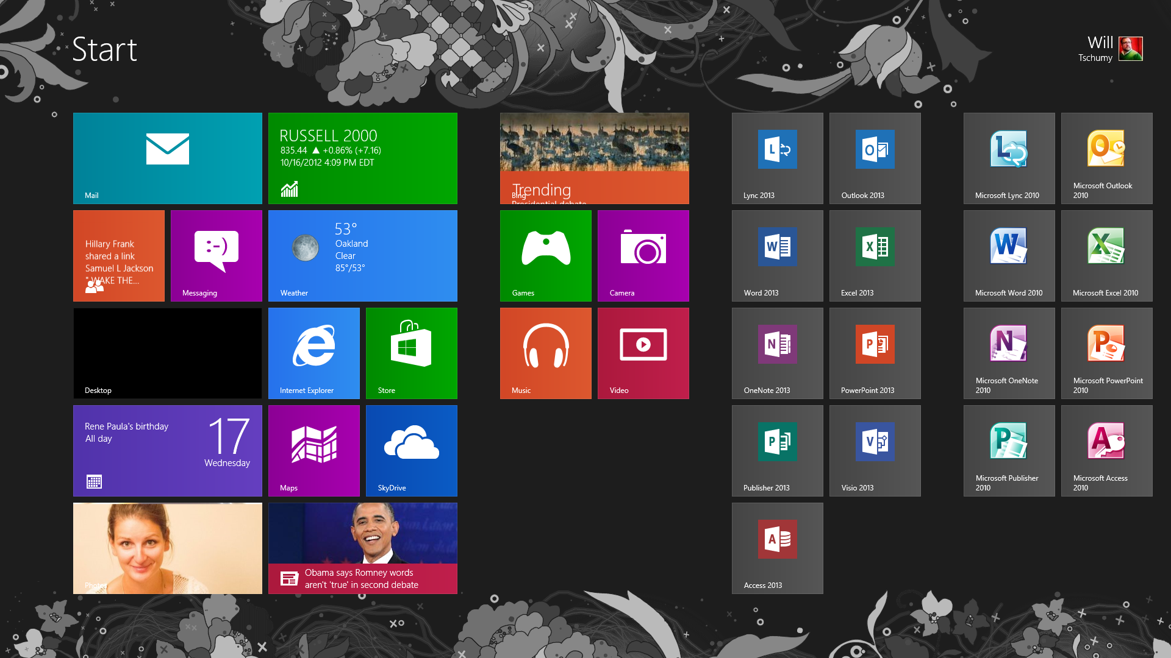

Slide 19
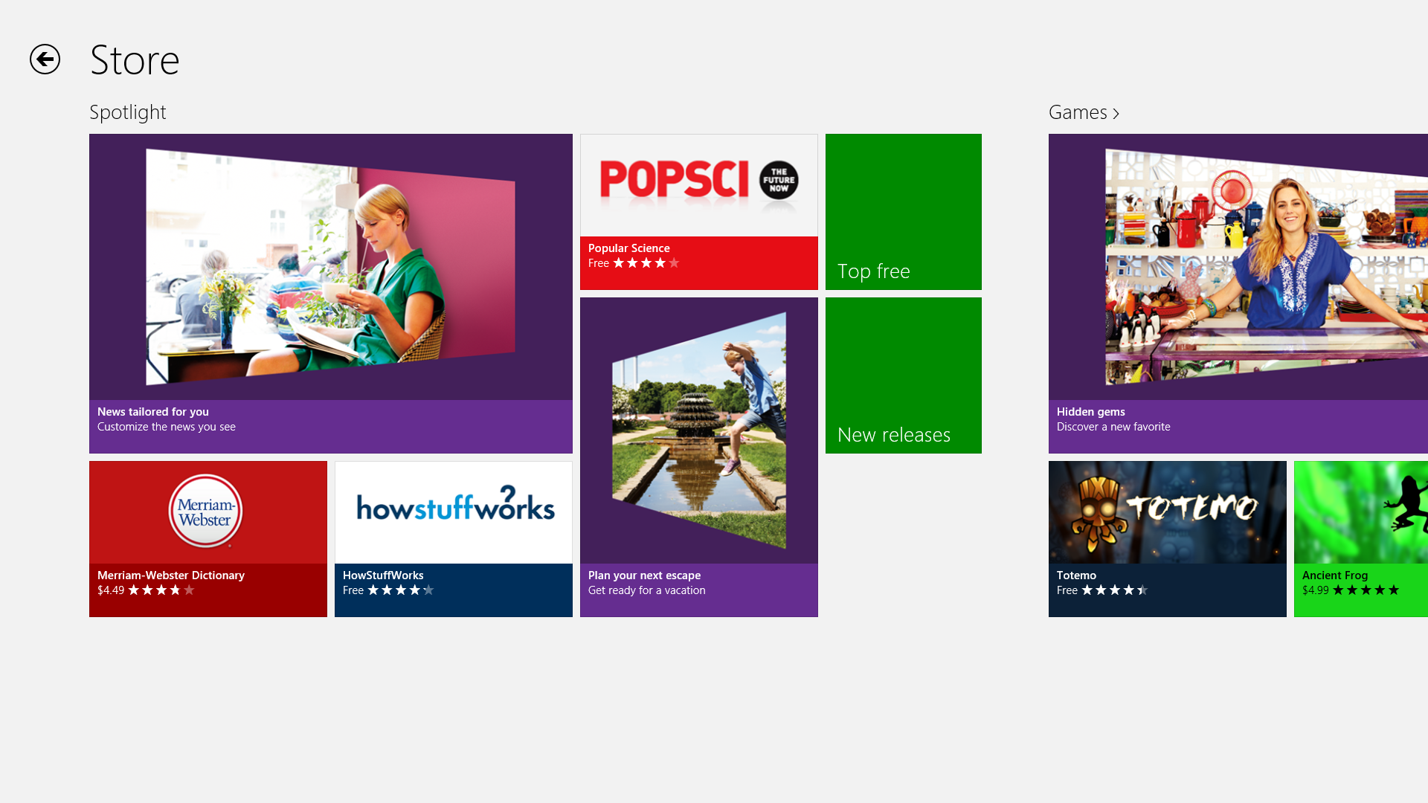

Slide 20
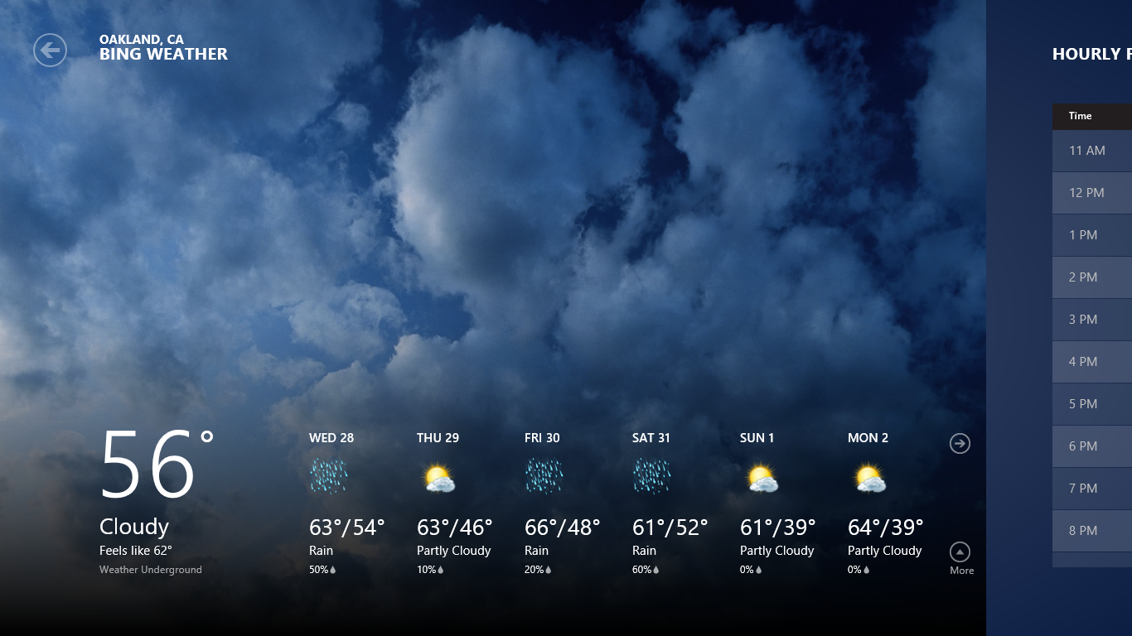

Slide 21
The core idea

Slide 22
Content before chrome

Slide 26
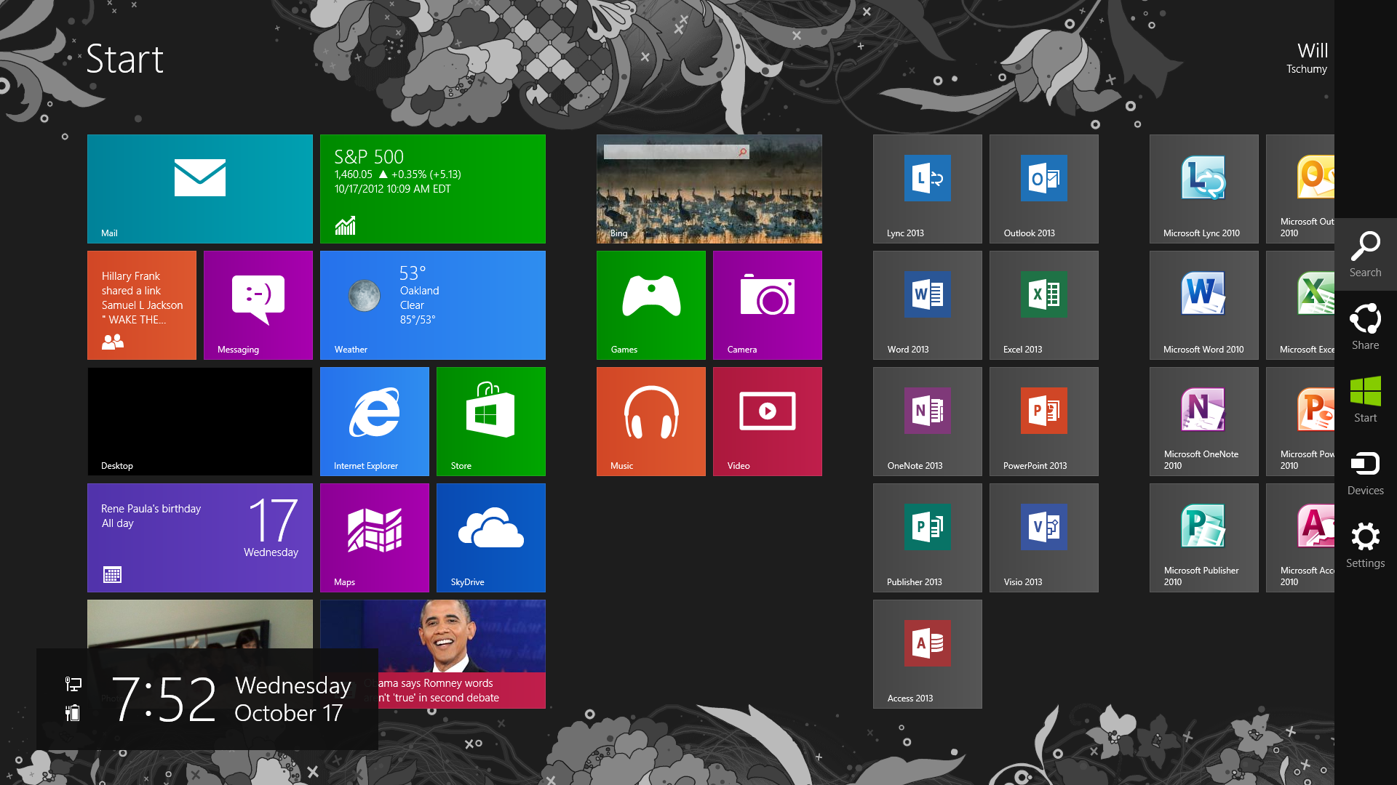

Slide 27
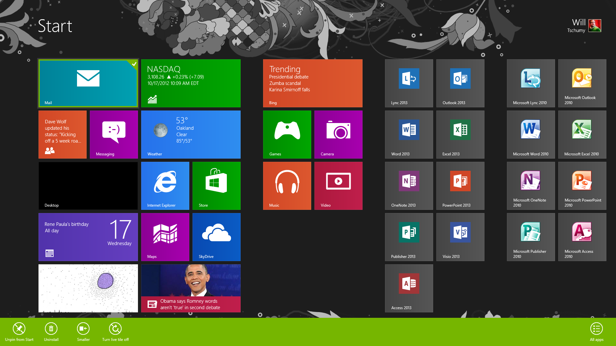

Slide 28
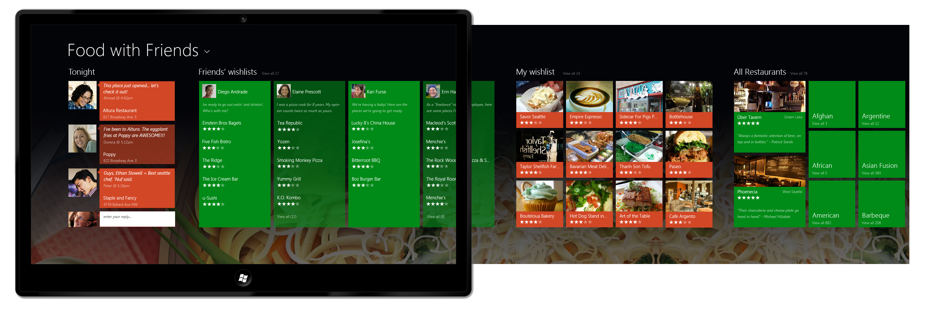

Slide 30
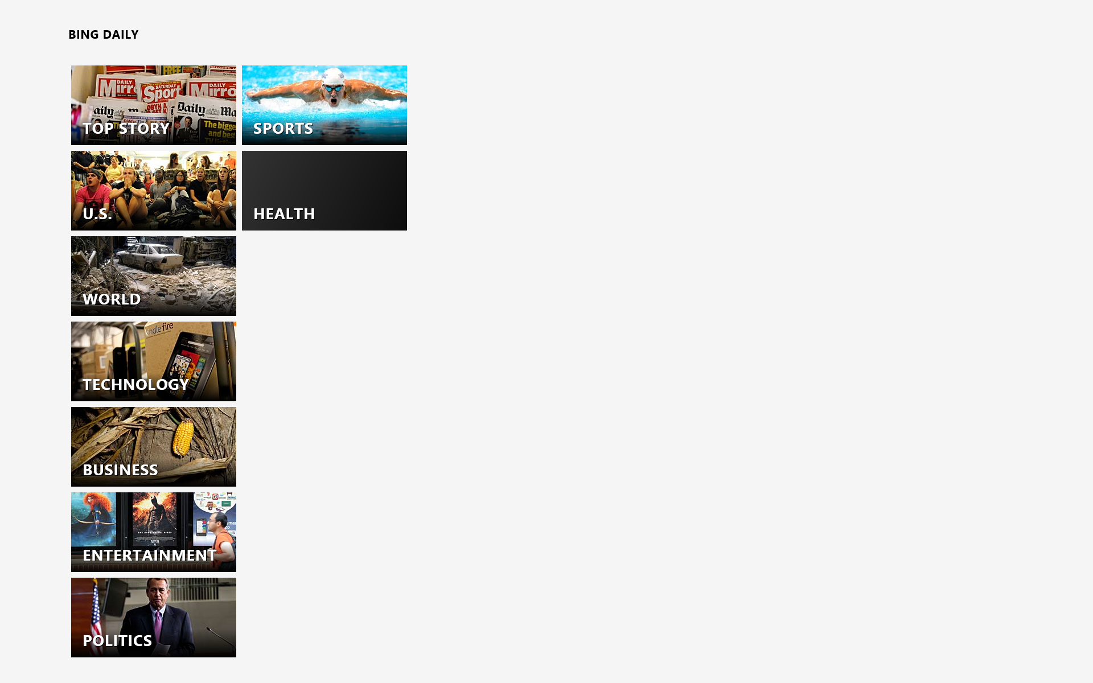

Slide 31
Content before chrome

Slide 32
The five principles of Microsoft design
Pride in craftsmanship
Be fast and fluid
Authentically digital
Do more with less
Win as one

Slide 33
Pride in craftsmanship
Attention to detail
Make it safe and reliable
Balance, symmetry, and hierarchy
Alignment to the grid

Slide 34
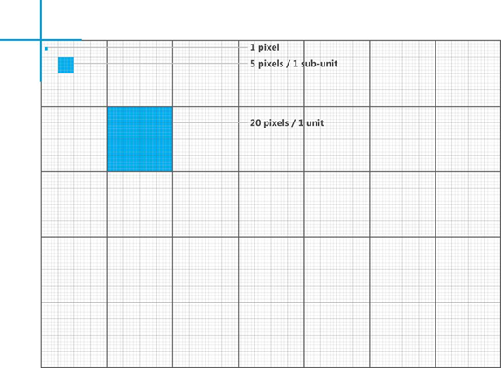
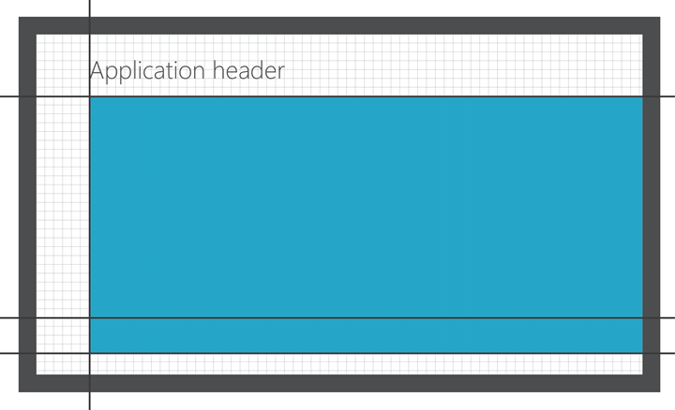
App layout aligns to silhouette
Apps can purposely deviate from the standard silhouette
Any deviation should feel intentional and designed

Slide 35
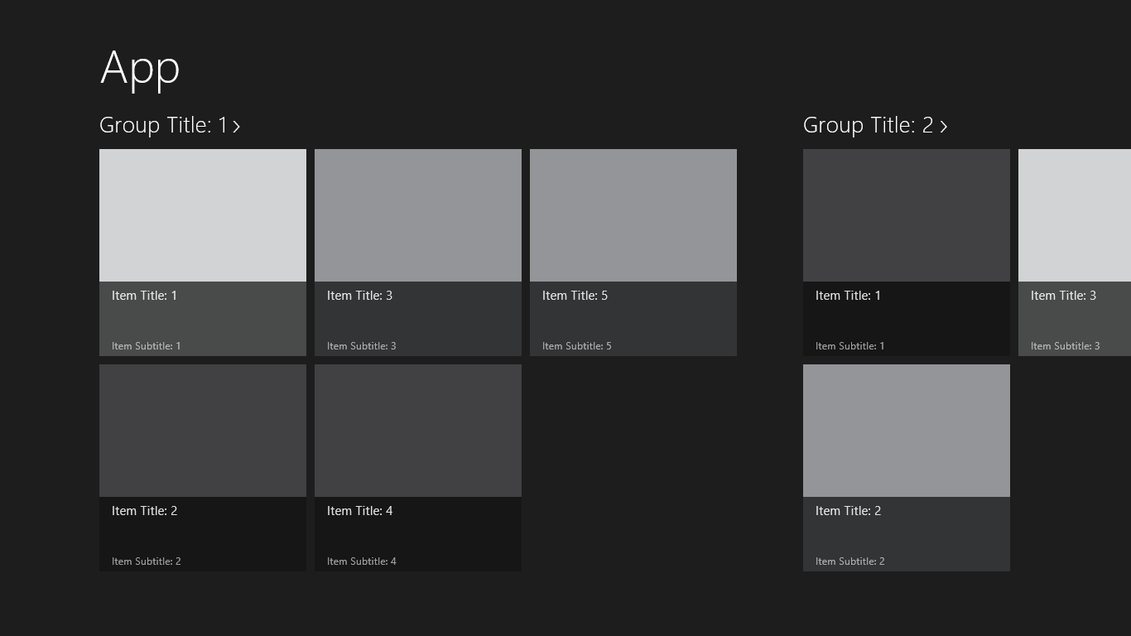

Slide 36
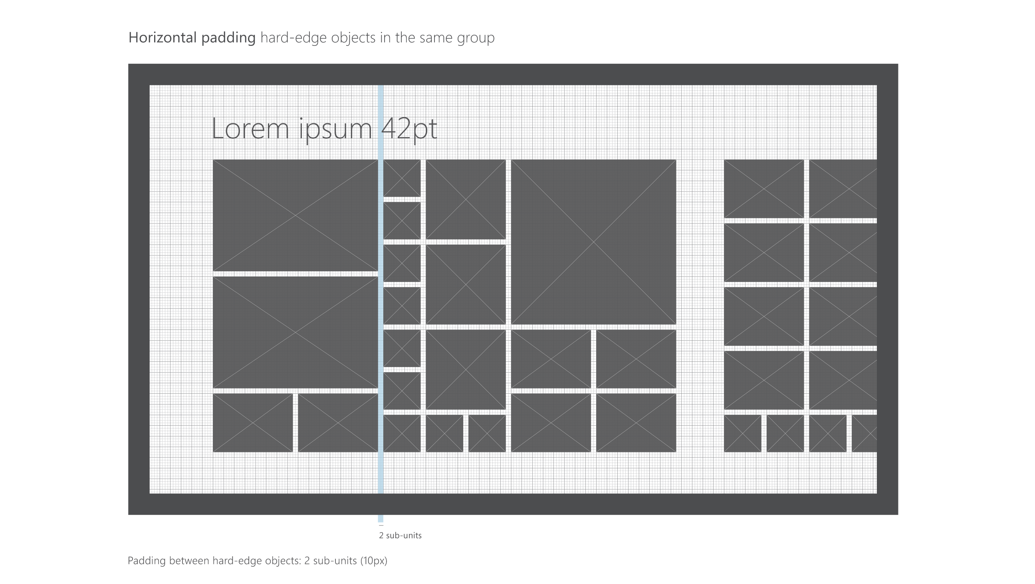

Slide 37
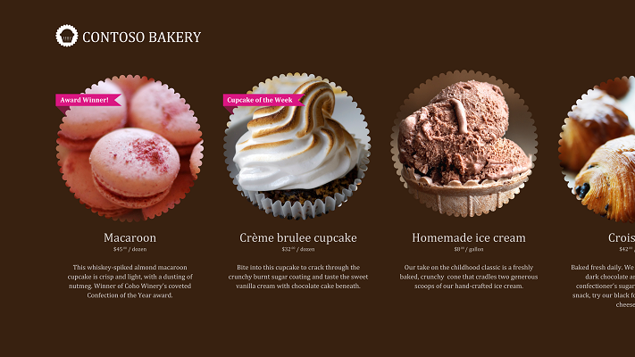

Slide 39
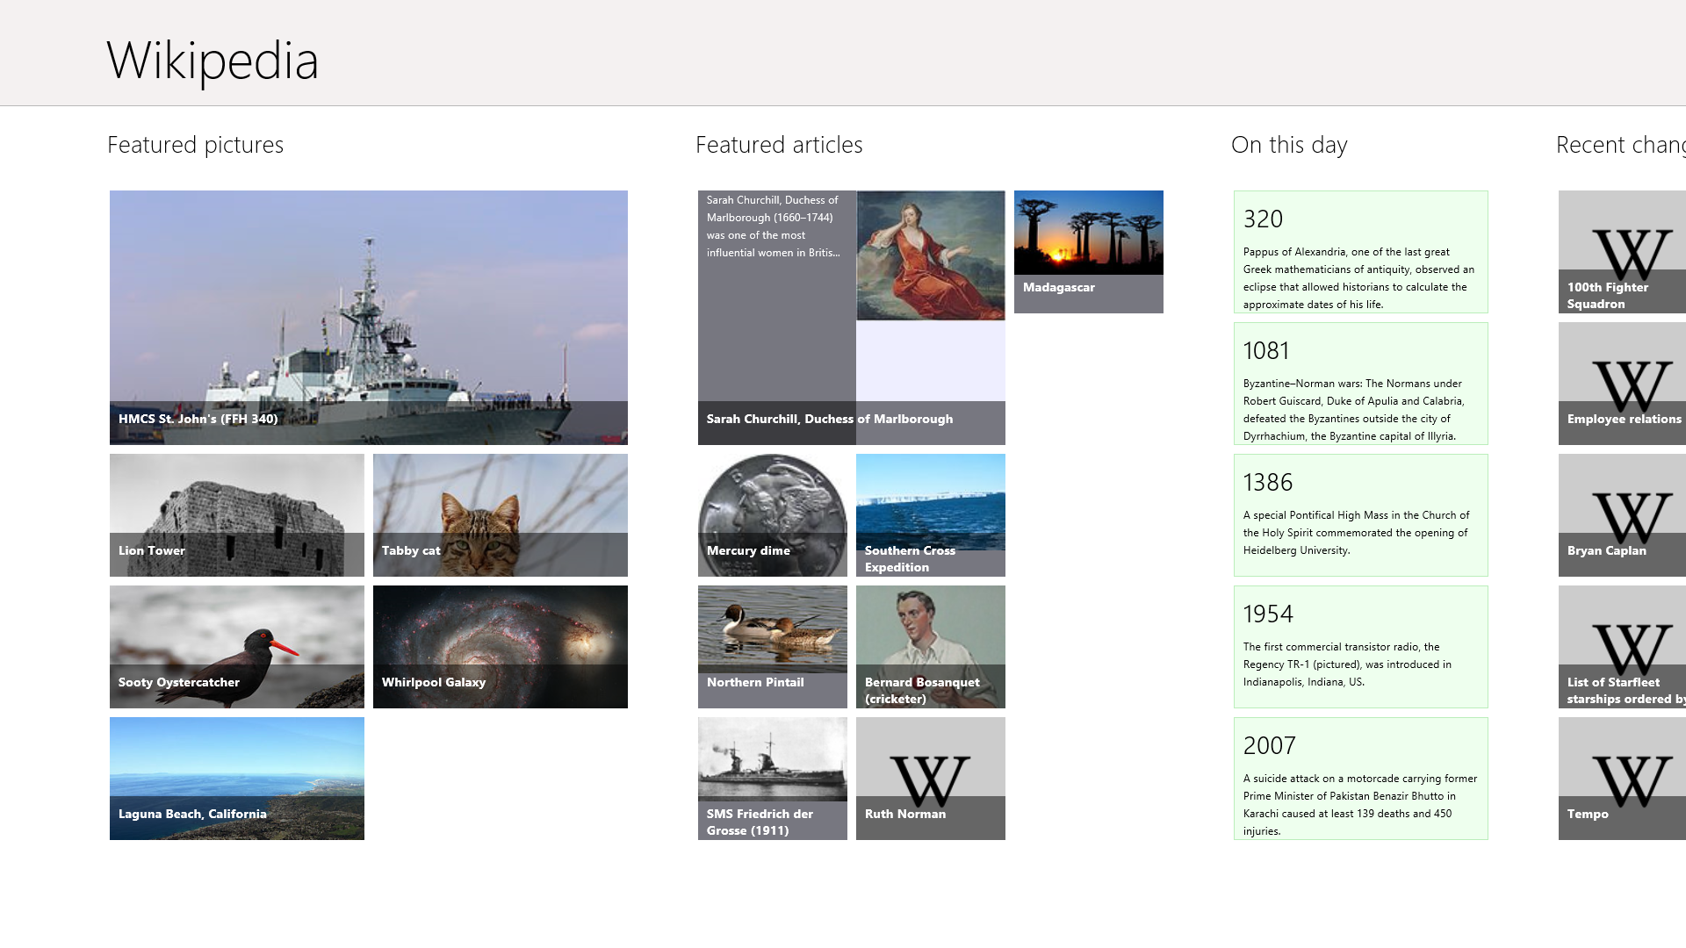
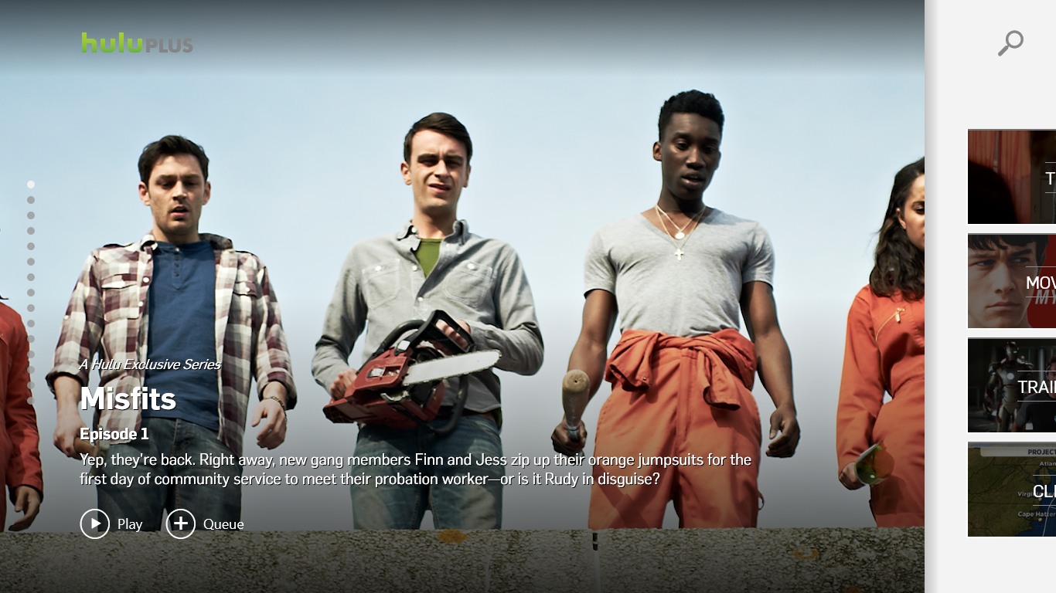
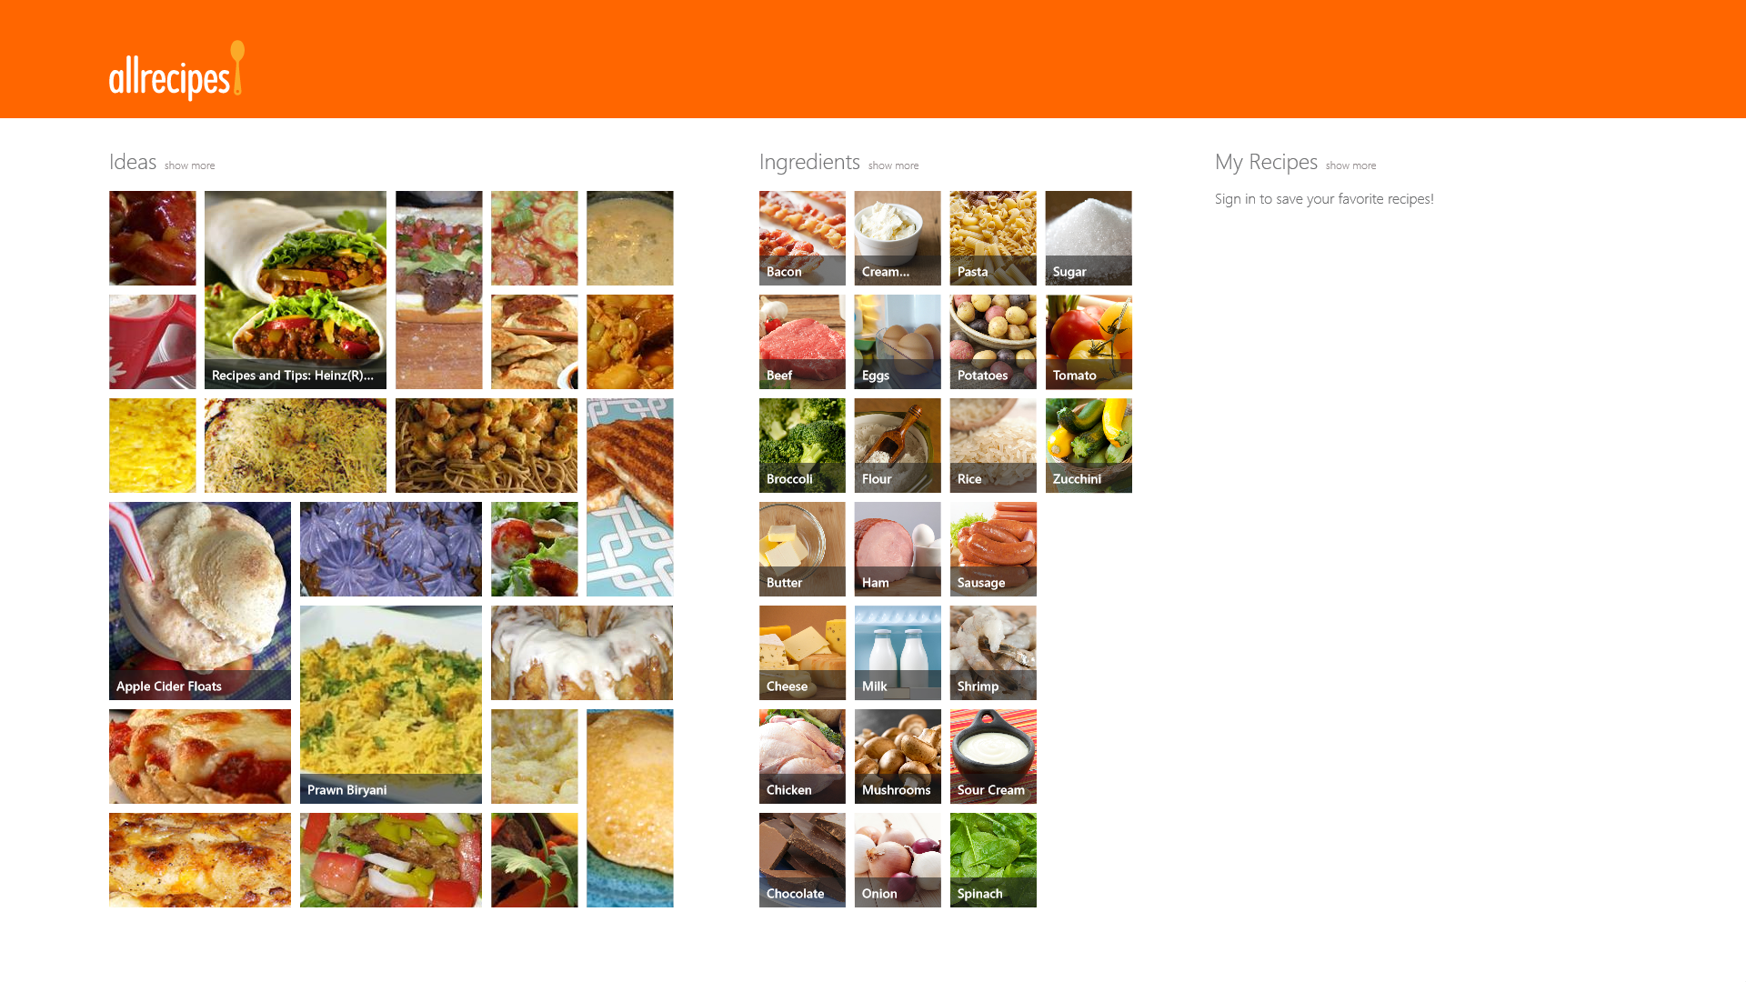
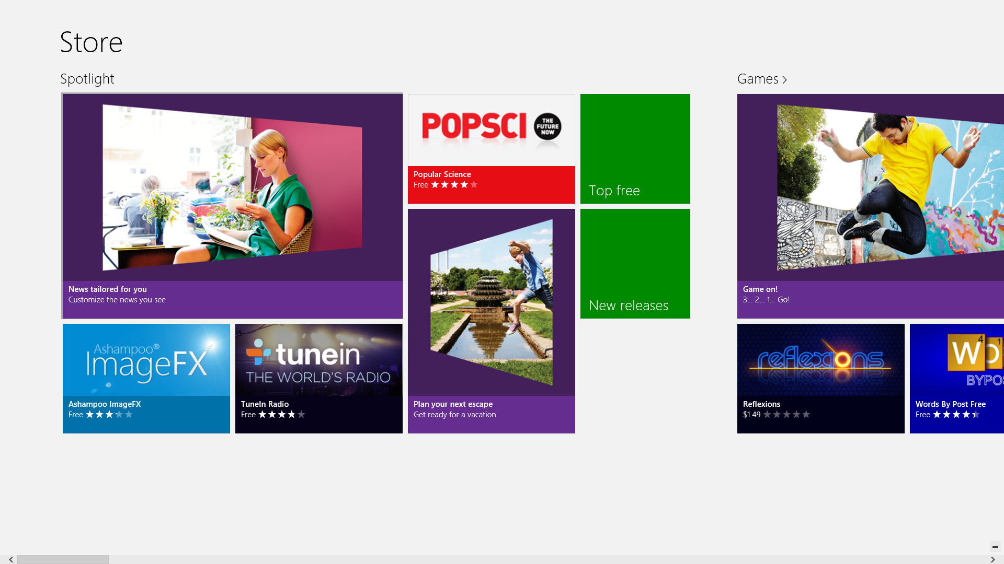

Slide 40
Be fast and fluid
Design for touch
Responsive
Intuitive interaction
Immersive and compelling
Delight with motion
Life is mobile

Slide 41
Start experience Netflix Photos

Slide 42
Authentically digital
Embrace the medium
Modern
Cloud connected
Bold, vibrant colors
Motion

Slide 43
What is the role of design? What is the role of the designer? Is design inherent or surface?

Slide 44
“…[the] designer should be offered no refuge in the past but should be equipped for the modern world in its various aspects, artistic, technical, social, economic, spiritual, so that he may function in society not as a decorator but as a vital participant.” — Bauhaus, Alfred Barr, 1938

Slide 46
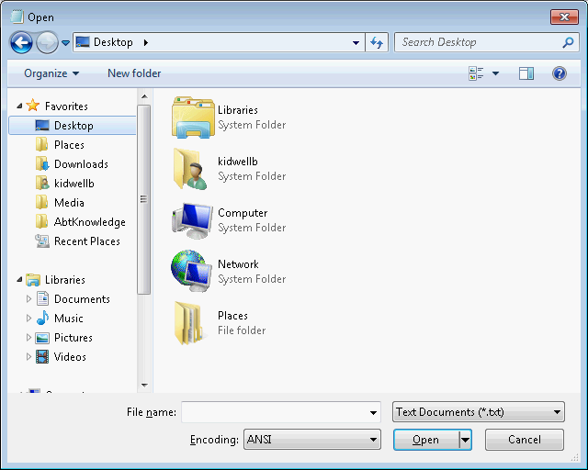

Slide 47
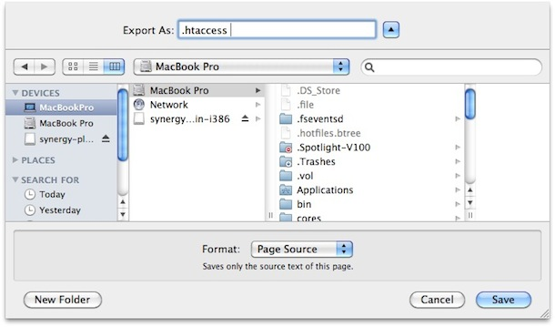

Slide 48
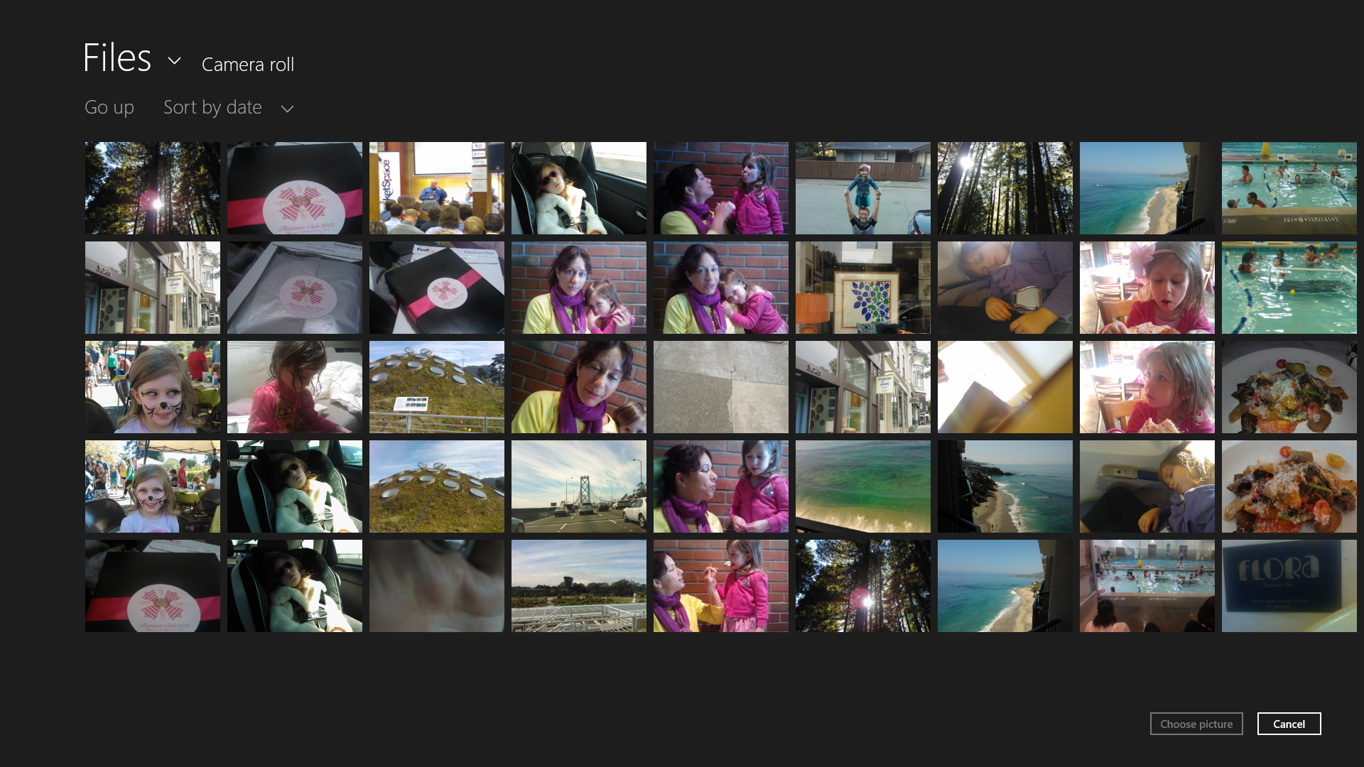

Slide 51
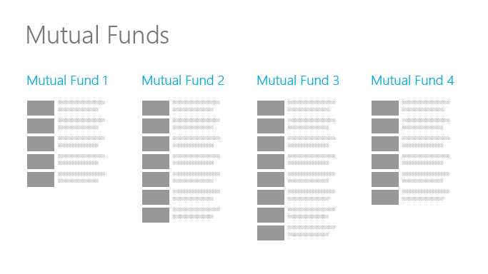

Slide 52
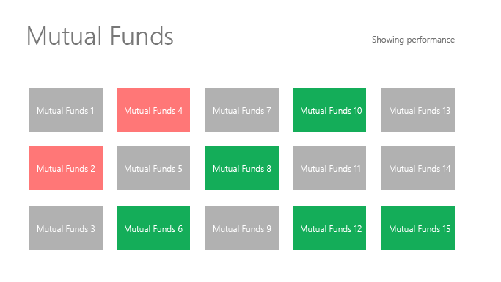

Slide 55
Do more with less
Be great at something
Focused and direct
Content before chrome
Inspire confidence

Slide 56
Clearance
sale
Gifts for
kids
Holiday
shopping
Home and
garden
Everything
for winter

Slide 57
Clearance
sale
Gifts for
kids
Holiday
shopping
Home and
garden
Everything
for winter

Slide 58
Title

Slide 59
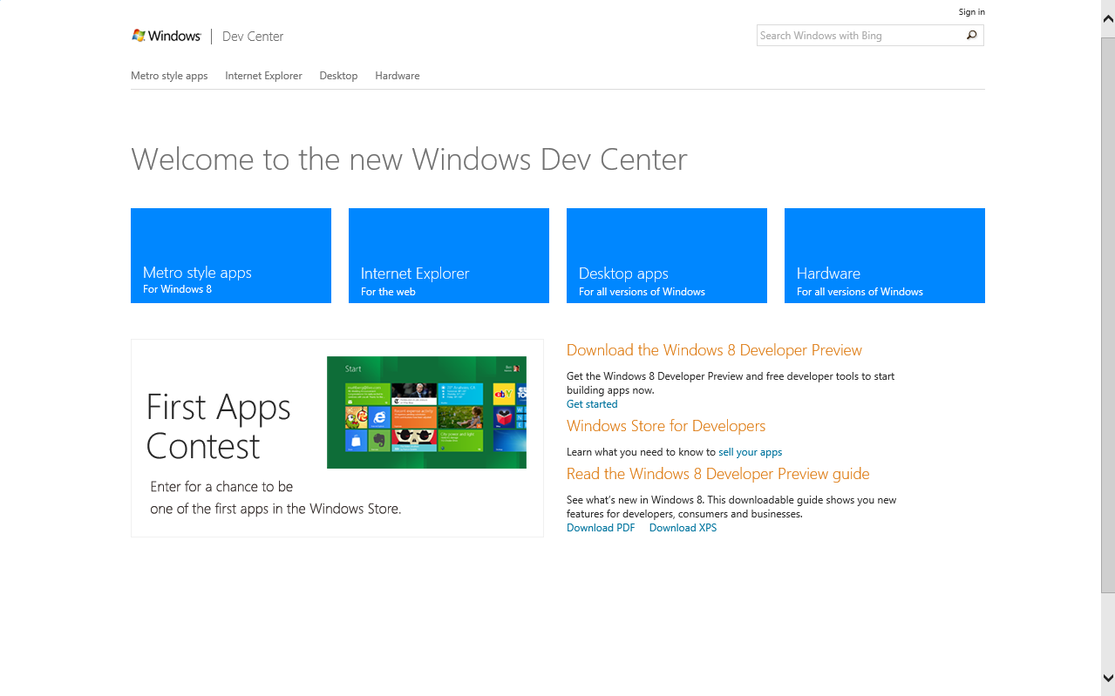

Slide 60
Product name
Product name
Product name
Product name
Product name
Product name
Product name
Product name
Product name
Product name

Slide 61
Win as one
Work together to complete scenarios
Fit into the user experience model
Leverage the platform

Slide 62
Search All recipes and People Internet Explorer and Wikipedia

Slide 63
The five principles of Microsoft design
Pride in craftsmanship
Be fast and fluid
Authentically digital
Do more with less
Win as one

Slide 64
Windows reimagined

Slide 65
“The beginning is a delicate time…” — David Lynch, Dune, 1984

Slide 66
How will your apps be reimagined?
How can you be authentic to the medium
Where will your apps become alive?
What do your users need to focus on?
How will your apps integrate with the ecosystem?

Slide 67
Content before chrome

Slide 68
Resources
design.windows.com
windowsuserexpeirencetraining.com
Please submit session evals by using the Build Windows 8 app
or at http://aka.ms/BuildSessions

Slide 69
Resources
Develop: http://msdn.microsoft.com/en-US/windows/apps/br229512
Design: http://design.windows.com/
Samples: http://code.msdn.microsoft.com/windowsapps/Windows-8-Modern-Style-App-Samples
Videos: http://channel9.msdn.com/Windows
Please submit session evals by using the Build Windows 8 app
or at http://aka.ms/BuildSessions

