Slide 1
Bringing Existing C++ Code to Windows Store Apps
Tarek Madkour
Group Program Manager – Visual C++
3-000

Slide 2
Agenda
Key Differences
APIs
WinRT Wrapping
Demo

Slide 3
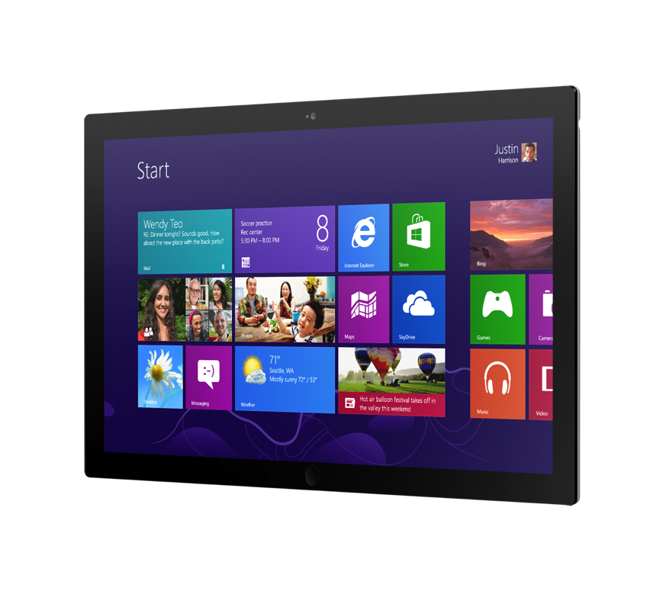
What’s Different?
New user experience
Touch-friendly
Trust
Battery-power
Fast and fluid
New user interface
New APIs
API restrictions
Performance
Responsiveness

Slide 4
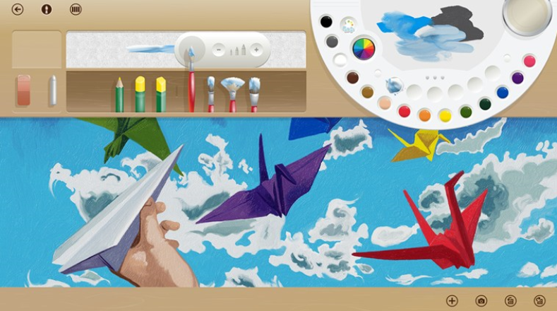
User Interface
Your app needs new UI
Touch-friendly
Snaps & scales
Participates in contracts
DirectX for C++ apps
XAML for C++ and .NET apps
HTML5 for Java Script apps
Visual Studio 2012 has great tools for Windows 8 UI development

Slide 5
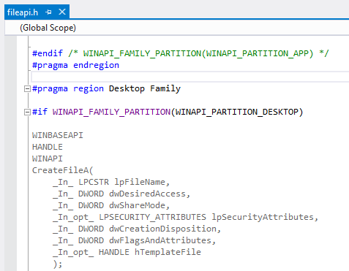
API Restrictions
Only a subset of Win32 and COM APIs are available
New replacements available for most APIs
Restricted API usage will result in:
Runtime failures
Rejection from Windows Store
Restriction applies to app code
… and packaged 3rd party libraries

Slide 6
API Restrictions: What to expect?
UI: MFC, GDI
UI: DirectX |  | still need to rethink user experience
ISO C++
VC++ Runtime (CRT, PPL, …)
C++/CLI
OS / Win32 |  | WinRT + Win32 subset
COM / ATL |  | ATL subset
3rd party libraries |  | it depends
Everything else |  | it depends
View
Model
Other

Slide 7
API Restrictions: What to do?
Preferred: Use the Windows Application Certification Kit
Run it on the original binaries
The generated API list is your “to do” list
The VS IDE can help find all references to APIs in your list
Not Recommended: Use the pre-processor
Set the WINAPI_FAMILY_PARTITION macro
Work through the compiler errors

Slide 8
Demo: Windows App Cert Kit
Notes:
Things to show:
Deploy app to prepare for WACK
How to run WACK
WACK report for OpenCVTest
How to search for an API (e.g. CreateFileA)
The WINAPI_FAMILY_PARTITION macros (e.g. in fileapi.h which defines CreateFileA)

Slide 9
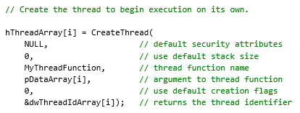
API Restriction: Threading Example
Threading is key to performance and battery usage
Needed to strike a tough balance between:
Great user experience
Advanced usage
Compatibility
Result: the code example on this slide will not work

Slide 10
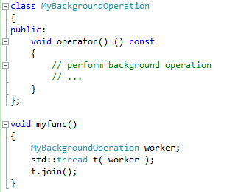
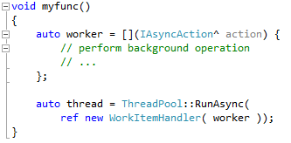
API Restriction: Threading Example
Available options for Windows Store apps:
WinRT ThreadPool (namespace: Windows::System::Threading)
Tailored for Windows Store app performance
Available only for Windows Store apps (not on Desktop)
Parallel Patterns Library Tasks
Higher level of abstraction
Available for both Windows Store and Desktop apps
ISO C++: std::thread, std::future
Low level of abstraction
Available cross-platform

Slide 11
API Restriction: File I/O Example
Application Isolation is essential for Windows Store apps
Default access is restricted only to application data
App manifest can request a few more permissions
Available options for Windows Store apps:
WinRT Storage APIs
namespace: Windows::Storage
ISO C++
<fstream>, <filesystem>, …

Slide 12
New APIs: WinRT
User Interface
HTML5/CSS
XAML
DirectX
Controls
Data Binding
SVG
Tiles
Input
Accessibility
Printing
Devices
Communications & Data
Geolocation
Portable
Sensors
NFC
Contracts
Local & Cloud Storage
Web
Media
Notifications
Streams
Playback
Capture
PlayTo
Visual Effects
Background Transfer
XML
Networking
SMS
Fundamentals
Application Services
Threading/Timers
Memory Management
Authentication
Cryptography
Globalization

Slide 13
New APIs: Asynchronous Pattern
Common pattern for WinRT APIs
Important for creating smooth experiences
Very common pattern among key WinRT APIs
Favors non-blocking scenarios
Provides you the control over when to block if needed

Slide 14
Async: Basic Pattern

Slide 15
Async: Example

Slide 16
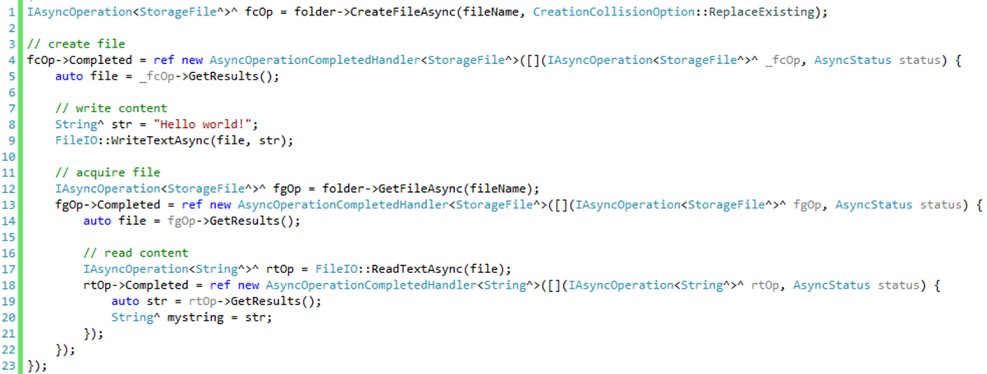
Async: Example

Slide 17
WinRT Components
Great for interoperating with Java Script and .NET apps
... if you are a multi-language app developer
… if you are a library vendor seeking wider exposure
C++/CX (or WRL) at the boundary to expose WinRT types
Maintain or change the C++ interface
Extension SDKs make consumption from VS projects easier

Slide 18
WinRT Components
Java Script
C# / VB (.NET)
C++
WinRT Wrapper
DLL
WinMD
Existing C++ Code

Slide 19
Demo: Putting it all together

Slide 20
Conclusion
“
Your existing investment in C++ code is very valuable in the new world of Windows Store applications.
Rethink your app user experience
Your C++ code will move forward
3rd party libraries need attention
New world of WinRT available to you
”

Slide 21
Related Sessions
Tue | 2:15 | The Power of C++ Project Austin
Tue | 5:45 | Connecting C++ Apps to the Cloud via Casablanca
Wed | 11:15 | All About Performance
Wed | 1:45 | DirectX Graphics Development
Wed | 5:15 | Diving Deep Into C++/CX and WinRT
Thu | 10:15 | Building Windows Store Apps using XAML and C++
Fri | 12:45 | The Future of C++

Slide 22
Resources
Visual C++ Blog
http://blogs.msdn.com/b/vcblog/
Windows Dev Center
http://msdn.microsoft.com/en-us/windows/apps
Channel9 GoingNative
http://channel9.msdn.com/Shows/C9-GoingNative
MSDN Forums
http://social.msdn.microsoft.com/Forums/en-US/category/windowsapps
User Research Feedback
http://bit.ly/x6dtHt

