Slide 1
Designing awesome XAML apps in Visual Studio and Blend for Windows 8 and Windows Phone 8
Jeffrey Ferman
Program Manager
3-006

Slide 2

Designing awesome XAML apps
Code Organization
Designing and Styling
Platform Features

Slide 3
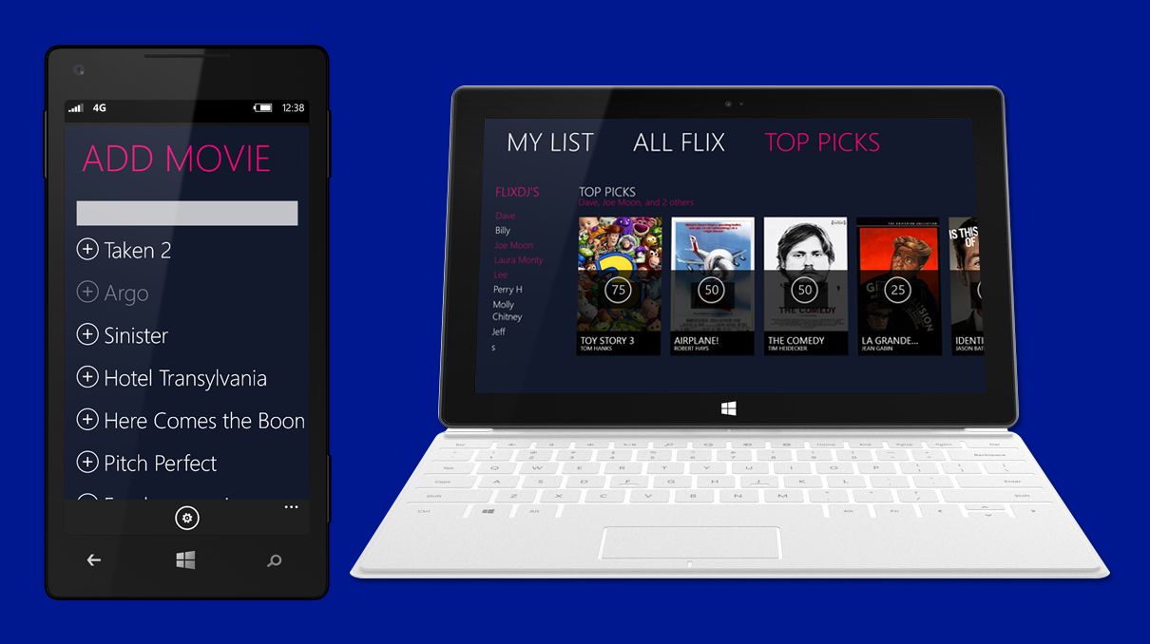
FLIX DJ

Slide 4

An awesome app
Our lens to explore
Blend and Visual Studio

Slide 5


Structure
web services
model/portable library

Slide 6
Blend and Visual Studio
Blend is optimized for visual design tasks
Visual Studio is optimized for coding and debugging

Slide 7
Tooling
DESIGN TASKS
CORE AUTHORING TASKS
CODING TASKS
VISUAL STUDIO
  Styling
  Path-editing
  Animation
  Visual States
  Transitions
  Control creation
  Layout
  Property editing
  Basic data
  View authoring
  Code editing
  Refactoring
  Debugging
  Code analysis
  Profiling
BLEND

Slide 8
Project Templates
Full screen
High Contrast
Light Theme
Filled
Snapped

Slide 9
Designing and Styling
Demo

Slide 10
Designing awesome XAML apps
Code Organization
Designing and Styling
Platform Features

Slide 11
Questions?
Jeff Ferman
JFerman@microsoft.com

Slide 12
Related Sessions
Thursday 2:30pm – B33 McKinley – How To Leverage Your Code Across Windows Phone 8 and Windows 8
Friday 12:45pm – B92 Nexus/Normandy – Create Cross-Platform Apps Using Portable Class Libraries

