Slide 1
Modern JavaScript
Luke Hoban
Program Manager — JavaScript
Microsoft Corporation
3-014

Slide 2
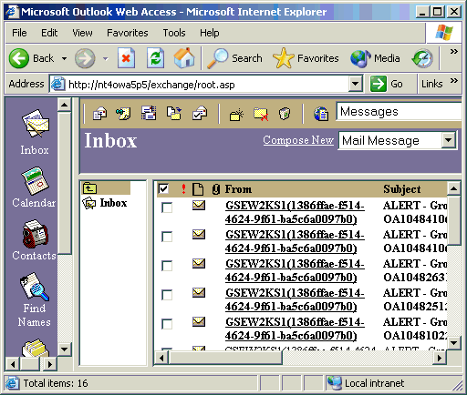
JavaScript
<INPUT TYPE="button" Value="CLICK HERE" onClick="alert(' Wouldn\'t one of these be cool on your page? ')")>
— Free JavaScripts, 1996
— Outlook Web Access, 1997
“Gmail is comprised of 443,000 lines of JavaScript, 978,000 lines if comments are included.”
— Google, 2010

Slide 3
Modern JavaScript
JavaScript language
ECMAScript 5 and strict mode
Test262
JavaScript libraries and runtime
Binary data – JavaScript typed arrays
Using multiple cores – Web workers
JavaScript and Windows (8, Phone 8, Azure)
Projection of Windows into JavaScript
IE10 and ES5 on Windows Phone 8
Node.js on Azure

Slide 4
JavaScript language

Slide 5
ECMAScript

Slide 6
ECMAScript 5 accessor properties
// Data Property
var bankAccount = {
balance: 1257
}
// Accessor Property
var bankAccount2 = {
get balance() { return 1257; }
set balance(v) { };
}
Can’t intercept reads/writes
Accessor property
Optional setter

Slide 7
ECMAScript 5 property descriptors
Data Descriptor:
{
value : 47, writable : false, enumerable : true, configurable : true }
Accessor Descriptor:
{ get : function() { }, set : function(v) { }, enumerable : true, configurable : true }
Can the value be changed?
Will the property be enumerated by “for..in”?
Can the property descriptor be changed?

Slide 8
Objects, properties and DOM
demo

Slide 9
ECMAScript 5 Array APIs
Common boilerplate
var items = ["a", "b", "c"];
for (var i = 0; i < items.length; i++) {
setTimeout(function () { console.log(items[i]) }, i*1000);
}
Subtle bug - ‘i‘ will have changed

Slide 10
ECMAScript 5 Array APIs
var items = ["a", "b", "c"];
for (var i = 0; i < items.length; i++) {
(function(i) {
setTimeout(function () { console.log(items[i]) }, i*1000);
})(i);
}
Fix the bug

Slide 11
ECMAScript 5 Array APIs
var items = ["a", "b", "c"];
items.forEach(function(item, i) {
setTimeout(function () { console.log(item) }, i * 1000);
}
New forEach API
forEach
filter
map
reduce
reduceRight
indexOf
some
every

Slide 12
ECMAScript 5 strict mode
(function () {
"use strict";
// this function is strict...
x = 5; // Error!
arguments.caller; // Error!
arguments.callee; // Error!
var o = { x: 5};
Object.freeze(o);
o.x = 7; // Throws
}());
Backward compatible opt-in
Can’t accidentally add to global
Restrict some common information leaks, like arguments.caller/callee
Writing to non-writable property is an exception

Slide 13
Strict mode and Test262
demo

Slide 14
JavaScript libraries and runtime

Slide 15
Runtime capabilities for apps
Working with binary data
Typed arrays
XHR + File API + WebSockets
Leveraging multiple cores
Web workers
Message passing

Slide 16
JavaScript typed arrays
// Create an 8 byte buffer
var buffer = new ArrayBuffer(8);
// View as an array of Uint8s and put 0x05 in each byte
var uint8s = new Uint8Array(buffer);
for (var i = 0; i < 8; i++) {
uint8s[i] = 0x05;
}
// View the same buffer as an array of Uint32s
var uint32s = new Uint32Array(buffer);
uint32s[0] === 84215045 // 0x05050505 == 84215045
ArrayBuffer is an block of native memory
Typed arrays are views over a buffer
Indexing just like an array, but fixed length
 | ArrayBuffer
uint8s | 0x05 | 0x05 | 0x05 | 0x05 | 0x05 | 0x05 | 0x05 | 0x05
uint32s | 0x05050505 |  |  |  | 0x05050505
Different views over same buffer

Slide 17
HTML5 APIs supporting typed arrays
var bytes = new Uint8Array(100);
// XMLHttpRequest
var xhr = new XMLHttpRequest()
xhr.open("PUT", "http://myserver");
xhr.send(bytes);
// Blob & File
var blob = new Blob([bytes]);
var reader = new FileReader();
reader.readAsArrayBuffer(file);
// WebSockets
var socket = new WebSocket("ws://myserver")
socket.send(bytes);
Send or receiver binary data over XHR
Create blobs for rendering, storage
Read files from disk
Read or write binary data on a web socket

Slide 18
Binary file inspector
demo

Slide 19
HTML5 web workers
// index.html
<script type='text/javascript'>
var worker = new Worker('adder.js');
worker.onmessage = function(e) {
document.body.innerHTML = e.data.result;
}
worker.postMessage({x: 47, y: 32});
</script>
// adder.js
onmessage = function(e) {
var result = e.data.x + e.data.y;
postMessage({result: result});
}
Create a worker from a script file
Listen for messages from the worker
Send a message to the worker
In the worker, listen for messages from app
And reply when computation is done

Slide 20
Raytracer
demo

Slide 21
Windows Runtime using JavaScript

Slide 22
APIs for JavaScript metro style apps

Slide 23
APIs for JavaScript metro style apps

Slide 24
APIs for JavaScript metro style apps

Slide 25
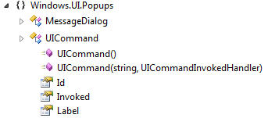
WinRT in JavaScript
var Popups = Windows.UI.Popups,
UICommand = Popups.UICommand,
MessageDialog = Popups.MessageDialog
var dialog = new MessageDialog("What next?");
var customCommands = [
new UICommand("Say hi", function () { console.log("hello"); }),
new UICommand("Say bye", function () { console.log("goodbye"); })
];
dialog.defaultCommandIndex = 0;
dialog.commands.replaceAll(customCommands);
dialog.showAsync();
Namespaces are objects
Classes are constructor functions
Can pass primitives like strings, functions
Class members projected as properties
Asynchronous programming using Promises

Slide 26
Tour of WinRT from JavaScript
demo

Slide 27
JavaScript across Microsoft platforms
demo

Slide 28
Thanks!
Questions?

